Slide 1
UPI Transactions Dashboard Analysis
Power BI Analysis of Digital Payment Trends in India
Analysis Period: January 2024 – July 2024
Data Source: Kaggle | Tool: Microsoft Power BI
Period
Coverage
Jan 2024 – Jul 2024
All Major UPI Platforms
Scope
Report Type
National Transaction Analysis
Power BI Dashboard Insight
A Power BI analysis of India's digital payment ecosystem — analyzing transaction patterns across 125,406 UPI transactions processed between January and July 2024.

Slide 2

Project Overview & Objectives
Project Objective:
"Analyze UPI transaction patterns across applications, banks, transaction types, states, time periods and transaction status using Power BI."
Key Questions
Which UPI apps have the highest share?
Which banks process the highest amount?
Which states contribute the most?
Which transaction types dominate?
When is activity highest?
What is the success rate?
What patterns appear in flagged transactions?

Slide 3
DATASET & DATA SOURCE
Dataset & Data Source
Data Source
Dataset
Analysis Period
Kaggle
UPI Transactions Dataset
January 2024 – July 2024
Records
Coverage
Tool
125,406 Transactions
India
Microsoft Power BI
Key Fields
Transaction Date
Transaction Amount
UPI App
Bank
State
Transaction Type
Transaction Status
Device Type
Merchant Category
Cashback
Fraud/Flag Status

Slide 4






Data Preparation & Transformation
Kaggle Dataset
Data Transformation
Data Import
DAX Measures
Data Cleaning
Data Visualization
Data Type Validation
Interactive Dashboard
Data was imported, cleaned, validated, transformed, and prepared for visualization in Power BI.

Slide 5
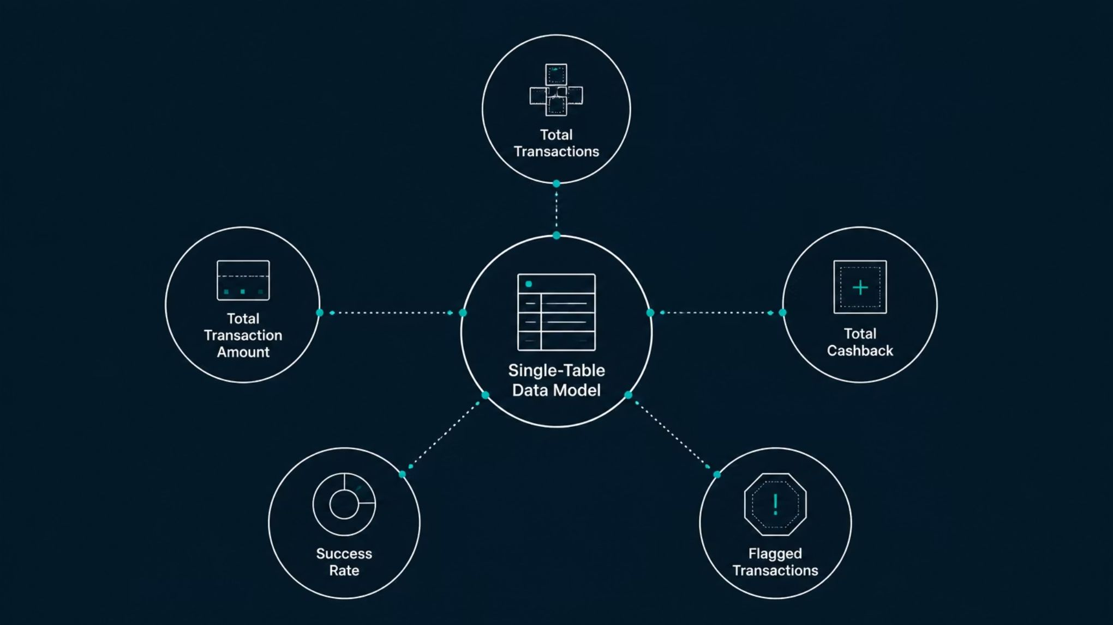
DATA MODELING
Data Model & DAX Measures
Single-Table Analytical Model
Total Transactions
Total Transaction Amount
Total Cashback
Success Rate
Flagged Transactions

Slide 6
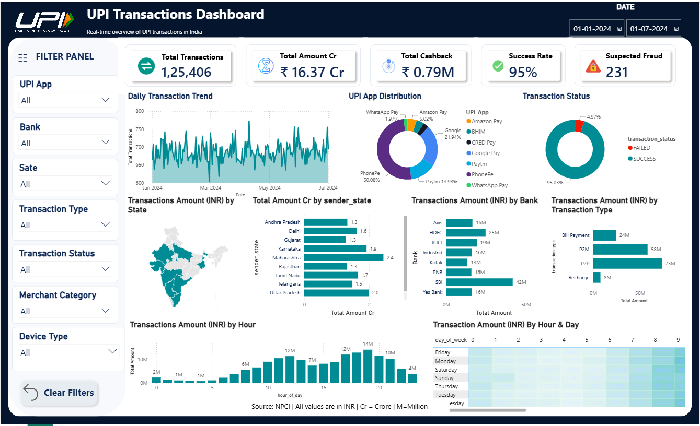

Slide 7
EXECUTIVE SUMMARY
Key Performance Indicators
The following metrics represent the aggregate performance of UPI infrastructure across all major platforms and banking partners for the 7-month analysis window.
125,406
₹16.37Cr
₹0.79M
Total Transactions
Amount Processed
Cashback Distributed
125,406 transactions were analyzed across the January–July 2024 period.
₹16.37 Cr in transaction value was recorded in the dataset.
₹0.79M in cashback was recorded.
95%
231
Success Rate
Flagged Fraud Cases
95% of transactions were recorded as successful.
231 transactions were flagged during the analysis period.
System Health Summary
Financial Efficiency
The dataset shows a 95% transaction success rate and 231 flagged transactions during the January–July 2024 analysis period.
The dataset records ₹0.79M in cashback against ₹16.37 Cr in total processed volume.

Slide 8
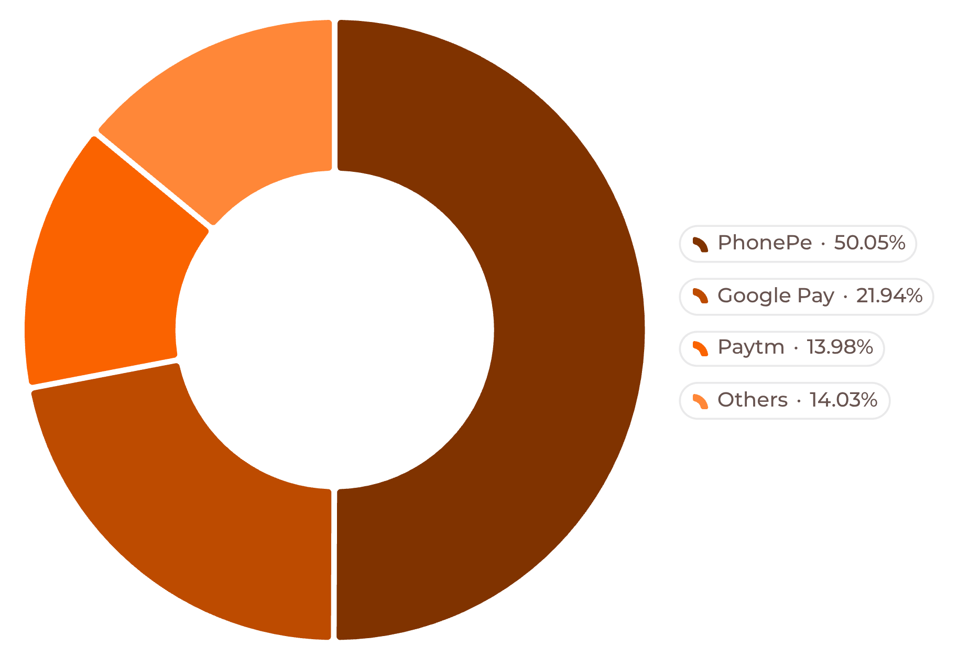
MARKET SHARE ANALYSIS
UPI App Market Share
Competitive Landscape
PhonePe — 50.05%
Google Pay — 21.94%
PhonePe recorded the highest transaction share at 50.05%.
Google Pay and Paytm followed with 21.94% and 13.98% respectively.
Paytm — 13.98%
Others — 14.03%
Google Pay and Paytm followed with 21.94% and 13.98% respectively.
Other UPI apps accounted for the remaining 14.03% of transaction share.

Slide 9
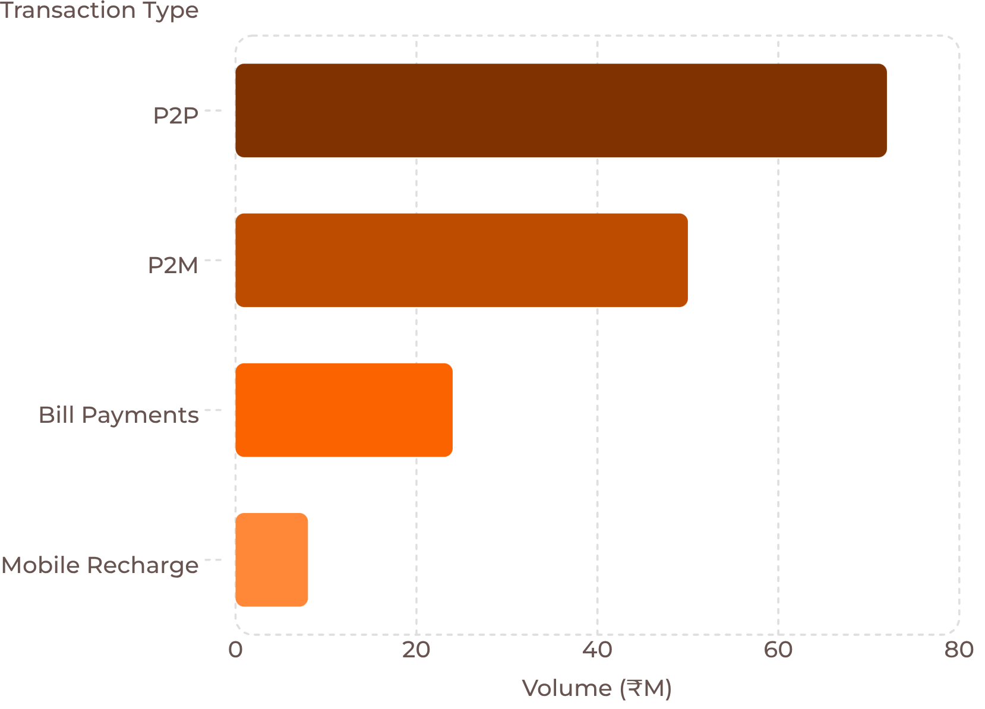
TRANSACTION BREAKDOWN
Transaction Amount by Transaction Type
Use Case Analysis
Person-to-Person (P2P) — ₹72M
P2P recorded the highest transaction amount among the transaction types analyzed.
Person-to-Merchant (P2M) — ₹50M
Retail and commerce segment at 32.5% share. QR-code adoption at kirana stores, restaurants, and e-commerce checkouts is accelerating P2M growth.
Bill Payments — ₹24M
Utilities and subscriptions at 15.6% share. BBPS integration has made UPI the default channel for electricity, water, and OTT subscription payments.
Mobile Recharge — ₹8M
Telecom services at 5.2% share. The smallest category — competitive prepaid plans have reduced recharge frequency but sustained baseline volume.

Slide 10
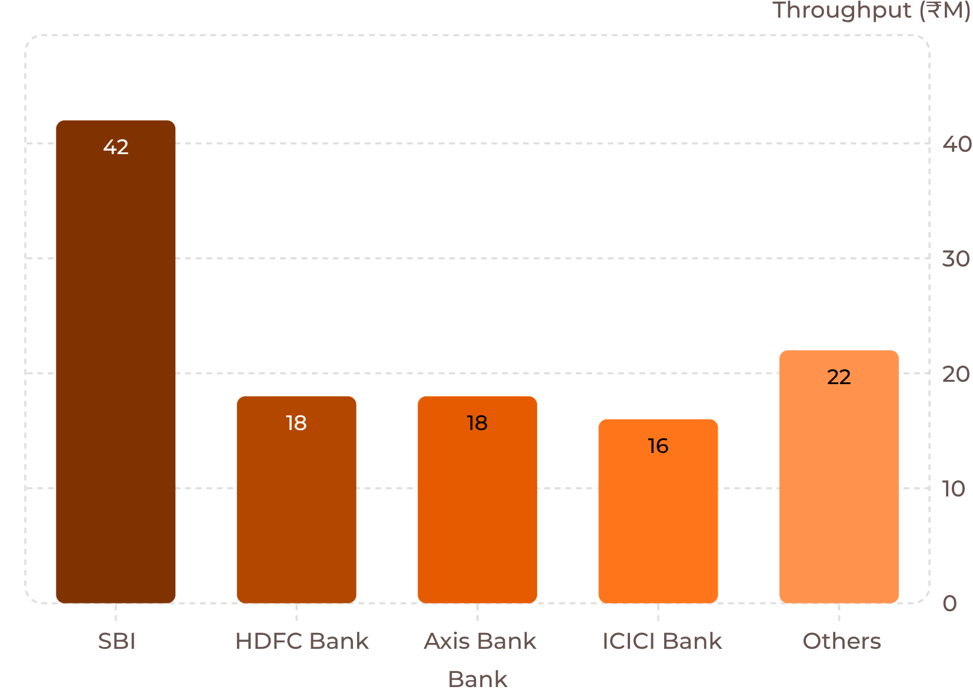

BANKING INFRASTRUCTURE
Bank-wise Transaction Analysis
Bank Performance Breakdown
The chart compares transaction amounts across the banks shown, highlighting the relative throughput of each institution in the data set.
SBI
HDFC
₹42M
Market Leader
₹18M
Private Sector
Axis
ICICI
₹18M
Competitive
₹16M
Established
Key Insight: SBI recorded the highest transaction amount among the banks shown.

Slide 11
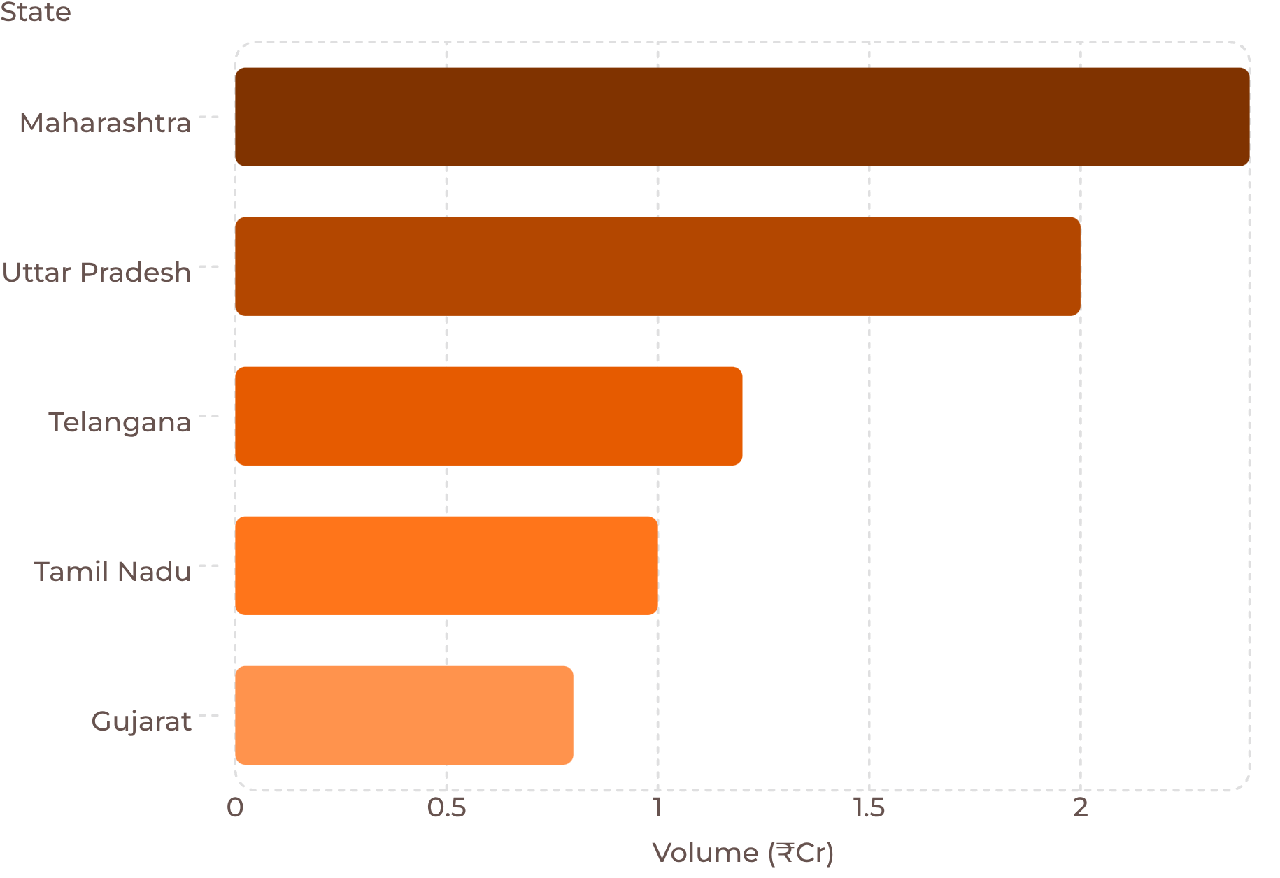
GEOGRAPHIC INTELLIGENCE
State-wise Transaction Analysis
State-Level Insights
Maharashtra — ₹2.4 Cr
Uttar Pradesh — ₹2.0 Cr
Maharashtra recorded the highest transaction amount among the states analyzed.
Uttar Pradesh ranked second among the states shown.
Telangana — ₹1.2 Cr
Tamil Nadu & Gujarat
Strong transaction activity is visible at the state level.
Tamil Nadu (₹1.0 Cr) and Gujarat (₹0.8 Cr) round out the distribution across the states analyzed.

Slide 12

BEHAVIORAL PATTERNS
Transaction Timing & Behavioral Patterns
⚡ Peak Window
📅 Highest Volume Days
12 PM – 8 PM
.
Friday & Monday
🌙 Off-Peak Hours
📊 Pattern Consistency
2 AM – 6 AM
Predictable Daily Cycles
Off-Peak
Peak Surge
2AM–6AM minimal load, maintenance window
12PM–8PM maximum volume, lunch and evening
Ramp-Up
6AM–12PM moderate activity, morning commerce

Slide 13


RISK & RELIABILITY
Transaction Risk & Reliability
Health Scorecard
System Reliability Analysis
95% Transaction Success Rate
95% of transactions in the dataset were recorded as successful.
95%
0.18% Flagged Transaction Rate
Flagged transactions represent approximately 0.18% of the total transactions.
231 Flagged Transactions
231 transactions were flagged out of 125,406 total transactions.
Transaction Success Rate
Further Analysis
Transaction failures and flagged cases can be further analyzed by app, bank, state, device and time period.
0.18%
Flagged Transaction Rate
231 Flagged Transactions out of 125,406 Total Transactions.

Slide 14
DASHBOARD FUNCTIONALITY
Interactive Dashboard Features
Interactive slicers allow users to filter the dashboard and explore transaction patterns across different dimensions.
UPI App
Bank
State
Transaction Status
Device Type
Merchant Category

Slide 15
KEY INSIGHTS
Key Insights & Findings
APP PERFORMANCE
BANKING
1
4
PhonePe: 50.05% market share
SBI: ₹42M highest amount
TRANSACTION TYPE
TIME PATTERN
2
5
P2P: ₹72M highest amount
Peak: 12 PM – 8 PM
GEOGRAPHY
RELIABILITY
3
6
Maharashtra: ₹2.4 Cr highest
Success Rate: 95%

Slide 16
STRATEGIC CONCLUSIONS
Key Takeaways & Strategic Insights
Six evidence-based conclusions derived from the Jan–Jul 2024 UPI transaction dataset, with direct implications for platform strategy, infrastructure investment, and market development.
UPI Dominance
1
125,406 transactions across 7 months confirm India's digital payment revolution is no longer nascent — it is structural. UPI has become the default payment rail for both retail and commerce.
PhonePe Leadership
2
50% market share reflects durable competitive moats — merchant network density, SuperApp features, and BBPS integration create strong switching costs for PhonePe's installed base.
P2P Strength
3
₹72M in peer transfers validates UPI's core value proposition. The dominance of P2P over P2M signals continued opportunity to convert informal cash transfers to digital — particularly in semi-urban markets.
Geographic Concentration
4
Maharashtra and UP account for approximately 44% of volume. Tier-2 and Tier-3 cities represent the next growth frontier — lower smartphone penetration and merchant QR density are the key addressable gaps.
Infrastructure Resilience
5
A 95% success rate and 0.18% fraud incidence across 125K+ transactions validate NPCI's system maturity. The UPI stack is ready to support the next order-of-magnitude volume increase.
Peak Hour Optimization
6
The 12 PM – 8 PM concentration window, combined with Friday–Monday volume spikes, enables highly targeted capacity planning — proactive scaling in this window can reduce the 5% failure rate significantly.

Slide 17
STRATEGIC OUTLOOK
Conclusion & Future Scope
Conclusion
The Power BI dashboard provides an interactive view of UPI transaction behavior across applications, banks, states, transaction types and time periods.
Key Outcomes
✓ Identified leading UPI applications
✓ Analyzed transaction types and transaction values
✓ Compared bank and state performance
✓ Identified peak transaction periods
✓ Analyzed transaction success and flagged cases
✓ Enabled interactive filtering for deeper analysis
Future Scope
Add more recent transaction data
Add month-over-month growth analysis
Add city-level analysis
Add predictive analytics
Add advanced fraud-risk analysis
Add additional KPIs and drill-through pages

