Slide 1



XerXEZ MLOPS ORCHESTRATION UsiNG MLFLOW IN K-Mean CLUSTERING TECHNIQUE
LET’S GET STARTED!
Welcome and introductions
Intended audience and course focus
Course objectives and modules
Course exam and certification information
Learning Center tasks

Slide 2
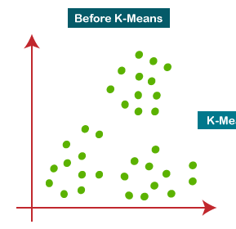
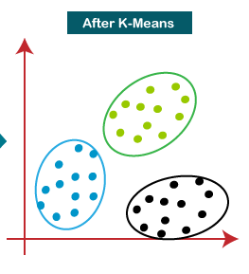
KMean - Clustering
K-Means Clustering is an Unsupervised Learning algorithm, which groups the unlabeled dataset into different clusters.
Here K defines the number of pre-defined clusters that need to be created in the process, as if K=2, there will be two clusters, and for K=3, there will be three clusters, and so on.
The k-means clustering algorithm mainly performs two tasks:
Determines the best value for K center points or centroids by an iterative process.
Assigns each data point to its closest k-center. Those data points which are near to the k-center, create a cluster.

