Slide 1



XerXEZ MLOPS ORCHESTRATION UsiNG MLFLOW IN K-Mean CLUSTERING TECHNIQUE
LET’S GET STARTED!
Welcome and introductions
Intended audience and course focus
Course objectives and modules
Course exam and certification information
Learning Center tasks

Slide 2
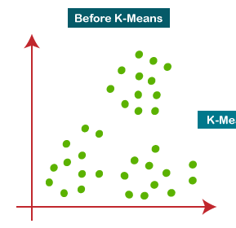
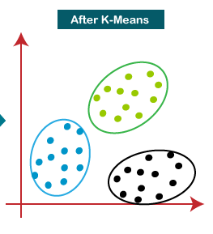
KMean - Clustering
K-Means Clustering is an Unsupervised Learning algorithm, which groups the unlabeled dataset into different clusters.
Here K defines the number of pre-defined clusters that need to be created in the process, as if K=2, there will be two clusters, and for K=3, there will be three clusters, and so on.
The k-means clustering algorithm mainly performs two tasks:
Determines the best value for K center points or centroids by an iterative process.
Assigns each data point to its closest k-center. Those data points which are near to the k-center, create a cluster.

Slide 3
KMean - Clustering
The working of the K-Means algorithm is explained in the below steps:
Step-1: Select the number K to decide the number of clusters.
Step-2: Select random K points or centroids. (It can be other from the input dataset).
Step-3: Assign each data point to their closest centroid, which will form the predefined K clusters.
Step-4: Calculate the variance and place a new centroid of each cluster.
Step-5: Repeat the third steps, which means reassign each datapoint to the new closest centroid of each cluster.
Step-6: If any reassignment occurs, then go to step-4 else go to FINISH.
Step-7: The model is ready.

Slide 4
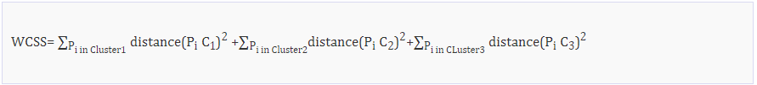
KMean - Clustering
K number of clusters
The Elbow method is one of the most popular ways to find the optimal number of clusters. This method uses the concept of WCSS value. WCSS stands for Within Cluster Sum of Squares, which defines the total variations within a cluster. The formula to calculate the value of WCSS (for 3 clusters) is given below:

