Slide 1
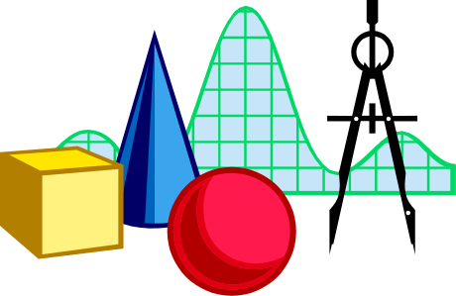
BS EN 55011:1998 CISPR 11:1997
INTRODUCTION
EMC GROUP (GZ)

Slide 2
SCOPE:
ISM equipment: designed to generate and/or use
locally RF energy for ISM.
And spark erosion equipment.
Definition:
Boundary of the equipment under test

Slide 3
Classification
Group
group 1: generated and/or used conductive coupled RF energy.
group 2: in the form of electromagnetic radiation for the treatment
of material, and spark erosion equipment.
Class
class A: use in all establishment other than domestic
class B: use in the domestic establishment.

Slide 4
Limits of electromagnetic disturbances
Class A is tested in a test site or situ as preferred by the manufacture
Class B is tested in a test site.
Limits are under consideration for:
RF excited arc welding equipment;
radiology equipment;
RF surgical diathermy equipment
Limits for signal line disturbance voltage are u.c.

Slide 5
Limits of electromagnetic disturbances
Group 1
class A: 9-150kHz(U.C.)
continuous disturbance(0.15-30)
radiation disturbance(0.15-1000)
protect specific safety service in particular
class B: 9-150kHz(U.C.)
continuous disturbance(0.15-30)
radiation disturbance(0.15-1000)
protect specific safety service in particular

