Slide 1
Test plan discussion
Dimmer

Slide 2
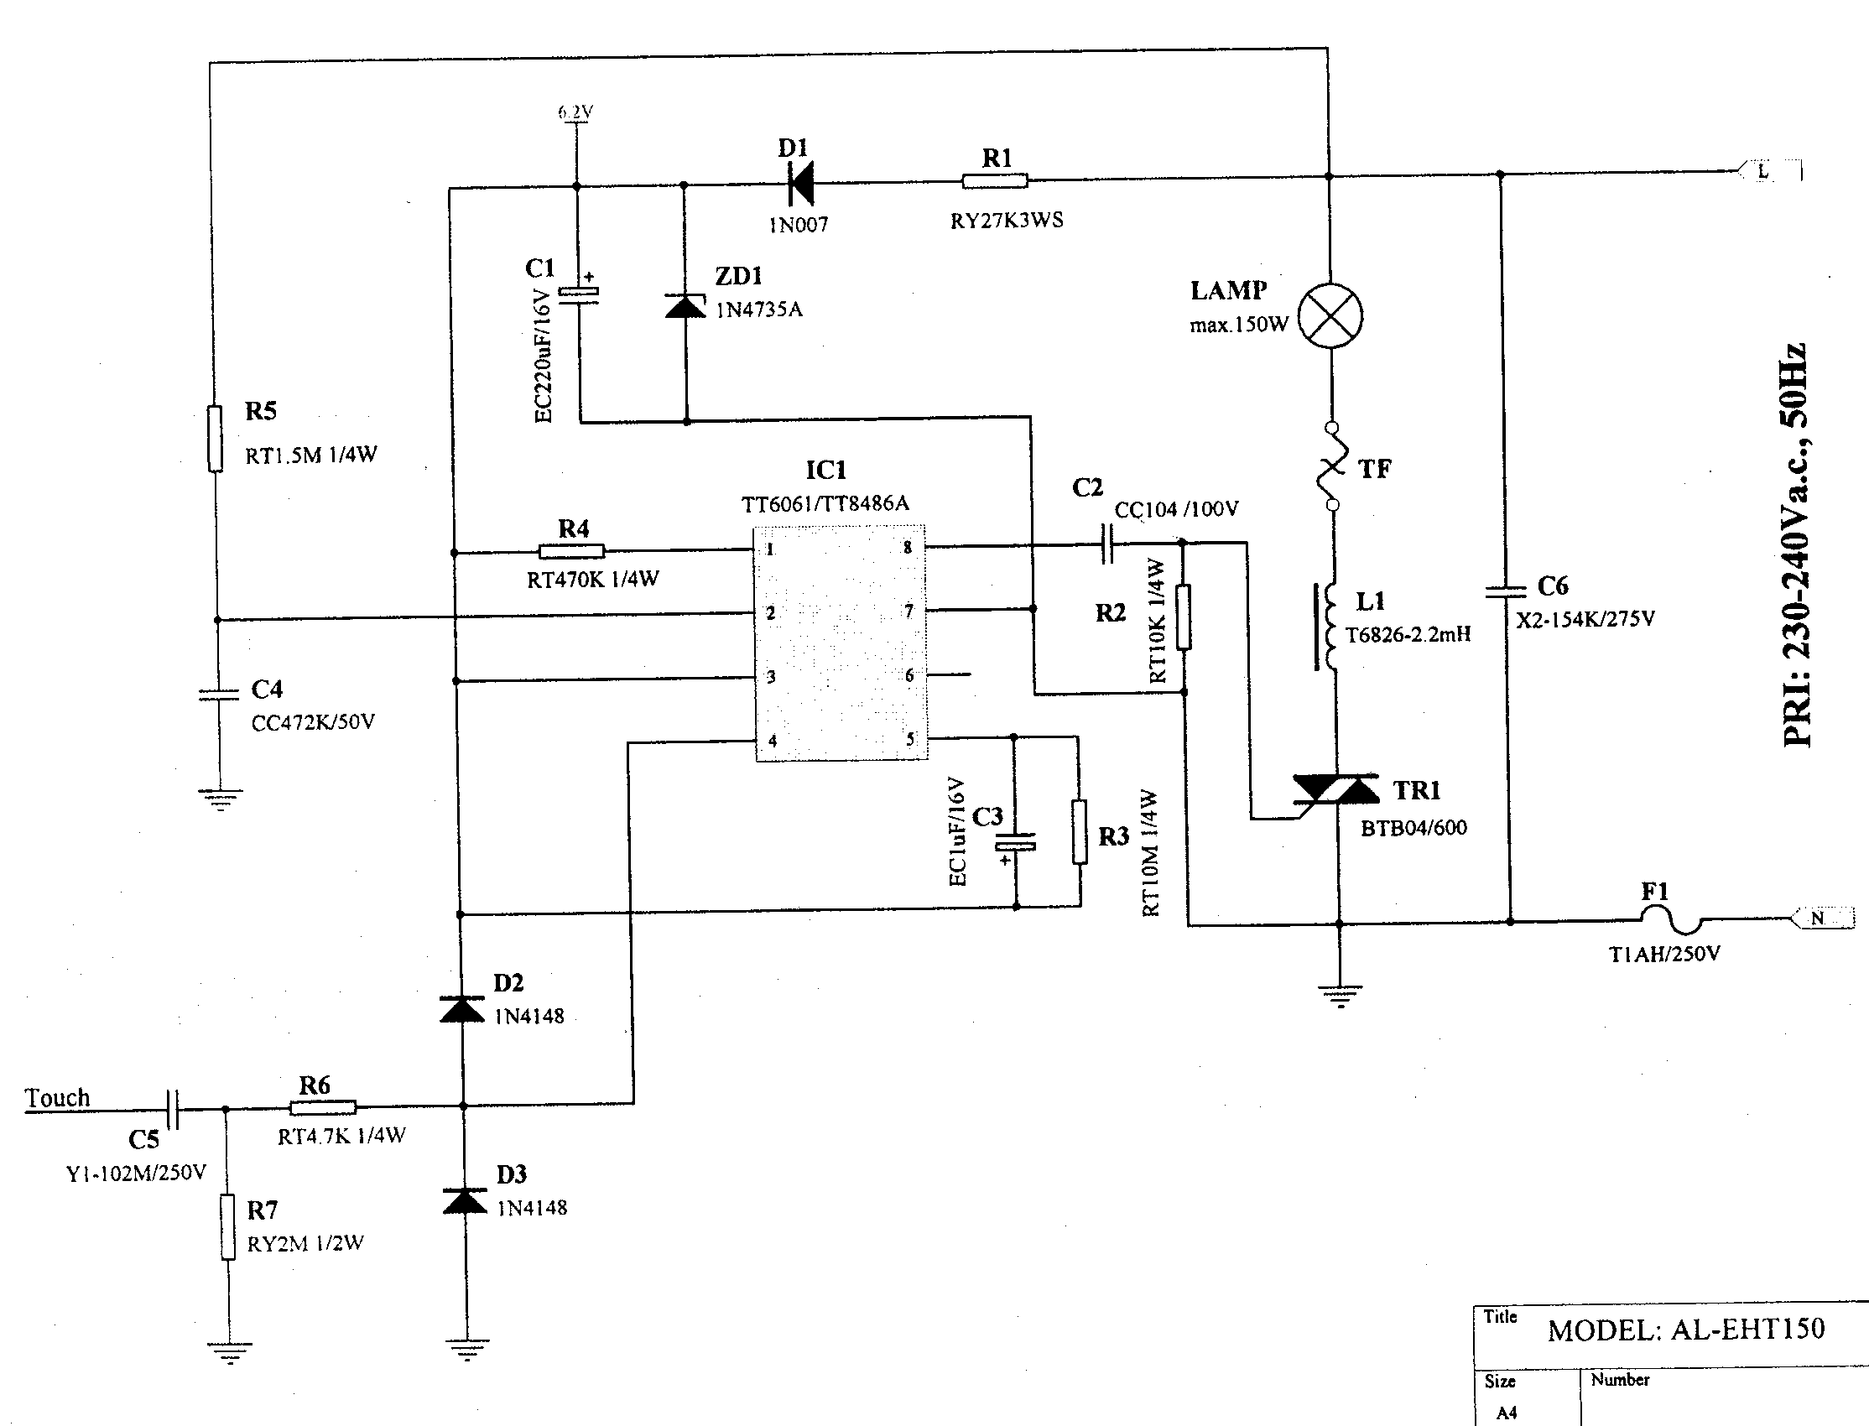
Circuit Diagram

Slide 3
Principle

Slide 4
Disturbance Source
IC
TRIAC

Slide 5
Sensitive components for immunity test
IC
TRIAC

Slide 6
Applicable standards
Light standard
EN 55015-1
EN 61547
EN 61000-3-2
EN 61000-3-3

Slide 7
Test items/operation modes
Disturbance voltage
  AC Mains
  Output port
No Click test

Slide 8
Test items/operation modes
Harmonics
  Adjust to find the maximum disturbance
No test on Flicker
ESD
  According to the sensitive component, TRIAC should be adjust to 30%, 60%, 90% luminous intensity
EFT
  Same as ESD
CS
  Same as ESD
Surge
  Same as ESD
Dips
  Same as ESD

