Slide 1
Basic EMC Knowledge
Coupling
Signal Spectra
Common Mode Emission
Differential Mode Emission

Slide 2
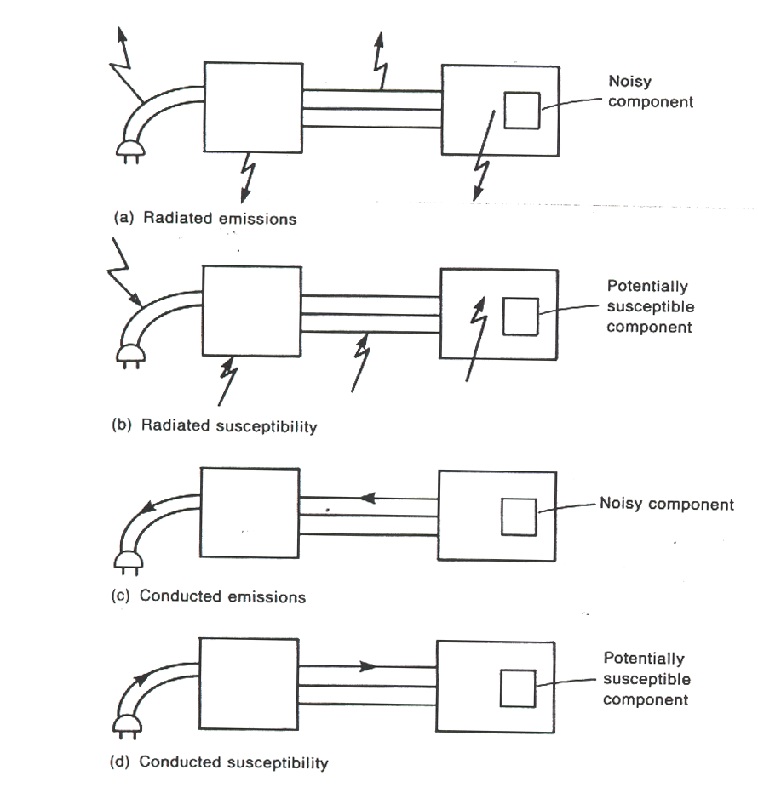
Four basic EMC problems

Slide 3
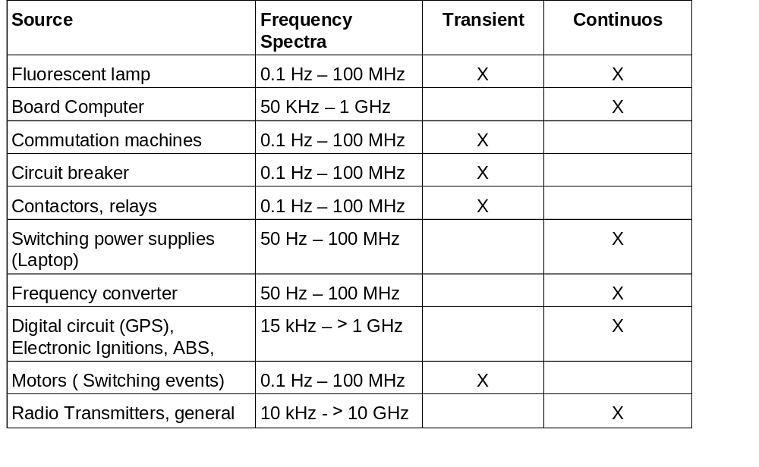
Sources of disturbances and their frequency spectra

Slide 4
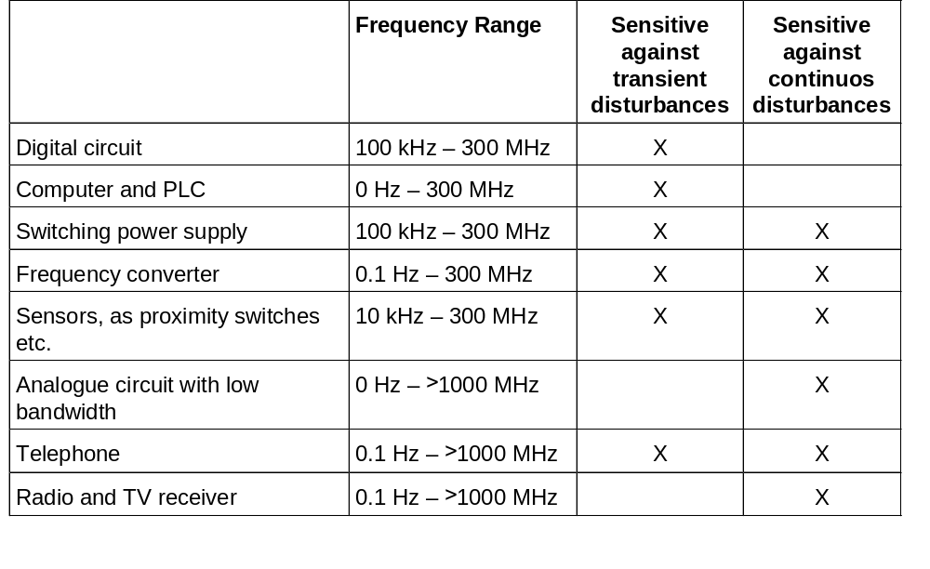
Sensitivity of different products

Slide 5
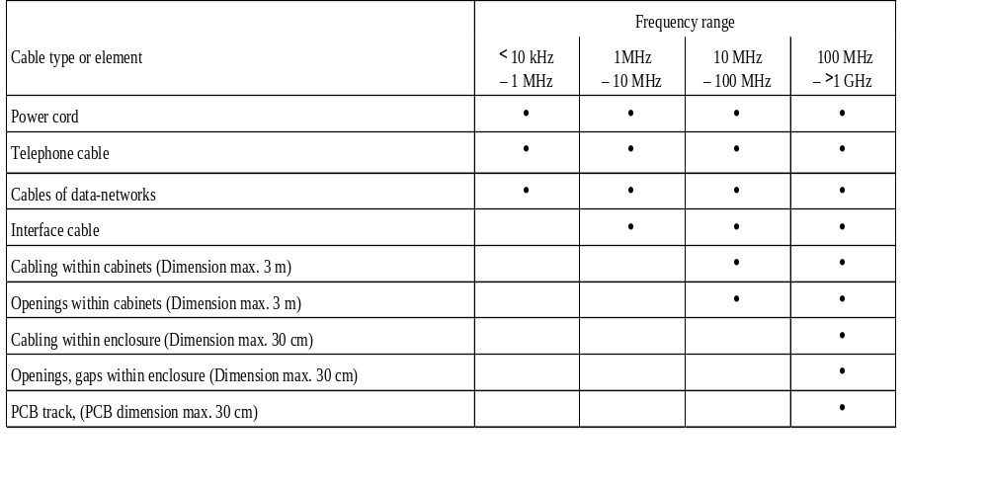
Type of cables or elements acting as antennas

Slide 6
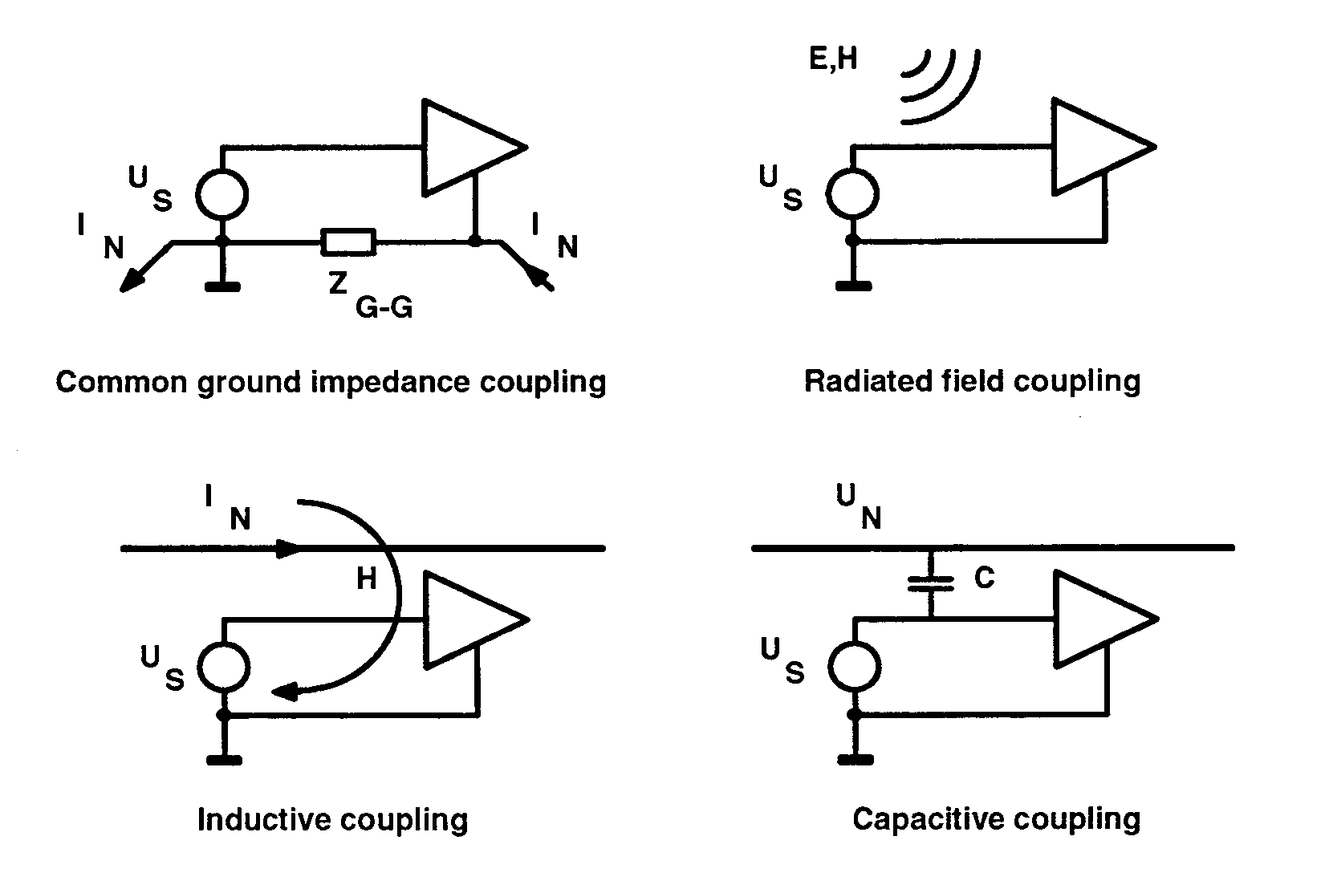
The four coupling mechanism

Slide 7
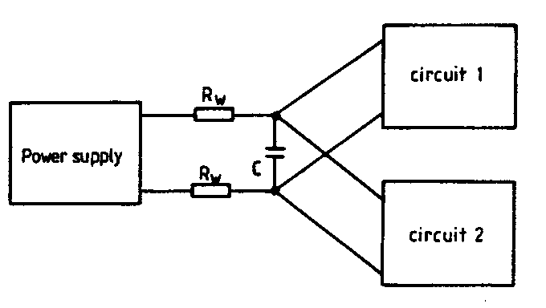
Common impedance coupling
Common impedance R_{v}

Slide 8
Common impedance coupling
No common ground for different circuits
Separation between power-electronics ground and signal-electronics ground
Reducing the impedance of the grounding system

Slide 9
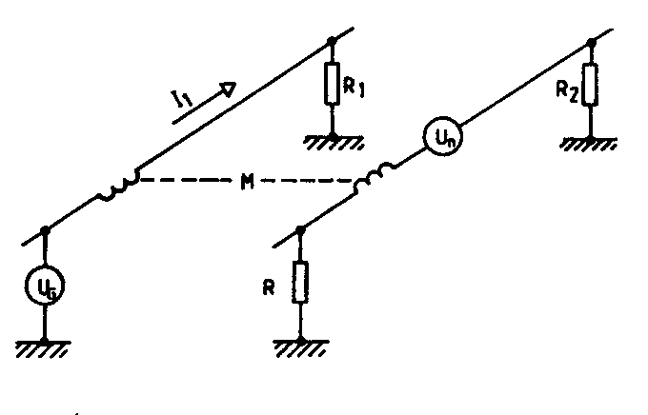
Inductive coupling
Example of inductive coupling M = mutual inductance

Slide 10
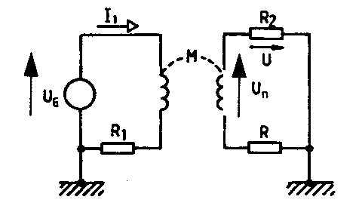
Inductive coupling
Example of inductive coupling M = mutual inductance
U_{L} = L x (d_{i}/d_{t})

Slide 11
Inductive coupling
Limitation of ΔI/ Δt, ΔΦ/ Δt
Limitation of the loop-area between cables and cable and ground
Use twisted pair
Use coaxial cable
The induced EMI voltage is proportional to the loop-area

Slide 12
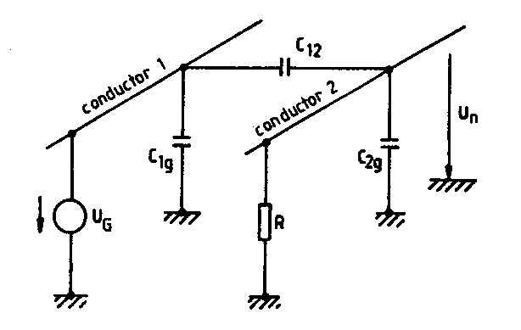
Capacitive coupling
Example of capacitive coupling C₁₂

Slide 13
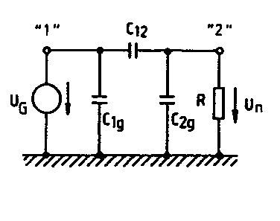
Capacitive coupling
Example of capacitive coupling C₁₂
I_{c} = C x (d_{i}/d_{t})

Slide 14
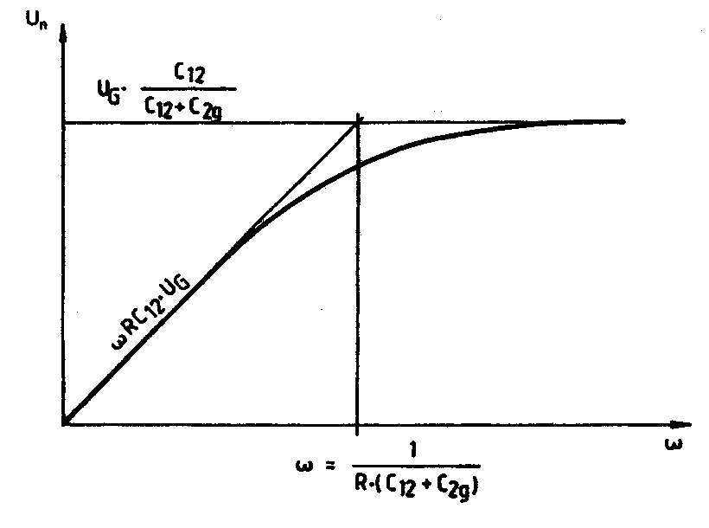
Capacitive coupling
Range of capacitive coupling
First Cut-off Frequency
ω = 1 /R x (C₁₂ + C_{2g})

Slide 15
Capacitive coupling
Limitation of ΔU/ Δt
Use shielded cable
Low impedance circuit design
No parallel conductors
Separation between cables

Slide 16
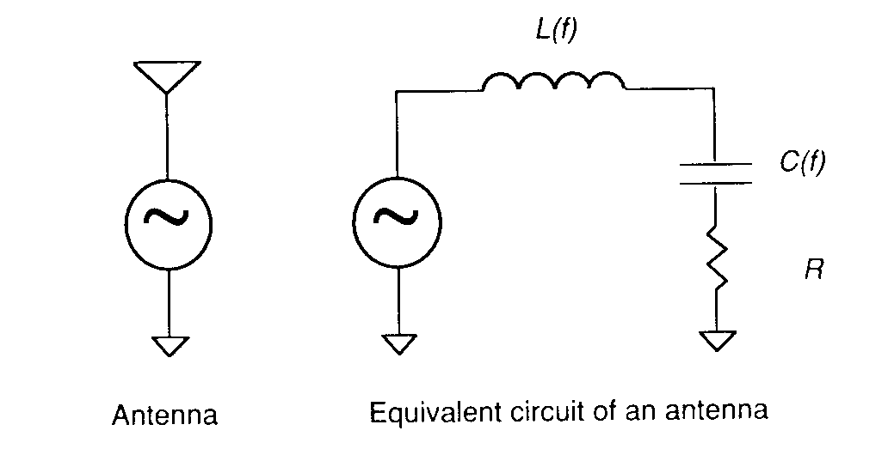
Radiated field coupling

Slide 17
Radiated field coupling
Limitation of the loop-area
Shielding
Filtering
Above applies to PCB and cabling

Slide 18
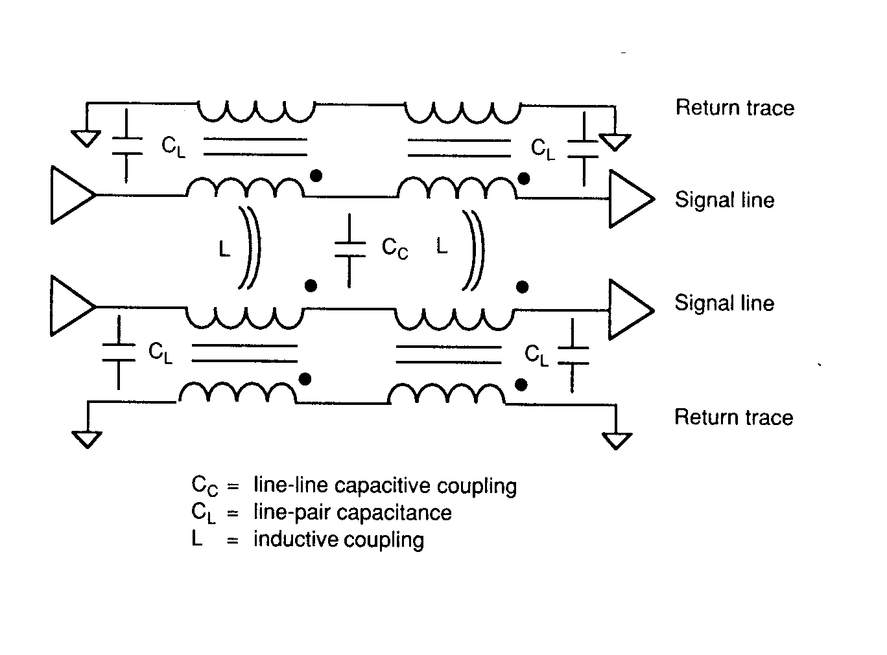
Mixed coupling on PCB

Slide 19
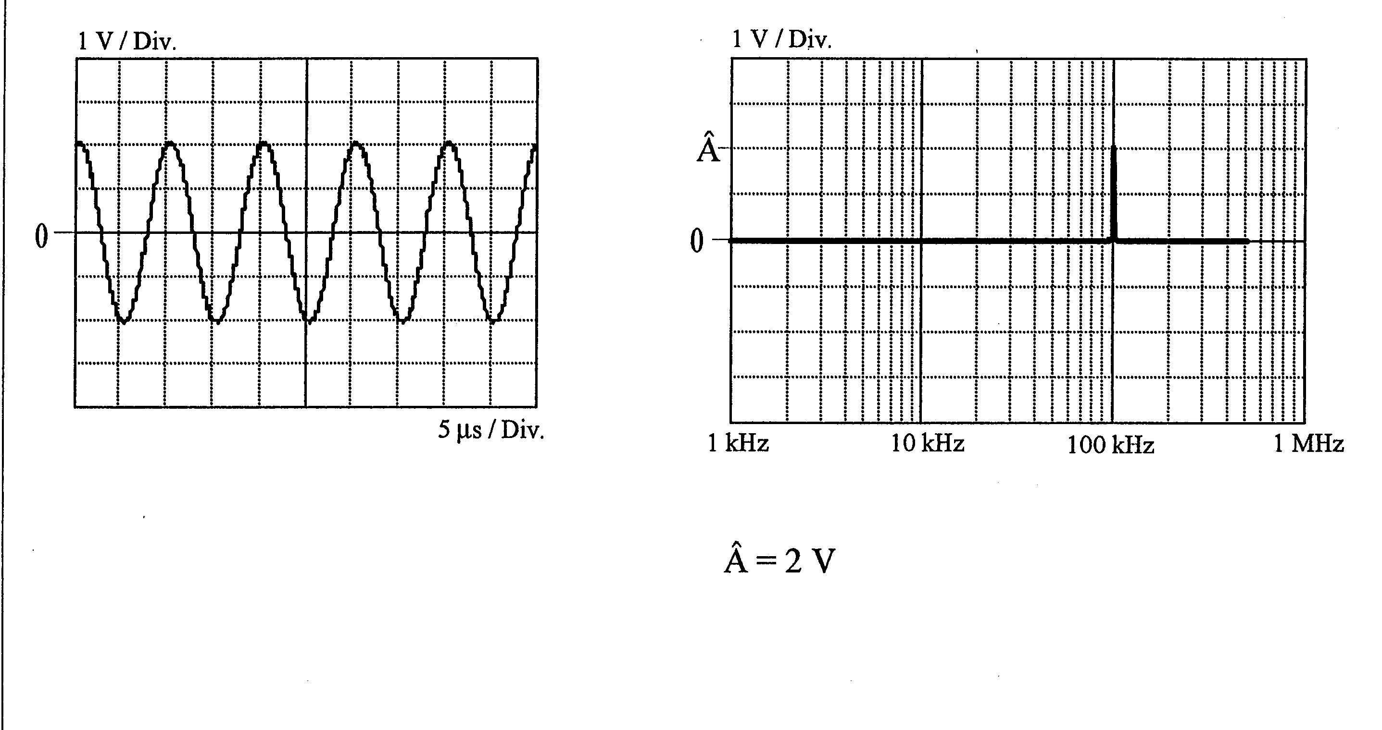
Typical waveforms and their harmonics
Sinus Signal

Slide 20
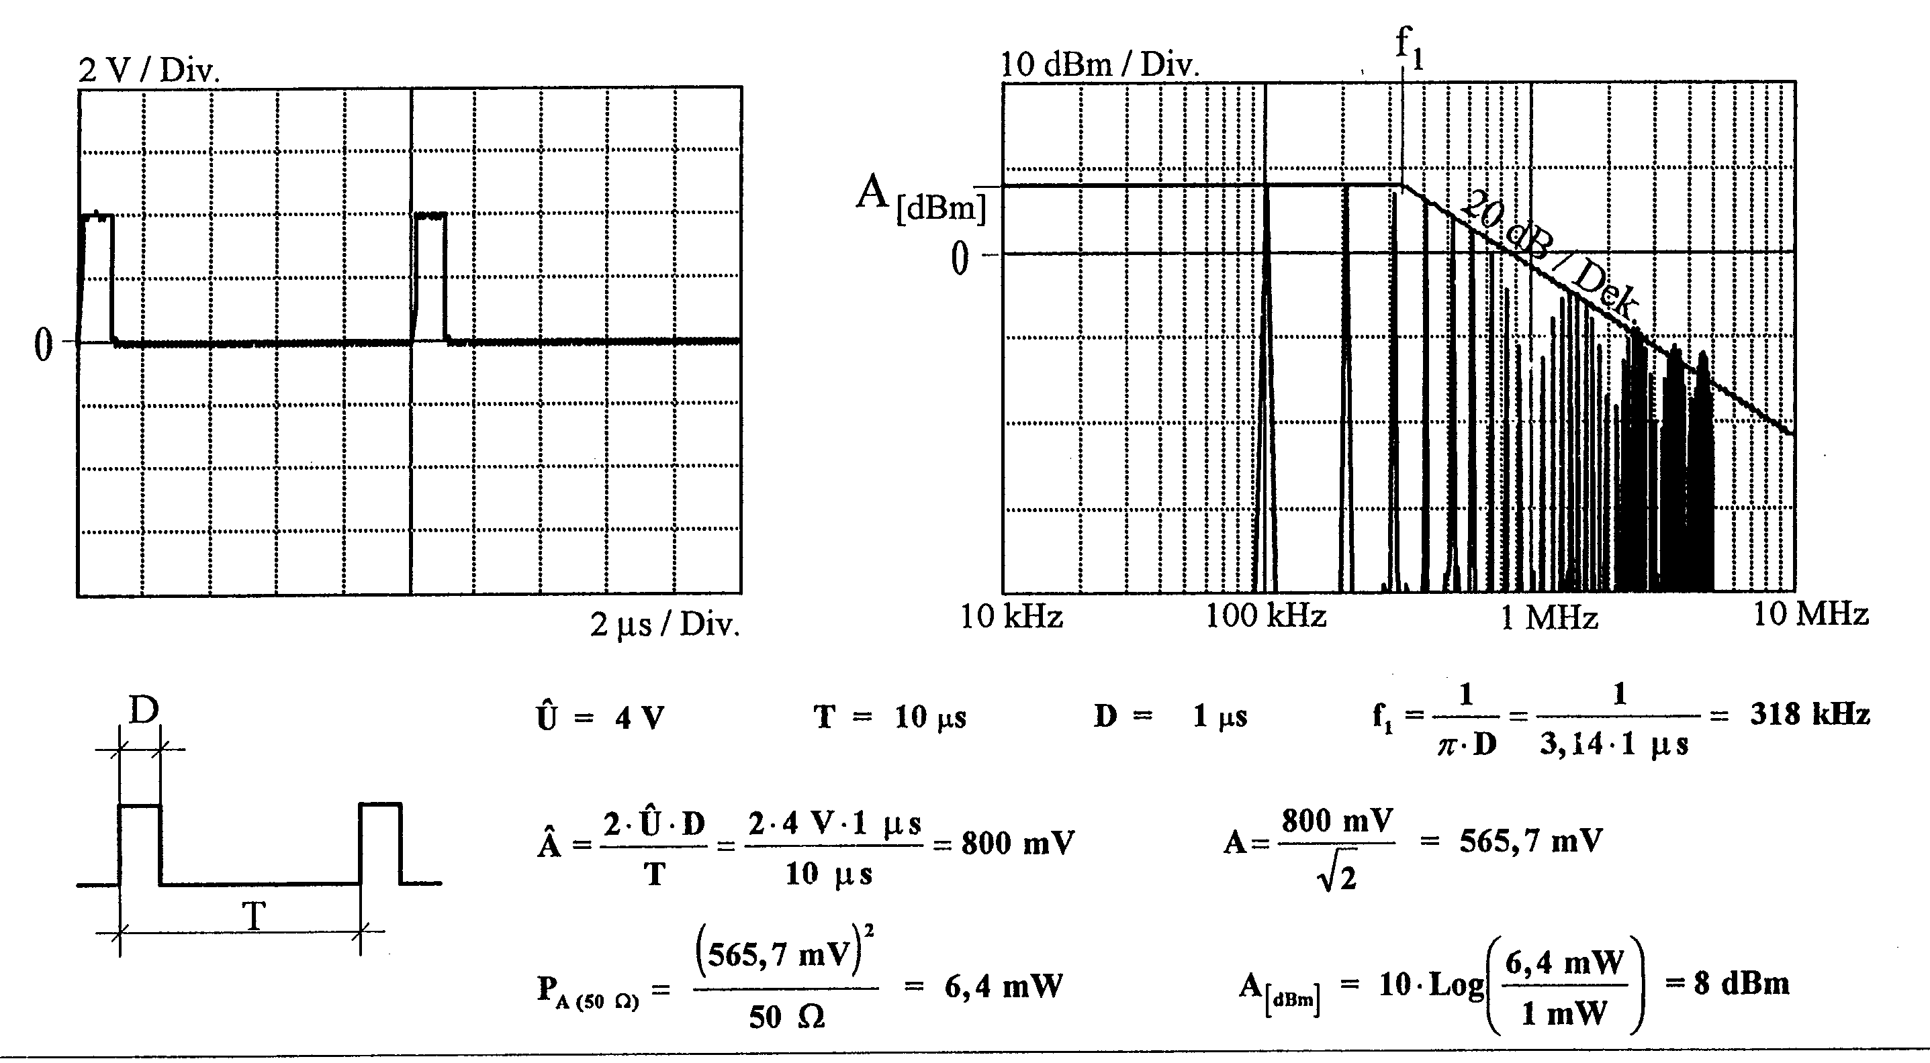
Typical waveforms and their harmonics
Periodic square wave

Slide 21
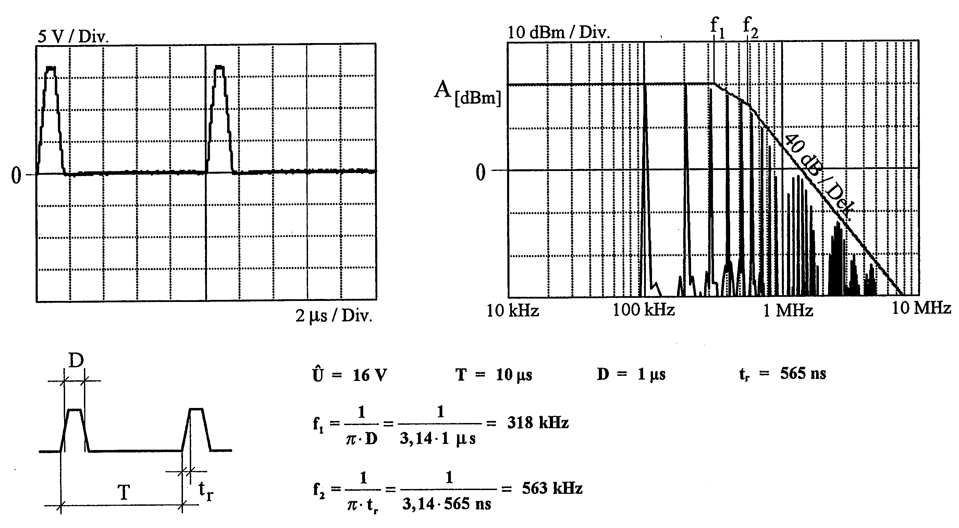
Typical waveforms and their Harmonics
Periodic square wave slow rise time

Slide 22
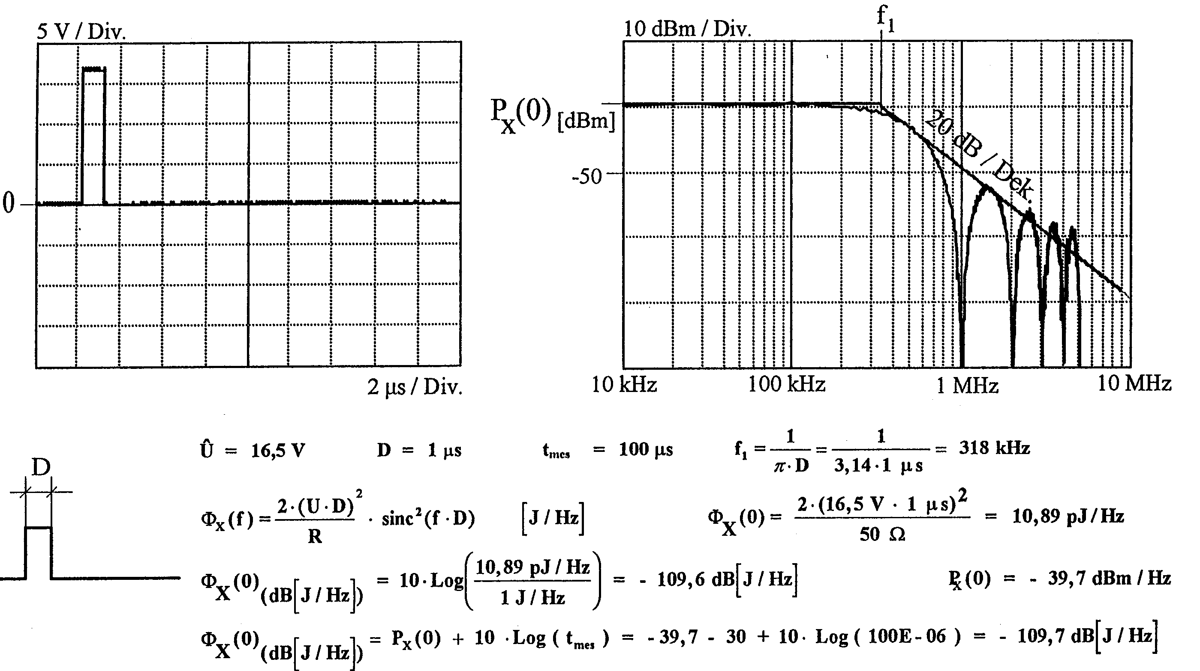
Typical waveforms their Harmonics
Non-periodic square wave

Slide 23
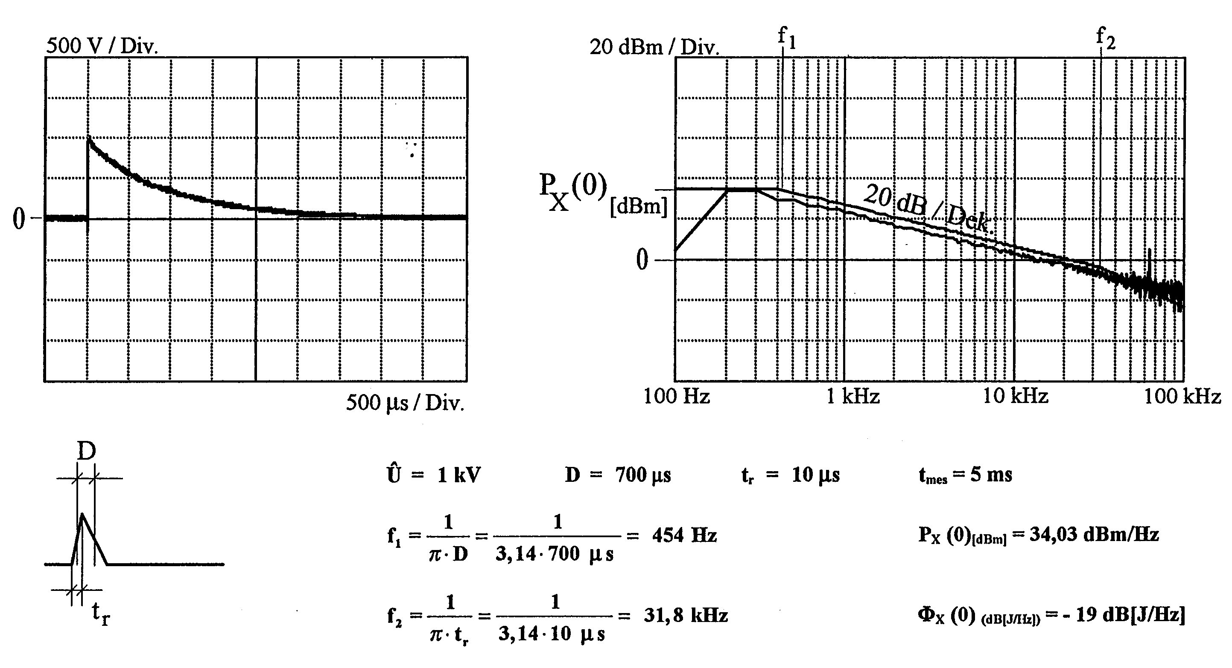
Typical waveforms their Harmonics
Non-periodic 10/700 μs Impulse

Slide 24
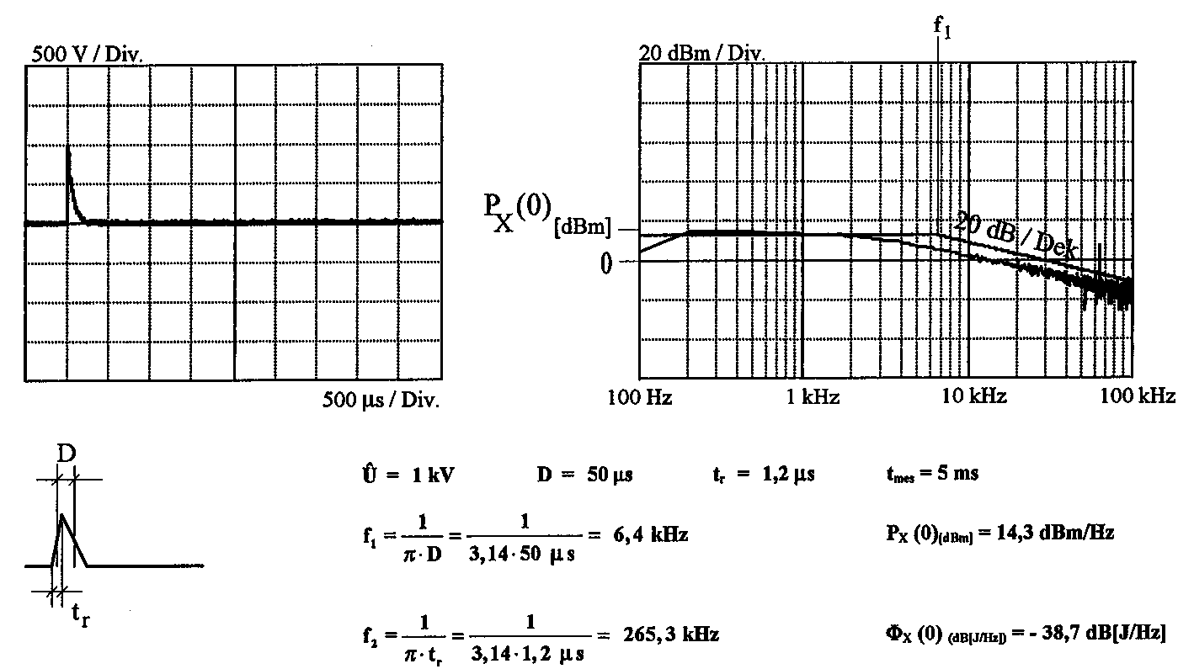
Typical waveforms their Harmonics
Non-periodic 1.2/50 μs Impulse

Slide 25
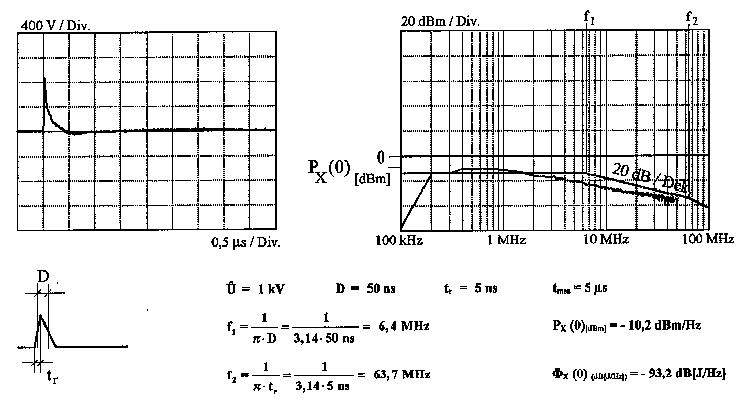
Typical waveforms their Harmonics
Non-periodic 5/50 ns Impulse (EFT)

Slide 26
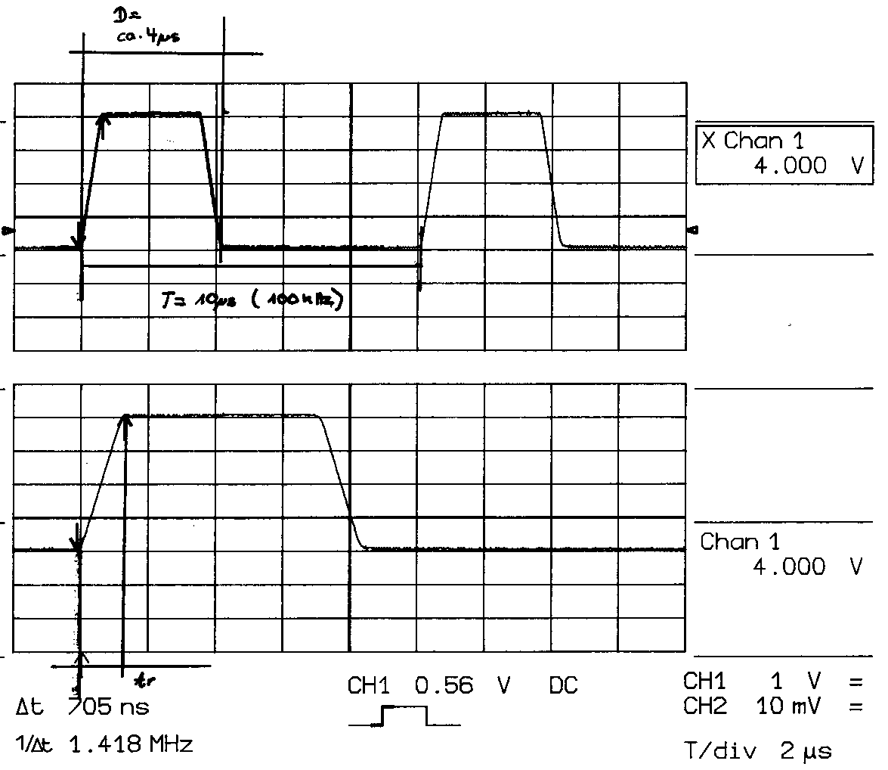
The influence of the rise time and pulse duration
Rise time 705 ns - pulse duration 4 μs

Slide 27
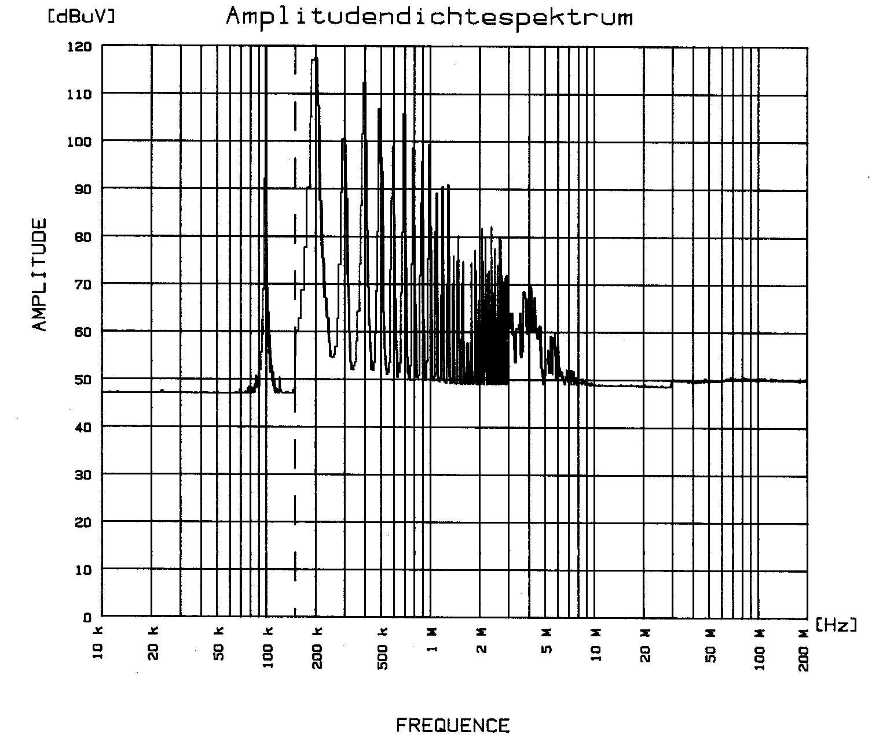
The influence of the rise time and pulse duration
Rise time 705 ns - pulse duration 4 μs

Slide 28
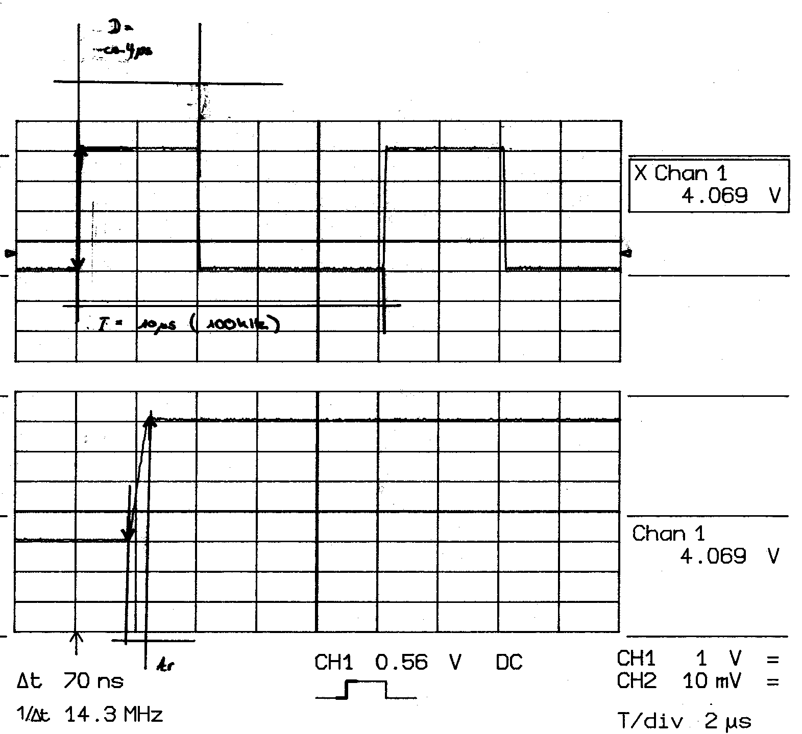
The influence of the rise time and pulse duration
Rise time 70 ns - pulse duration 4 μs

Slide 29
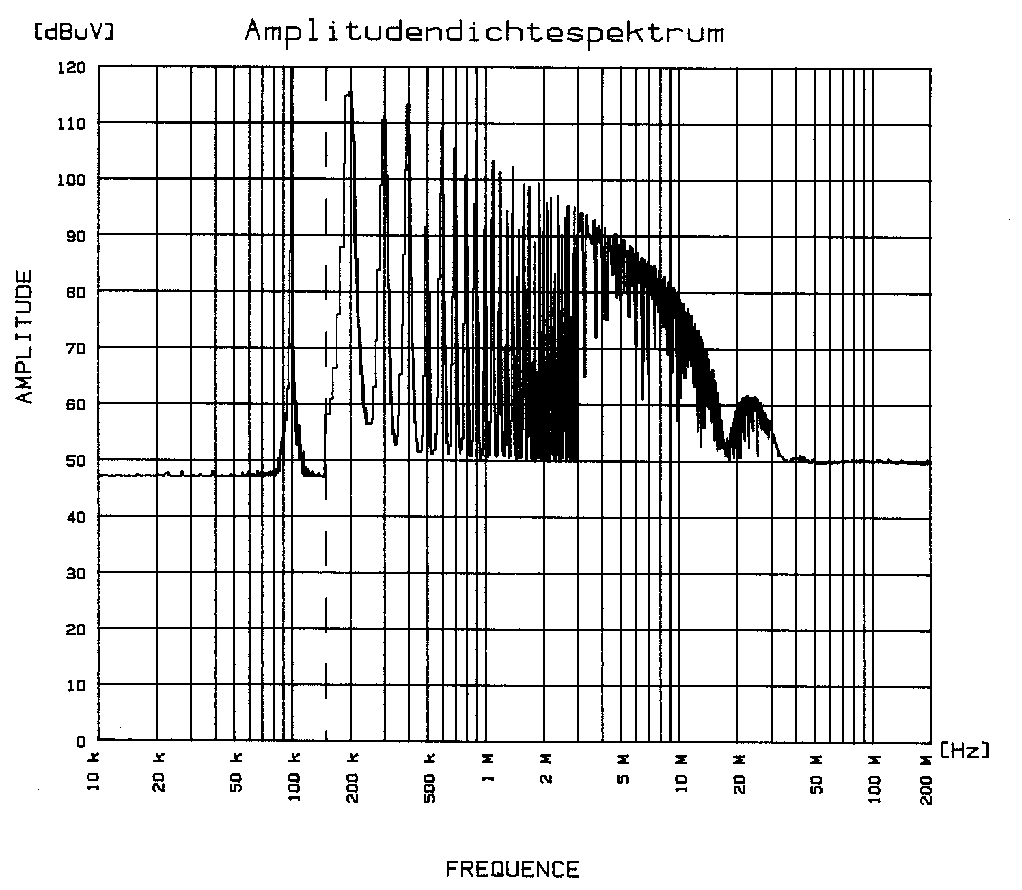
The influence of the rise time and pulse duration
Rise time 70 ns - pulse duration 4 μs

Slide 30
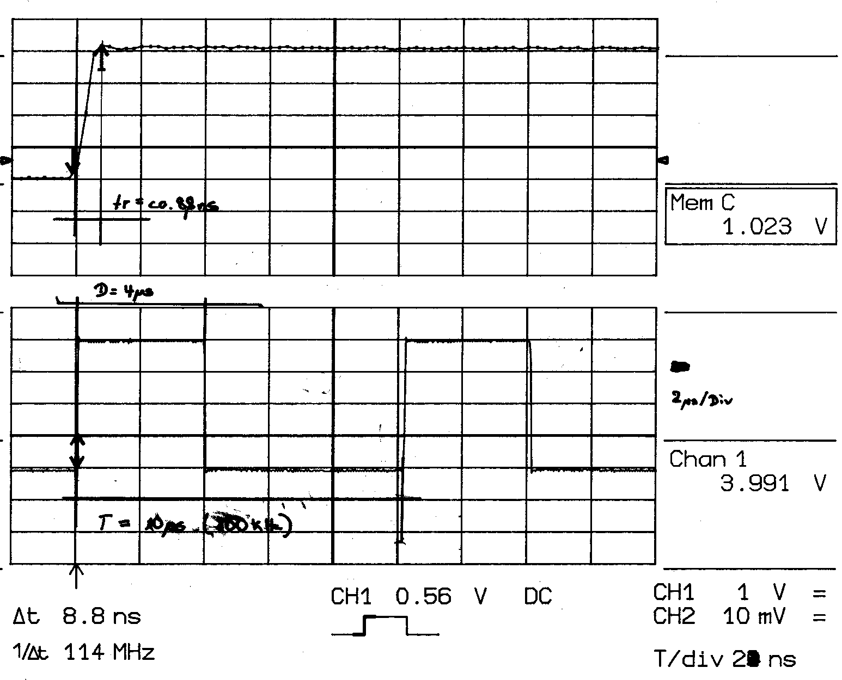
The influence of the rise time and pulse duration
Rise time 7 ns - pulse duration 4 μs

Slide 31
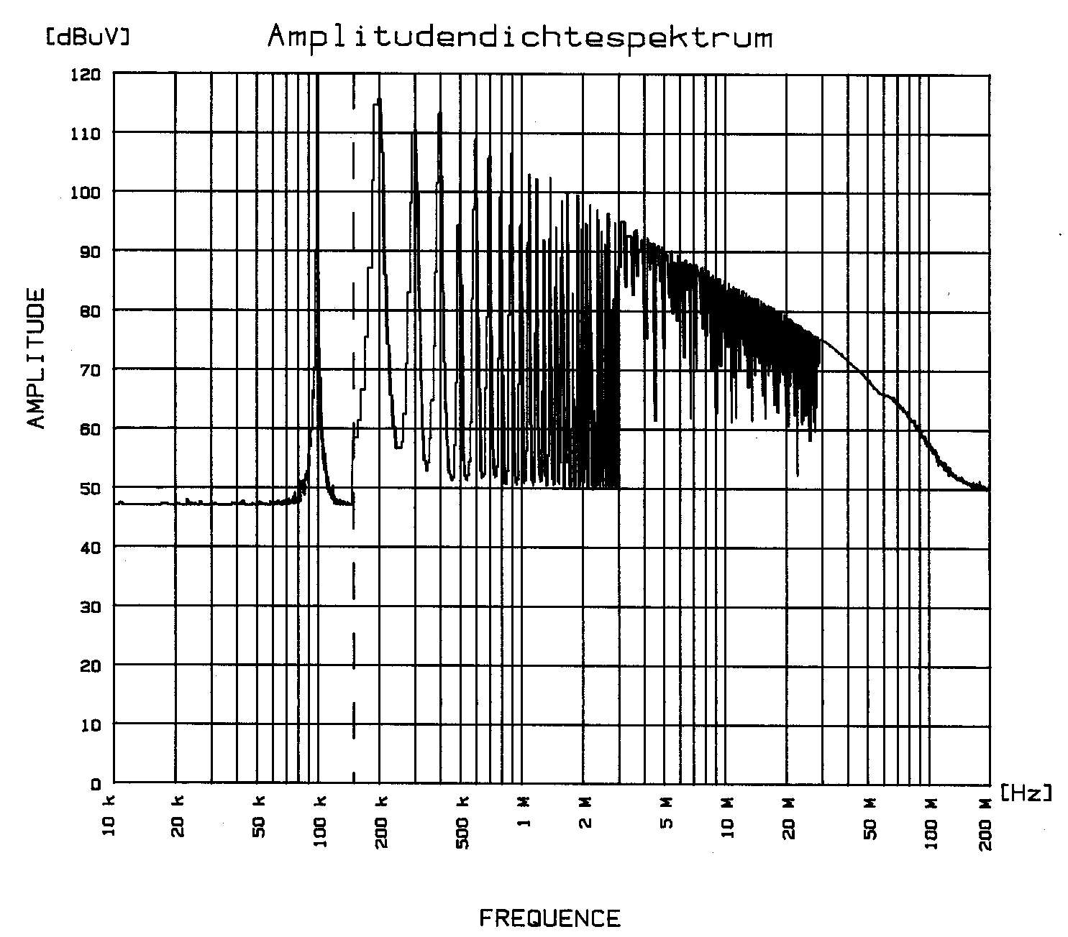
The influence of the rise time and pulse duration
Rise time 7 ns - pulse duration 4 μs

Slide 32
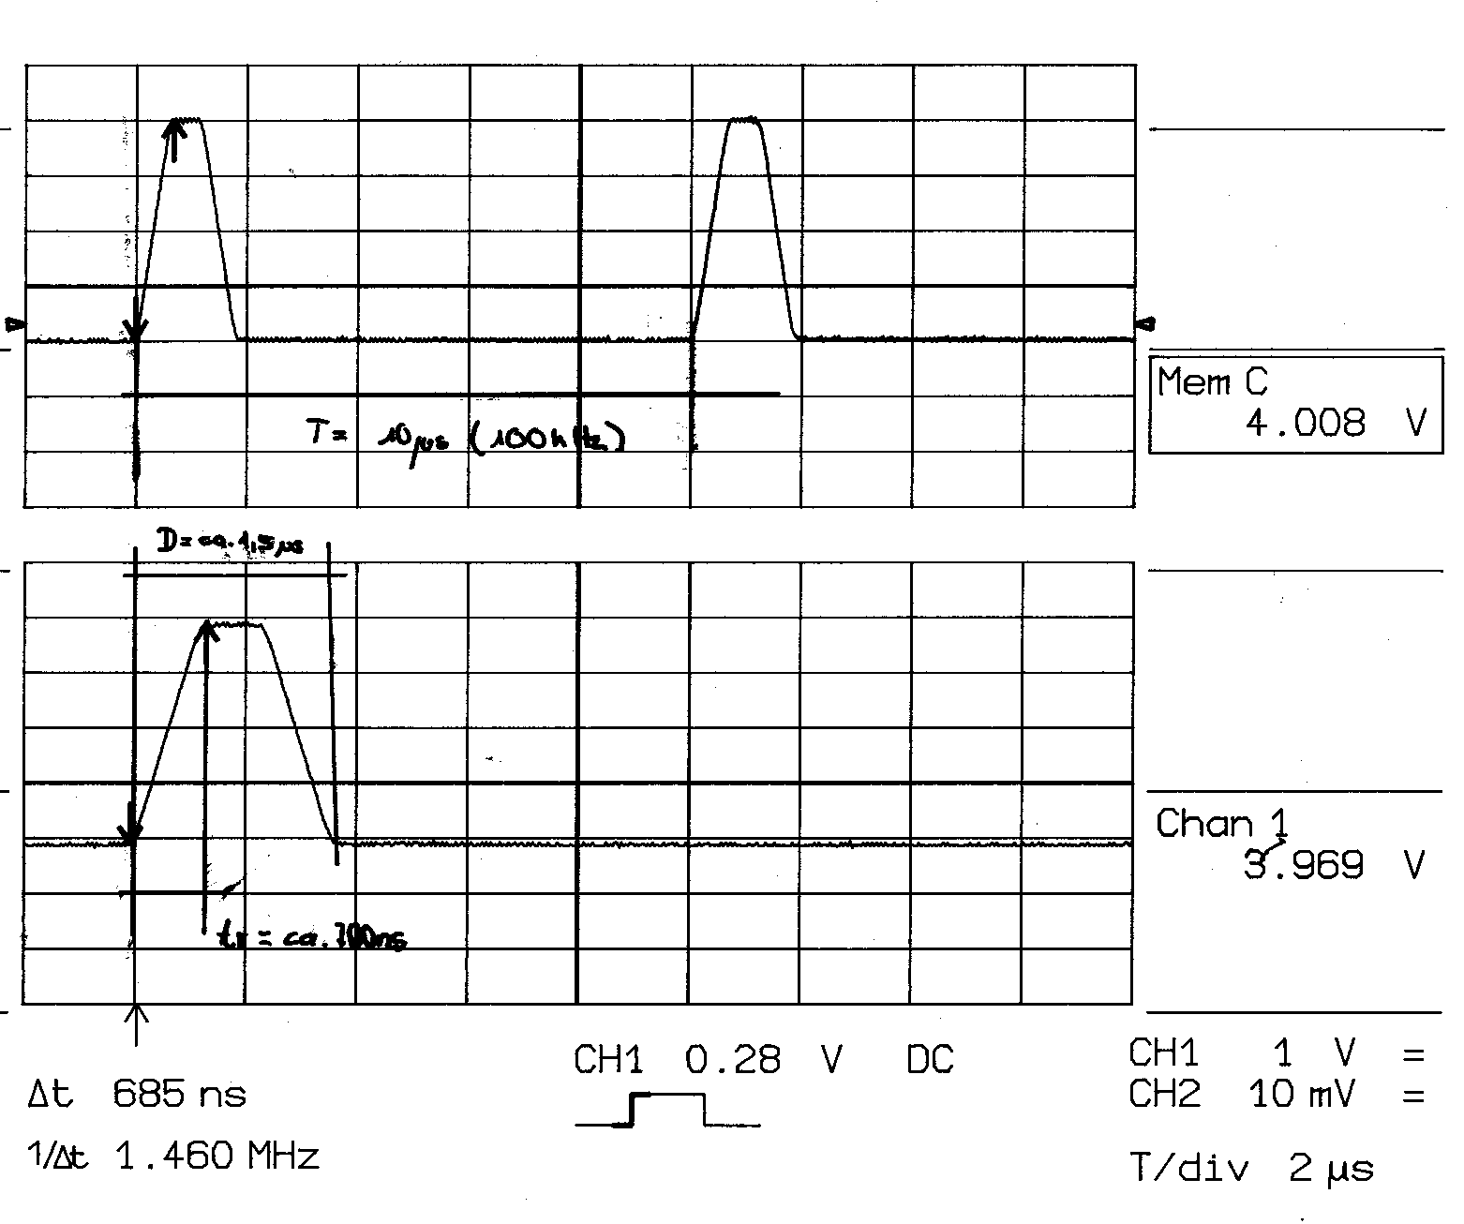
The influence of the rise time and pulse duration
Rise time 700 ns - pulse duration 1 μs

Slide 33
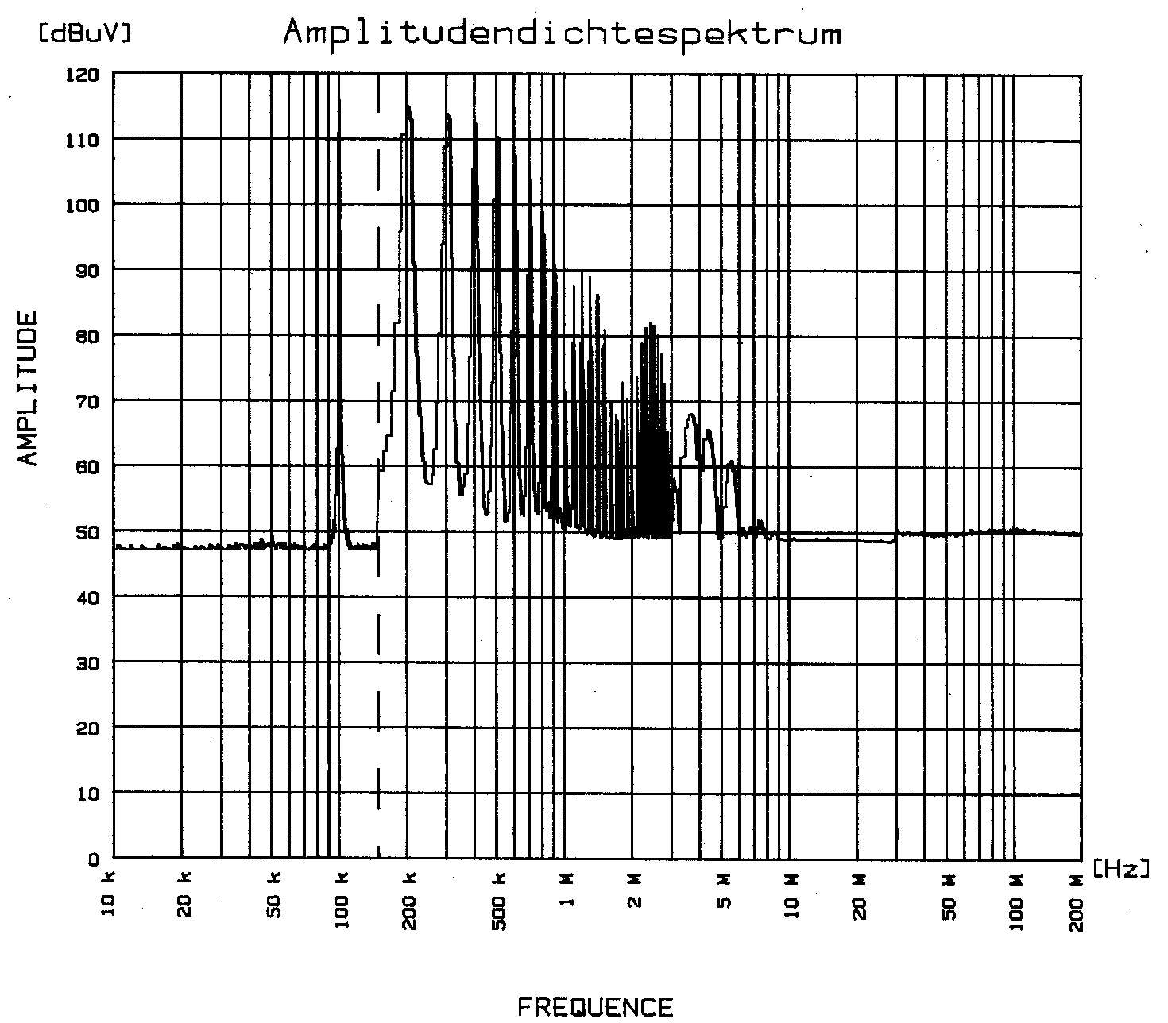
The influence of the rise time and pulse duration
Rise time 700 ns - pulse duration 1 μs

Slide 34
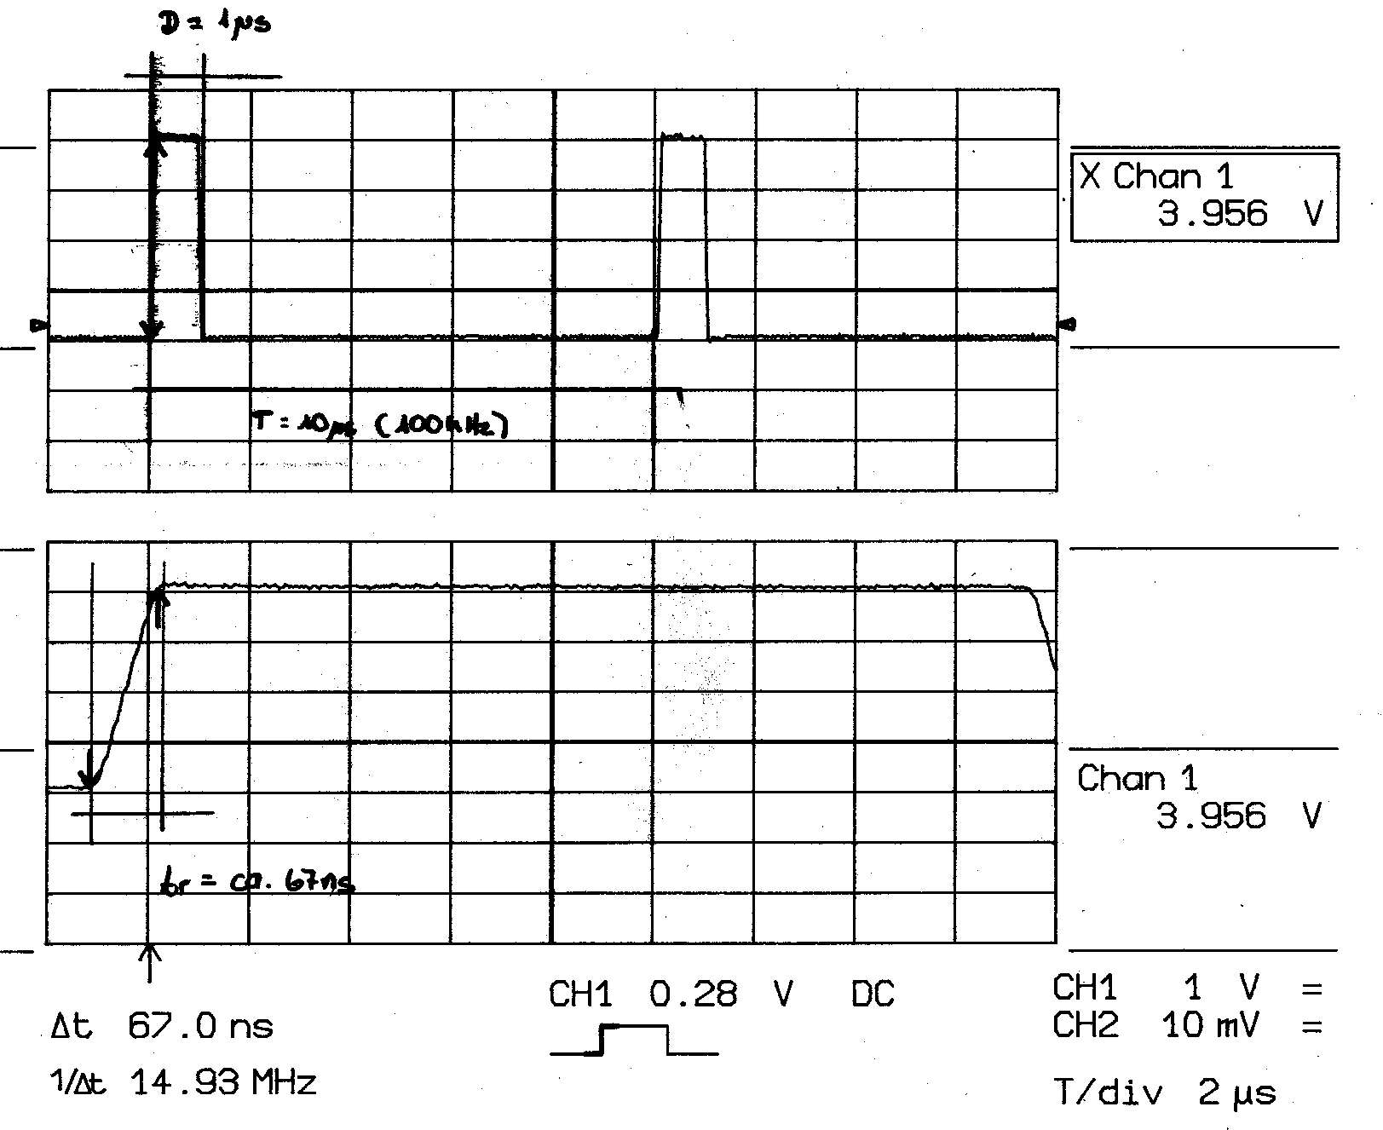
The influence of the rise time and pulse duration
Rise time 70 ns - pulse duration 1 μs

Slide 35
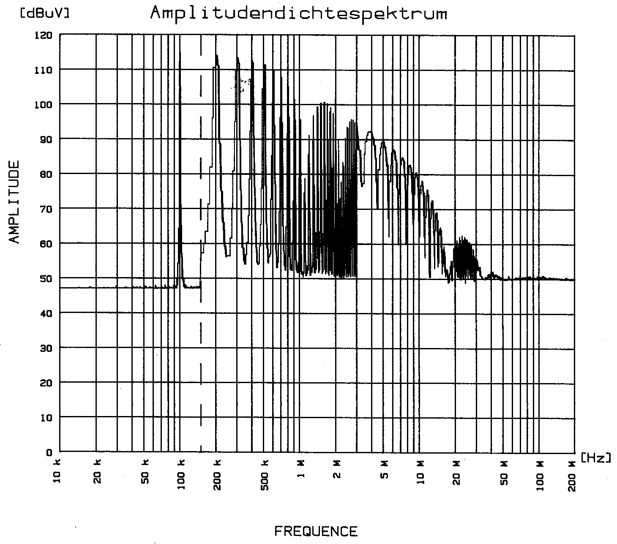
The influence of the rise time and pulse duration
Rise time 70 ns - pulse duration 1 μs

Slide 36
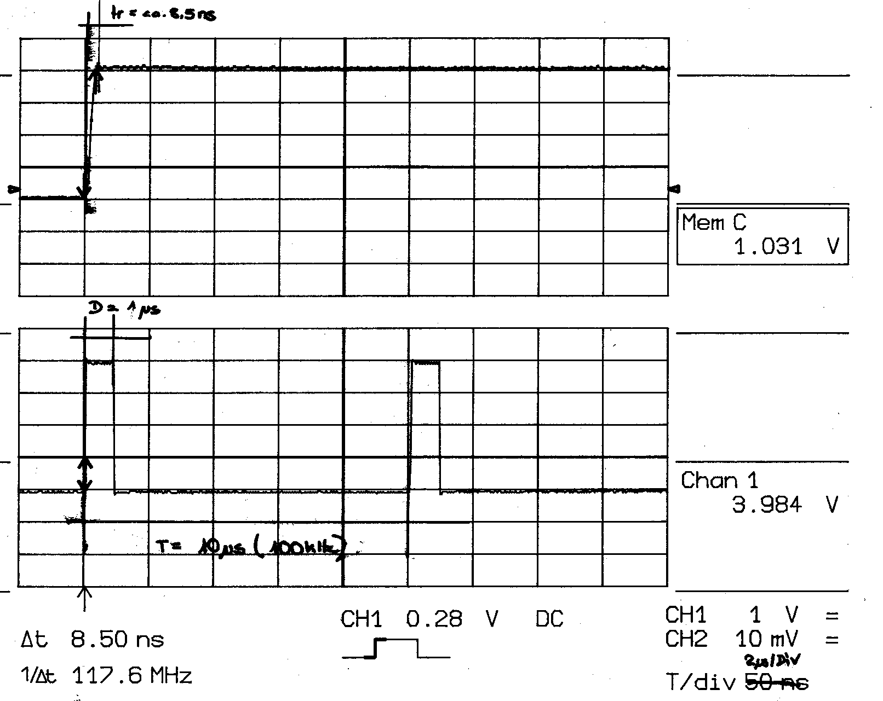
The influence of the rise time and pulse duration
Rise time 7 ns - pulse duration 1 μs

Slide 37
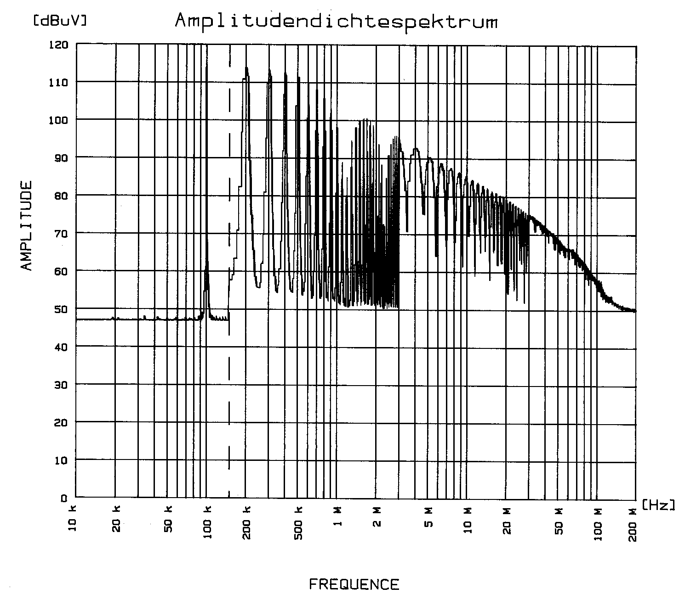
The influence of the rise time and pulse duration
Rise time 7 ns - pulse duration 1 μs

Slide 38
Common mode and differential mode
Common mode = asymmetrical mode
Differential mode = symmetrical mode
Common mode radiation
Common mode current
Differential mode radiation
Differential mode current

Slide 39
Signal Spectra Overview
Trapezoidal Waveform
First corner frequency f1 = 1/πτ
2A
-20 dB/decade
Second corner frequency f2 = 1/πτ_{r}
-40 dB/decade
F
τ
τ_{r}

Slide 40
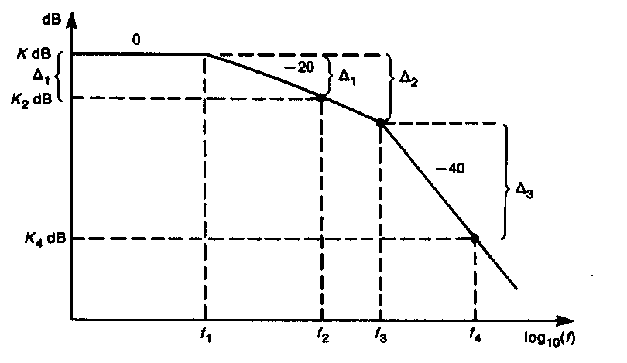
Signal Spectra Overview
Trapezoidal Waveform

Slide 41
Signal Spectra Overview
Trapezoidal Waveform
First corner frequency f1 = 1/πτ
2A
-20 dB/decade
Second corner frequency f2 = 1/πτ_{r}
-40 dB/decade
F
f3 Wanted frequency 110 MHz

Slide 42
Signal Spectra Overview
Trapezoidal Waveform
Frequency: 10 MHz, 50% duty cycle (τ = 50 ns)
Rise time τ_{r} : 5 ns
Amplitude: 1V
F
τ
τ_{r}

Slide 43
Signal Spectra Overview
1. Step identify the 3 key frequencies fo, f1 and f2
f0 = fundamental frequency
f1 = first edge frequency
f2 = second edge frequency
f3 = wanted frequency
2. Step calculate expected amplitude
Formula: 20 log10 (1V) - Δ1 - Δ2
Δ1 = -20 log10 (f2/f1)
Δ2 = -40 log10 (f3/f2)

Slide 44
Signal Spectra Overview
Result:
20 log (1V) - 20log10 (63.7MHz/6.37 MHz) - 40 log10 (110 MHz/63.7 MHz)
= 120 dBμV - 20 dB - 9.49 dB
= 90.5 dBμV

Slide 45
Signal Spectra Overview
Trapezoidal Waveform Example 2
Frequency: 10 MHz, 50% duty cycle (τ = 50 ns)
Rise time τ_{r} : 20 ns
Amplitude: 1V
F
τ
τ_{r}

Slide 46
Signal Spectra Overview
Result:
20 log (1V) - 20log10 (15.9MHz/6.37 MHz) - 40 log10 (110 MHz/15.9. MHz)
= 120 dBμV - 7.95 dB - 33.6 dB
= 78.45 dBμV

Slide 47
Signal Spectra Overview
Trapezoidal Waveform Example 3
Frequency: 1 MHz, 50% duty cycle (τ = 50 ns)
Rise time τ_{r} : 20 ns
Amplitude: 1V
F
τ
τ_{r}

Slide 48
Signal Spectra Overview
Result:
20 log (1V) - 20log10 (15.9MHz/6.37 kHz) - 40 log10 (110 MHz/15.9. MHz)
= 120 dBμV - 32 dB - 33.6 dB
= 54.5 dBμV

Slide 49
Common Mode and Differential Mode

Slide 50
Common Mode and Differential Mode
Common mode = asymmetrical mode
Differential mode = symmetrical mode
Common mode radiation
Common mode current
Differential mode radiation
Differential mode current

Slide 51
Common Mode and Differential Mode
In any electronic or electrical circuit exist both common mode (CM) and differential mode (DM) currents. At the source, every current flow, is at the first moment a differential mode current (signal current) and is later transformed to a common mode current mainly because of parasitic effects between the conductors carrying the signal current.

Slide 52
Common Mode and Differential Mode
Differential mode currents carrying a information and are wanted. Common Mode current is side effect of differential mode current and unwanted.

Slide 53
Common Mode and Differential Mode
Differential Mode current:
Carry the desired information
Cause minimal interference (radiation) as the currents cancel each other out, if the basic rules are considered

Slide 54
Common Mode and Differential Mode
Common Mode current:
Are the major source of radiated emission above 30 MHz
Are the major source of conducted emission above 2-5 MHz
Contain no useful information

Slide 55
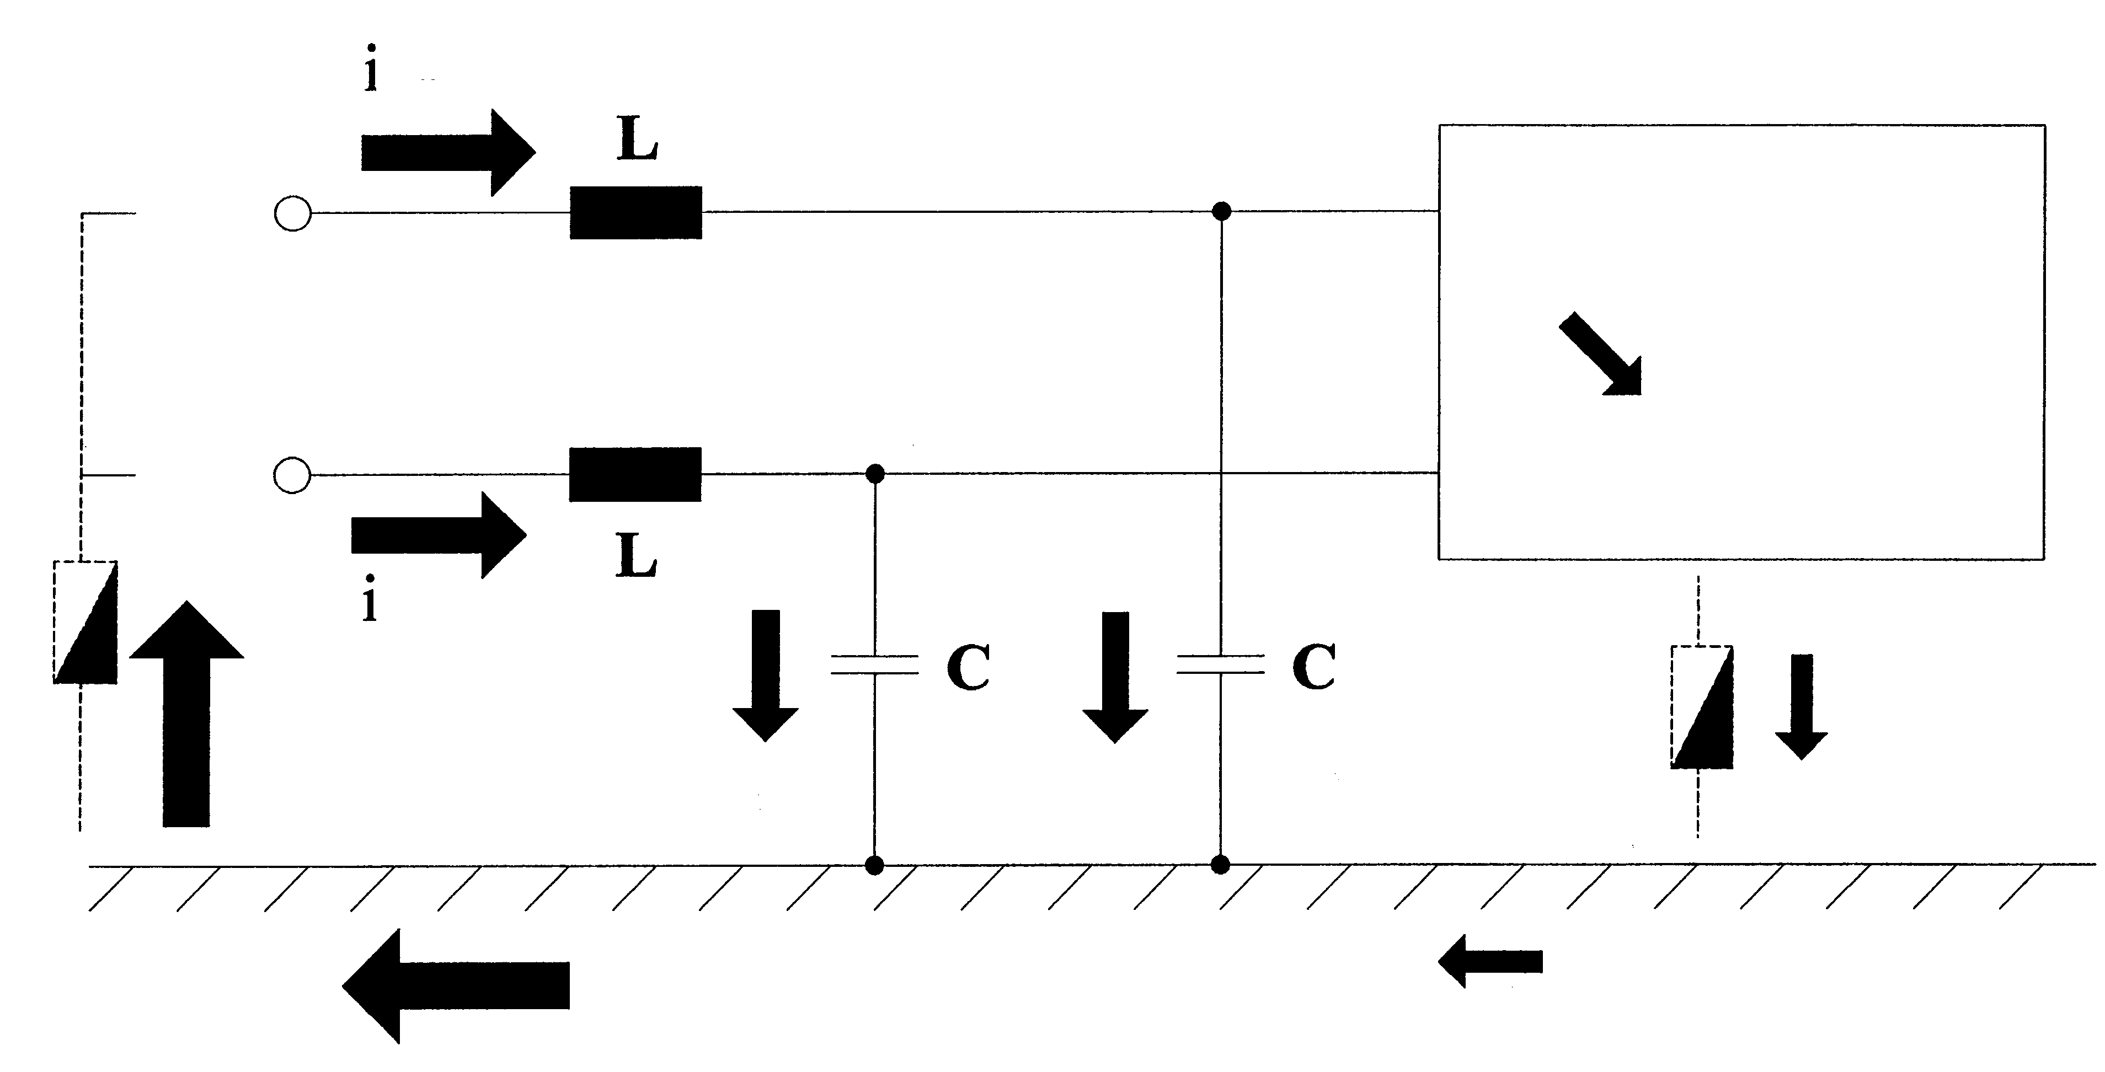
Common mode model immunity

Slide 56
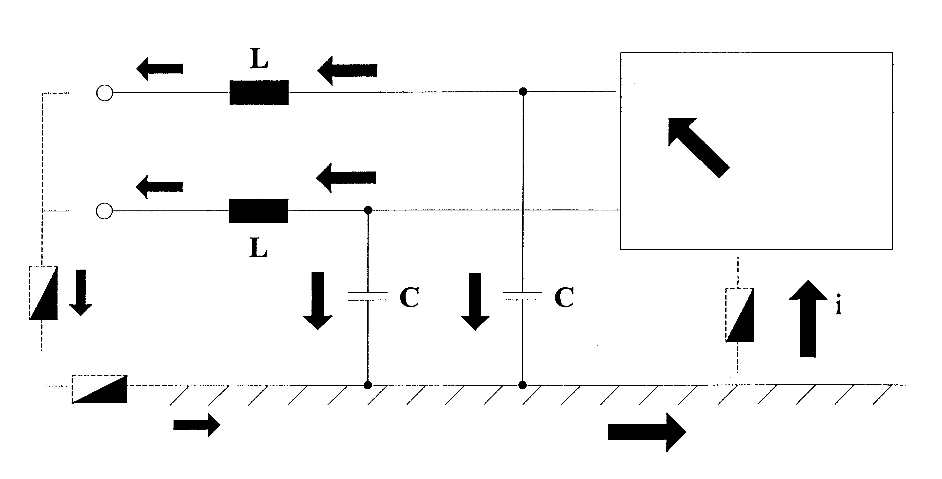
Common mode model emission

Slide 57
Common Mode
Common mode currents is the component of an RF energy present on both signal and return path. Common mode current is the major cause of RF emission, especially from I/O cables.
Common mode radiation is caused by voltage drops in a circuit. The far field can be calculated with:
E = 1.257x10-6 x (Icxfxl/d)
Whereas: E = electric field in μV/m
I = common mode current in A
f = freqiency
d = distance in m

Slide 58
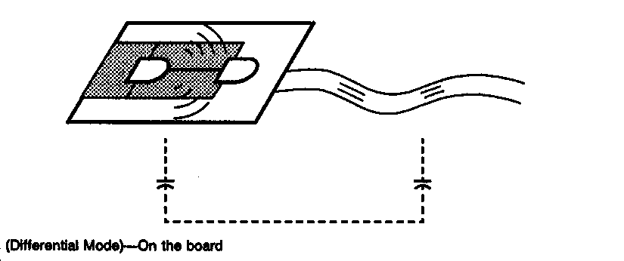
Common Mode
Model common mode

Slide 59
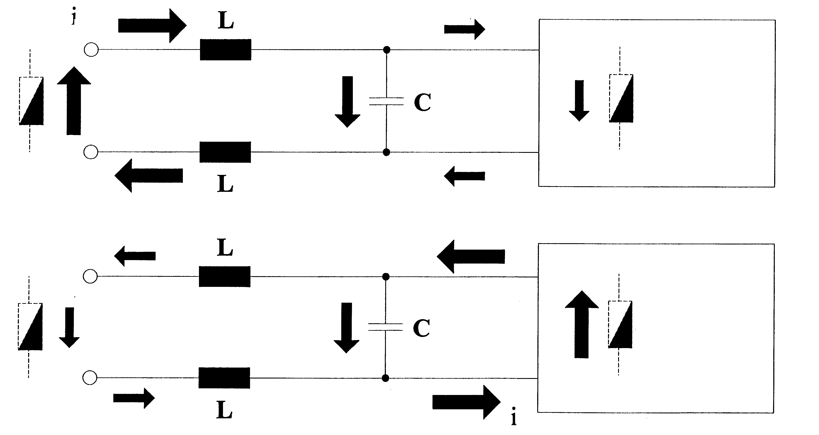
Differential Mode Model Emission and Immunity

Slide 60
Differential Mode
Differential mode currents cause differential mode radiation. The radiation depends on the loop area, the current and the frequency.
The maximum field radiated by a loop can be calculated with:
E = Af² x Is / (360 x d)
Whereas: A = loop area (cm²)
d = distance between loop and antenna
Is = differential mode current
f = frequency
E = electric field-strength in dBμV/m

Slide 61
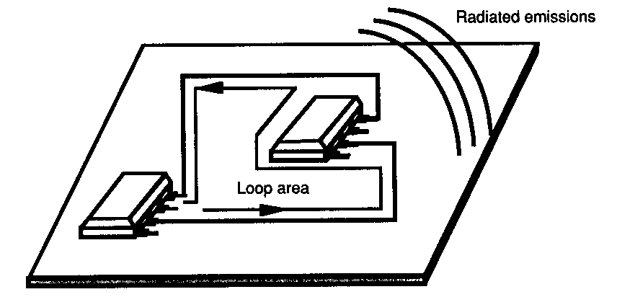
Differential Mode
Example:
Loop area: 4 cm2
Current: 5 mA
Frequency: 100 MHz
Distance: 10 m
Calculated field:
52.6 dBuV/m

Slide 62
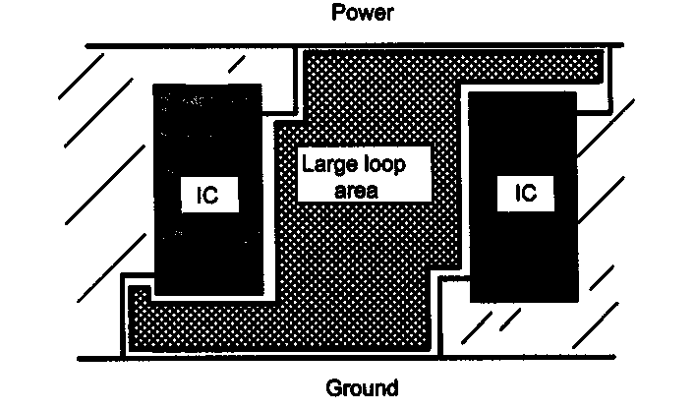
Differential Mode
Example:
Large loop area

Slide 63
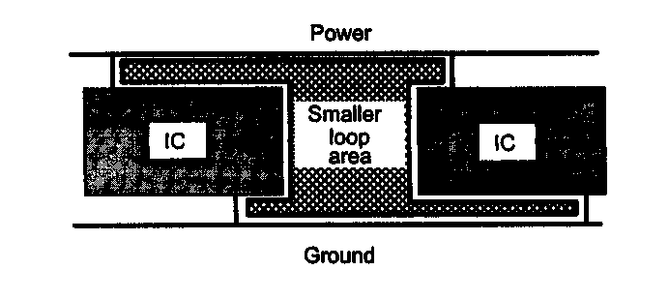
Differential Mode
Example:
Reduce loop area

Slide 64
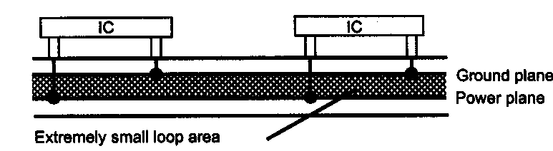
Differential Mode
Example:
Small loop area

Slide 65
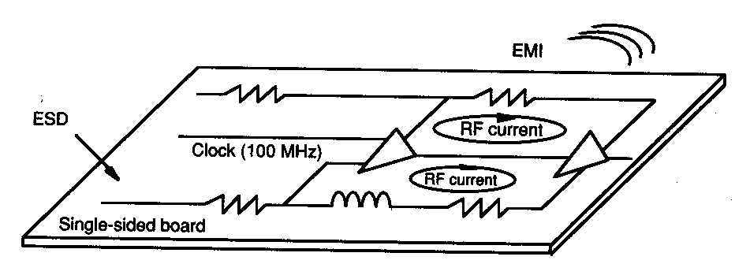
Differential Mode
Recognizing Loop areas

Slide 66
Source of common mode and differential mode emission
In digital circuits the major source of the emission are the clock frequencies and its harmonics as well as the fast rise time of the logic circuits

Slide 67
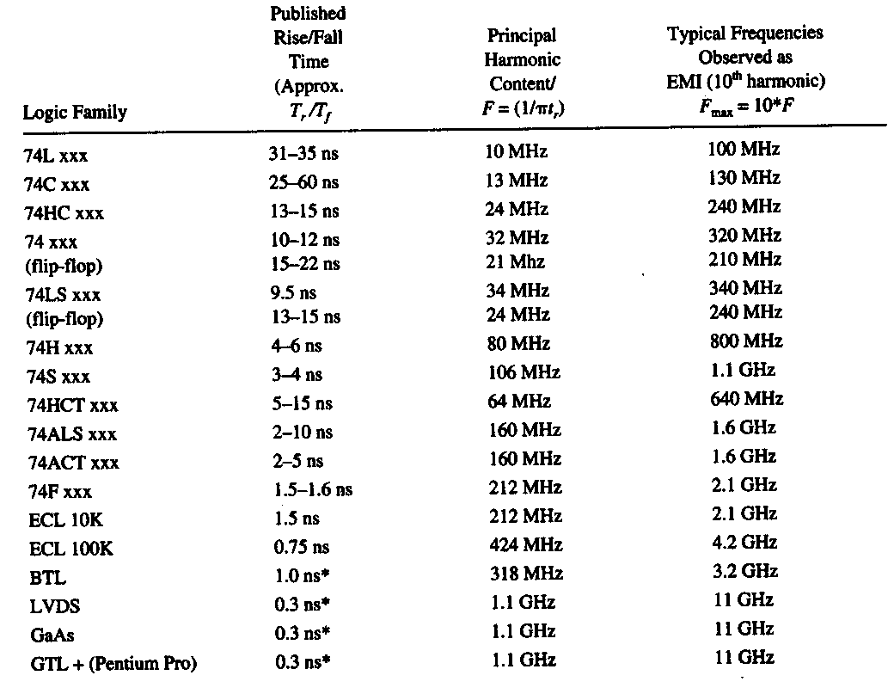
Source of common mode and differential mode emission

Slide 68
Source of common mode and differential mode emission
For high-speed logic, higher frequencies will be generate, due to higher fundamental frequencies and shorter rise time
To minimize the distribution of RF currents, proper layout of the pcb traces, component placement and other provisions to allow RF current to return to its source
To minimize development of common mode current, proper decoupling of switching devices is required. Keep the impedance as low as possible.
To minimize propagation of RF currents, proper termination of transmission lines is required.

Slide 69
Source of common mode and differential mode emission
A optimal 0V reference must be provided. (ground plane)
At low frequencies RF currents are not a major problem.
At higher frequencies RF currents caused problems and will radiate within the structure and cables

