Slide 1

EMC Standards
EN 55012
EMC GROUP (GZ)

Slide 2
BS EN 55012:2002
Vehicles, boats and internal combustion engine driven devices
——Radio disturbance characteristic(RE)
——Limits and methods of measurement

Slide 3
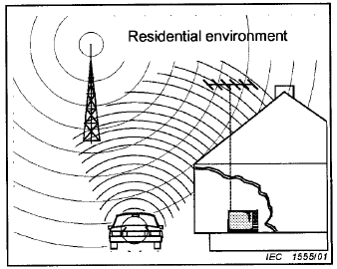

Scope
Provide protection
Emission Source:
Vehicles
Boats
Devices
Notes:
The limits in EN55012 are designed to provide protection for broadcast receivers in the frequency range of 30MHz to 1000MHz when used in the residential environment.
This standards applies to the emission of broadband and narrowband electromagnetic energy which is emitted from
a)Vehicles propelled by an internal combustion engine,electrical means or both;
b)Boats propelled by an internal combustion engine,electrical means or both;
c)Devices equipped with internal combustion engines.

Slide 4
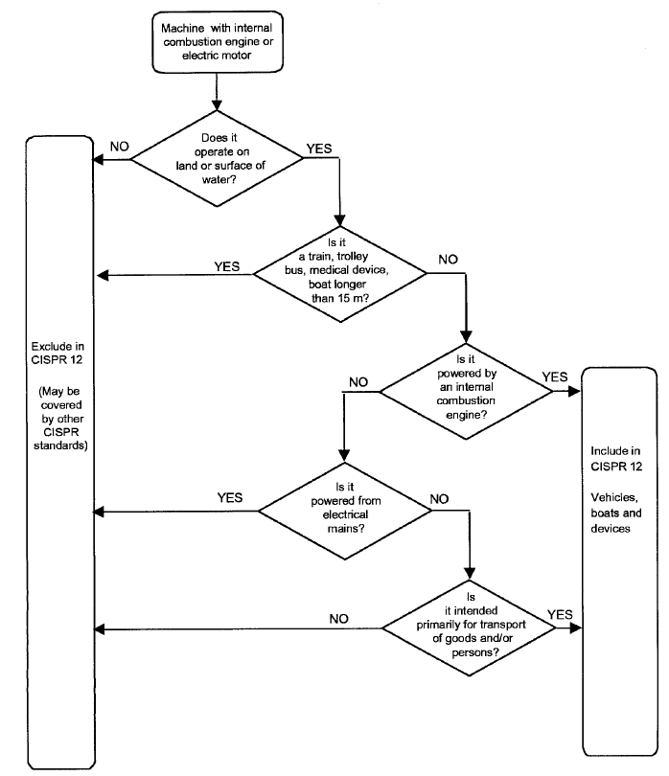
Applicability

Slide 5


Test equipments
Receiver
Antenna
other
Pls. Refer to CISPR 16-1

Slide 6
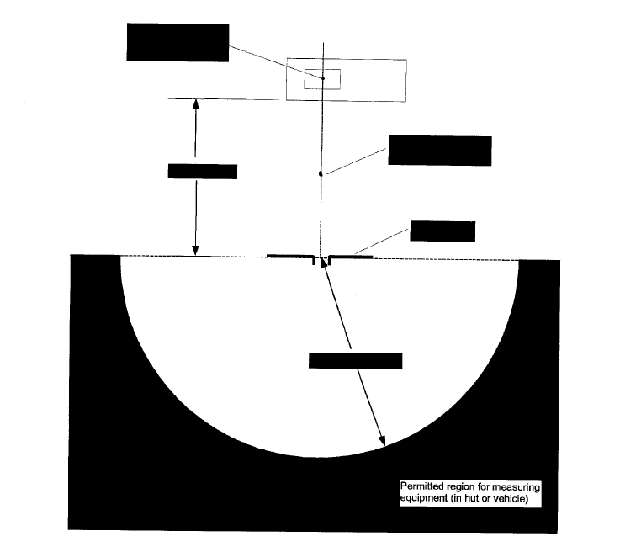
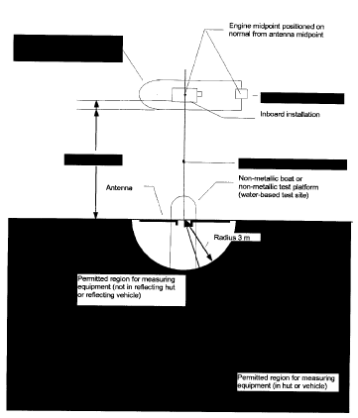
Measuring site-OATS (for the large EUT)
OATS for vehicles and devices
OATS for boats
Notes:
OATS---Open area test sites.
The test site shall be a clear area free from electromagnetic reflecting surfaces within a circle of minimum radius 30 m measured from a point midway between the engine under test and the antenna.

Slide 7
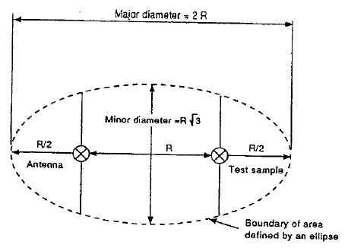
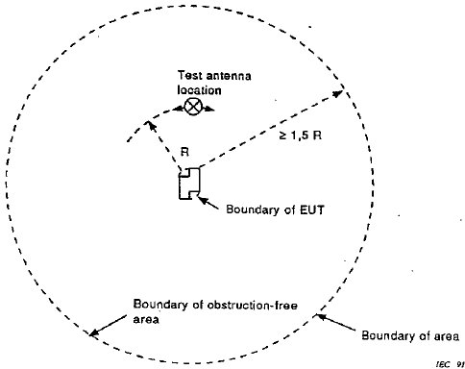
Measuring site-OATS (for EUT of Length and width less the 2meter)
OATS with a turntable
OATS with a stationary EUT

Slide 8
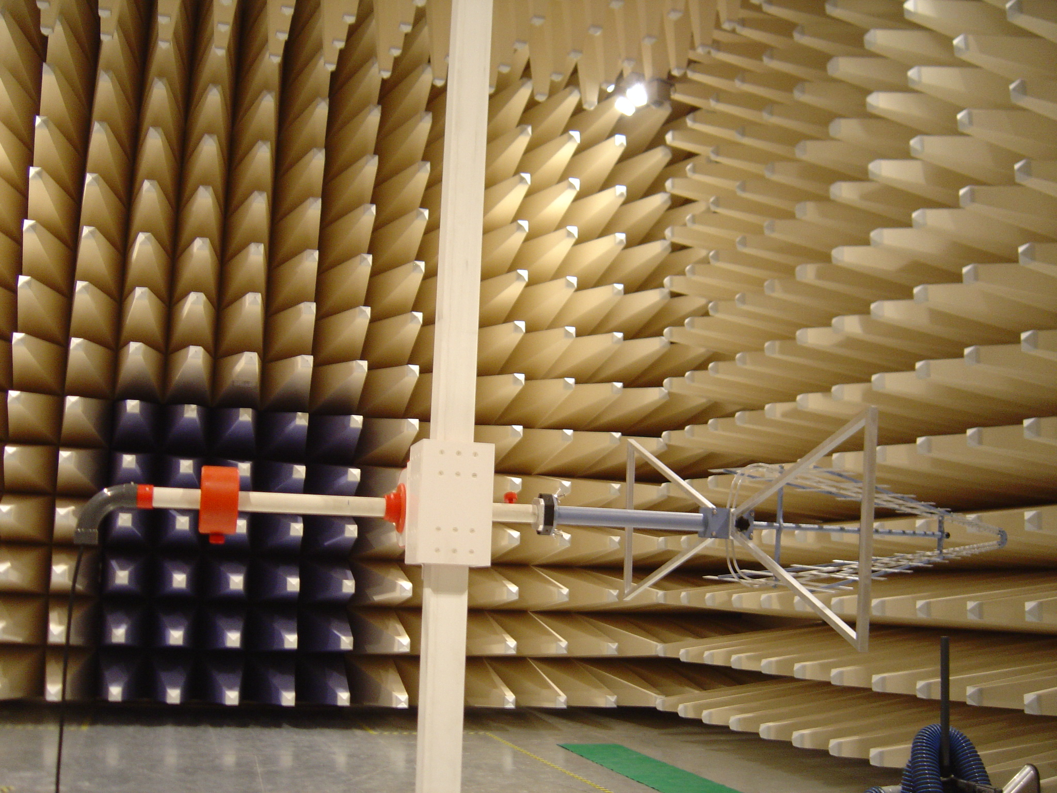
Measuring site- Chamber

Slide 9
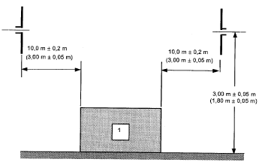
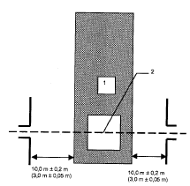
Antenna requirements
Vertical polarization
Horizontal polarization
Notes:
垂直极化：
天线与EUT距离10米，天线距离地面的高度为3米；
天线与EUT距离3米，天线距离地面的高度为1.8米；
水平极化：

Slide 10
Ambient requirements
The ambient noise shall be at least 6dB below the limits of disturbance

Slide 11
Test object conditions for Vehicle and Boats
Measurements shall be made on the left and right sides of vehicles or boat.
Internal combustion engine operating speeds
Number of cylinder | Engine speed
1 >1 | 2500 rev/min 1500 rev/min

Slide 12

Test object conditions for Devices
Normal positions and heights
Normal full load and No load at idle speed
Three orthogonal planes

Slide 13
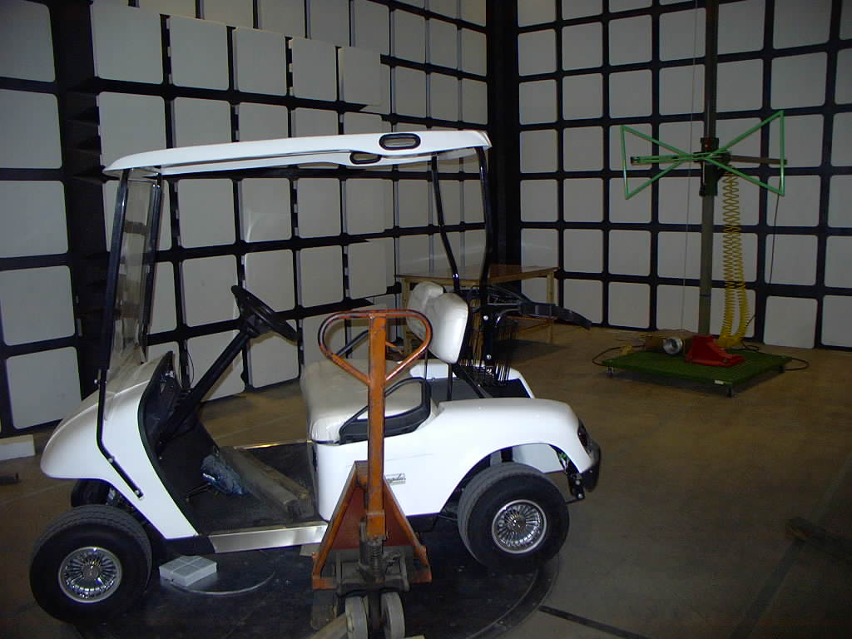
Test arrangement for RE (for example)

Slide 14
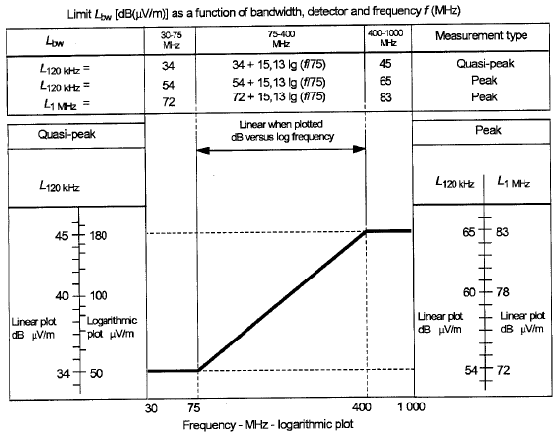
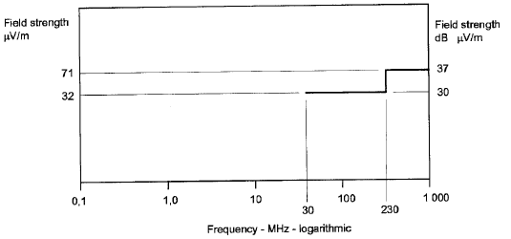
Limits for broadband emission and narrowband emissions
Broadband 10 m
Narrowband 10 m
Plus 10dB at 3 m antenna distance

Slide 15
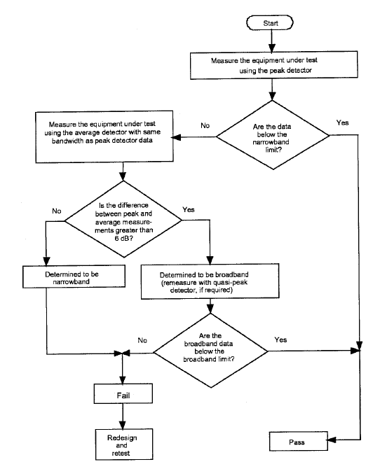
Determination of the appropriate limit level

Slide 16
Thanks

