Slide 1
Welcome to the training !!!
EN 55013 : 2001 (AV Products)
DOP: 2002-06-01 DOW: 2004-09-01

Slide 2

What is the standard’s construction?
Scope & object
Limits
Measurements

Slide 3
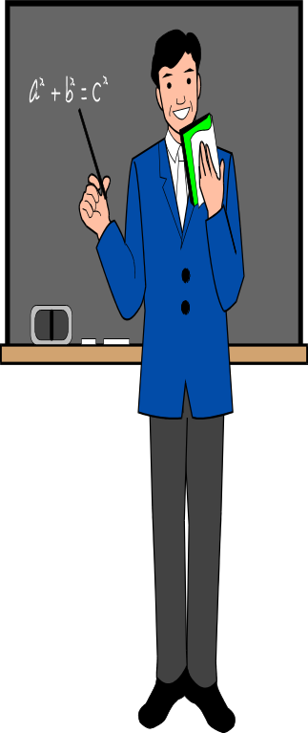
Scope:
  Sound receivers
  Television receivers
  Associated equipment

Slide 4

Scope:
Some explanations:
CATV and MATV are covered by IEC 60728-2
(60728-2 is Cabled distribution system)
The telecommunication port of broadcast receivers is covered by CISPR 22
Measurements at the telecommunication port are only performed with the broadcast reception functions.
Multifunction equipment is subjected simultaneously to different clauses or other standards.

Slide 5

Requirements and Limits:
Note : (multifunction equipment)
If each function can be operated in isolation,
it is ok when each function has satisfied the requirement .
If each function can not be operated in isolation,
the EUT shall be deemed to have complied if it meets the provisions with the necessary functions operative.

Slide 6

Requirements and limits:
Limits list: (table 1-7)
  Table 1-Disturbance at the mains terminals
  Table 2-Disturbance voltage at the antenna terminals
  Table 3-the wanted signal and disturbance voltage at RF output terminals with RF video modulator
  Table 4-disturbance power
  Table 5-radiated disturbances at 3 m distance
  Table 6- radiated power of tuner unit of direct to home satellite receivers
  Table 7-radiated power of outdoor units of direct to home satellite receivers

Slide 7
Measurement Procedures:
Object:
television receivers
Other equipment with video signal input/output
RF modulator
Standard test signal:
standard television color bar signal (ITU-R BT 471-1).
Teletext picture.

Slide 8
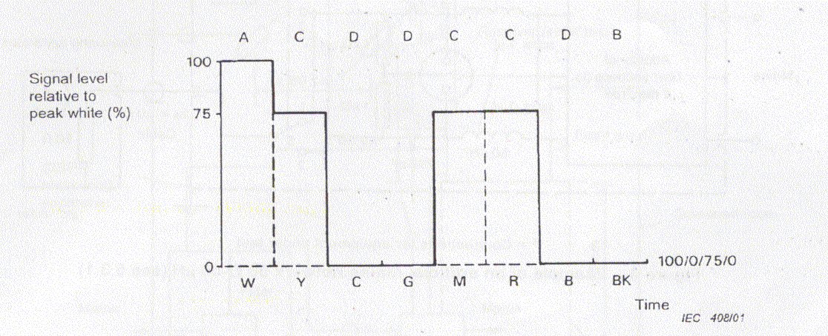
Standard television color bar signal:

Slide 9
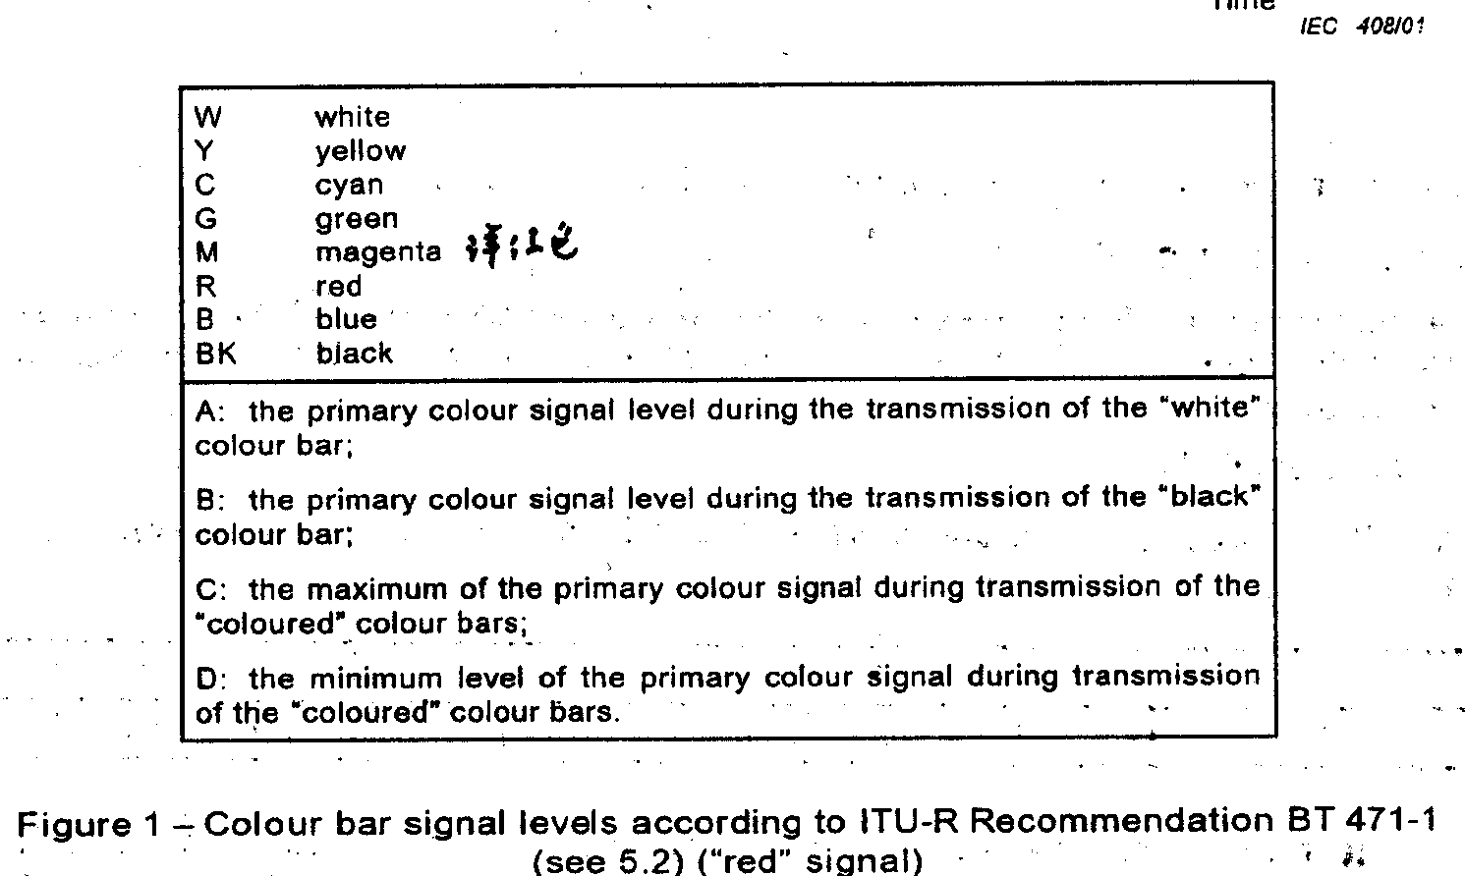
Standard television color bar:

Slide 10
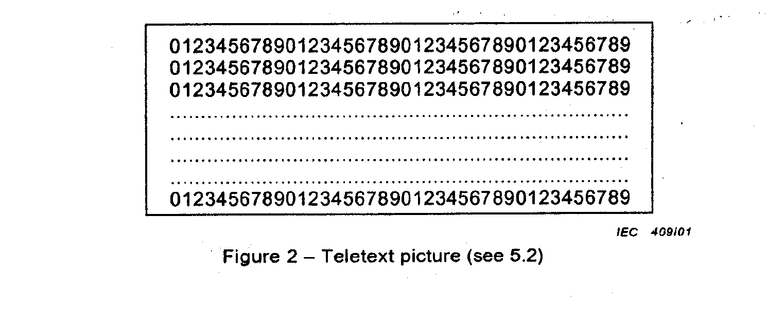
Teletext picture:

Slide 11

Object:
Radio receivers
Standard test signal:
Band II
LW/MW/SW

Slide 12

Object:
Associated equipment
Standard test signal:
Sinusoidal signal at 1 kHz
(audio amplifier & infrared headphone)
Tape or disc recorded 1 kHz
(eg.audio tape recorders, CD player)
Television color bar signal
(eg. Video tape player, camcorders, laser disc player)
Depressing the upper C note(approx 523 Hz)
(electronic organs)
A permanent transmission
(infrared remote controls)
Note : Remote controls marketed seperately are only tested on radiated disturbances.

Slide 13

At Mains terminals: Disturbance voltage
Frequency: 150 kHz to 30 MHz
General:
Site: screened room
Setup refer to figure 5 and 6
Floor-standing EUT :
If it is not insulating legs or wheels, the EUT should be
placed on the insulating material of up to 12 mm thickness

Slide 14
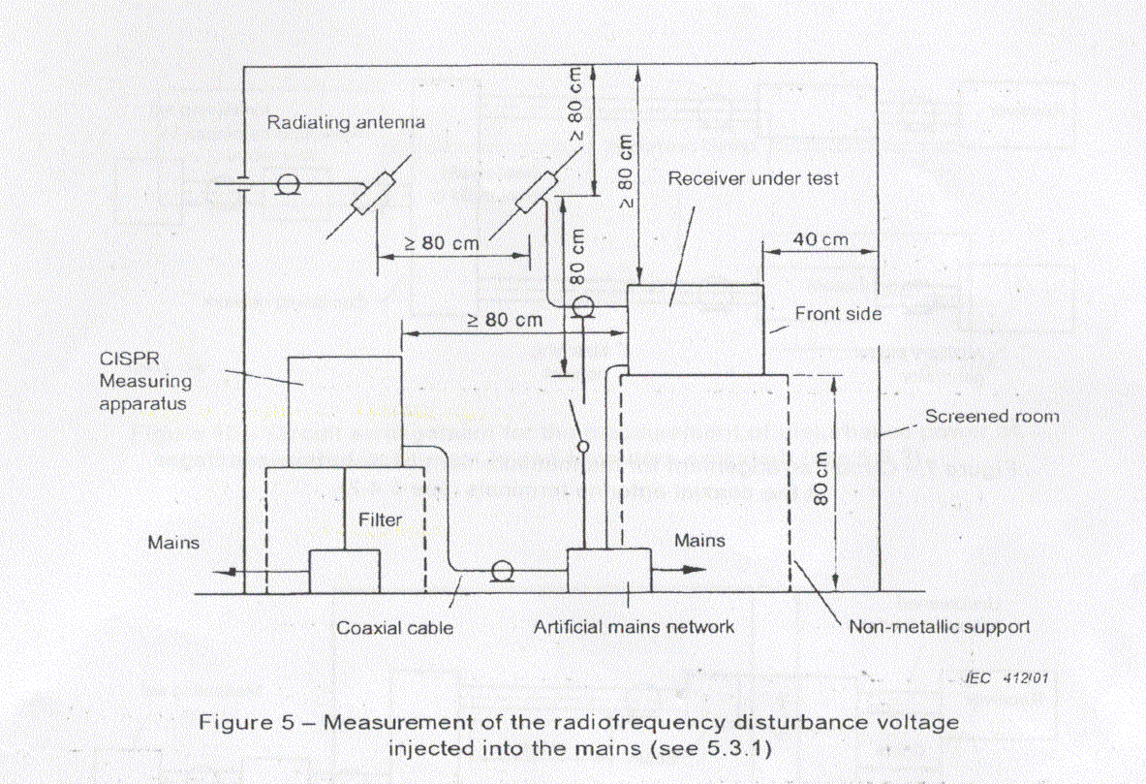
At Mains terminals: Disturbance voltage

Slide 15
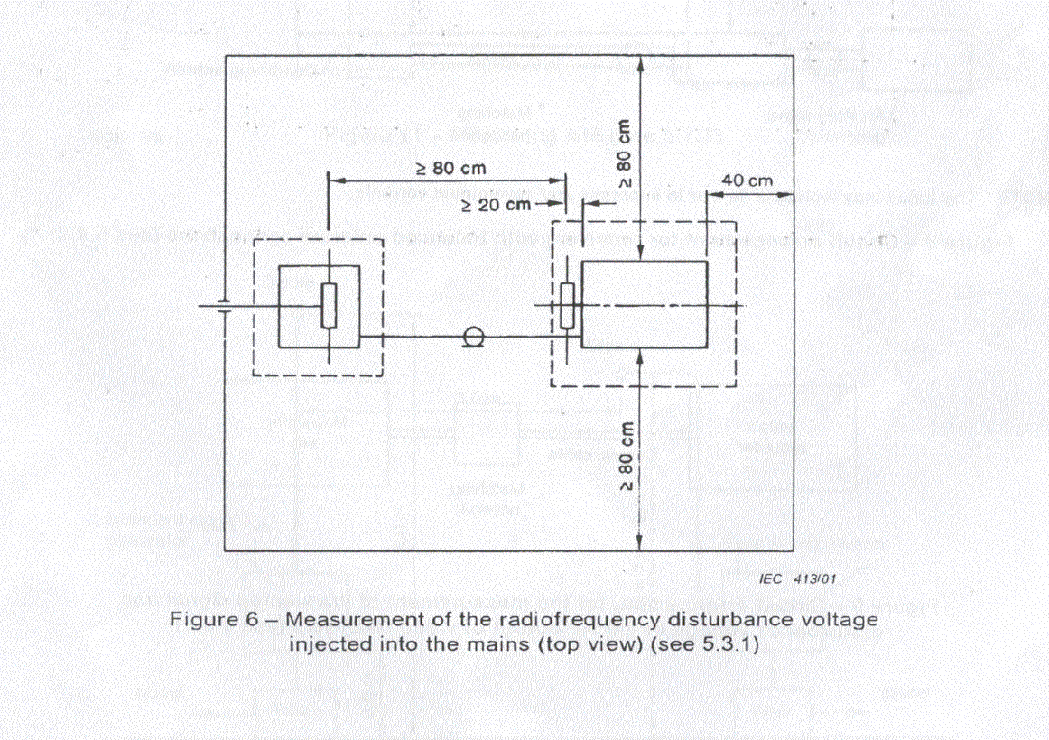
At Mains terminals: Disturbance voltage

Slide 16


At Mains terminals: Disturbance voltage
Television receivers :
Input signal (strong enough to give a noise–free picture)
A small pick-up antenna
The normal picture is obtained
Note:
monitor TV: Via 75 ohm isolation transformer
Television receivers with teletext facilities shall be tested in teletext mode with teletext picture.

Slide 17
At Mains terminals: Disturbance voltage
Sound receivers :
a radiating loop or radiating rod antenna
Input signal
1/8 of the rated audio output power
Other controls is in their middle or neutral positions
AM/FM receivers shall be in FM mode

Slide 18

At Mains terminals: Disturbance voltage
Associated equipment :
Input signal
With RF input
A part of functions unique to a sound or television receiver

Slide 19
At Mains terminals: Disturbance voltage
Audio amplifiers :
Input signal :
audio frequency signal generator via isolation transformer
Output terminal with a resistive load equal to the rated load
Volume control to be 1/8 of the rated output power
Other controls shall be in middle or neutral position

Slide 20
At antenna terminals: disturbance voltage
Frequency: 30 MHz to 2,15 GHz
General:
An auxiliary generator
60 dB(μV) for FM receiver ( an unmodulated carrier)
70 dB(μV) for television receivers on 75 ohm

Slide 21

At antenna terminals : Disturbance voltage
Receiver or equipment with coaxial antenna connections:
Setup refer to figure 7
EUT is set to the wanted signal

Slide 22
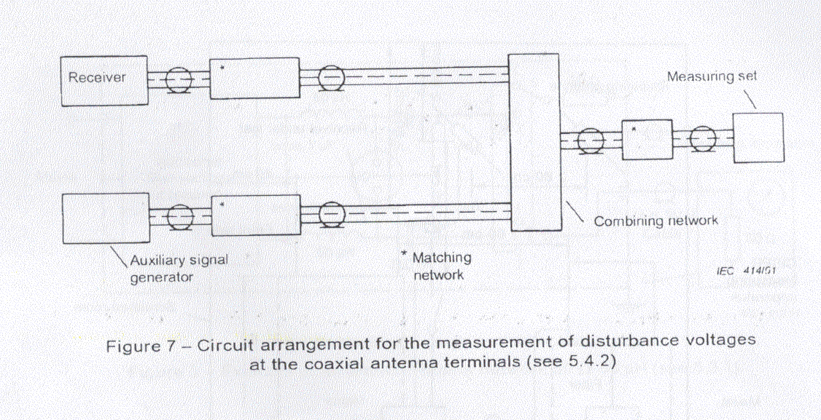
At antenna terminals : Disturbance voltage

Slide 23

At antenna terminals : Disturbance voltage
Receiver or equipment with balanced antenna connections:
Same as above item
Setup refer to figure 8

Slide 24
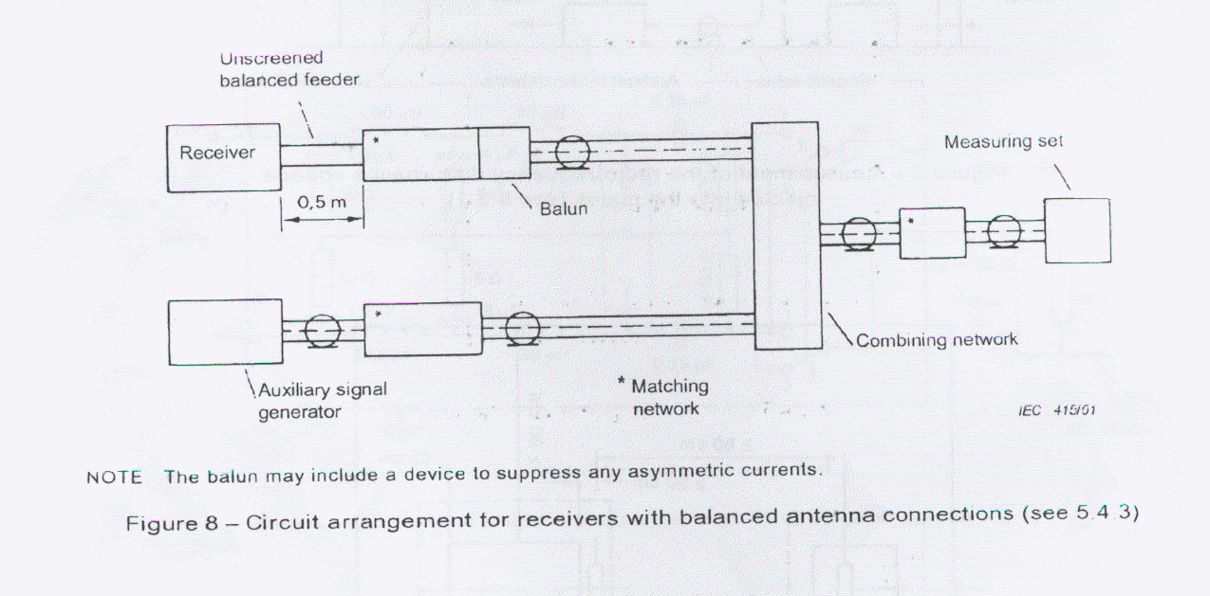
At antenna terminals : Disturbance voltage

Slide 25

At RF output terminals:
wanted signal & disturbance voltage
Frequency: 30 MHz to 2,15 GHz
General:
Connected to the input of measuring set
Setup refer to figure 9
EUT produce signal: vertical color bar

Slide 26
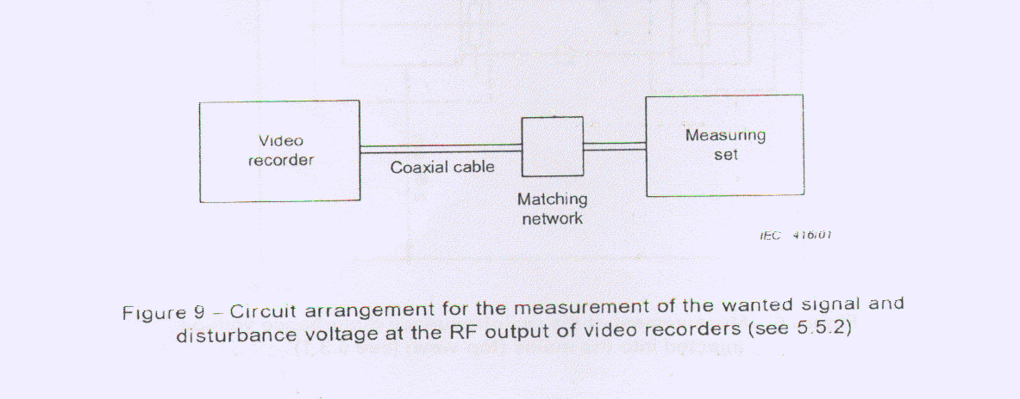
At RF output terminals :

Slide 27
Disturbance Power
Frequency: 30 MHz to 1 GHz
General:
Test Ports: mains lead and other connected leads
Setup refer to figure 10
Other lead shall be disconnected or fitted with ferrite fings
All connectors shall be terminated

Slide 28
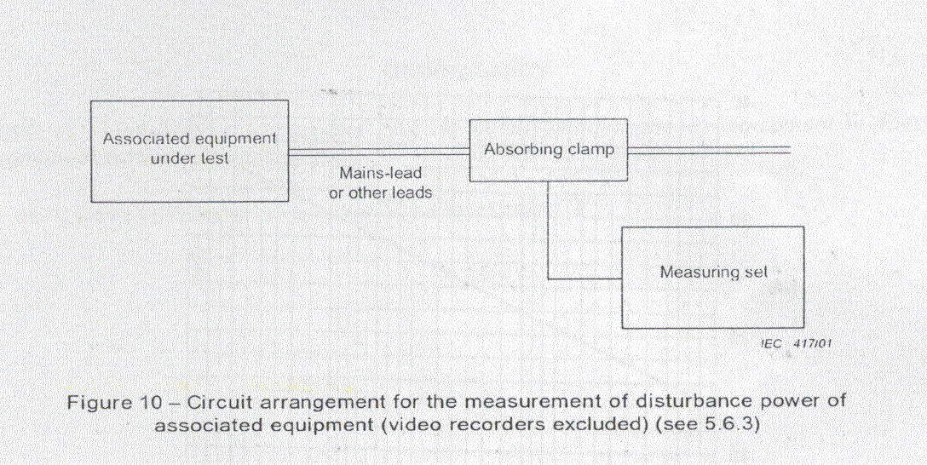
Disturbance Power

Slide 29

Radiation at 3 m distance
Frequency: 30 MHz to 1 GHz (electric field strength)
General:
Test site: anechoic room(free of reflection) or outdoor site
What is 3 m? refer to figure 12, 14.

Slide 30
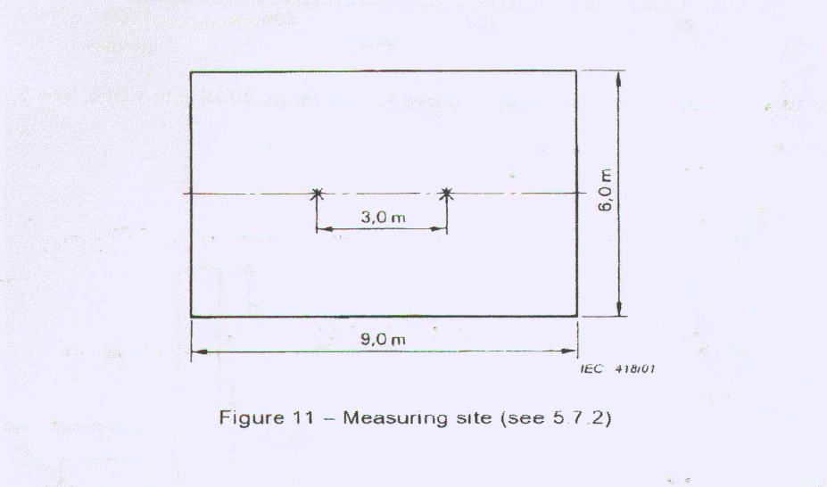
Radiation at 3 m distance

Slide 31
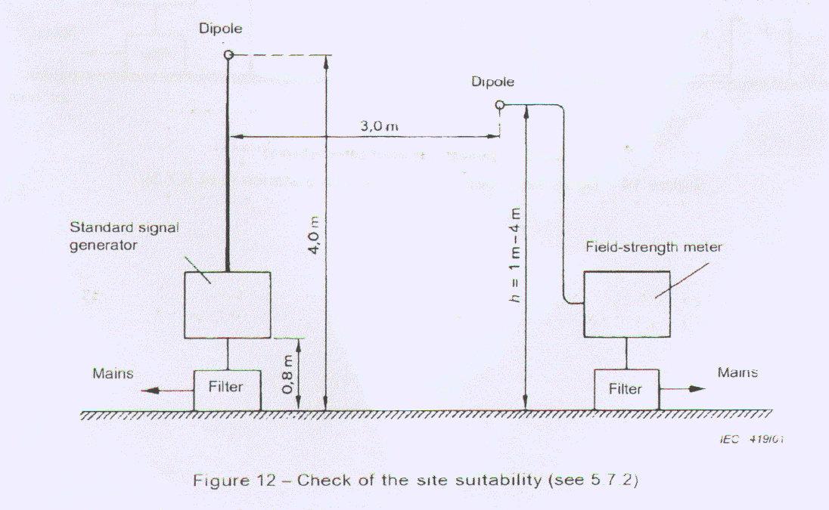
Radiation at 3 m distance

Slide 32
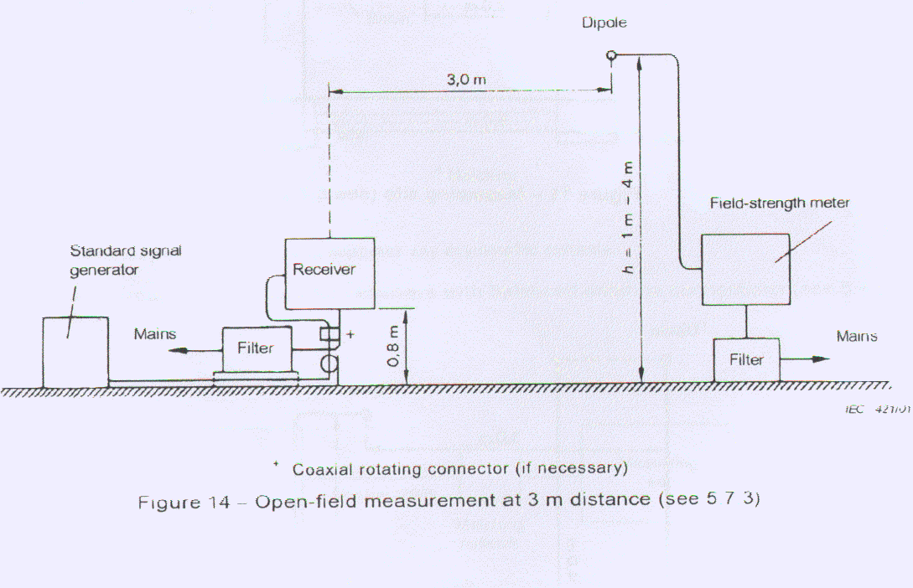
Radiation at 3 m distance

Slide 33
Radiation at 3 m distance
Disposition of EUT :
Refer to figure 14
The center of EUT and the center of the measuring antenna shall be in the same vertical plane
EUT with a build-in antenna
EUT with telescopic antennas
PC tuner
???

Slide 34

Radiation at 3 m distance
Disposition of the field-strength meter :
Refer to figure 14
Antenna
Feeder
Field-strength meter

Slide 35
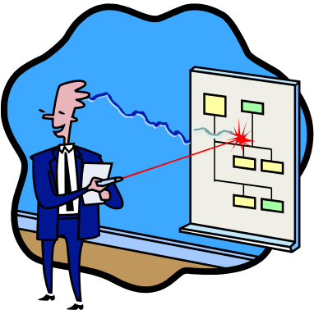
Radiation at 3 m distance
procedure :
Antenna varied from 1 m to 4m
EUT is rotated
Antenna varied from 1 m to 4m and note the max value

Slide 36

Radiation
Frequency: 1 GHz to 18 GHz (horn antenna)
General:
EUT were placed on 1 m non-metallic material
Unused output terminal shall be terminated with their nominal impedance by means of non-radiating loads.
Mains lead shall placed vertically
Measure vertical and horizontal component
The height above ground between EUT and antenna is same

Slide 37

Radiation
Procedure:
Substitution method
Horizontal and vertical polarizations.
Turntable with the EUT

Slide 38

Local oscillator power at the input terminal of the outdoor unit
General:
measure directly by power meter
Spectrum analyzer combined with a corresponding adapter

Slide 39

The end

