Slide 1
Test plan discussion
Humidifier

Slide 2
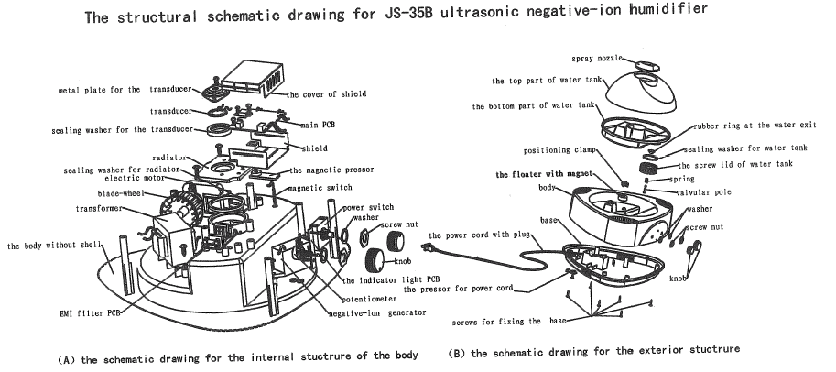
Construction

Slide 3
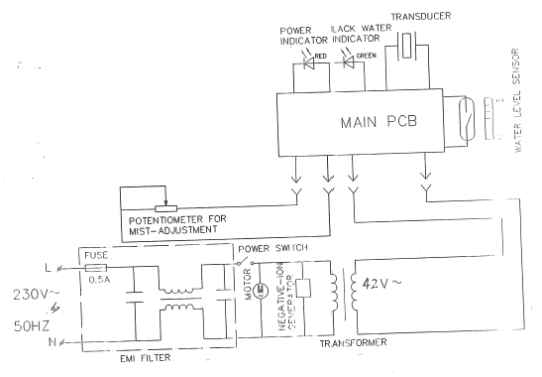
Circuit Diagram 1

Slide 4
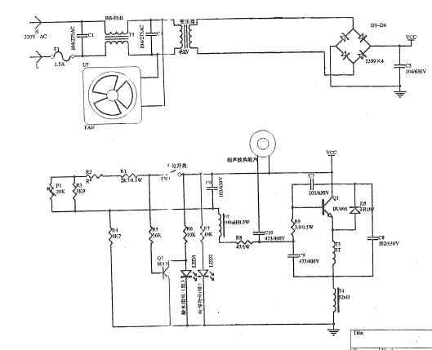
Circuit Diagram 2

Slide 5
Disturbance Source

Slide 6
Sensitive components for immunity test

Slide 7
Applicable standards
EN 55014-1:2000+A1+A2
EN 55014-2:1997+A1
EN 61000-3-2:2000
EN 61000-3-3:1995+A1

Slide 8
Test items/operation modes
DV ( On )
DP ( On )
EMS for Household ( On )

