Slide 1
Test plan discussion
Bread Maker

Slide 2
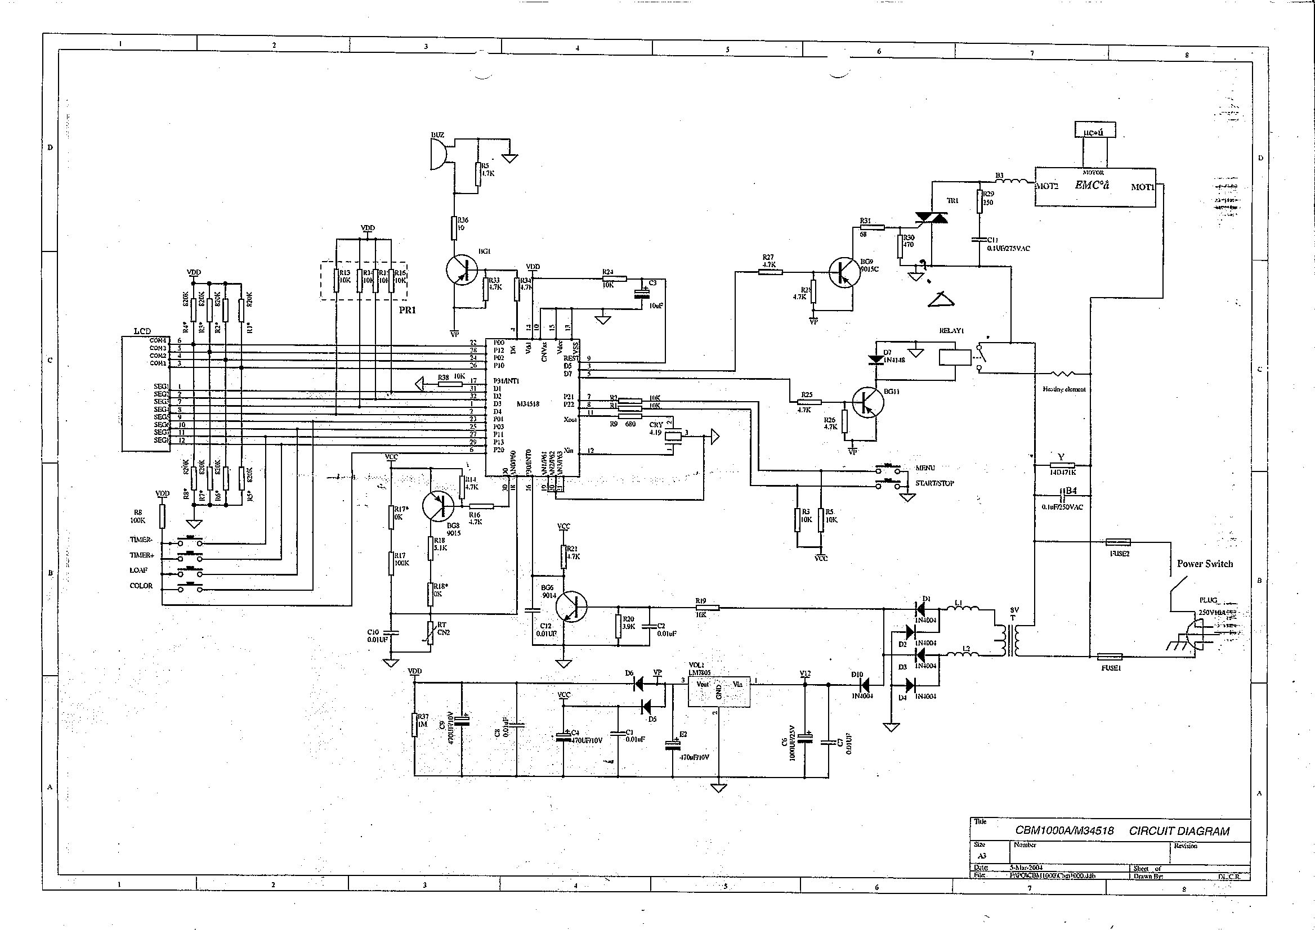
Circuit Diagram

Slide 3
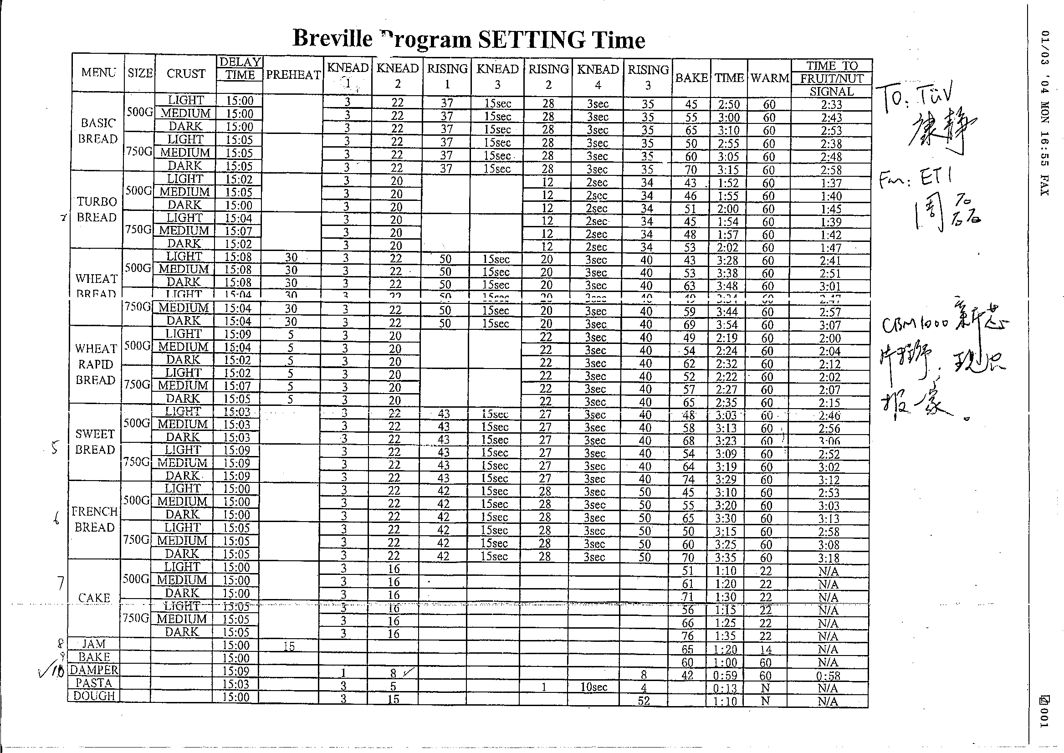
Additional information- program chart

Slide 4
Disturbance Source
Triac controlling the motor + controlling program --- click
Relay controlling the heater + controlling program --- click
DC motor --- broadband disturbance
Crystal --- narrow band disturbance
Heater + relay + controlling program --- Flicker

Slide 5
Sensitive components for immunity test
LCD Display IC
Main controlling IC

Slide 6
Applicable standards
Nominal household appliance with motor and heater
EN 55014-1
EN 55014-2
EN 61000-3-2
EN 61000-3-3

Slide 7
Test items/operation modes
Disturbance voltage
  According to the disturbance sources analysis, DC motor and oscillator should be running during test. Therefore,
  operation mode: damper in 2nd knead stage selected according to the program chart
Disturbance power
  Same as above
Click
  According to the disturbance source analysis, Triac and relay should be consider. The most frequently switching program should be selected for testing.
  First we should check whether the triac can produce click by click analyzer with 1st Knead and record the click rate.
    If yes, this stage will provide the highest click rate and the back stage provide 2nd high click rate
    If no, back produce the highest click rate
  Operation mode:
    if Triac produce click, choose the program with highest time percentage of 1st Knead and because bake have to be in the program, the highest time percentage for 1st Knead + back: Cake 750G Dark
    If Trriac does not produce click, bake

Slide 8
Test items/operation modes
Harmonics
  Heater does not provide harmonics in this case, choose stage with motor running, e.g. damper at 2nd knead
Flicker
  According to the disturbance source analysis, back
ESD
  According to the sensitive component, two IC should be running during testing. Any of the program
EFT
  Same as ESD
CS
  Same as ESD
Surge
  Same as ESD
Dips
  Same as ESD

