Slide 1
Harmonics Standard
EN 61000-3-2 : 2000
Old version :
EN 61000-3-2:1995+A1+A2+A14
Date of withdraw (dow): 2004-01-01

Slide 2
CONTENT:
Introduction
Classification of equipment
Control methods
Test configuration and Measurement procedure
Limitation

Slide 3
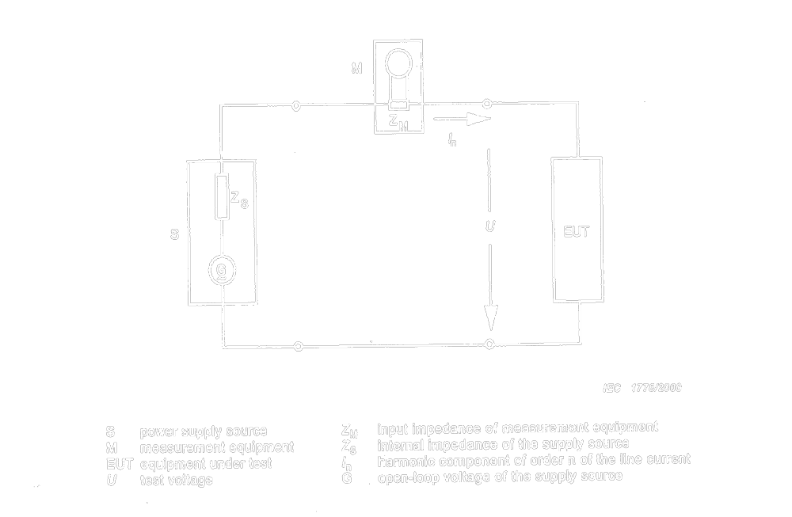
Introduction
Scope
Measurement Circuit
Notes:
Voltage and Ampere
Zin and Resonance
61000-4-7 Testing and measurement techniques---guide line

Slide 4
Classification of equipment
Class A
Class B
Class C
Class D
Notes:
Class A
Balanced three-phase equipment
Household appliances excluding equipment as Class D
Tools excluding portable tools
Dimmer for incandescent lamp
Audio equipment.
Class B
Portable tools
Arc welding equipment which is not for profession equipment.
Class C
Lighting equipment(convertor(unadjustable))
Class D
IT and <600W, TV

Slide 5
Control Method:
Normal connected system for harmonics
Asymmetrical control
Symmetrical Control
Notes:
Asymmetrical control:
half wave rectification a) Only solution of detection of unsafe condition
b) <=100W
c) portable, 2wires, for a short time (hairdryer)
asymmetrical only for the control of motors
Symmetrical
<=200W or,
fulfill the the limit of Class D, means table 3

Slide 6
Test Configuration and Measure Procedure
Test configuration for each type of appliance
refer to Annex C
e.g. Vacuum cleaner
Lighting Equipment
Air conditioner
Notes:
If possible, the control shall be set to a firing-angle of 90°±5° or the closest step during harmonics test.
Further more, the vacuum cleaner is tested in continuous operation with an empty dust bag and filter, and with its tube if existing, but without extending pipe and nozzle. The air inlet shall be adjusted to give a power input P­_{m} as follow:
P_{m}=0,5(P_{f}+P_{i}); P_{f} is the power after 3 min of operation with the air inlet unobstructed; P_{I} is the power after a further 20s of operation with the air inlet blocked.
Lighting Equipment:
Tempreture : 20~27±1
Working Duration: 100h.

Slide 7
Limitation
<=75W;
Class A Table 1
Class B Table *1.5
Class C Table 2
Class D Table 3
Notes:
Refer to Dave Xie Test Result

Slide 8
Q&A

