Slide 1
Tabluaue_SAVED_Data_Visualization
File created on: 12/12/2024 11:17:59 PM

Slide 2
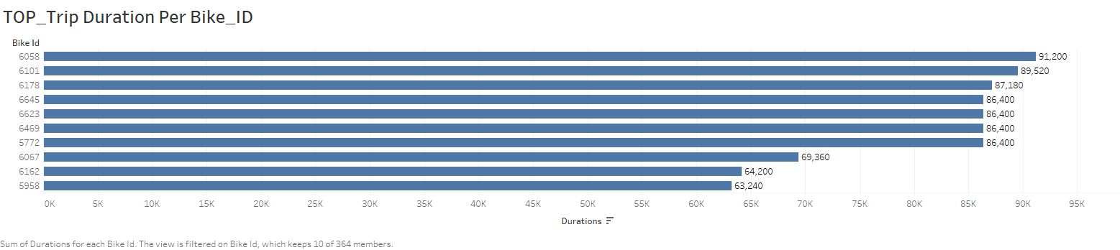

Slide 3
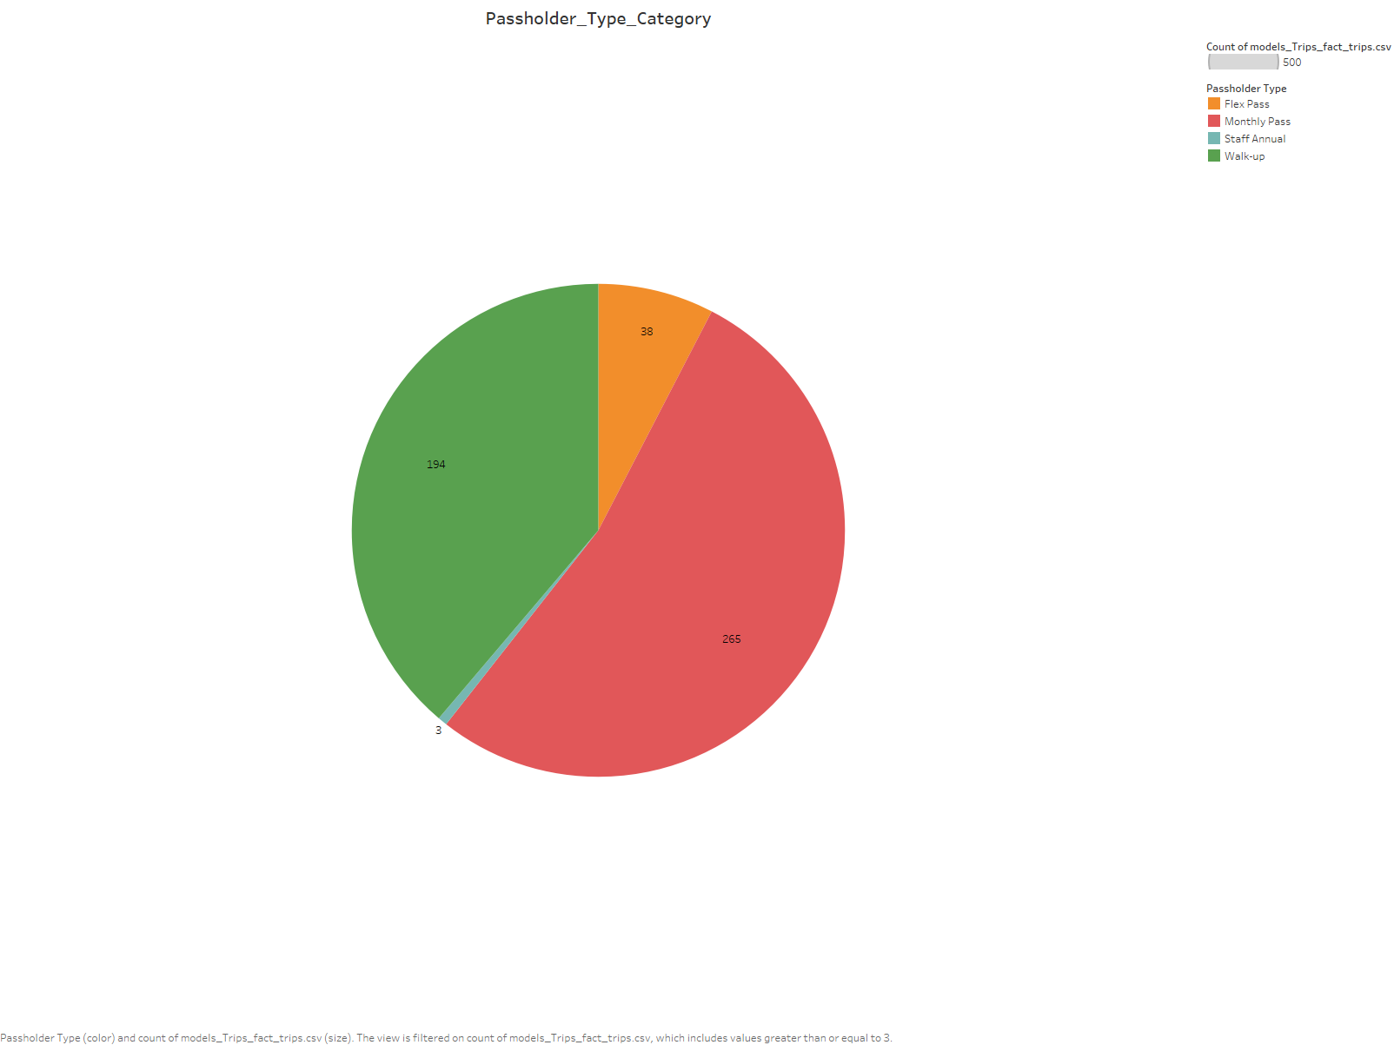

Slide 4
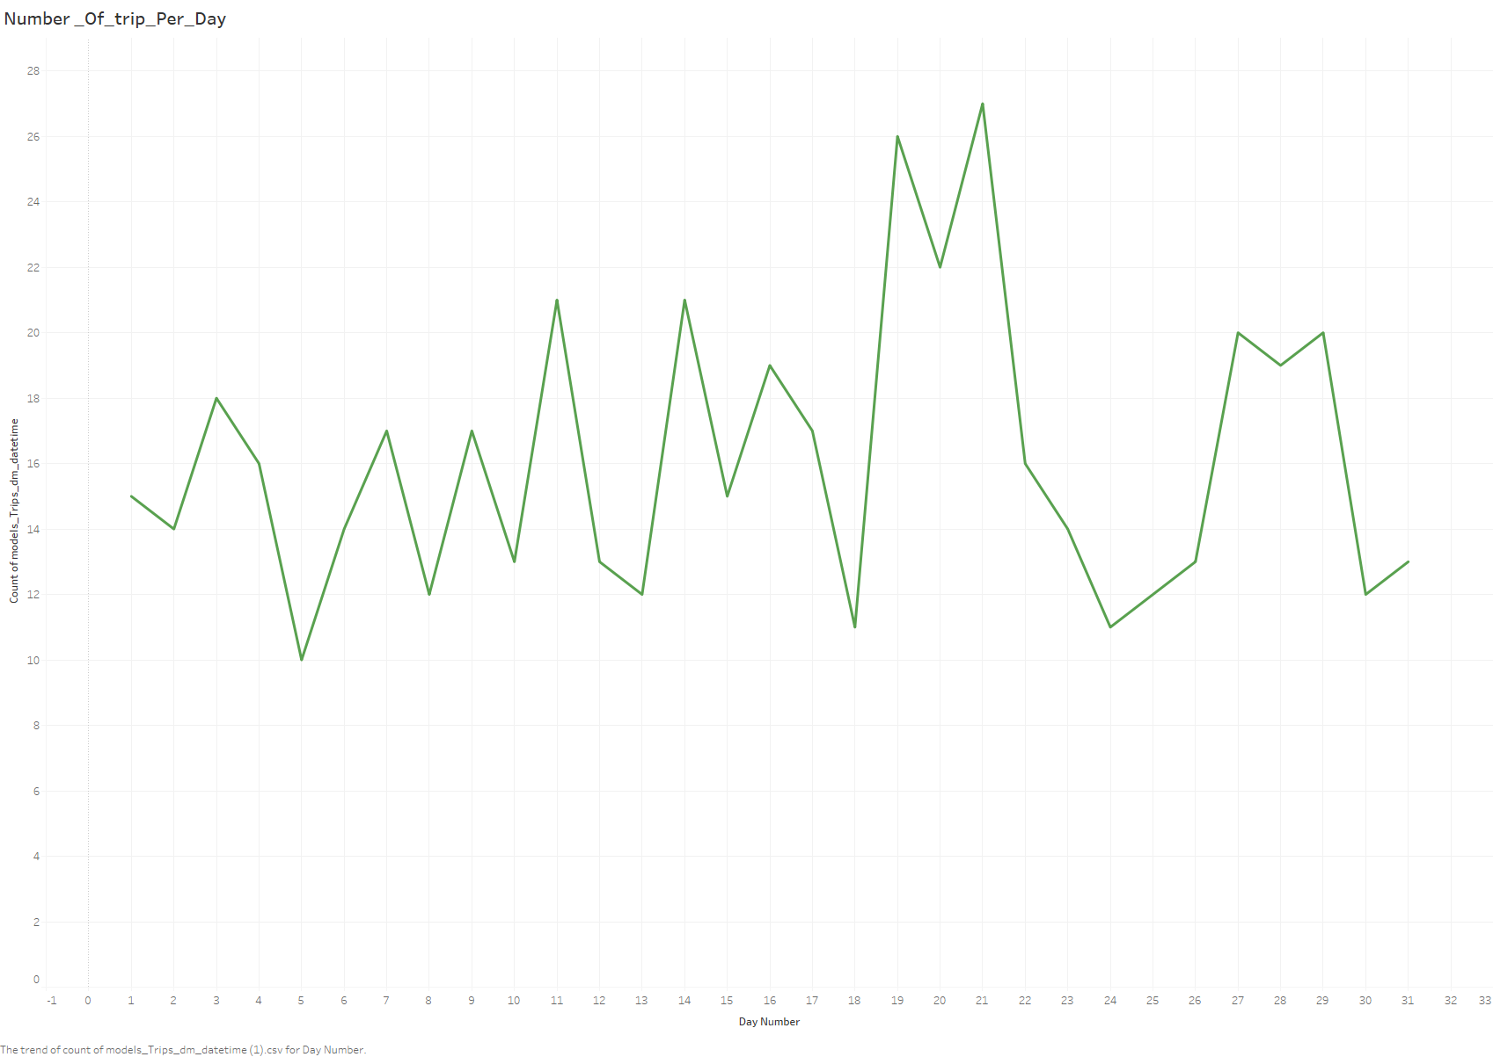

Slide 5
