Slide 1




Channabasaveshwara Institute of Technology (Affiliated to VTU, Belgaum & Approved by AICTE, New Delhi) (An ISO 9001:2015 Certified Institution) NH 206 (B.H. Road), Gubbi, Tumkur – 572216. Karnataka.
DEPARTMENT OF ARTIFICIAL INTELLIGENCE AND DATA SCIENCE 2024-2025
PREDICTING AD CLICKS CLASSIFICATION
BY USING MACHINE LEARNING
Presented by :
Md Fardeen [1CG21AD022]
Md Tanzil Masud [1CG21AD023]
Mohammed Shaheed M [1CG22AD404]
Mahammad Jaffer Nawaz [1CG22AD403]
Under the guidance of :
Mr.Dharaneshkumar M L, M.Tech., Assistant Prof., Dept. of AD, CIT, Gubbi, Tumakuru.

Slide 2
INTRODUCTION
Explosion of digital advertising across platforms like Google, Facebook, Amazon.
Importance of understanding user behaviour for ad personalization
CTR (Click-Through Rate) is a key metric in ad performance.
ML helps businesses analyze massive user datasets to make predictions.
Project focuses on using user demographic and behavioral data to predict ad clicks.

Slide 3
PROBLEM STATEMENT
Advertisers waste resources showing ads to uninterested users.
Manual segmentation lacks accuracy and scalability.
Low CTR leads to reduced conversions and profits.
Need for an intelligent, automated system to:
Predict ad engagement
Improve targeting
Maximize return on investment (ROI)

Slide 4
OBJECTIVES
Build predictive model using ML for binary classification (clicked or not).
Reduce guesswork in digital ad targeting.
Enable real-time ad optimization through automation.
Conduct comparative analysis of multiple ML algorithms.
Translate data insights into business strategies (age/gender targeting, ad scheduling).

Slide 5
EXISTING SYSTEM
Google Smart Bidding – Real-time bid optimization via ML.
Facebook/Meta Ads – DNN-based personalization with billions of user signals.
Amazon Ads – Ad-to-purchase tracking with shopping pattern analysis.
TikTok Ads – Engagement-based targeting using video watch behavior.
Criteo – Real-time retargeting using FFM models.

Slide 6
PROPOSED SYSTEM
Custom ML pipeline trained on publicly available dataset.
Feature importance analysis using SHAP and tree-based models.
Integrates demographic & behavioral signals: age, income, browsing time, etc.
Personalized recommendation engine based on predicted user clusters.
Open-source, cost-effective, scalable for small & mid-size advertisers.

Slide 7
IMPLEMENTATION
Data Cleaning: Removed irrelevant features (city, timestamp, etc.).
Label Encoding: Converted gender to numerical format.
Feature Scaling: Used StandardScaler for consistent data scaling.
Train/Test Split: 80-20 split to avoid overfitting.
Hyperparameter Tuning: GridSearchCV for finding best model configs.
Cross Validation: 5-fold CV to check model robustness.

Slide 8
TOOLS AND TECHNOLOGIES
Python Libraries: pandas, numpy, matplotlib, seaborn, scikit-learn, xgboost.
Deployment: Flask, Streamlit for interface,Docker for containerization.
Visualization: seaborn, matplotlib for correlation, KDE, boxplots.
Development Tools: Jupyter Notebook, Google Colab, GitHub.
Cloud Platforms: Heroku, AWS, GCP for hosting ML model.

Slide 9
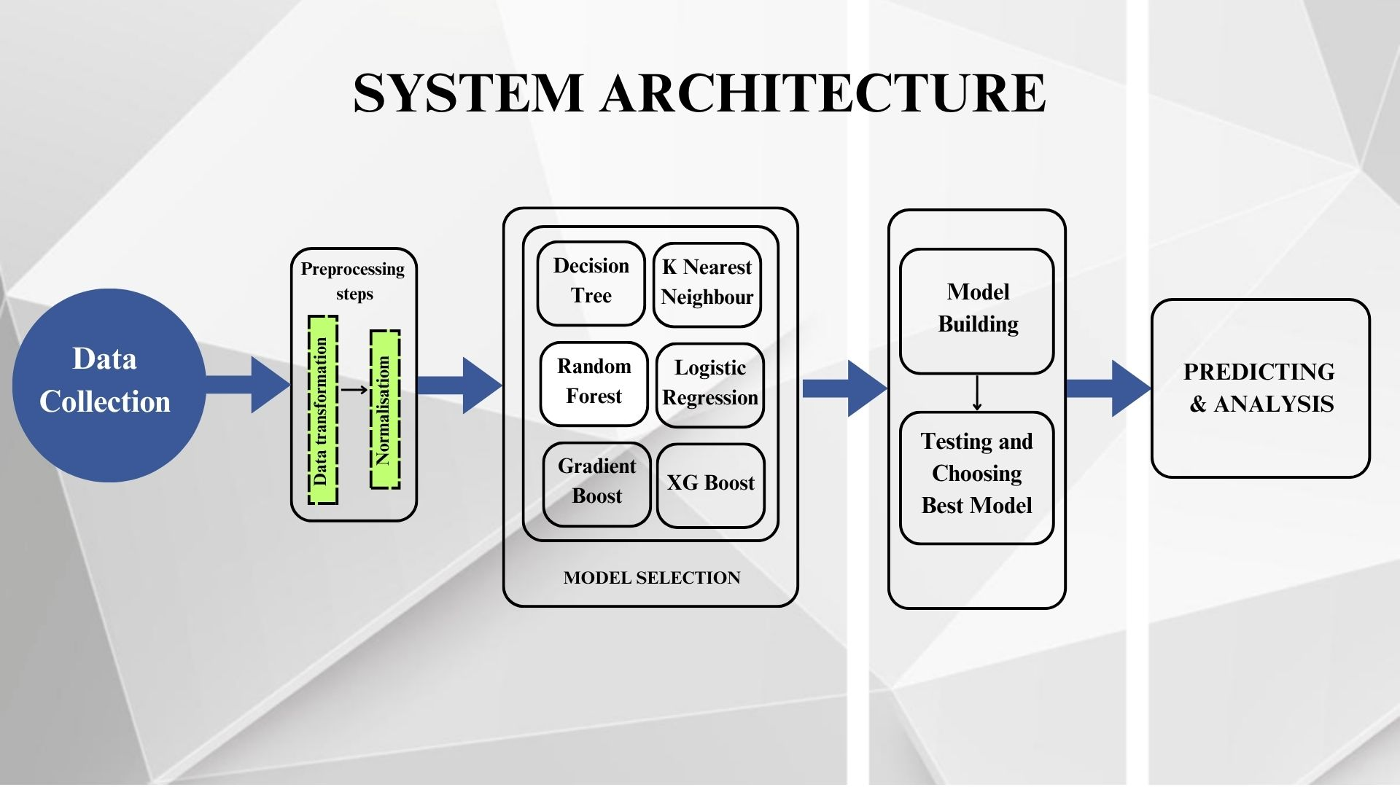
SYSTEM ARCHITECTURE

Slide 10
MACHINE LEARNING ALGORITHOMS
Logistic Regression – Fast, interpretable, great for initial benchmarks.
Decision Tree – Visual, handles both numeric and categorical data.
Random Forest – Robust to noise, low overfitting.
K-Nearest Neighbors – Simple, no training phase, slow for large data.
Gradient Boosting – High accuracy, can overfit without tuning.
XGBoost – Best for structured data, used in Kaggle competitions.

Slide 11
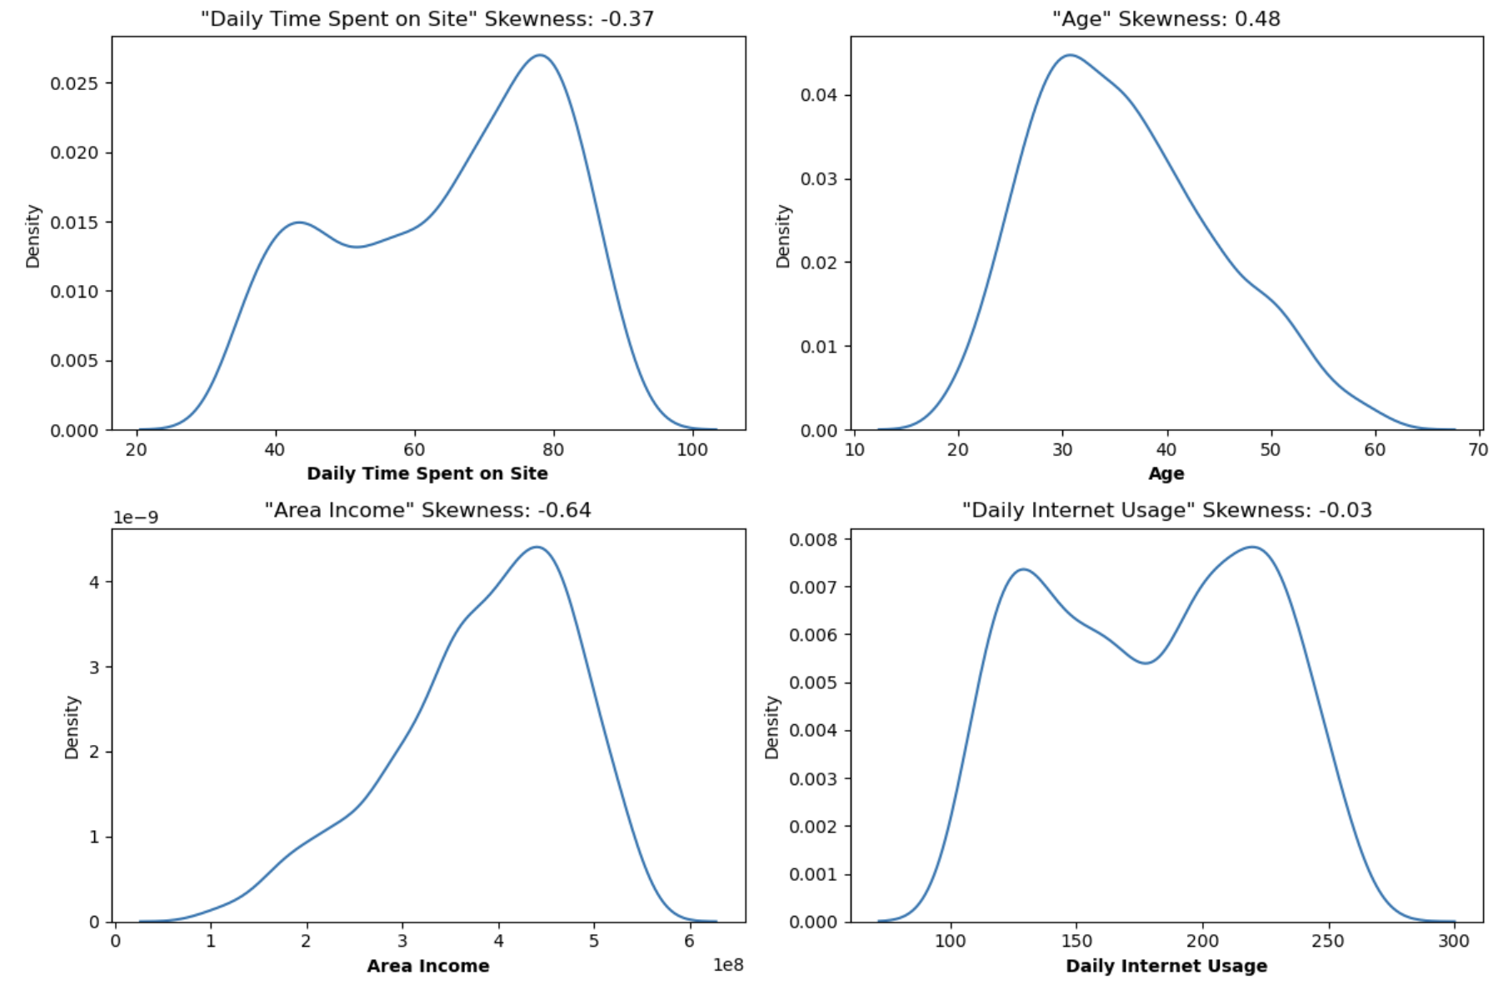
RESULTS 1.0

Slide 12
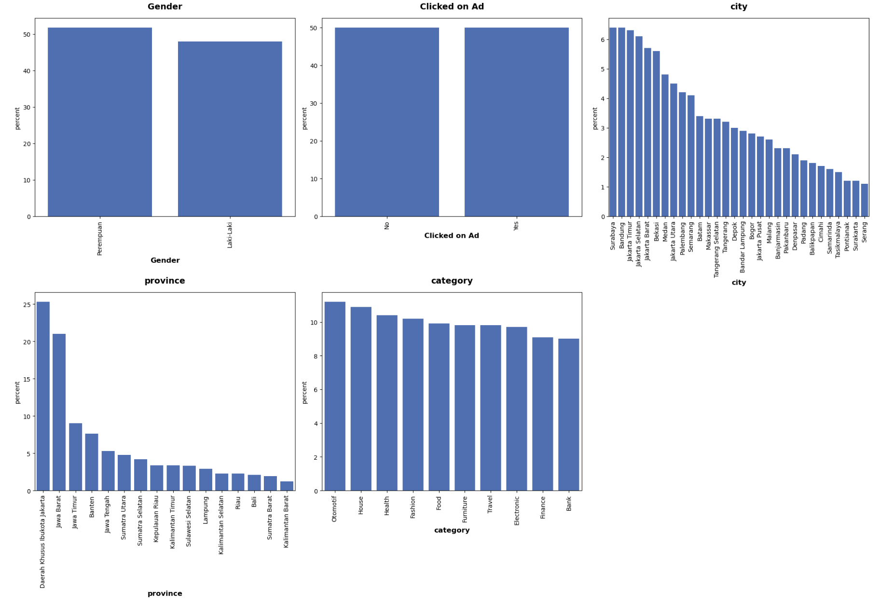
RESULTS 1.1

Slide 13
RESULTS 1.2

Slide 14
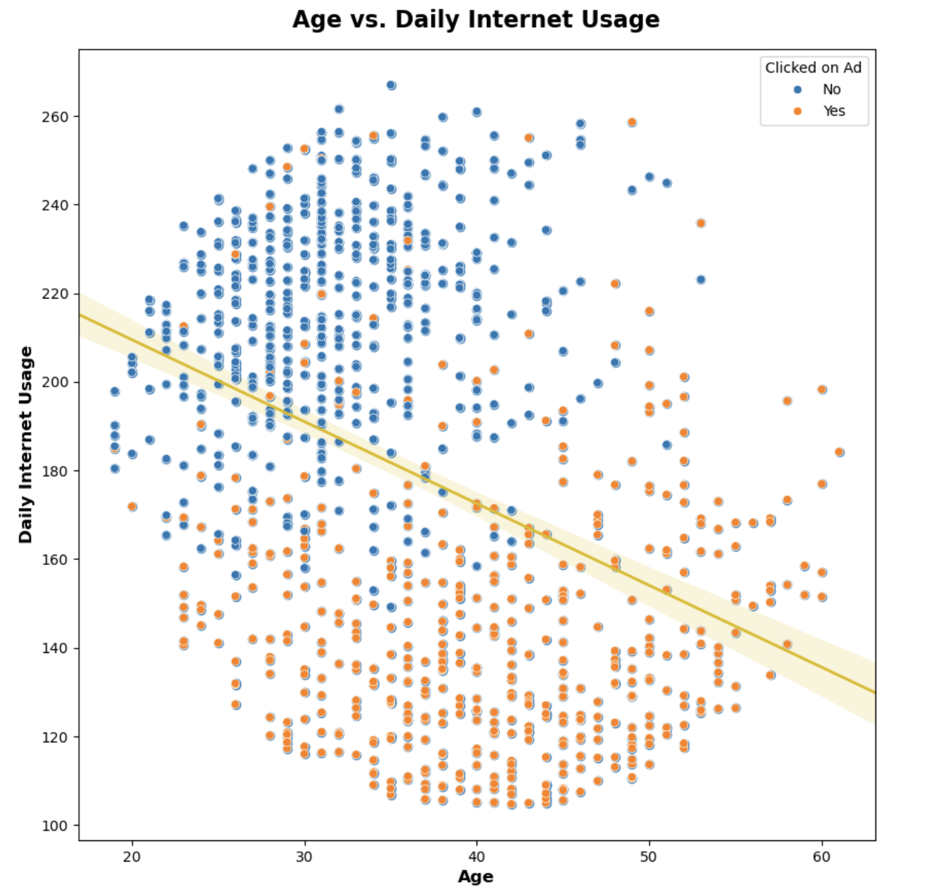
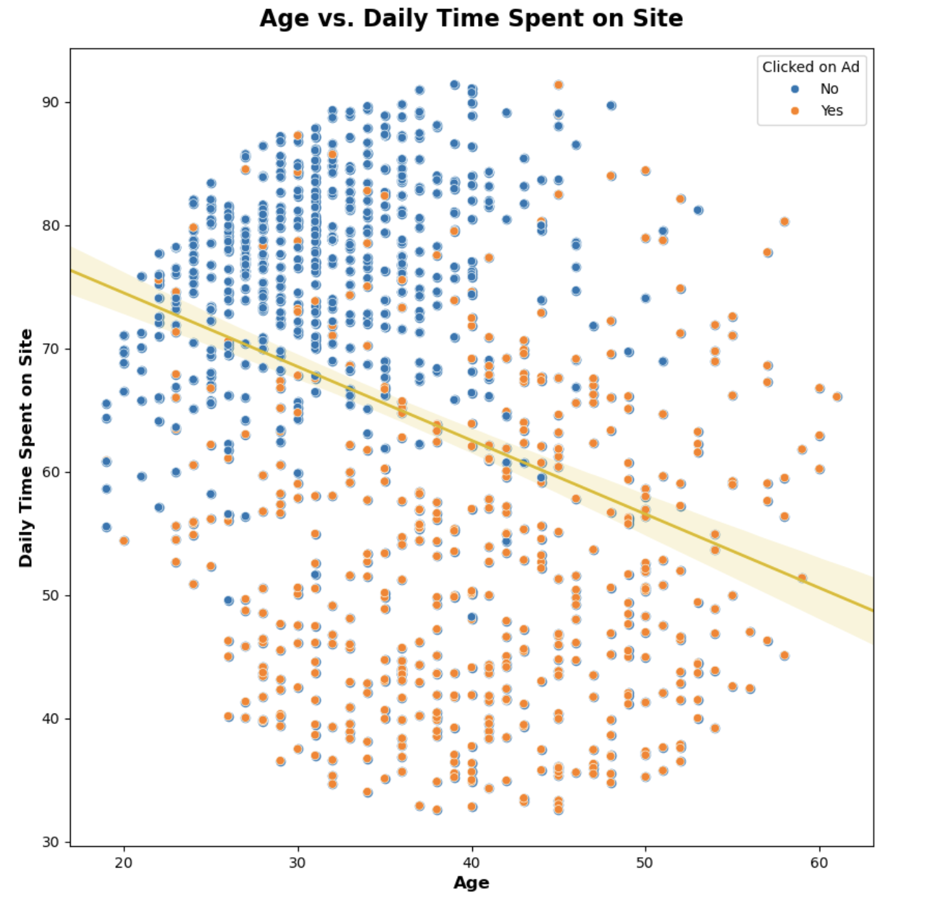
RESULTS 1.3

Slide 15
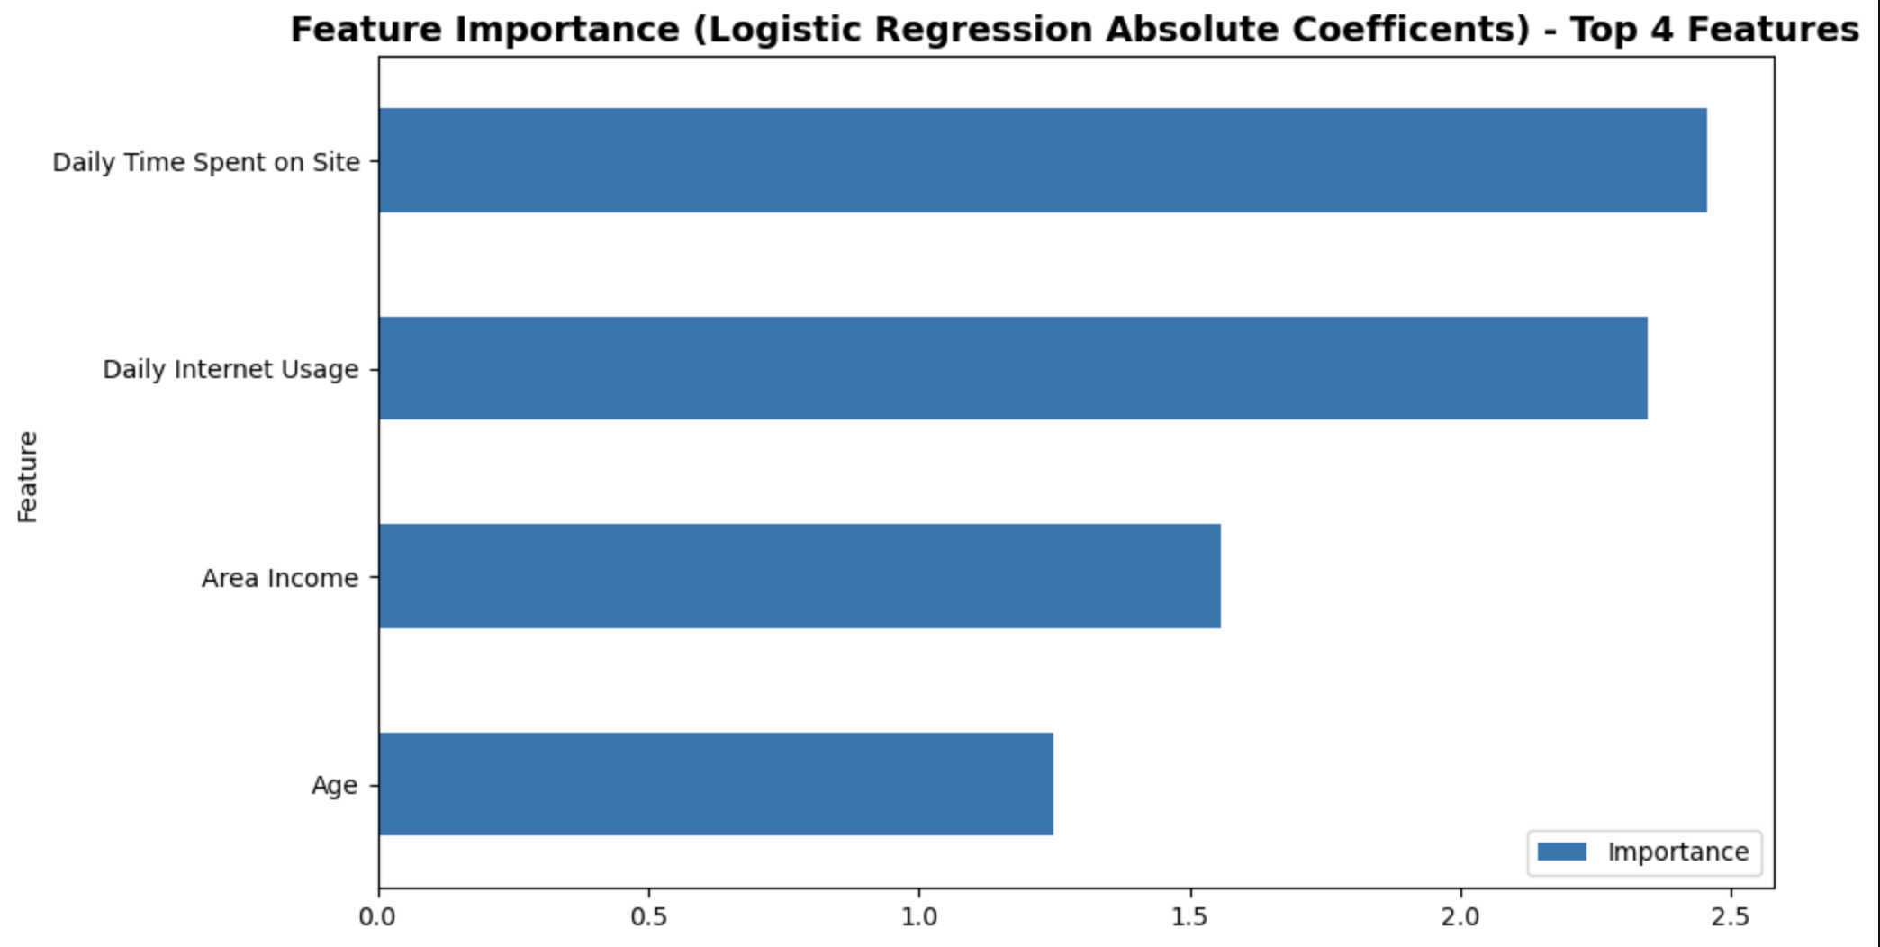
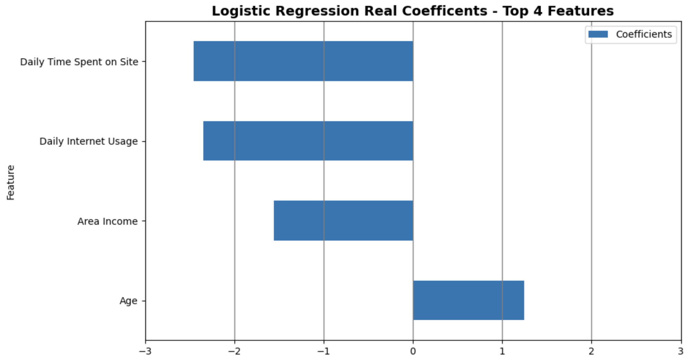
RESULTS 1.4

Slide 16
CONCLUSION
ML effectively classifies users likely to click ads.
Model insights help tailor content to audience segments.
Ad CTR increased from 50% to 96.8% using XGBoost.
Advertising profit increased by over 43%.
System is scalable, interpretable, and ready for real-world deployment.
Can be integrated with CRM, email marketing, or ad delivery systems.

Slide 17
REFERENCE
[1] Agarwal, D., & Chen, B. C. (2009). Predicting Clicks: Estimating the Click-through Rate for New Ads. Proceedings of the 2nd Workshop on Sponsored Search Auctions.
[2] McMahan, H. B., et al. (2013). Ad Click Prediction: A View from the Trenches. Proceedings of the 19th ACM SIGKDD International Conference on Knowledge Discovery and Data Mining. DOI: [10.1145/2487575.2488200]
[3] Cheng, H.-T., et al. (2016). Wide & Deep Learning for Recommender Systems. Proceedings of the 1st Workshop on Deep Learning for Recommender Systems, RecSys ’16.
[4] Zhou, G., et al. (2018). Deep Interest Network for Click-Through Rate Prediction. Proceedings of the 24th ACM SIGKDD. arXiv:1706.06978
[5] Rendle, S. (2010). Factorization Machines. IEEE International Conference on Data Mining (ICDM). DOI: [10.1109/ICDM.2010.127]
[6] Juan, Y., et al. (2016). Field-aware Factorization Machines for CTR Prediction. Proceedings of the 10th ACM Conference on Recommender Systems.

Slide 18
THANK YOU

