Slide 1



Channabasaveshwara Institute of Technology (Affiliated to VTU, Belgaum & Approved by AICTE, New Delhi) (An ISO 9001:2015 Certified Institution) NH 206 (B.H. Road), Gubbi, Tumkur – 572216. Karnataka.
DEPARTMENT OF ARTIFICIAL INTELLIGENCE AND DATA SCIENCE 2024-2025
Content Moderation System to detect harmful content on social media using NLP
Presented by :
Ayesha Shariff [1CG21AD005]
Ramya M P [1CG21AD034]
Yashaswini M C [1CG21AD054]
Shreni M S [1CG21AD042]
Under the gudiance of :
Mrs. Nagapushpa B M Associate Professor, Dept. of AD C.I.T, Gubbi, Tumkur.

Slide 2
Introduction
Social media platforms are powerful but vulnerable to harmful content.
It includes hate speech, cyber-bullying, mis-information, and offensive language.
NLP provides scalable and efficient detection to support moderation.
It enables detection of toxic comments using Machine Learning models.

Slide 3
Problem Statement
With the rise of social media, harmful user-generated content has become a major concern.
Manual moderation is not scalable due to the massive volume of data.
This project aims to build an automated content moderation system using NLP.
It classifies text into categories like toxic, obscene, threat, insult, and hate.
The goal is to support real-time, multi-label detection of harmful content.

Slide 4
Objectives
Detect and classify harmful content in user-generated text.
To identify various types of harmful content.
Build a scalable and efficient NLP pipeline.
Compare performance of multiple ML algorithms.
Evaluate accuracy and reliability of the system.

Slide 5
Existing System
Mostly manual moderation of content.
Basic keyword-based filtering techniques.
Limited accuracy and unable to handle context well.
Difficult to scale with increasing data volume.
High rate of false positives and negatives.

Slide 6
Proposed System
Use of machine learning models for multi-label classification.
Vectorization for feature extraction.
Application of models like Logistic Regression, Random Forest Classification and Regression.
System capable of detecting multiple toxic labels in a single comment.
High accuracy and scalability for real-time use.

Slide 7
Implementation
Dataset: Content Moderation System to detect harmful content on social media using NLP dataset.
Preprocessing: Cleaned text and applied TF-IDF.
Models: Logistic Regression, Random Forest Regression and Random Forest Classification.
Evaluation: Used classification report for performance metrics.
Using OneVsRest Classifiers estimator.

Slide 8
Tools and Technologies
Python: Main language for data processing and modeling.
Libraries: pandas, numPy for data manipulation
Scikit-learn for ML models and evaluation
Matplotlib, Seaborn for visualization
Jupyter Notebook: for development environment
Excel/CSV: Intermediate storage and formatting of datasets.

Slide 9
System Architecture
DATA SET
PRE PROCESSED
DATAET
TRAINING
DATAET
N
RANDOM FOREST CLASSIFIER
RANDOM
FOREST REGRESSORT
DDE
LOGISTIC
REGRESSORT
DE
MODEL
BUILDING
TESTING AND CHOOSING
BEST MODEL

Slide 10
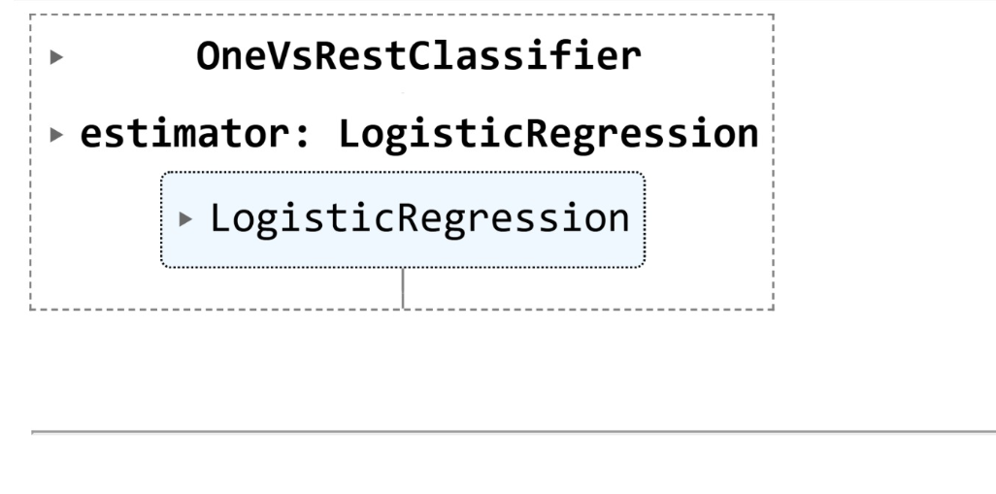
ML Algorithms
Logistic regression: is a supervised machine learning algorithm used for classification tasks where the goal is to predict the probability that an instance belongs to a given class or not. Logistic regression is a statistical algorithm which analyze the relationship between two data factors.

Slide 11
A random forest is an ensemble learning method that combines the predictions from multiple decision trees to produce a more accurate and stable prediction.
Random Forest Regressor: In regression task we can use Random Forest Regression technique for predicting numerical values. It predicts continuous values by averaging the results of multiple decision trees.

Slide 12
Random Forest Classifier: is a machine learning algorithm that uses an ensemble of decision trees to classify data. It combines the predictions of multiple individual decision trees to make a more accurate prediction than any single tree could achieve on its own.

Slide 13
Results
Accuracy: [Insert Accuracy]
Precision, Recall, F1-score: [Insert metrics]
Best performing model: [Insert model name]
Visualizations of confusion matrix and ROC curve.

Slide 14
Conclusion
Developed an automated content moderation system using NLP.
Used machine learning models to classify harmful content.
Achieved efficient multi-label classification performance.
Proposed system provides better scalability and accuracy than manual methods.
Useful for real-time content filtering on social media platforms.

Slide 15
References
[1]Smith, J. (2020). Machine Learning Applications in Social Media Moderation. AI Research Journal, 14(2), 115–130.
[2]Kumar, R., & Sharma, P. (2021). Natural Language Processing for Toxic Comment Detection. International Conference on Intelligent Systems, 233–240.
[3]Gupta, A. (2019). Multi-label Classification Techniques for Text Data. Journal of Computer Science and Engineering, 11(3), 77–85.
[4]Thomas, L., & Nguyen, M. (2022). Content Moderation and AI: Balancing Freedom and Safety Online. Ethics in AI Review, 9(1), 56–64.
[5]Banerjee, S. (2018). A Comparative Study on SVM and Random Forest for Text Classification. Machine Intelligence Review, 6(4), 210–218.
[6]Das, P., & Roy, S. (2020). Real-Time Content Filtering Using NLP and Deep Learning. Advances in Information Technology, 7(3), 99–107.
[7]Williams, H. (2021). TF-IDF and its Role in Modern NLP Pipelines. Applied Data Science Quarterly, 8(2), 145–152.
[8]Mishra, D., & Bhatnagar, A. (2022). Ethical Challenges in Automated Moderation Systems. Journal of Digital Ethics, 10(1), 31–38.
[9]Alok, K. (2020). Text Preprocessing Techniques in NLP Applications. Indian Journal of Computer Science, 14(1), 44–51.
[10]Patel, N., & Khan, Z. (2019). Supervised Learning Approaches for Detecting Online Abuse. Proceedings of the International NLP Summit, 66-73

Slide 16
THANK YOU

