Slide 1
2D Animated Journey
Course:Computer Graphics Lab
Course Code:CSE 435L
Submitted by:
Ummay Tanzila Alaam
ID: 22302003
Submitted to:
Md. Habibur Rahman
Date: 18th August 2025

Slide 2
Introduction
Overview:
2D animations can create realistic environments.
Problem Statement:
Most campus animations are generic and not location specific and lack emotional connection
Objective:
Create location-specific, story-driven 2D animation with real CIU landmarks.

Slide 3
Literature Review
Existing works:
Campus tours with visual orientation
Scene Modeling:
• Texture mapping
• Keyframe animation
Our Project Builds on:
• OpenGL-real time rendering
• Blender modeling
• Hierarchical animation

Slide 4
Methodology
Design Steps:
• Modeling of CIU & Jamalkhan landmarks
• Character rigging & animation
• Cinematic camera movement
• Texturing & Lighting
• Rendering with optimization
Tools & Technologies:
• C++ with OpenGL
• Code::Blocks IDE
• Windows 10

Slide 5
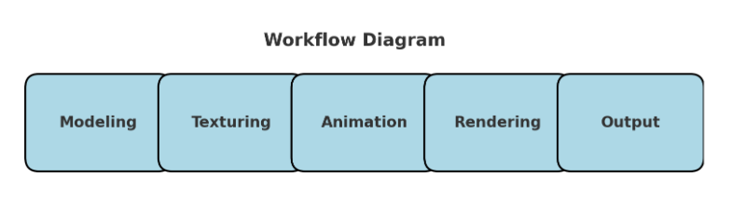

Slide 6
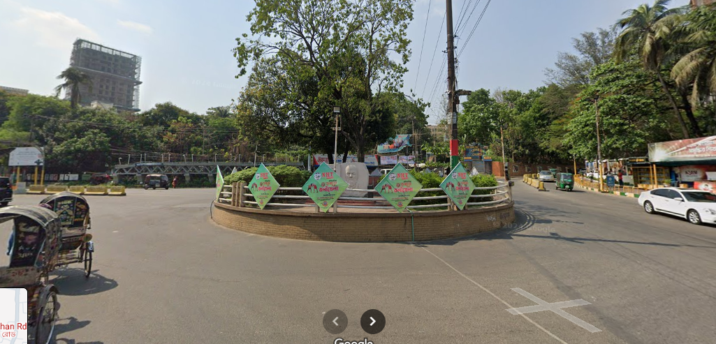
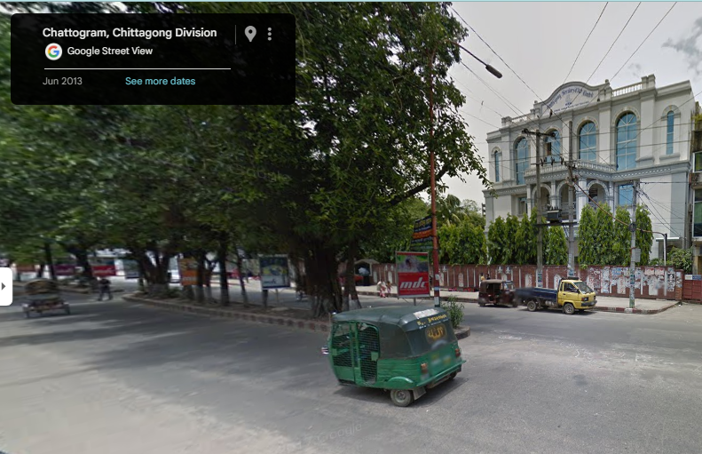
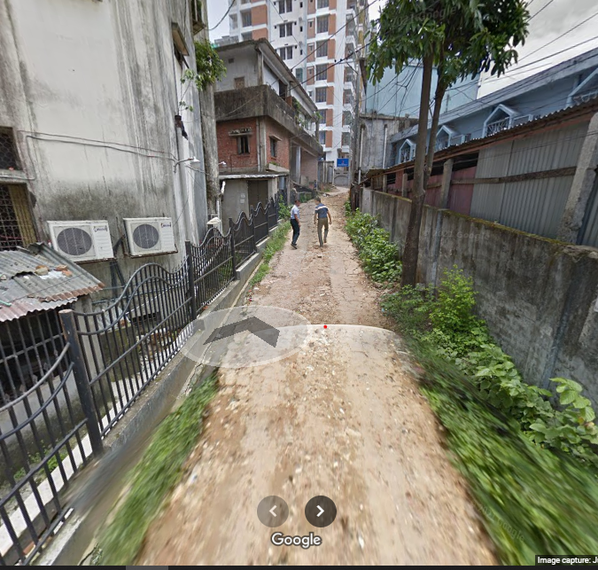
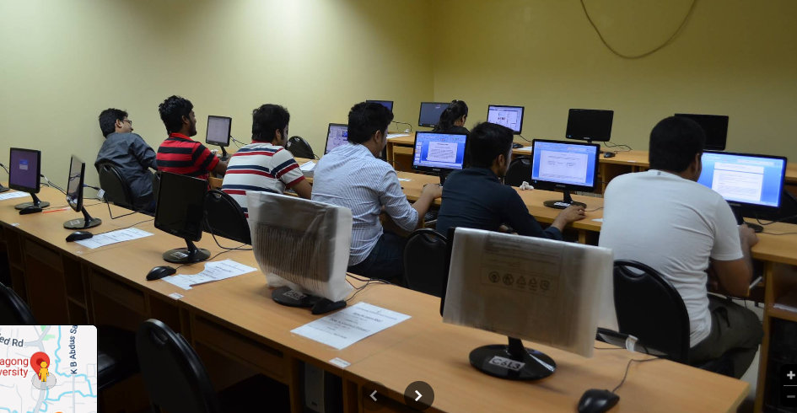
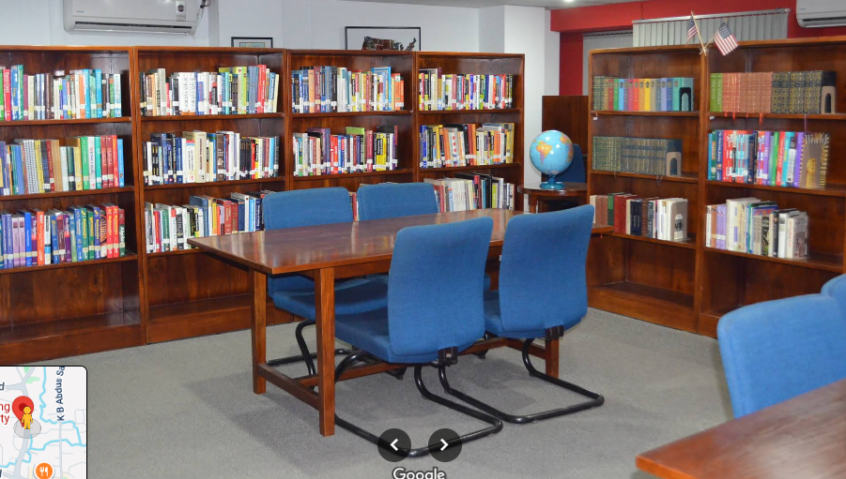
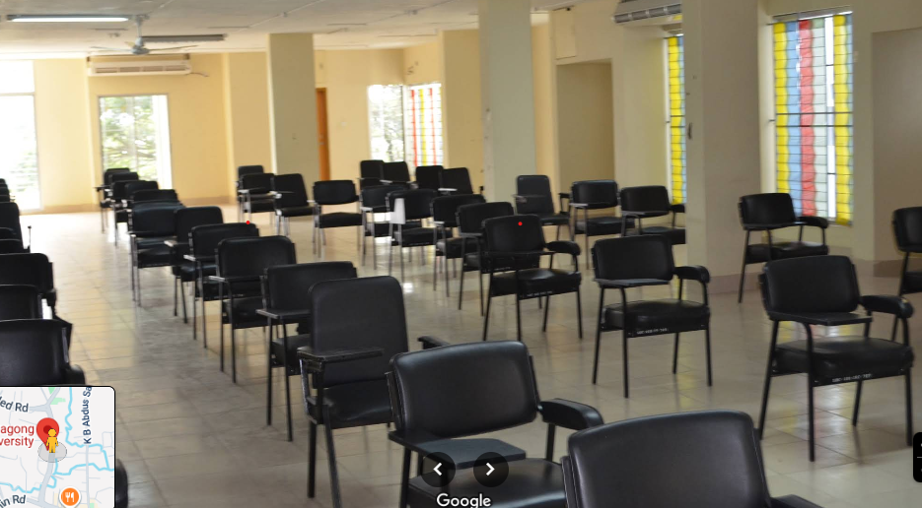
Implementation
Model blueprints:

Slide 7
Code Samples:
// Church - made more visible
drawChurch(450, 40, 0.8f);
// Shops on sidewalks
drawShop(480, 500, 70, 55, Color(0.7f, 0.9f, 0.6f), "general");
drawShop(680, 120, 75, 65, Color(0.8f, 0.6f, 0.8f), "general");
My project implements:
•Environment modeling
•Character animation
•Camera movements

Slide 8
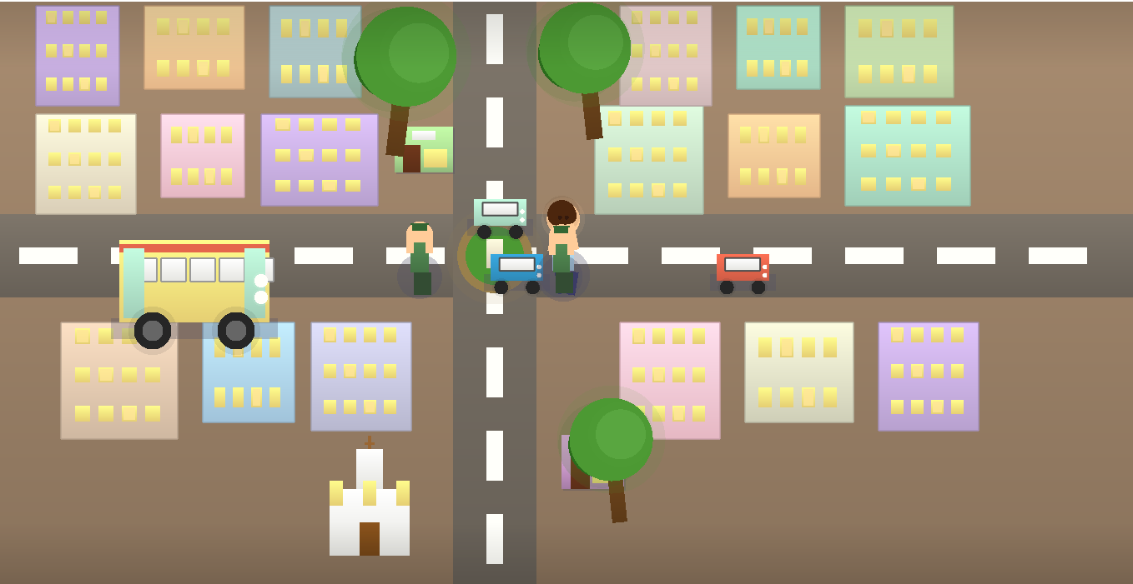
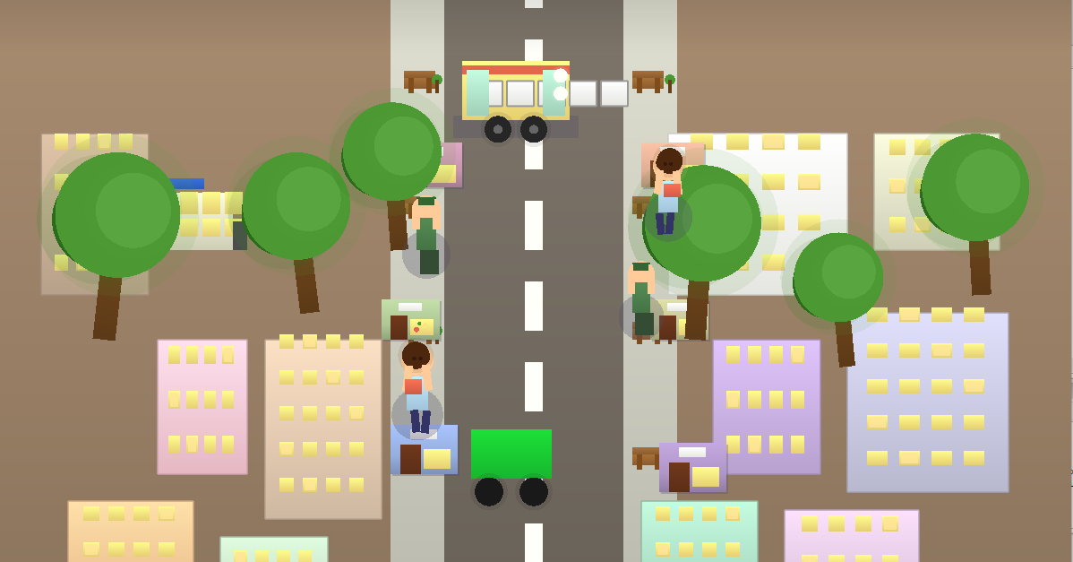
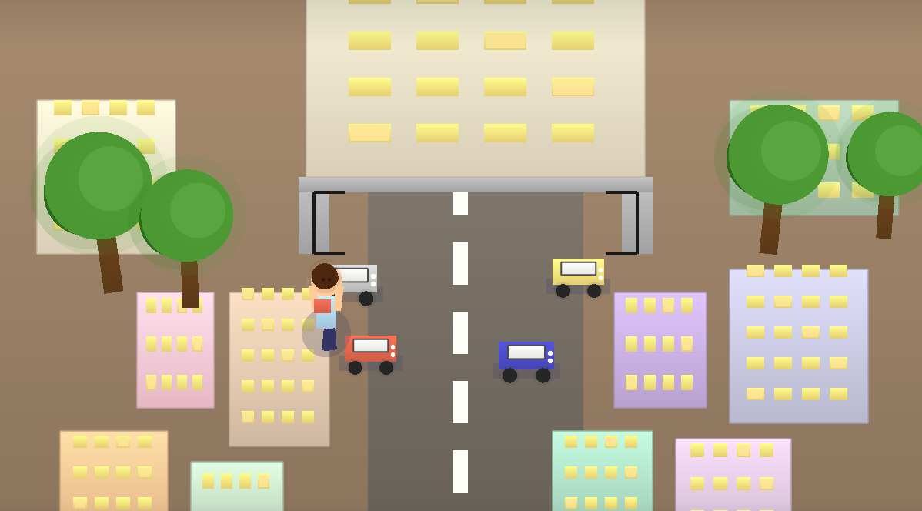
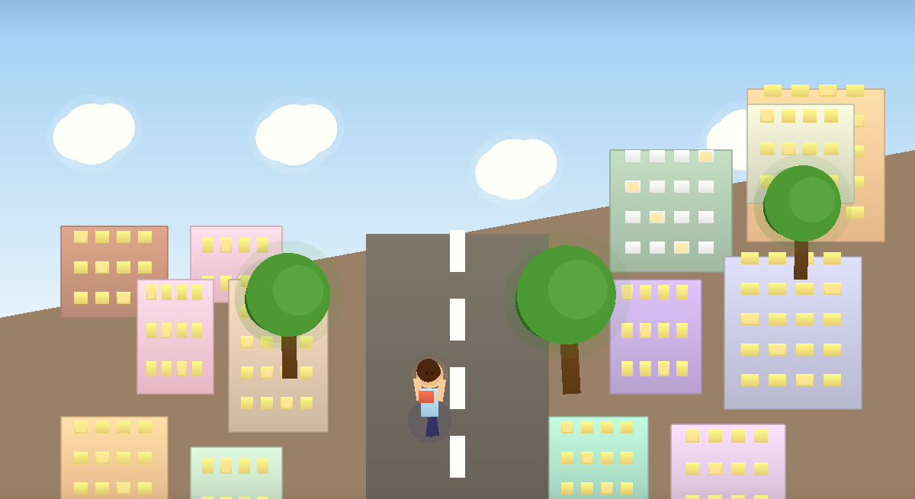
Result

Slide 9
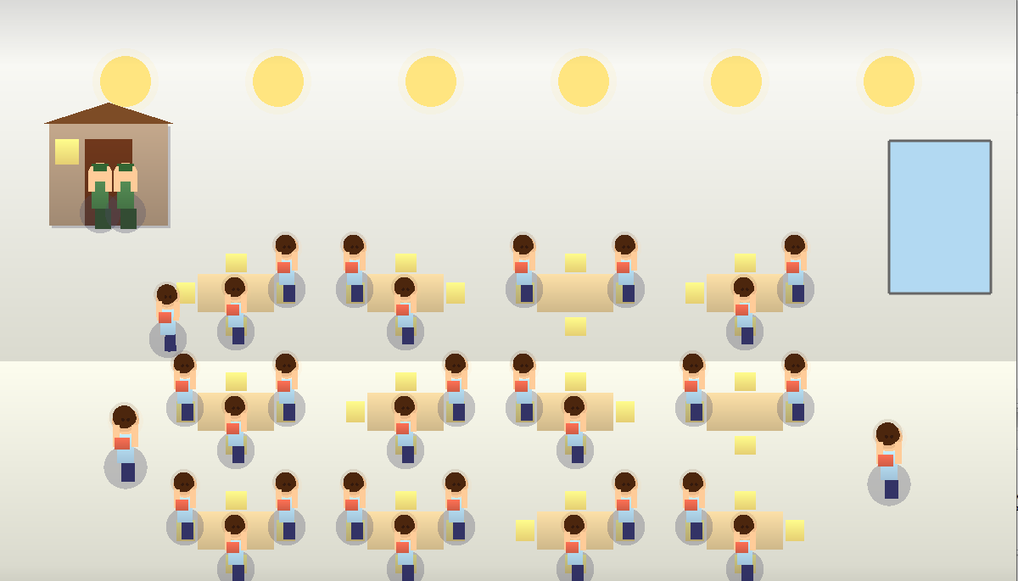
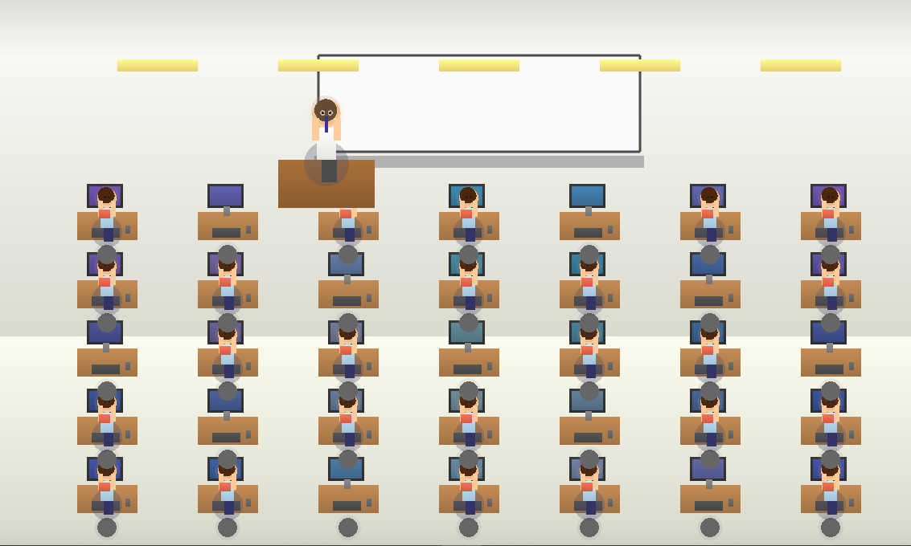
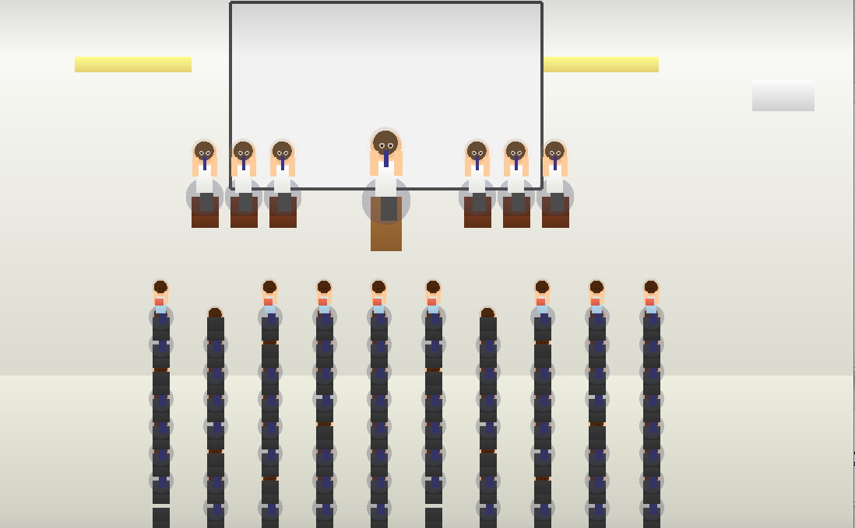
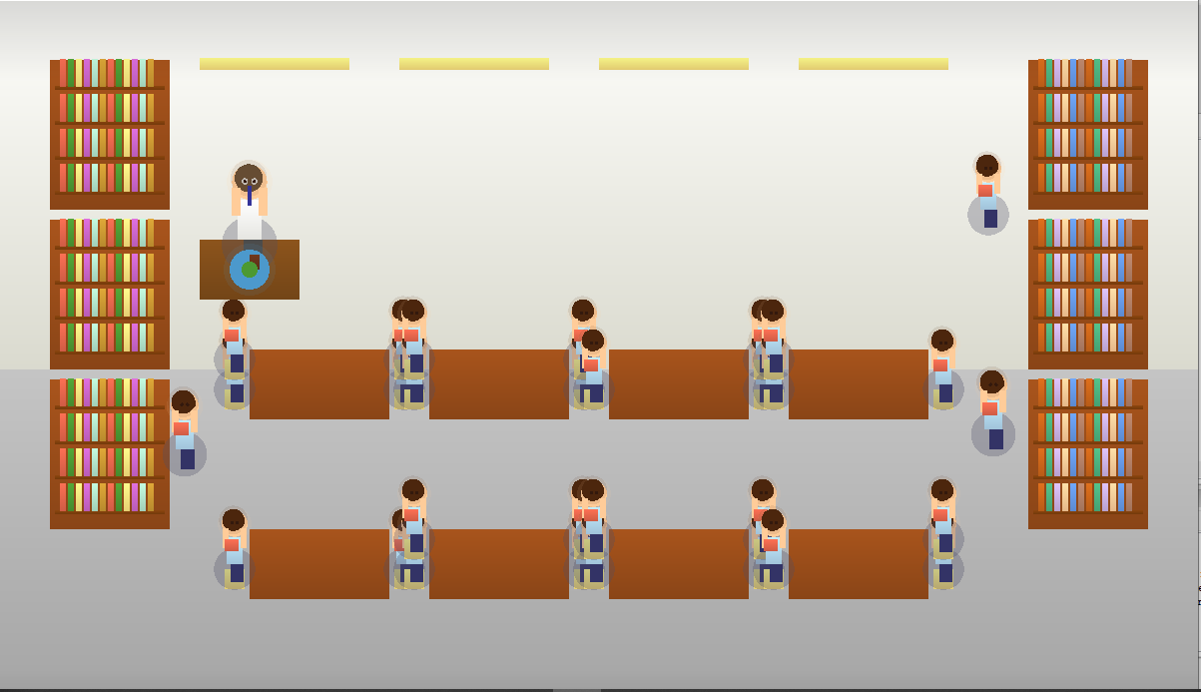
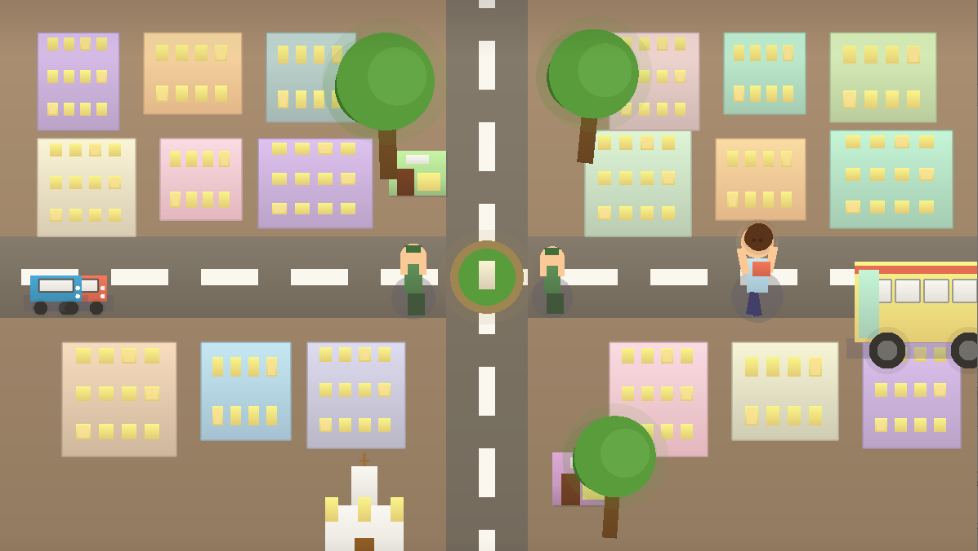

Slide 10
Analysis
Visual quality produced realistic atmosphere.
Characters achieved natural motion after iterative refinements.
Scene transitions ensured fluid storytelling
System Performance was efficient and optimal

Slide 11
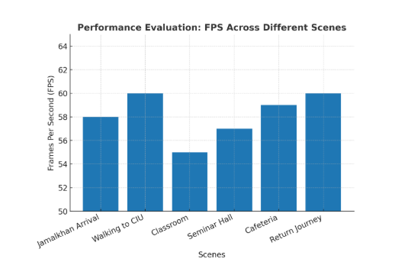

Slide 12
Challenges Faced
Designing location specific view
Realistic animations
Rendering elements in right co-ordinates
Camera placements
Iterative testing of animation cycles

Slide 13
Conclusion & Future Work
Conclusion:
Achieved immersive 2D animated journey with realistic storytelling.
Future Work:
• VR Integration for interactive campus tour
• 3D implementation
• User-driven navigation
• Weather & time variations
• Multi-character interaction

Slide 14
References
● Angel, E., & Shreiner, D. (2019). Interactive computer graphics. Pearson. ● Feiner, S. K., & Van Dam, A. (2006). Schaum’s outline of computer graphics (2nd ed.). McGraw-Hill Education.
● OpenGL. (n.d.). OpenGL documentation. https://www.opengl.org
● Blender Foundation. (n.d.). Blender manual. https://docs.blender.org ● OpenAI. (n.d.). ChatGPT. https://chatgpt.com/
● Anthropic. (n.d.). Claude. https://claude.ai/

