Slide 1

MARKET RESEARCH AND BUSINESS BUILDING

Slide 2
Marketing
It’s a social process by which individual groups obtain what they need and want through creating offerings and freely exchanging products and services of value with others

Slide 3
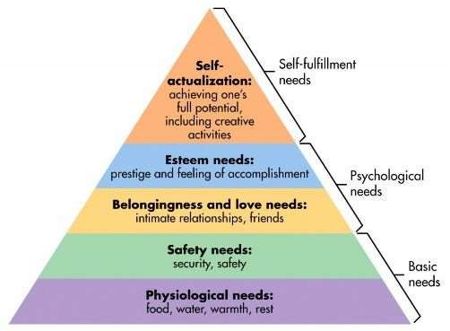
Maslow’s Hierarchy of Needs

Slide 4
Features of Marketing
Identifying needs and wants
Creating a market offering
Customer value
Exchange mechanism

Slide 5
Function Of Marketing
Marketing Research
Market Planning
Product design and development
Buying and assembling
Packaging and labelling
Branding
Pricing of Products
Storage and warehousing

Slide 6
Scope Of Marketing
1. GOODS Physical goods comprise the volume of most countries’ production and marketing effort.
2. SERVICES as economies progress, a growing proportion of their activities are concentrated on the production of services. Through organizing a number of services and goods, one can generate, stage, and market experiences.
3. EXPERIENCES Marketers endorse time-based events.
4. EVENTS
5. PERSONS celebrity marketing has turn into a main and popular business.

Slide 7
6. PLACES Place marketers consist of economic development specialists, real estate agents, commercial banks, local business associations, and advertising and public relations agencies.
7. PROPERTIES are intangible rights of ownerships of either real property organizations aggressively labor to create a strong, positive image in the mind of their publics.
8. ORGANIZATIONS
9.INFORMATION The production, packaging, and distribution of information is one of society’s chief industries.
10. IDEALS Each market offering has a fundamental idea at its core.

Slide 8
What Is Market Research?
The process of gathering, analyzing and interpreting information about a market, about a product or service to be offered for sale in that market, and about the past, present and potential customers for the product or service; research into the characteristics, spending habits, location and needs of your..
Market research is an organized effort to gather information about target markets or customers. It is a very important component of business strategy.

Slide 9
How To Do Market Research
Define your buyer persona.
Identify a portion of that persona to engage.
Engage your market research participants.
Prepare your research questions.
List your primary competitors.
Summarize your findings.

Slide 10

Conducting thorough market research can help businesses grow better, but doing it right is just as important. Here's how to do market research step-by-step.

Slide 11
1. Define your buyer persona
Before you dive into how customers in your industry make buying decisions, you must first understand who they are. This is the beginning of your primary market research — where buyer personas come in handy.
Buyer personas — sometimes referred to as marketing personas — are fictional, generalized representations of your ideal customers. They help you visualize your audience, streamline your communications, and inform your strategy. Some key characteristics you should be keen on including in your buyer persona are:
Age, gender, location. job titles, family size, income

Slide 12
2. Identify a portion of that persona to engage.
Now that you know who your buyer personas are, you'll need to find a representative sample of your target customers to understand their actual characteristics, challenges, and buying habits.
These should be folks who recently made a purchase (or purposefully decided not to make one), and you can meet with them in a number of ways:
In-person via a focus group
Administering an online survey
Individual phone interviews
We've developed a few guidelines and tips that'll help you get the right participants for your research. Let's walk through them.

Slide 13
3. Engage your market research participants
Market research firms have panels of people they can pull from when they want to conduct a study. The trouble is, most individual marketers don't have that luxury — and that's not necessarily a bad thing. In fact, the time you'll spend recruiting exclusively for your study will often lead to better participants.
4. Prepare your research questions
The best way to make sure you get the most out of your conversations is to be prepared. You should always create a discussion guide — whether it's for a focus group, online survey, or a phone interview — to make sure you cover all of the top-of-mind questions and use your time wisely.

Slide 14
Background Information (5 Minutes)
Describe to me how your work team is structured.
Tell me about your personal job responsibilities.
What are the team's goals and how do you measure them?
What has been your biggest challenge in the past year?
Awareness
Here, you want to understand how they first realized they had a problem that needed to be solved without getting into whether or not they knew about your brand yet.
Think back to when you first realized you needed a [name the product/service category, but not yours specifically]. What challenges were you facing at the time?
How did you know that something in this category could help you?
How familiar were you with different options on the market?

Slide 15
5. List your primary competitors.
Understanding your competitors begins your secondary market research. But keep in mind competition isn't always as simple as Company X versus Company Y.
Sometimes, a division of a company might compete with your main product or service, even though that company's brand might put more effort in another area. Apple is known for its laptops and mobile devices, for example, but Apple Music competes with Spotify — which doesn't sell hardware (yet) — over its music streaming service.

Slide 16
6. Summarize your findings.
To make the process easier, try using your favorite presentation software to make a report, as it will make it easy to add in quotes, diagrams, or call clips. Feel free to add your own flair, but the following outline should help you craft a clear summary:
Background. Your goals and why you conducted this study.
Participants. Who you talked to. A table works well so you can break groups down by persona and customer/prospect.
Executive Summary. What were the most interesting things you learned? What do you plan to do about it?
Awareness. Describe the common triggers that lead someone to enter into an evaluation. Note: Quotes can be very powerful.
Consideration. Provide the main themes you uncovered, as well as the detailed sources buyers use when conducting their evaluation.
Decision. Paint the picture of how a decision is really made by including the people at the center of influence and any product features or information that can make or break a deal.

Slide 17

BUSINESS MODELLING

Slide 18
A business model describes the rationale of how an organization creates, delivers, and captures value, in economic, social, cultural or other contexts. The process of business model construction and modification is also called business model innovation and forms a part of business strategy.

Slide 19
The process of business model design is part of business strategy. Business model design and innovation refer to the way a firm (or a network of firms) defines its business logic at the strategic level.
In contrast, firms implement their business model at the operational level, through their business operations. This refers to their process-level activities, capabilities, functions and infrastructure (for example, their business processes and business process modeling), their organizational structures (e.g. organigrams, workflows, human resources) and systems (e.g. information technology architecture, production lines).
The brand is a consequence of the business model and has a symbiotic relationship with it, because the business model determines the brand promise, and the brand equity becomes a feature of the model. Managing this is a task of integrated marketing.

Slide 20
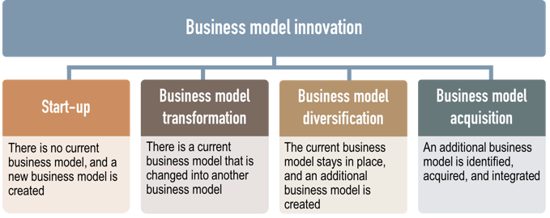

Slide 21
Are students at the heart of the new business building?
Are undergraduate students wanted in this building? I pose this as a serious question. It is based on these issues that I have serious reason to believe this building was not built for undergraduate business students to study, but rather as a space for start-ups, executives, conferences, and the generation of revenue. It better serves as a means of soaking up some of the extra students from the overcrowded Arts Block than as a genuinely student-inclusive space.

Slide 22
There is no doubt that the new Business Building is beautiful. It is sleek, the architecture is modern and future-focused. It is fully accessible for people with disabilities and it is an almost zero-energy building – these qualities should be recognized and applauded.
Trinity is on the cusp of starting its new €1 billion campus in the Docklands, and I look forward to one day seeing it. However, I do hope that Trinity remembers that its core will always be its students, and that their educational needs come first.

Slide 23


