Slide 1
MARKET RESEARCH AND BUSINESS BUILDING

Slide 2
What is Market Research?
Before we start about market research,
First we understand what is marketing:
MARKETING is the activity of institutions, and processes for creating, communicating, delivering, and exchanging offerings that have value for customers, clients, partners, and society at large.

Slide 3
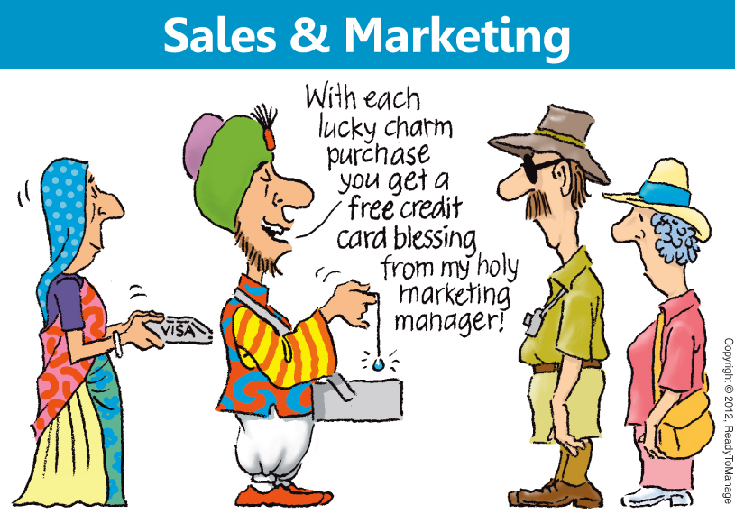
Marketing With The Customer

Slide 4
Market Research:
Market research is the process of determining the viability of a new service or product through research conducted directly with potential customers
Market research allows a company to discover the target market and get opinions and other feedback from consumers about their interest in the product or service

Slide 5

Market research helps by focusing people's attention on the facts about
Market research is an essential tool for communities to use in figuring out

Slide 6
Ways to Teach Students about Marketing
1. Slogan making
2. Turning the old into the new
3. Making commercials and recording radio promos
4. Product implementation

Slide 7
When you are asked, “What is your business model,” really, multiple questions are being asked:
Who is your target market/customer?
What value do you offer?
How will you reach your customers, and keep them wanting more?
How will you make revenue?
What's your cost structure?
What's your profit margin?

Slide 8
Factors That Can Be Investigated Through Market Research Include:
Market information: Through market information one can know the prices of different commodities in the market, as well as the supply and demand situation. Market researchers have a wider role than previously recognized by helping their clients to understand social, technical, and even legal aspects of markets
Market segmentation: Market segmentation is the division of the market or population into subgroups with similar motivations. It is widely used for segmenting on geographic differences, demographic differences (age, gender, ethnicity, etc.), technographic differences, psychographic differences, and differences in product use. For B2B segmentation firmographics is commonly used

Slide 9
Market trends: Market trends are the upward or downward movement of a market, during a period of time. Determining the market size may be more difficult if one is starting with a new innovation. In this case, you will have to derive the figures from the number of potential customers, or customer segments
SWOT analysis: SWOT is a written analysis of the Strengths, Weaknesses, Opportunities and Threats to a business entity. A SWOT may also be written up for the competition to understand how to develop the marketing and product mixes. SWOT method helps to determine and also reassess strategies and analyze business process

Slide 10
PEST analysis: PEST is an analysis about external environment . It includes a complete examine of a firm's Political, Economical, Social and Technological external factors. which may impact firms objective or profitability. They may become a benefit for the firm or harm its productivity
Brand health tracker: Brand tracking is way of continuously measuring the health of a brand, both in terms of consumers’ usage of it (i.e. Brand Funnel) and what they think about it. Brand health can be measured in a number of ways, such as brand awareness, brand equity, brand usage and brand loyalty

Slide 11
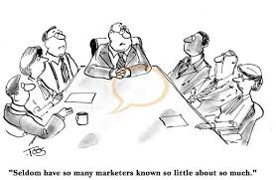
Marketing With The People

Slide 12
Market Research Helps:
Market research can replace assumptions and guesses with fact; it gives kids in your community and their parents a voice with which to tell you their needs; and it will empower you with specific, concrete information for stakeholders to get their buy-in and support for your community's OST needs

Slide 13

Business building

Slide 14
As many entrepreneurs know, dedicating time and energy to a business venture is a job all its own. It takes willpower to start a business at any age, but starting your first enterprise while still in school is especially challenging.

Slide 15


