Slide 1
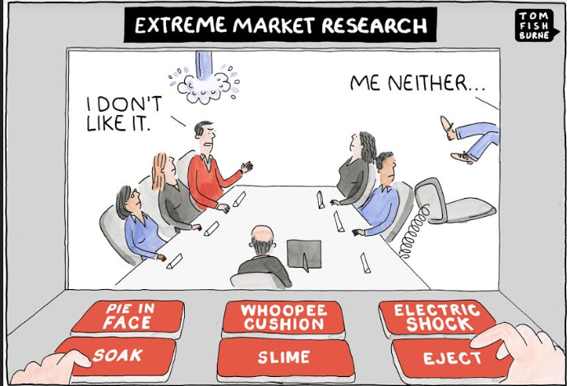
Market Research and Business Building

Slide 2
Market and Business Building
Market research is the process of determining the viability of a new service or product through research conducted directly with potential customers
Business building means a building or part thereof for transaction of record therefore, offices, banks, all professional establishments, court houses classified as business buildings if their principal function is transaction of business and /or keeping of books and records

Slide 3

SCOPE OF MARKETING

Slide 4

1.Goods
Physical goods comprise the volume of most countries production and marketing effort

Slide 5

2.Services
As economies progress, a growing proportion of their activities are concentrated on the production of services.

Slide 6

3.Experiences
Through organizing a number of services and goods, one can generate, stage, and market experiences.

Slide 7

4.Events
Marketers endorse time-based events

Slide 8
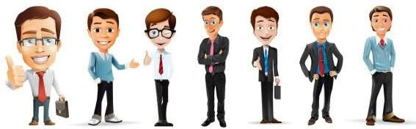
5.Persons
Celebrity marketing has turn into a main and popular business

Slide 9
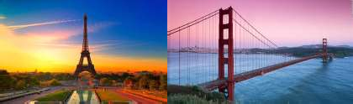

6.Places
Place marketers consist of economic development specialists, real estate agents, commercial banks, local business associations, and advertising and public relations agencies

Slide 10

7.Properties
Properties are intangible rights of ownerships of either real property

Slide 11
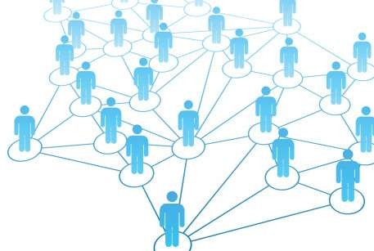
8.Organizations
Organizations aggressively labor to create a strong, positive image in the mind of their publics

Slide 12

9.Information
The production, packaging, and distribution of information is one of society’s chief industries

Slide 13

10.Ideas
Each market offering has a fundamental idea at its core

Slide 14
Goals are different
marketing
The SMART mnemonic helps as a test or filter which the firm can use to assess the quality of measures
how the business can benefit from channels. So, goals are the broad aims used to shape strategy. They describe how marketing will contribute to the business in key areas of growing sales, communicating with audience and saving money

Slide 15

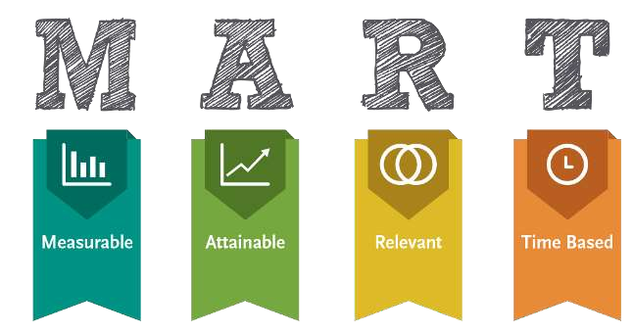

Slide 16
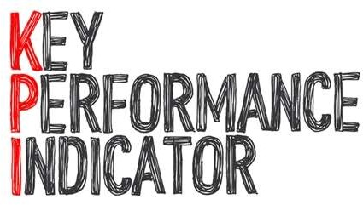
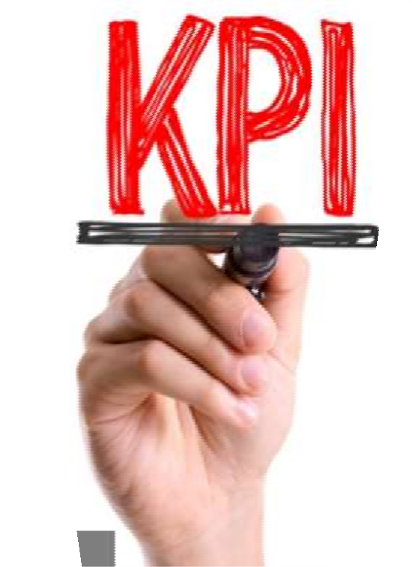
Key performance indicators (KPIs) are used to check that the marketing activities of a company are on track. KPIs are specific metrics which are used to track performance to make sure the firm is on track to meet specific objectives. They are sometimes known as performance drivers or critical success factors for this reason.

Slide 17

Examples of noteworthy marketing goals
Identifying the target market
Increasing sales and profits
Increasing brand awareness
Increasing market share
Countering competitive strategies
Reputation
Increasing distribution channels

Slide 18

Conclusion
Ultimately, market research provides information that reduces risk and uncertainty and increases your chance of business success. The final conclusions should meet your initial objectives; consider what options you have discovered in your analysis to best meet your larger business objectives

Slide 19


