Slide 1
Hierarchical Clustering for Seed Categorization CSE 6363 – Machine Learning Final Project
Tanzima Sultana
UTA ID - 1001759430
Dept. of Computer Science and Engineering

Slide 2
Problem
Hierarchical Clustering on the UCI seed dataset
Apply nearest neighbor classification based on the cluster IDs to identify the species

Slide 3
Solution
Hierarchical Clustering
Single Linkage Clustering – the two clusters with the smallest minimum pairwise distance.
Complete Linkage Clustering - smallest maximum pairwise distance.
K Nearest Neighbor(KNN) – Choose K neighbors based on Euclidean distance.

Slide 4
Implementation
Hierarchical Clustering
Calculate Euclidean distance between all nodes (train dataset).
Merge two nodes/clusters with the smallest minimum/maximum pairwise distance.
Repeat this process until all the nodes are divided into given number of groups/clusters.

Slide 5
KNN
For each test node, calculate Euclidean distance with all train nodes (used for clustering).
For each test node, find K nearest neighbors.
Assign the node with a cluster ID based on majority of its neighbor nodes belongs to which cluster.

Slide 6
Dataset
UCI seeds dataset
3 different varieties of wheat: Kama, Rosa and Canadian.
70 elements in each group. Total = 210
Kama – 1 (1-70)
Rosa – 2 (71-140)
Canadian – 3 (141-210)
Train – 190, Test - 20

Slide 7

Results Seed = [1, 2, 3] No of cluster – [3, 4, 5] K = [3, 5]
Seed | Single Linkage Clustering |  |  |  |  |  | KNN
 | No of clusters
 | 3 |  | 4 |  | 5
 | Train | Test | Train | Test | Train | Test
1 | 100 | 80 | 100 | 85 | 100 | 85 | 3
 | 100 | 80 | 100 | 85 | 100 | 85 | 5
2 | 66.84 | 55 | 100 | 85 | 100 | 85 | 3
 | 66.84 | 60 | 100 | 90 | 100 | 90 | 5
3 | 96.84 | 85 | 96.84 | 85 | 96.84 | 85 | 3
 | 96.84 | 85 | 96.84 | 85 | 96.84 | 85 | 5
Table 1: Accuracy (%) of Single Linkage clustering

Slide 8
Seed | No of clusters |  |  |  |  |  | KNN
 | 3 |  | 4 |  | 5
 | Clustering | Sklearn | Clustering | Sklearn | Clustering | Sklearn
1 | 80 | 85 | 85 | 90 | 85 | 95 | 3
 | 80 | 85 | 85 | 90 | 85 | 95 | 5
2 | 55 | 50 | 85 | 75 | 85 | 75 | 3
 | 60 | 50 | 90 | 75 | 90 | 75 | 5
3 | 85 | 80 | 85 | 80 | 85 | 90 | 3
 | 85 | 80 | 85 | 80 | 85 | 90 | 5
Table 2: Accuracy (%) comparison between Single Linkage and Sklearn library

Slide 9
Seed | No of clusters |  |  |  |  |  | KNN
 | 3 |  | 4 |  | 5
 | Single | Complete | Single | Complete | Single | Complete
1 | 80 | 70 | 85 | 70 | 85 | 70 | 3
 | 80 | 75 | 85 | 80 | 85 | 80 | 5
2 | 55 | 70 | 85 | 85 | 85 | 85 | 3
 | 60 | 80 | 90 | 90 | 90 | 90 | 5
3 | 85 | 80 | 85 | 85 | 85 | 85 | 3
 | 85 | 85 | 85 | 85 | 85 | 85 | 5
Table 3: Accuracy (%) comparison with between Single and Complete Linkage Clustering

Slide 10
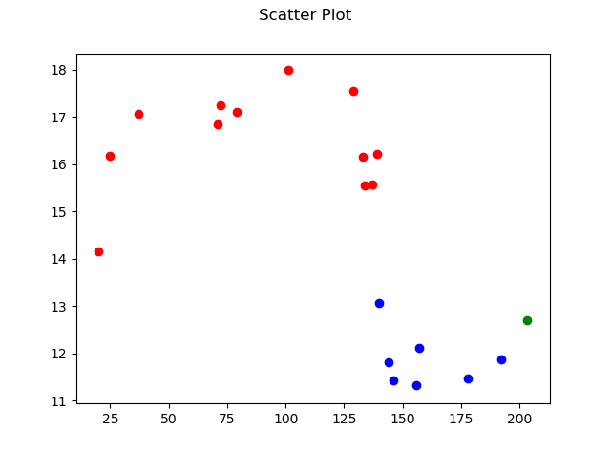
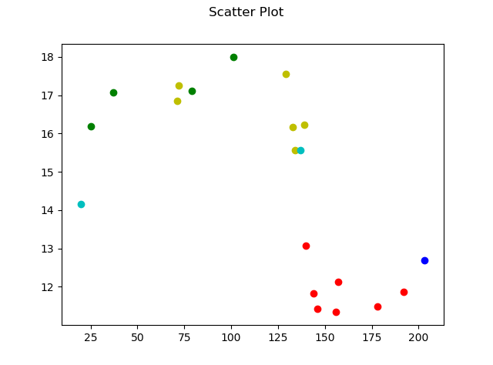
Fig 1: Single Linkage, cluster = 3, K = 3
Fig 2: Complete Linkage, cluster = 5, K = 5

Slide 11
Conclusion
For different no of seed, different train-test accuracy.
Most of the cases, increasing number of cluster, increases accuracy.
For seed = [2], cluster = [4, 5], K = [5], train accuracy = 100%, test = 90%.
Sklearn performs better.

Slide 12
Thank You

