Slide 1
SAVE TEARS · UK–CHINA CORE TEAM
We Built It. Now We Need You.
LIVE
savetear.cloud
From a winter camp prototype to a live greywater platform — now ready for the next engineering stage.
Public entry verified
18 JUN 2026
Recruiting 2–4
long-term core members
LIVE PRODUCT
VALIDATED ML
OPEN PROBLEMS
Own domain · Own server
R² 0.7498 on public data
Real data · Greywater AI
Telecom + Software Engineering
Sources: approved recruitment design; savetear.cloud public entry, 18 Jun 2026
01

Slide 2
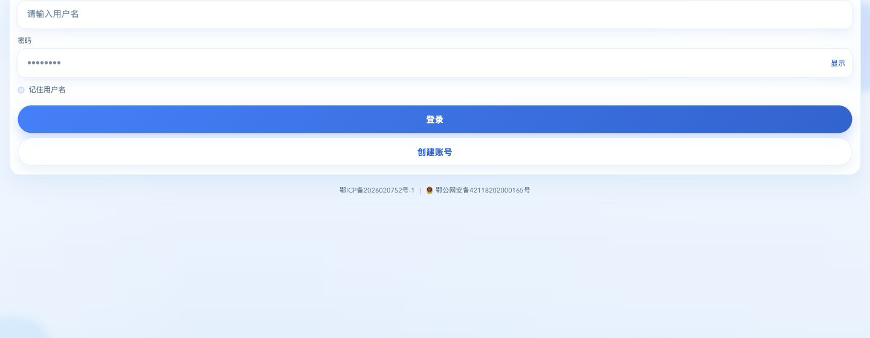
FROM IDEA TO DELIVERY
From Winter Camp to a Live Product
01
Winter Camp
02
Working Product
03
Live Deployment
The project begins
Frontend + backend
Own domain + server
Public entry screen · no login attempted
Sources: Save Tears deployment record; public entry captured 18 Jun 2026
02

Slide 3
THE NEXT ENGINEERING STAGE
Three Challenges We Cannot Solve Alone
International deployment
Real-world data
Greywater-aware AI
Deploy and test Save Tears outside China.
Connect sensors through ThingCloud and replace mock data.
Forecast demand and generate safe dual-source plans.
01
02
03
UK test environment
Device-to-cloud pipeline
Dual-source decision logic
These are not hypothetical features. They are clear ownership opportunities for new core members.
Source: approved Save Tears UK recruitment-deck design
03

Slide 4
VALIDATED EXPERIMENT
Our First AI Result
R²
0.7498
Best result · Random Forest
810
households
131,220
samples
Scope: public normal-water data · 6 hours → next hour · no greywater, weather or temperature inputs yet
Source: Tao Jiacheng, AI course design report, Jun 2026, pp. 9–18
04

Slide 5
RESPONSIBLE DUAL-SOURCE INTELLIGENCE
Why Generic LLMs Are Not Enough
PROPOSED RESEARCH ARCHITECTURE
01
02
03
04
05
06
Forecast
demand
→
Greywater
availability
→
Allocation
rules
→
RAG
knowledge
→
LLM
explanation
→
User
plan
Next-hour normal-water baseline
What can be reused now
Safety, uses and ratio
Retrieve trusted guidance
Personalise the rationale
Clear actions and targets
The LLM explains the plan. It does not invent the greywater ratio.
Fine-tuning comes after real greywater examples and a measurable evaluation set.
Source: approved Save Tears UK recruitment-deck design — proposed architecture
05

Slide 6
TWO MAJORS · ONE WORKING SYSTEM
Two Majors, One Working System
Telecom Engineering
Software Engineering
Sensors and gateways
ONE
SYSTEM
International deployment
→
ThingCloud integration
Backend and data pipeline
Data reliability
Forecasting and AI planning
Devices → reliable data → deployment → prediction → a plan people can act on
Source: approved Save Tears UK recruitment-deck design
06

Slide 7
THE DECISION IS ON-SITE
Join the Core Team
2–4
Build the next stage of a product that already exists.
LONG-TERM
CORE MEMBERS
Deploy internationally
Connect real data
Telecom Engineering
+
Build responsible dual-source intelligence
Software Engineering
Choose Save Tears today.
One product. One core team.
Source: approved Save Tears UK recruitment-deck design
07

