Slide 1
Reductions, P, NP and NP-completeness
CS101 Fall 2023
Supplementary Notes
Excerpted from CS240 Spring 2022
By Prof. Rui Fan

Slide 2
Limits of efficiency
What is the fastest way to solve a problem?
E.g. sorting n numbers takes O(n log n) operations using mergesort.
Is there a different algorithm that sorts n numbers faster, say in O(n) time?
No. Sorting n numbers takes Ω(n log n) time if the algorithm can only compare numbers.

Slide 3
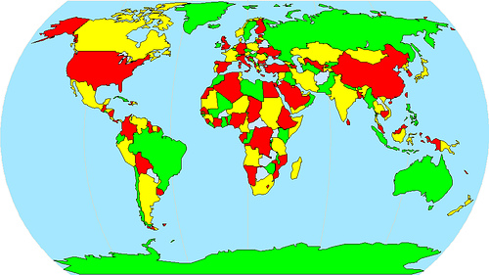
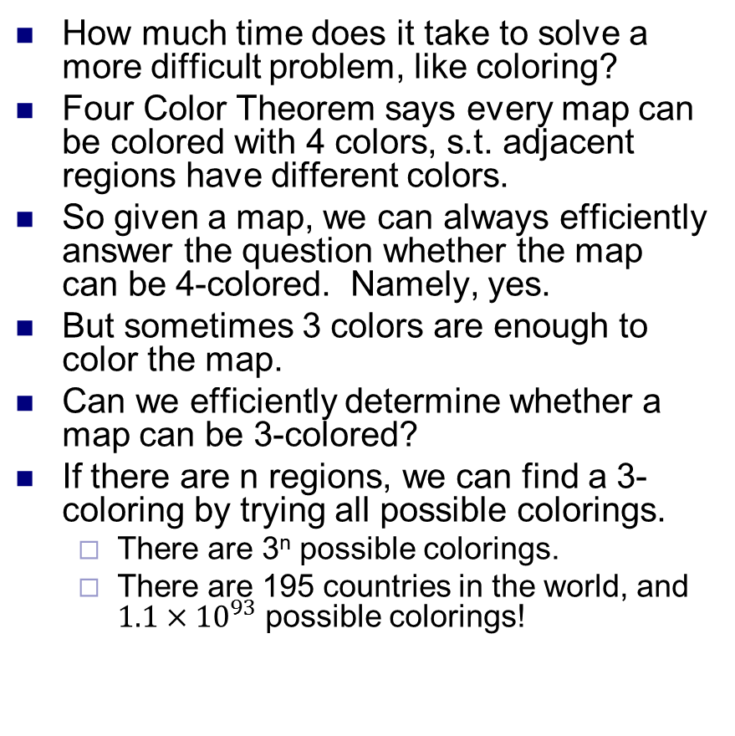
Limits of efficiency
How much time does it take to solve a more difficult problem, like coloring?
Four Color Theorem says every map can be colored with 4 colors, s.t. adjacent regions have different colors.
So given a map, we can always efficiently answer the question whether the map can be 4-colored. Namely, yes.
But sometimes 3 colors are enough to color the map.
Can we efficiently determine whether a map can be 3-colored?
If there are n regions, we can find a 3-coloring by trying all possible colorings.
There are 3^{n} possible colorings.
There are 195 countries in the world, and $1.1×{10}^{93}$ possible colorings!

Slide 4
Limits of efficiency
Is there a much more efficient algorithm?
Nobody knows of one. And almost everybody thinks no such algorithm exists.
But no one can prove it doesn’t exist either.
The theory of NP-completeness is a mathematical attempt to prove some problems have no efficient solutions.
So far, it’s led to more questions than answers...
We’ll define P, NP, and NP-completeness.

Slide 5
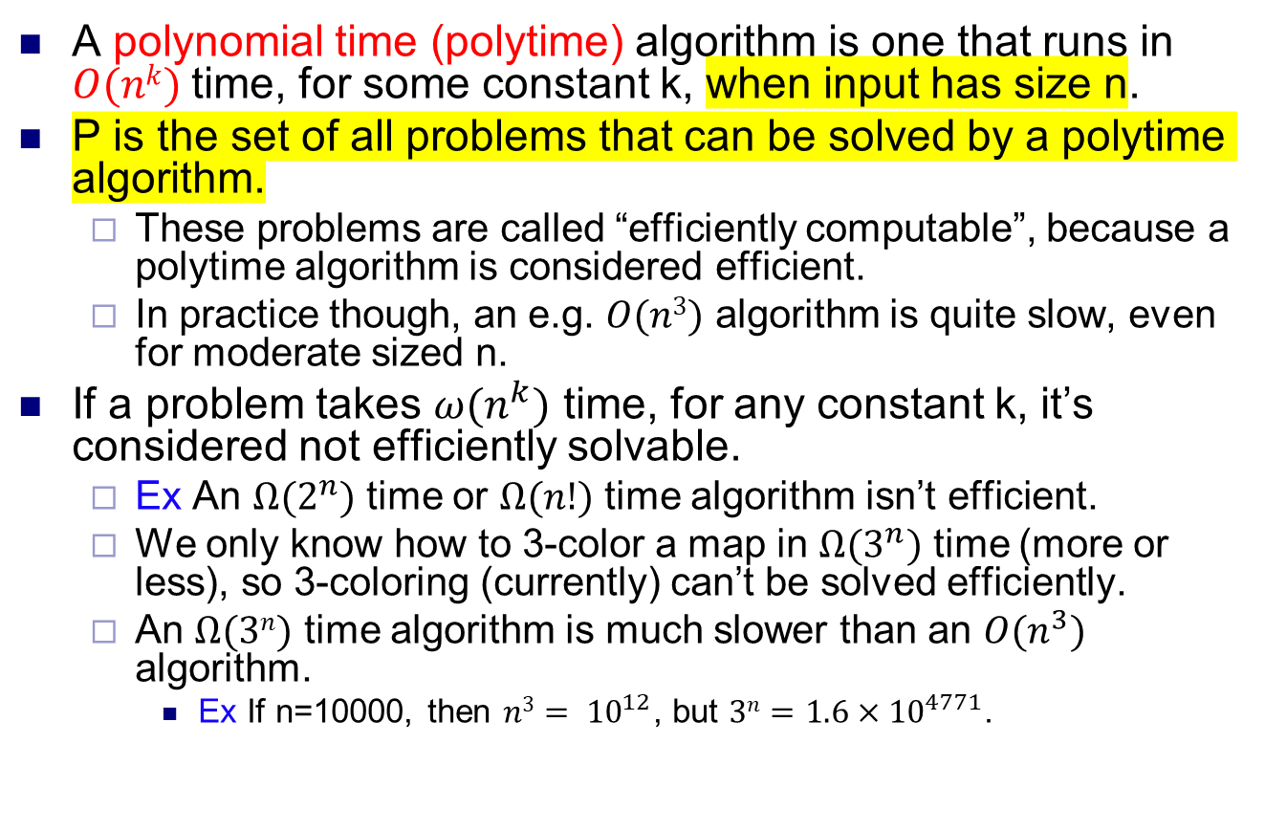
The class P
A polynomial time (polytime) algorithm is one that runs in $O(nk)$time, for some constant k, when input has size n.
P is the set of all problems that can be solved by a polytime algorithm.
These problems are called “efficiently computable”, because a polytime algorithm is considered efficient.
In practice though, an e.g. $O(n3)$ algorithm is quite slow, even for moderate sized n.
If a problem takes $ω(n^{k})$ time, for any constant k, it’s considered not efficiently solvable.
Ex An $Ω(2^{n})$ time or $Ω(n!)$ time algorithm isn’t efficient.
We only know how to 3-color a map in $Ω(3^{n})$ time (more or less), so 3-coloring (currently) can’t be solved efficiently.
An $Ω(3n)$ time algorithm is much slower than an $O(n^{3})$ algorithm.
Ex If n=10000, then $n3= {10}^{12}$, but $3n=1.6×{10}^{4771}$.

Slide 6
The class NP
NP = Nondeterministic polynomial time.
Def An instance of a problem consists of an input for the problem.
Ex An instance of the sorting problem is a set {3,1,2,4} that we want to sort.
Ex An instance of the SSSP problem is a weighted graph along with a source node.
P is the class of problems for which all instances can be solved in polynomial time by some algorithm.
NP is the class of problems for which the solvability of an instance can be verified in polynomial time.
The verification is done by a “verifier (certifier)” algorithm.
The verifier(certifier) needs an additional “hint” to work correctly.
The hint is also called a “witness” or “certificate”.
The verifier(certifier) doesn’t find a solution to a problem instance, but only checks that the instance has been solved.

Slide 7
The class NP
The verifier(certifier) has the following properties.
The verifier(certifier)’s input is a problem instance x, and a certificate y.
The verifier(certifier)’s output is either “accept(yes)” or “reject(no)”.
If x has a solution, then if y is a “good” certificate, the verifier(certifier) will output accept.
If y is not a “good” certificate, the verifier(certifier) can either accept or reject.
If x has no solution, the verifier(certifier) rejects no matter what y is.
Intuitively, the certificate y indicates x is solvable.
For example, y can be a solution to x.
But y can also be an indirect representation of a solution.
The verifier(certifier) is efficient, i.e. runs in polynomial time.

Slide 8
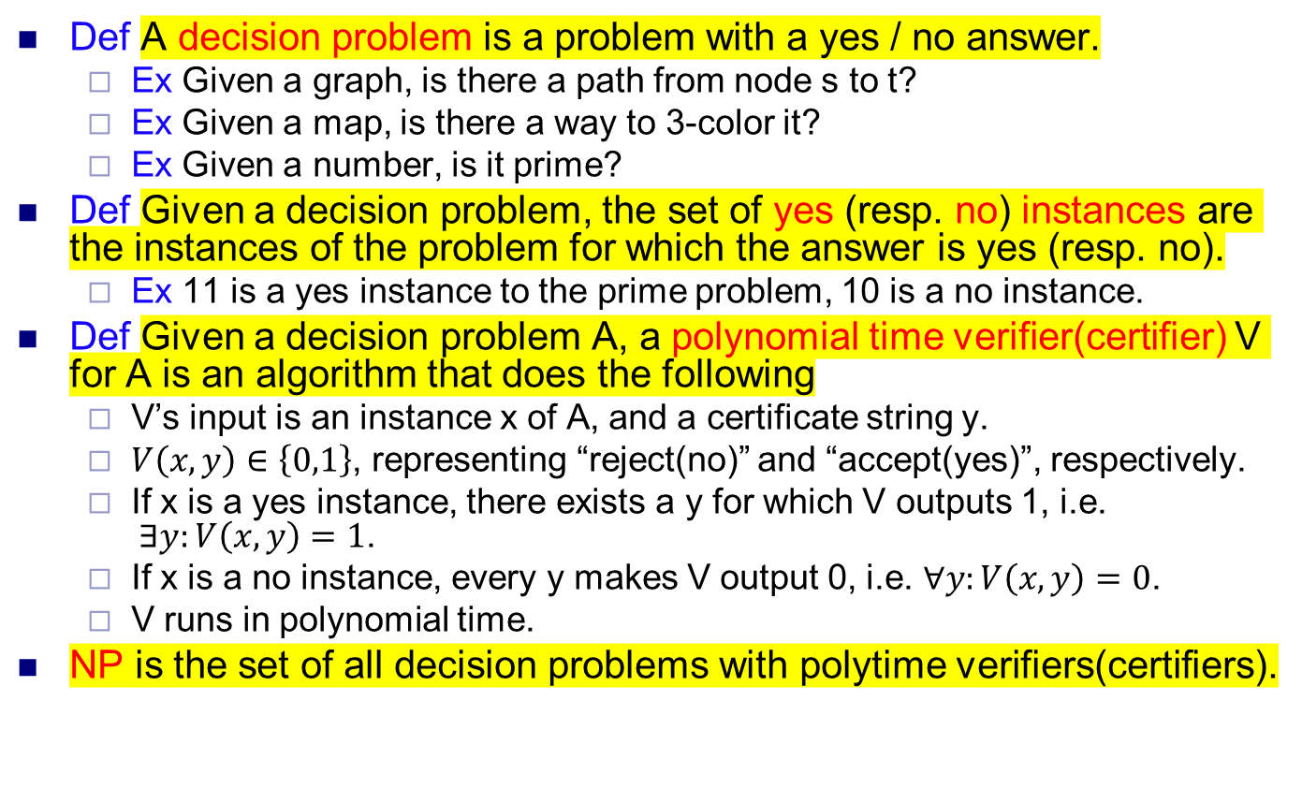
The class NP, formally
Def A decision problem is a problem with a yes / no answer.
Ex Given a graph, is there a path from node s to t?
Ex Given a map, is there a way to 3-color it?
Ex Given a number, is it prime?
Def Given a decision problem, the set of yes (resp. no) instances are the instances of the problem for which the answer is yes (resp. no).
Ex 11 is a yes instance to the prime problem, 10 is a no instance.
Def Given a decision problem A, a polynomial time verifier(certifier) V for A is an algorithm that does the following
V’s input is an instance x of A, and a certificate string y.
$V\left(x,y\right)∈\left\{0,1\right\}$, representing “reject(no)” and “accept(yes)”, respectively.
If x is a yes instance, there exists a y for which V outputs 1, i.e. $∃y:V\left(x,y\right)=1$.
If x is a no instance, every y makes V output 0, i.e. $∀y:V\left(x,y\right)=0$.
V runs in polynomial time.
NP is the set of all decision problems with polytime verifiers(certifiers).

Slide 9
Showing a problem is in P or NP
To show a problem is in P, give an algorithm solving the problem that runs in polynomial time.
To show a decision problem is in NP, give a polynomial time verifier(certifier) for the problem satisfying the properties on the previous slide.
This requires specifying what the certificates are, and how the verifier(certifier) operates, given an instance of the problem and a certificate.

Slide 10
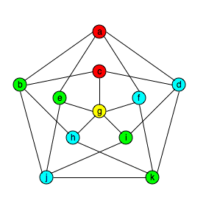
4-coloring is in NP
Given a graph, can we assign each vertex one of 4 colors, such that adjacent vertices have different colors?
Verifier (certifier)
Certificate y is an assignment of colors to the vertices of graph x.
Check y uses at most 4 colors. If not, output no.
Go through all edges of x, and checks endpoints of each edge have different colors.
If true for all edges, output 1. Else output 0.
If x has solution
Then x is 4-colorable.
So there’s way to assign each vertex one of 4 colors s.t. endpoints of each edge have different colors.
Let y be this assignment, and give y to V.
Clearly V outputs 1.
x has no solution
Then x is not 4-colorable.
So no matter how we assign 4 colors to vertices of x, some edge has endpoints with the same order.
So V outputs 0, for any input y.
V runs in polytime.
If x has n vertices, then it has O(n²) edges, so V runs in O(n²) time.

Slide 11
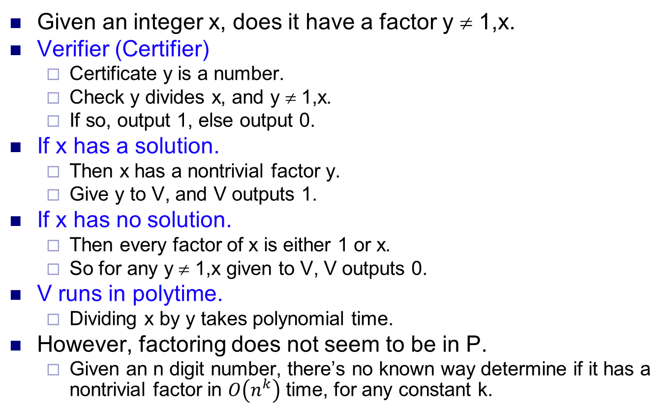
Factoring is in NP
Given an integer x, does it have a factor y ≠ 1,x.
Verifier (Certifier)
Certificate y is a number.
Check y divides x, and y ≠ 1,x.
If so, output 1, else output 0.
If x has a solution.
Then x has a nontrivial factor y.
Give y to V, and V outputs 1.
If x has no solution.
Then every factor of x is either 1 or x.
So for any y ≠ 1,x given to V, V outputs 0.
V runs in polytime.
Dividing x by y takes polynomial time.
However, factoring does not seem to be in P.
Given an n digit number, there’s no known way determine if it has a nontrivial factor in $O\left(n^{k}\right)$ time, for any constant k.
999999866000004473 = 999999929 x 999999937

Slide 12
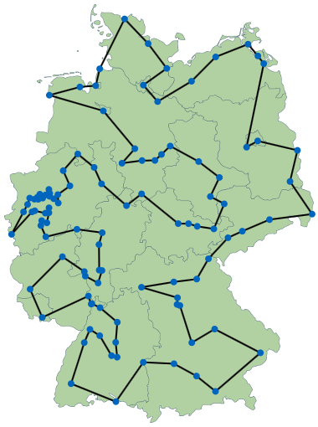
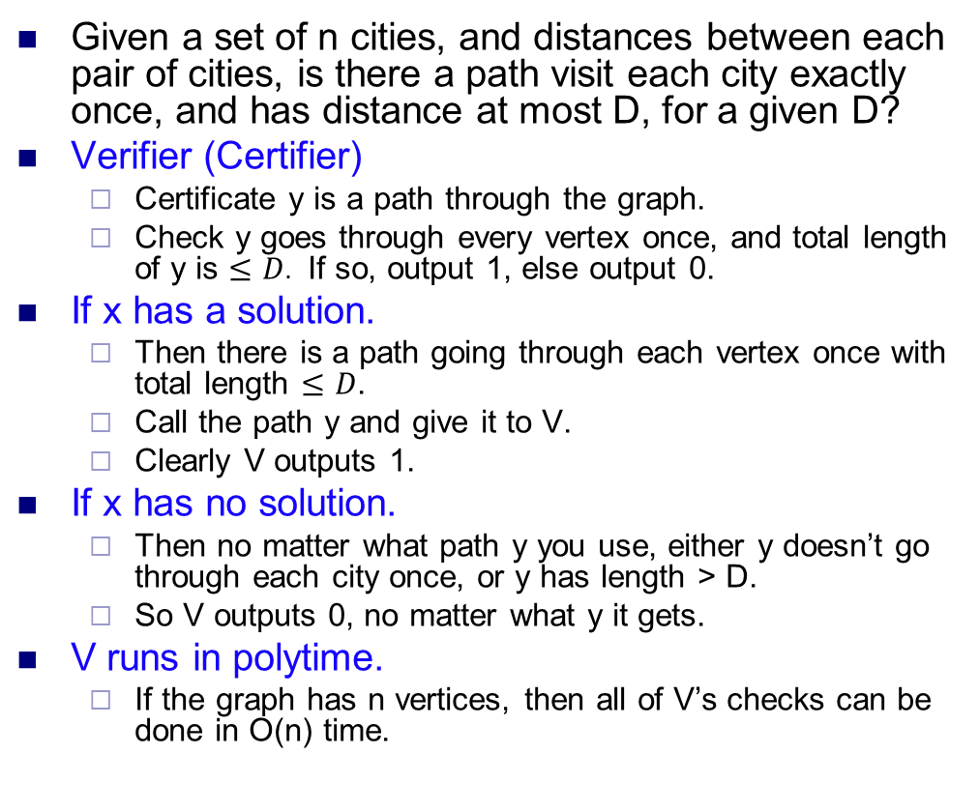
Traveling salesman is in NP
Given a set of n cities, and distances between each pair of cities, is there a path visit each city exactly once, and has distance at most D, for a given D?
Verifier (Certifier)
Certificate y is a path through the graph.
Check y goes through every vertex once, and total length of y is $≤D$. If so, output 1, else output 0.
If x has a solution.
Then there is a path going through each vertex once with total length $≤D$.
Call the path y and give it to V.
Clearly V outputs 1.
If x has no solution.
Then no matter what path y you use, either y doesn’t go through each city once, or y has length > D.
So V outputs 0, no matter what y it gets.
V runs in polytime.
If the graph has n vertices, then all of V’s checks can be done in O(n) time.

Slide 13
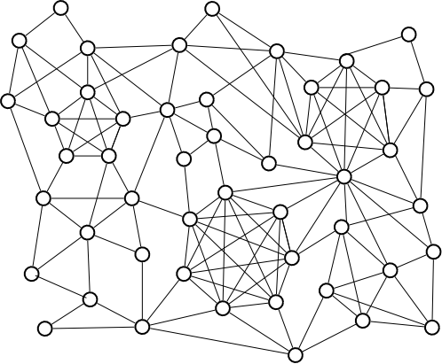
k-Clique is in NP
Given a graph with n nodes and a number k, are there k nodes that form a clique, i.e. that are all connected to each other?
Verifier (Certifier)
Certificate y is a set of k nodes in x.
Check each pair of the k nodes is connected by an edge. If so, output 1. Otherwise output 0.
If x has a solution.
Then there are k nodes that are mutually connected.
Call this set y and give it to V.
Clearly V outputs 1.
If x has no solution.
Then in any set of k nodes, some 2 nodes aren’t connected.
So V outputs 0, no matter what set of k nodes it gets.
V runs in polytime.
Checking k nodes are mutually connected takes O(k²) time.

Slide 14
All problems in P are in NP
Let A be a problem in P. I.e. there’s a polytime algorithm S s.t. on every instance x of A
If x has a solution, S returns a solution.
If x has no solution, S returns fail.
Verifier (Certifier)
V runs S. If S finds a solution, V outputs 1. Otherwise V outputs 0.
If x has a solution.
S finds a solution, so V outputs 1.
If x has no solution.
S returns fail, so V outputs 0.
V runs in polytime.
Because V just runs S, which runs in polytime.
Notice that for problems in P, V doesn’t need a certificate y.
For problems in P, it’s easy to determine if they’re solvable or not.
But for hard problems (not in P), V isn’t powerful enough to determine solvability by itself.
So it needs a hint / witness / certificate.
Ex In factoring, a polytime verifier(certifier) isn’t powerful enough to find a nontrivial factor of an input.
But if it’s given a nontrivial factor, it can check the factor works in polytime, and therefore verify the input is composite.

Slide 15
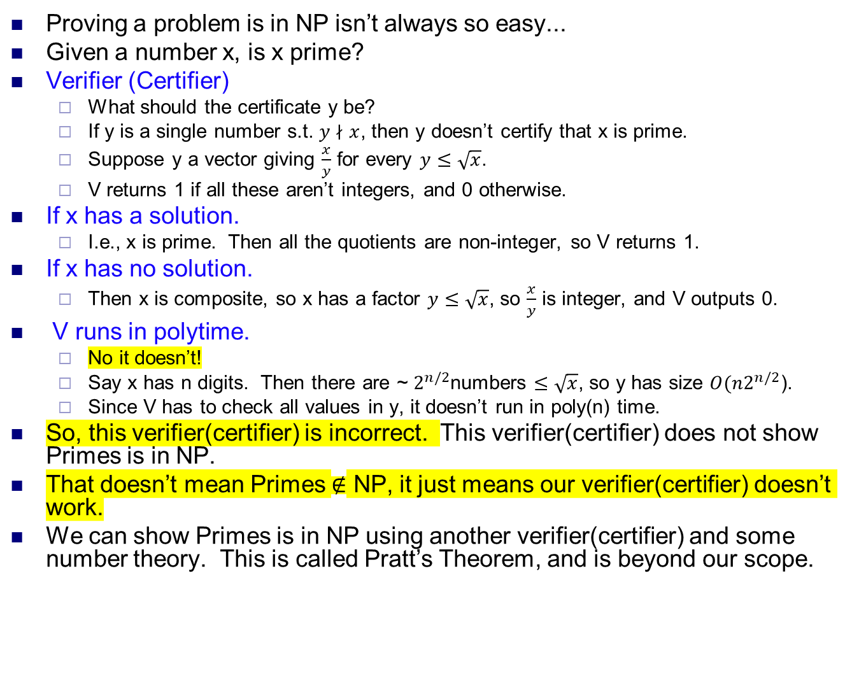
Primes is in NP
Proving a problem is in NP isn’t always so easy...
Given a number x, is x prime?
Verifier (Certifier)
What should the certificate y be?
If y is a single number s.t. $y∤x$, then y doesn’t certify that x is prime.
Suppose y a vector giving $\frac{x}{y}$ for every $y≤\sqrt{x}$.
V returns 1 if all these aren’t integers, and 0 otherwise.
If x has a solution.
I.e., x is prime. Then all the quotients are non-integer, so V returns 1.
If x has no solution.
Then x is composite, so x has a factor $y≤\sqrt{x}$, so $\frac{x}{y}$ is integer, and V outputs 0.
V runs in polytime.
No it doesn’t!
Say x has n digits. Then there are ~ $2^{n/2}$numbers $≤\sqrt{x}$, so y has size $O(n2^{n/2}$).
Since V has to check all values in y, it doesn’t run in poly(n) time.
So, this verifier(certifier) is incorrect. This verifier(certifier) does not show Primes is in NP.
That doesn’t mean Primes $∉$ NP, it just means our verifier(certifier) doesn’t work.
We can show Primes is in NP using another verifier(certifier) and some number theory. This is called Pratt’s Theorem, and is beyond our scope.

Slide 16
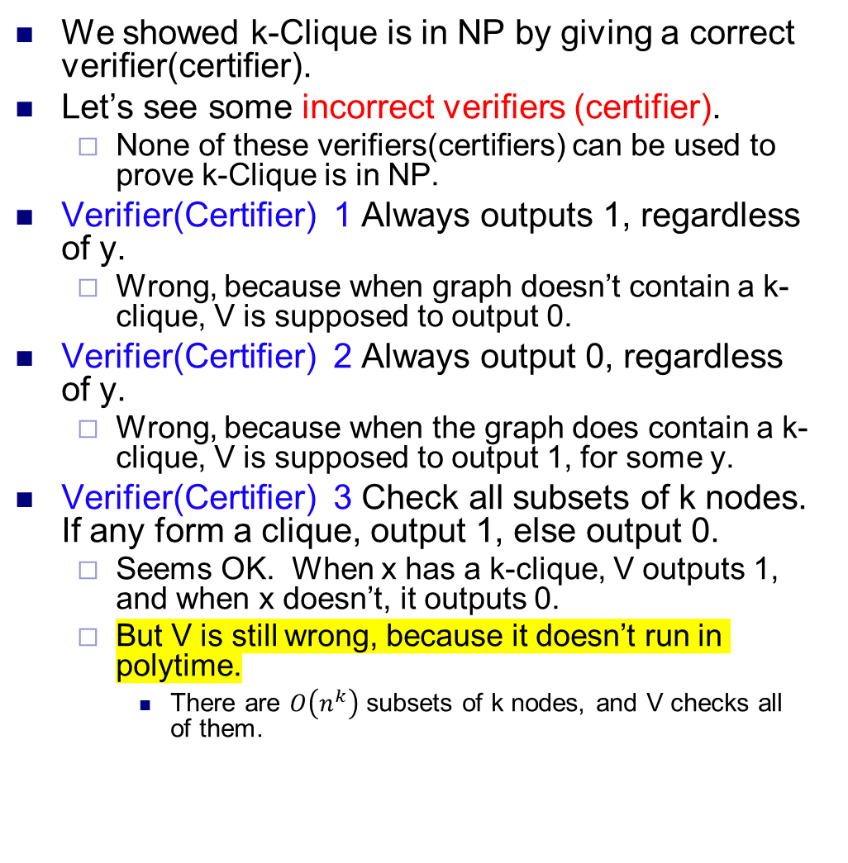
Incorrect verifiers(certifiers)
We showed k-Clique is in NP by giving a correct verifier(certifier).
Let’s see some incorrect verifiers (certifier).
None of these verifiers(certifiers) can be used to prove k-Clique is in NP.
Verifier(Certifier) 1 Always outputs 1, regardless of y.
Wrong, because when graph doesn’t contain a k-clique, V is supposed to output 0.
Verifier(Certifier) 2 Always output 0, regardless of y.
Wrong, because when the graph does contain a k-clique, V is supposed to output 1, for some y.
Verifier(Certifier) 3 Check all subsets of k nodes. If any form a clique, output 1, else output 0.
Seems OK. When x has a k-clique, V outputs 1, and when x doesn’t, it outputs 0.
But V is still wrong, because it doesn’t run in polytime.
There are $O\left(n^{k}\right)$ subsets of k nodes, and V checks all of them.

Slide 17
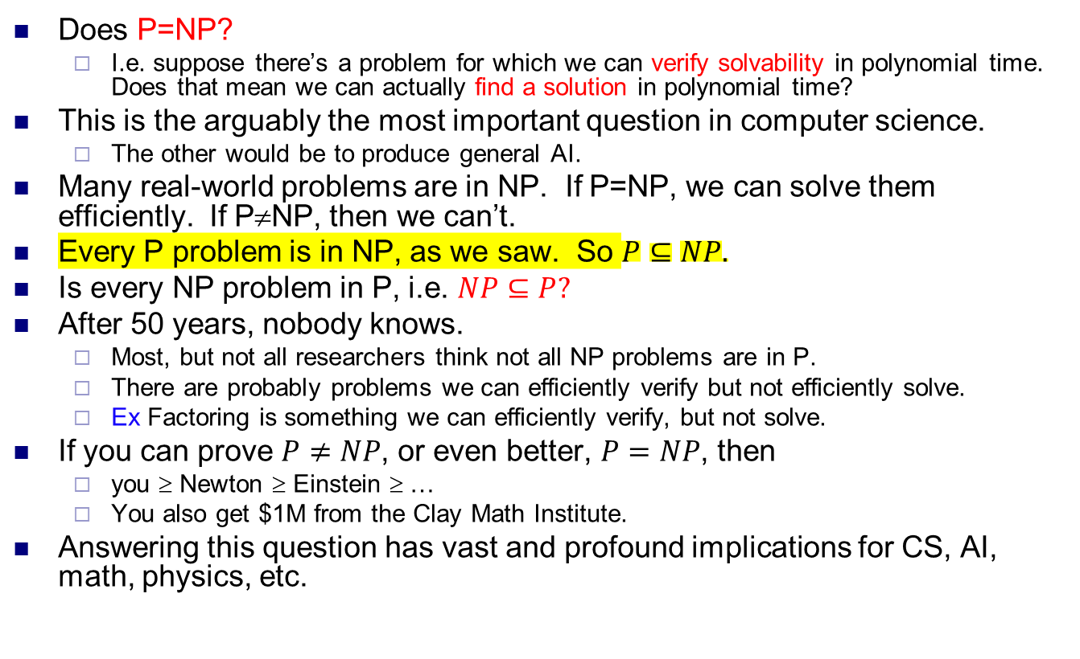
P vs NP
Does P=NP?
I.e. suppose there’s a problem for which we can verify solvability in polynomial time. Does that mean we can actually find a solution in polynomial time?
This is the arguably the most important question in computer science.
The other would be to produce general AI.
Many real-world problems are in NP. If P=NP, we can solve them efficiently. If P≠NP, then we can’t.
Every P problem is in NP, as we saw. So $P⊆NP.$
Is every NP problem in P, i.e. $NP⊆P?$
After 50 years, nobody knows.
Most, but not all researchers think not all NP problems are in P.
There are probably problems we can efficiently verify but not efficiently solve.
Ex Factoring is something we can efficiently verify, but not solve.
If you can prove $P≠NP$, or even better, $P=NP$, then
you ≥ Newton ≥ Einstein ≥ …
You also get $1M from the Clay Math Institute.
Answering this question has vast and profound implications for CS, AI, math, physics, etc.

Slide 18
NP-completeness
Out of all the NP problems, there’s a subset of NP problems called NP-complete (NPC) problems that are the “hardest” NP problems.
To determine whether P=NP, it suffices to know whether P=NPC.
If the hardest problems can be solved in polytime, then all NP problems can be solved in polytime. I.e. P=NP.
So the study of P vs NP focuses on NPC problems.

Slide 19
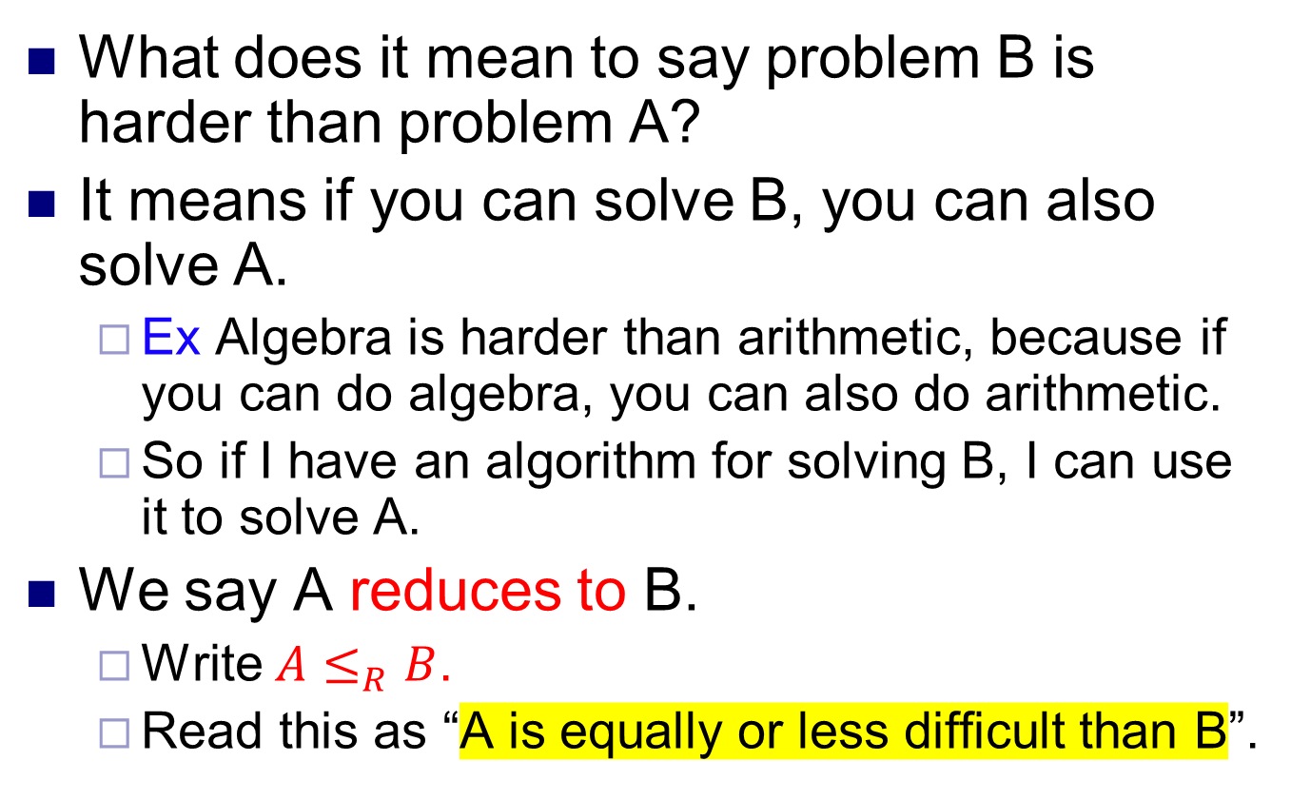
Hardness and reductions
What does it mean to say problem B is harder than problem A?
It means if you can solve B, you can also solve A.
Ex Algebra is harder than arithmetic, because if you can do algebra, you can also do arithmetic.
So if I have an algorithm for solving B, I can use it to solve A.
We say A reduces to B.
Write $A≤_{R}B$.
Read this as “A is equally or less difficult than B”.

Slide 20
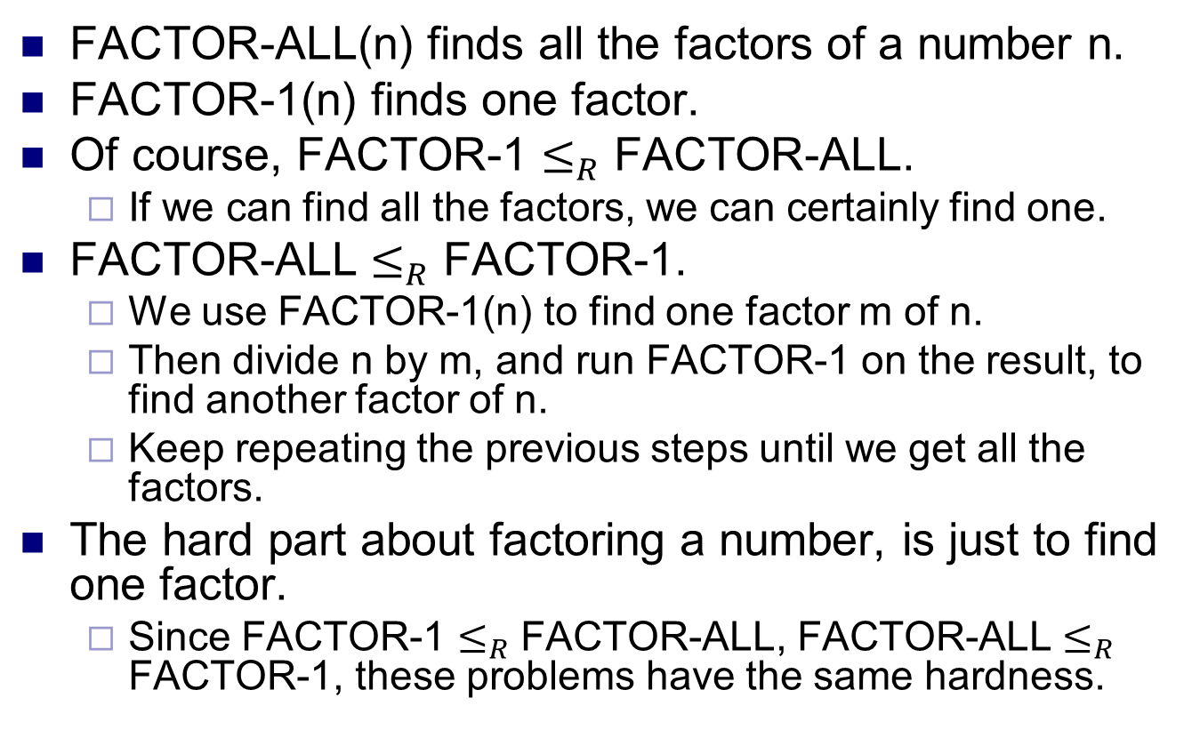
Example
FACTOR-ALL(n) finds all the factors of a number n.
FACTOR-1(n) finds one factor.
Of course, FACTOR-1 $≤_{R}$ FACTOR-ALL.
If we can find all the factors, we can certainly find one.
FACTOR-ALL $≤_{R}$ FACTOR-1.
We use FACTOR-1(n) to find one factor m of n.
Then divide n by m, and run FACTOR-1 on the result, to find another factor of n.
Keep repeating the previous steps until we get all the factors.
The hard part about factoring a number, is just to find one factor.
Since FACTOR-1 $≤_{R}$ FACTOR-ALL, FACTOR-ALL $≤_{R}$ FACTOR-1, these problems have the same hardness.

Slide 21
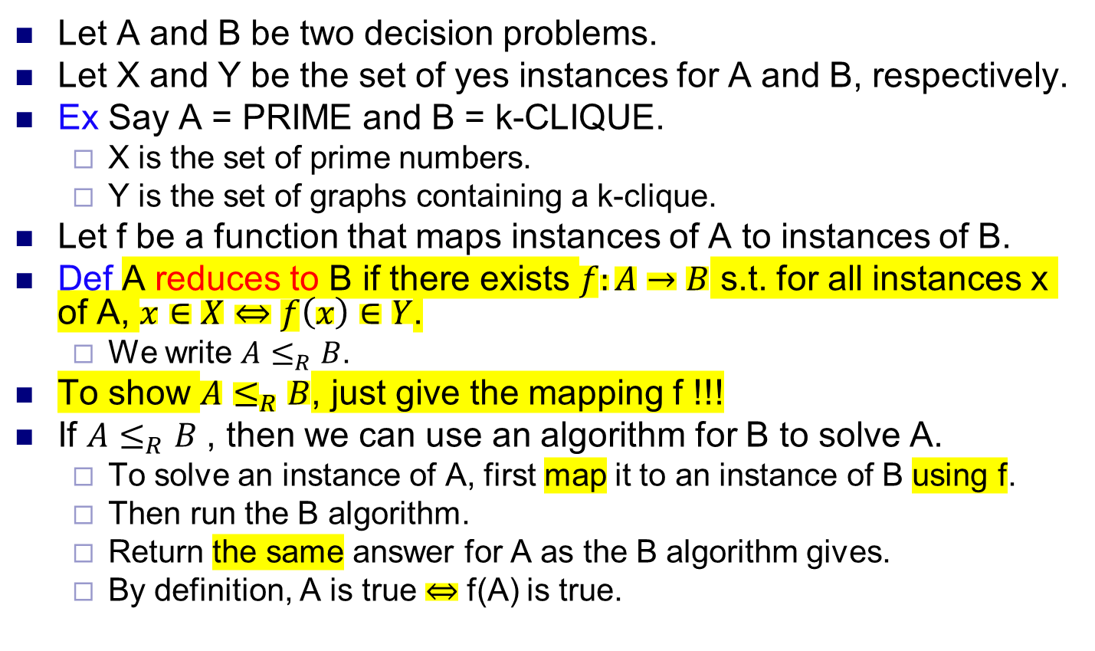
Reductions, formally
Let A and B be two decision problems.
Let X and Y be the set of yes instances for A and B, respectively.
Ex Say A = PRIME and B = k-CLIQUE.
X is the set of prime numbers.
Y is the set of graphs containing a k-clique.
Let f be a function that maps instances of A to instances of B.
Def A reduces to B if there exists $f:A→B$ s.t. for all instances x of A, $x∈X⇔f\left(x\right)∈Y$.
We write $A≤_{R}B$.
To show $A≤_{R}B$, just give the mapping f !!!
If $A≤_{R}B$, then we can use an algorithm for B to solve A.
To solve an instance of A, first map it to an instance of B using f.
Then run the B algorithm.
Return the same answer for A as the B algorithm gives.
By definition, A is true $⇔$ f(A) is true.

Slide 22
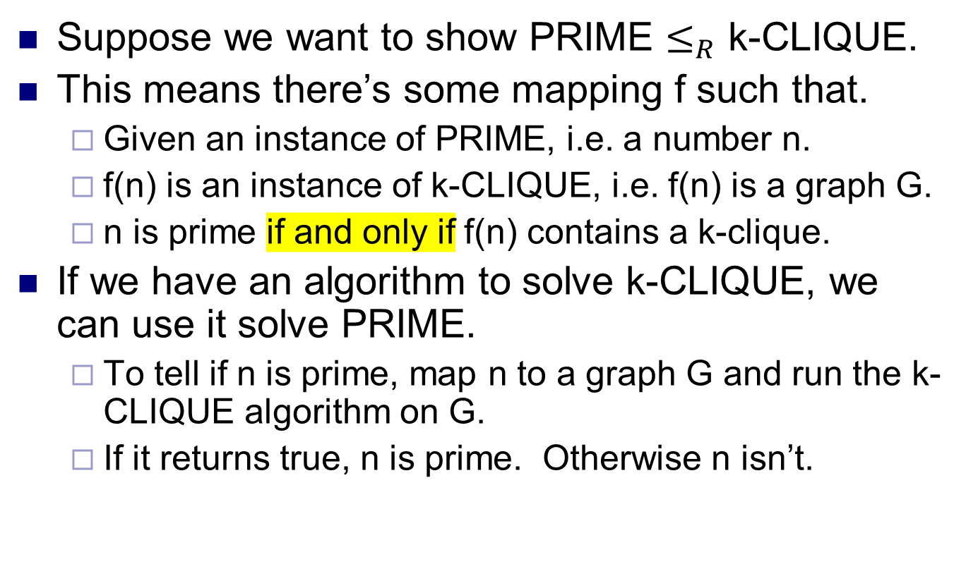
Example
Suppose we want to show PRIME $≤_{R}$ k-CLIQUE.
This means there’s some mapping f such that.
Given an instance of PRIME, i.e. a number n.
f(n) is an instance of k-CLIQUE, i.e. f(n) is a graph G.
n is prime if and only if f(n) contains a k-clique.
If we have an algorithm to solve k-CLIQUE, we can use it solve PRIME.
To tell if n is prime, map n to a graph G and run the k-CLIQUE algorithm on G.
If it returns true, n is prime. Otherwise n isn’t.

Slide 23
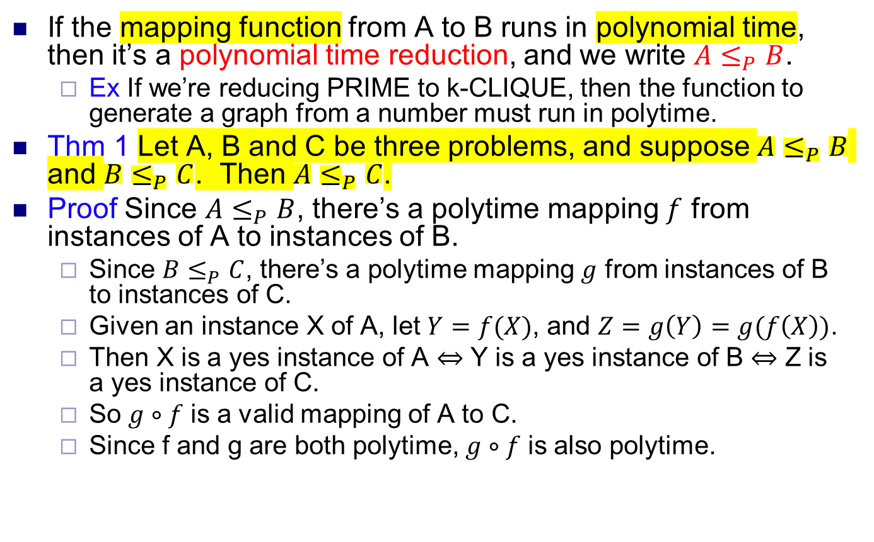
Polynomial time reductions
If the mapping function from A to B runs in polynomial time, then it’s a polynomial time reduction, and we write $A≤_{P}B$.
Ex If we’re reducing PRIME to k-CLIQUE, then the function to generate a graph from a number must run in polytime.
Thm 1 Let A, B and C be three problems, and suppose $A≤_{P}B$ and $B≤_{P}C$. Then $A≤_{P}C$.
Proof Since $A≤_{P}B$, there’s a polytime mapping $f$ from instances of A to instances of B.
Since $B≤_{P}C$, there’s a polytime mapping $g$ from instances of B to instances of C.
Given an instance X of A, let $Y=f(X)$, and $Z=g\left(Y\right)=g(f\left(X\right))$.
Then X is a yes instance of A $⇔$ Y is a yes instance of B $⇔$ Z is a yes instance of C.
So $g∘f$ is a valid mapping of A to C.
Since f and g are both polytime, $g∘f$ is also polytime.

Slide 24
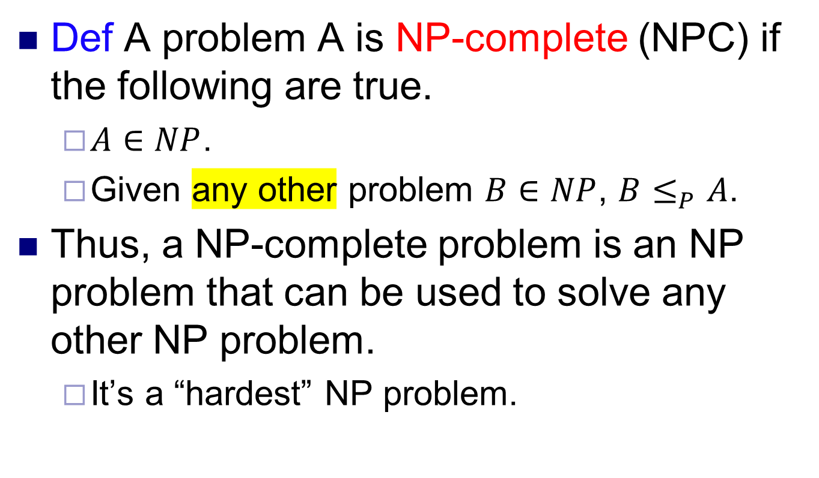
NP-completeness
Def A problem A is NP-complete (NPC) if the following are true.
$A∈NP$.
Given any other problem $B∈NP$, $B≤_{P}A$.
Thus, a NP-complete problem is an NP problem that can be used to solve any other NP problem.
It’s a “hardest” NP problem.

Slide 25
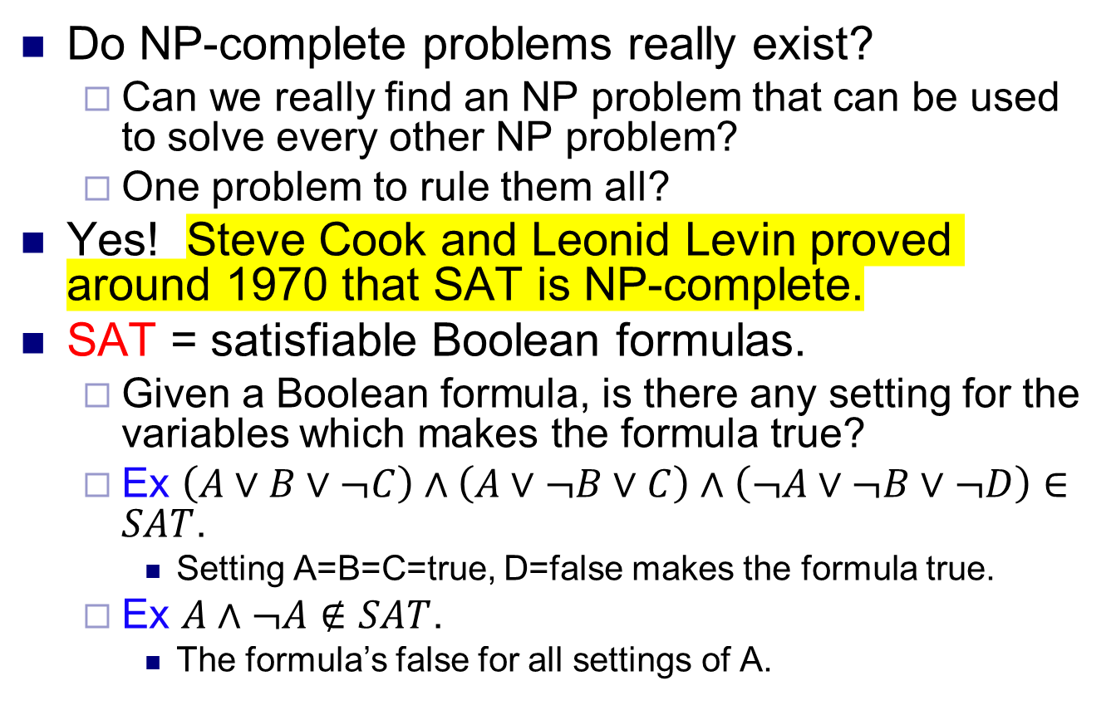
NP-completeness and SAT
Do NP-complete problems really exist?
Can we really find an NP problem that can be used to solve every other NP problem?
One problem to rule them all?
Yes! Steve Cook and Leonid Levin proved around 1970 that SAT is NP-complete.
SAT = satisfiable Boolean formulas.
Given a Boolean formula, is there any setting for the variables which makes the formula true?
Ex $\left(A∨B∨¬C\right)∧\left(A∨¬B∨C\right)∧\left(¬A∨¬B∨¬D\right)∈SAT$.
Setting A=B=C=true, D=false makes the formula true.
Ex $A∧¬A∉SAT$.
The formula’s false for all settings of A.

Slide 26
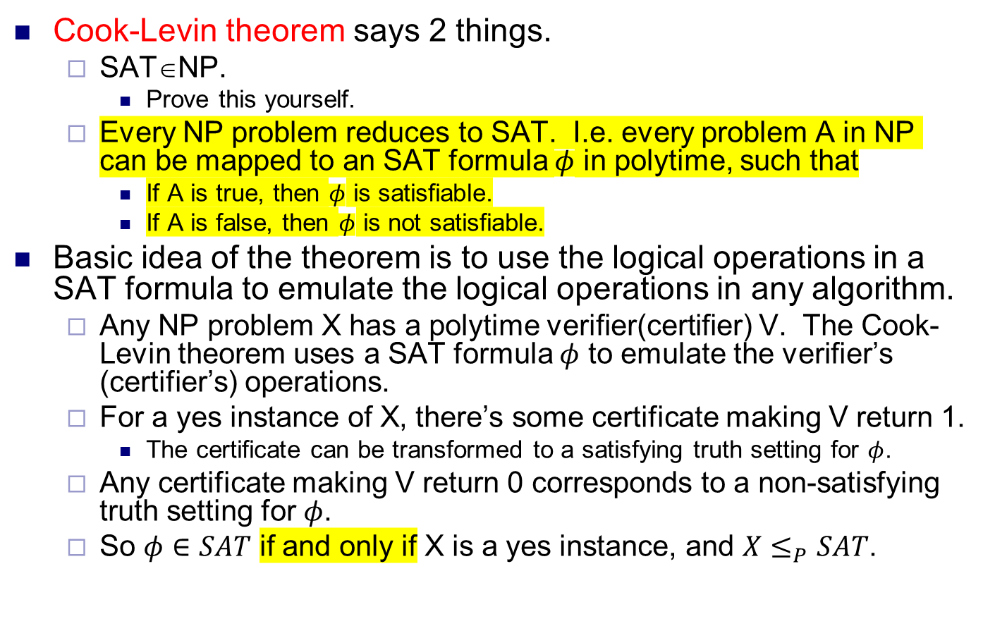
NP-completeness and SAT
Cook-Levin theorem says 2 things.
SAT∈NP.
Prove this yourself.
Every NP problem reduces to SAT. I.e. every problem A in NP can be mapped to an SAT formula $φ$ in polytime, such that
If A is true, then $φ$ is satisfiable.
If A is false, then $φ$ is not satisfiable.
Basic idea of the theorem is to use the logical operations in a SAT formula to emulate the logical operations in any algorithm.
Any NP problem X has a polytime verifier(certifier) V. The Cook-Levin theorem uses a SAT formula $φ$ to emulate the verifier’s (certifier’s) operations.
For a yes instance of X, there’s some certificate making V return 1.
The certificate can be transformed to a satisfying truth setting for $φ$.
Any certificate making V return 0 corresponds to a non-satisfying truth setting for $φ$.
So $φ∈SAT$ if and only if X is a yes instance, and $X≤_{P}SAT$.

Slide 27
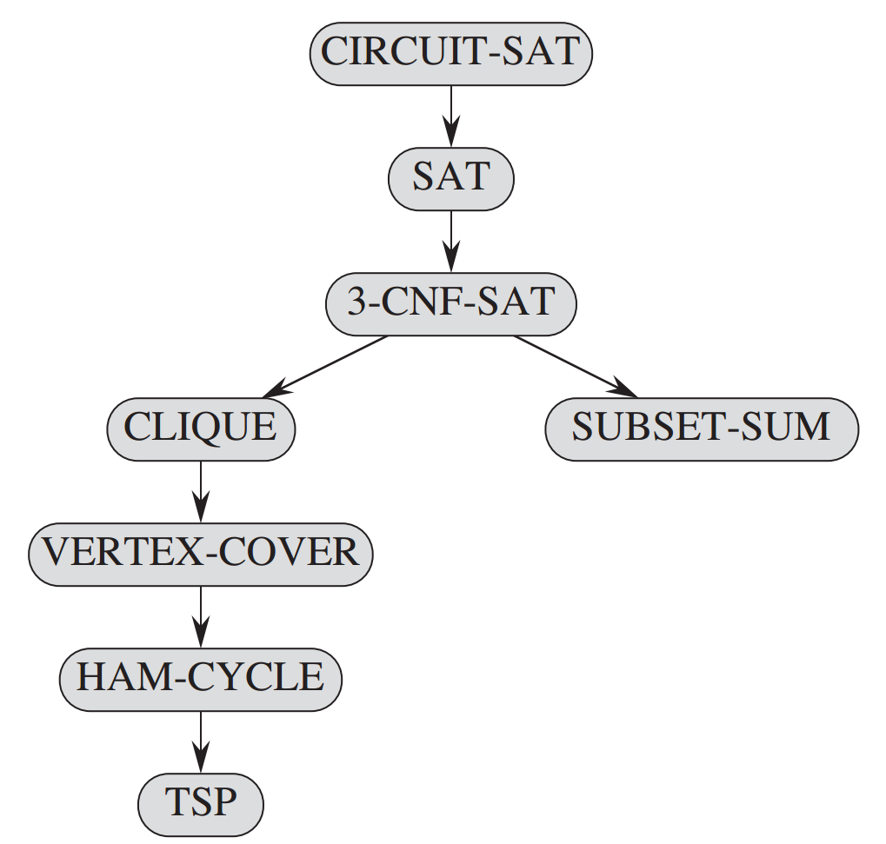
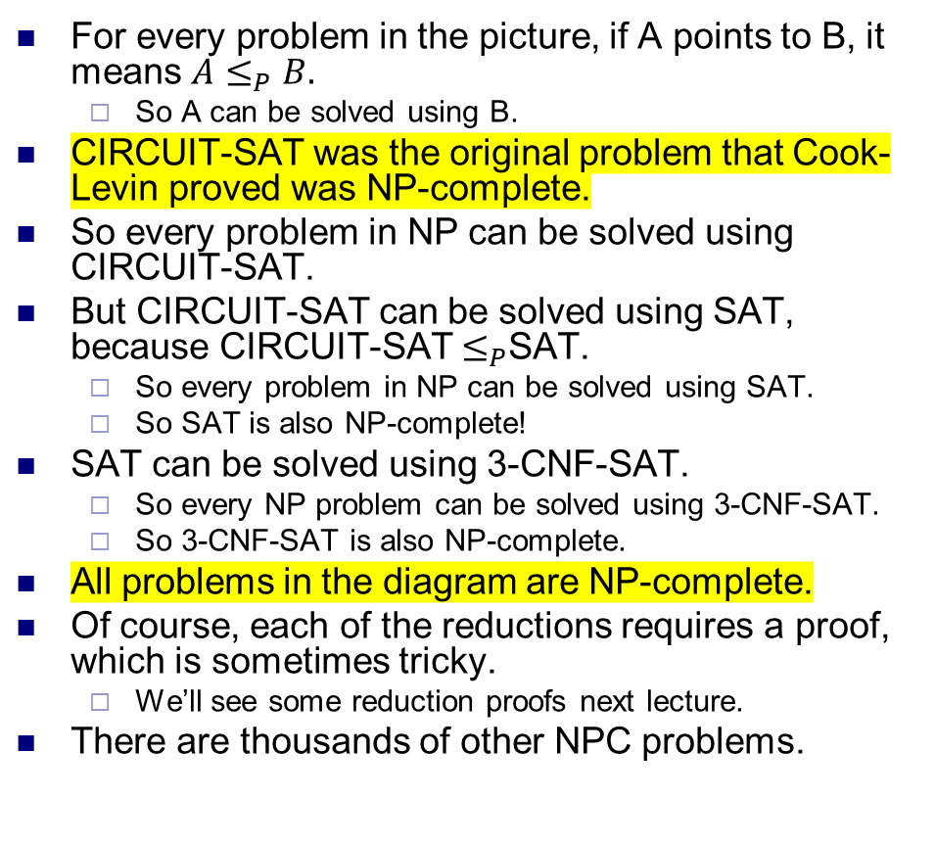
The web of NP-completeness
For every problem in the picture, if A points to B, it means $A≤_{P}B.$
So A can be solved using B.
CIRCUIT-SAT was the original problem that Cook-Levin proved was NP-complete.
So every problem in NP can be solved using CIRCUIT-SAT.
But CIRCUIT-SAT can be solved using SAT, because CIRCUIT-SAT $≤_{P}$SAT.
So every problem in NP can be solved using SAT.
So SAT is also NP-complete!
SAT can be solved using 3-CNF-SAT.
So every NP problem can be solved using 3-CNF-SAT.
So 3-CNF-SAT is also NP-complete.
All problems in the diagram are NP-complete.
Of course, each of the reductions requires a proof, which is sometimes tricky.
We’ll see some reduction proofs next lecture.
There are thousands of other NPC problems.

Slide 28
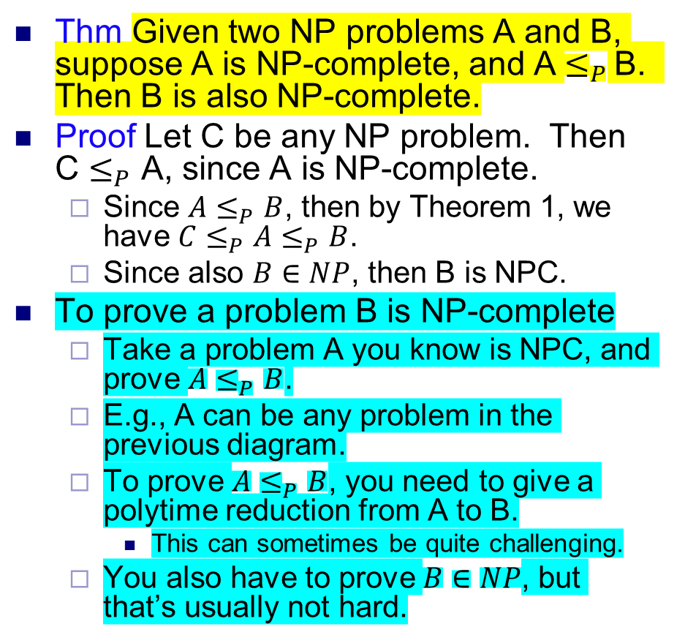
The web of NP-completeness
Thm Given two NP problems A and B, suppose A is NP-complete, and A $≤_{P}$ B. Then B is also NP-complete.
Proof Let C be any NP problem. Then C $≤_{P}$ A, since A is NP-complete.
Since $A≤_{P}B$, then by Theorem 1, we have $C≤_{P}A≤_{P}B$.
Since also $B∈NP$, then B is NPC.
To prove a problem B is NP-complete
Take a problem A you know is NPC, and prove $A≤_{P}B$.
E.g., A can be any problem in the previous diagram.
To prove $A≤_{P}B$, you need to give a polytime reduction from A to B.
This can sometimes be quite challenging.
You also have to prove $B∈NP$, but that’s usually not hard.
← Important!

Slide 29
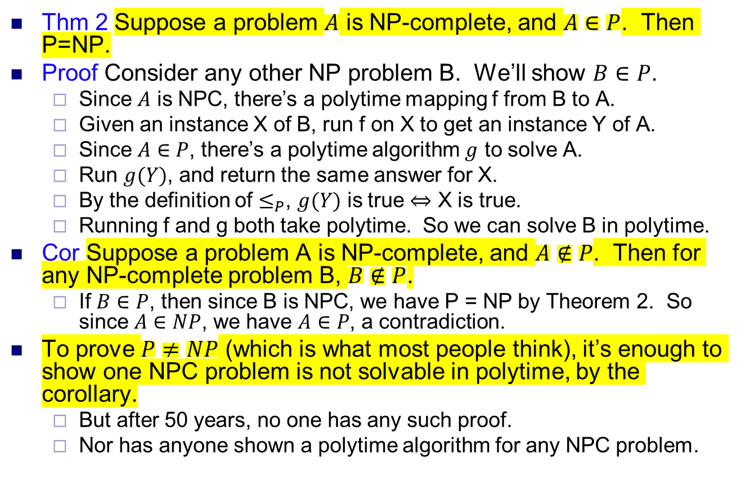
NP-completeness and P vs NP
Thm 2 Suppose a problem $A$ is NP-complete, and $A∈P$. Then P=NP.
Proof Consider any other NP problem B. We’ll show $B∈P$.
Since $A$ is NPC, there’s a polytime mapping f from B to A.
Given an instance X of B, run f on X to get an instance Y of A.
Since $A∈P$, there’s a polytime algorithm $g$ to solve A.
Run $g(Y)$, and return the same answer for X.
By the definition of $≤_{P}$, $g(Y)$ is true $⇔$ X is true.
Running f and g both take polytime. So we can solve B in polytime.
Cor Suppose a problem A is NP-complete, and $A∉P$. Then for any NP-complete problem B, $B∉P$.
If $B∈P$, then since B is NPC, we have P = NP by Theorem 2. So since $A∈NP$, we have $A∈P$, a contradiction.
To prove $P≠NP$ (which is what most people think), it’s enough to show one NPC problem is not solvable in polytime, by the corollary.
But after 50 years, no one has any such proof.
Nor has anyone shown a polytime algorithm for any NPC problem.

Slide 30
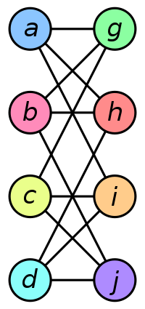
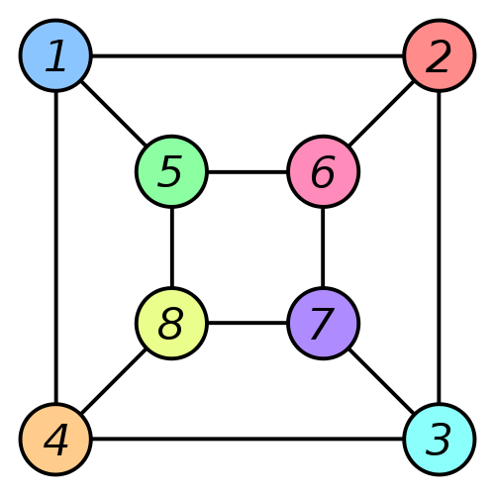
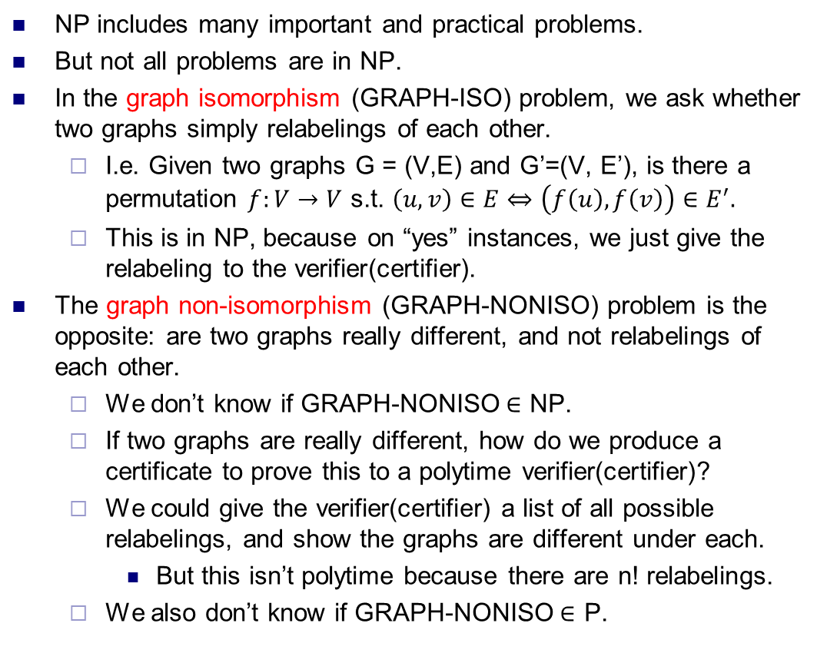
Beyond NP
NP includes many important and practical problems.
But not all problems are in NP.
In the graph isomorphism (GRAPH-ISO) problem, we ask whether two graphs simply relabelings of each other.
I.e. Given two graphs G = (V,E) and G’=(V, E’), is there a permutation $f:V→V$ s.t. $\left(u,v\right)∈E⇔\left(f\left(u\right),f\left(v\right)\right)∈E^{′}.$
This is in NP, because on “yes” instances, we just give the relabeling to the verifier(certifier).
The graph non-isomorphism (GRAPH-NONISO) problem is the opposite: are two graphs really different, and not relabelings of each other.
We don’t know if GRAPH-NONISO$∈$ NP.
If two graphs are really different, how do we produce a certificate to prove this to a polytime verifier(certifier)?
We could give the verifier(certifier) a list of all possible relabelings, and show the graphs are different under each.
But this isn’t polytime because there are n! relabelings.
We also don’t know if GRAPH-NONISO$∈$ P.

Slide 31
More complexity classes
co-NP All problems whose “complement” is in NP.
E.g. GRAPH-ISO∈NP, so GRAPH-NONISO∈co-NP.
PSPACE All problems whose computation takes polynomial amount of space.
Includes all problems in P.
EXPTIME All problems whose computation takes at most exponential amount of time.
Includes all problems in P and NP.
NEXPTIME All problems whose correct answer can be verified in at most exponential amount of time.
NEXPTIME is to EXPTIME what NP is to P.
Each of these is called a complexity class.
Many, many other complexity classes, some very obscure.
“Complexity zoo”: https://complexityzoo.uwaterloo.ca/Complexity_Zoo

Slide 32
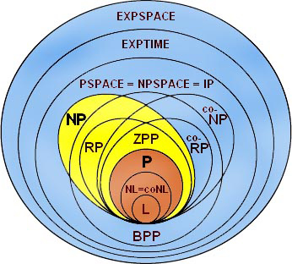
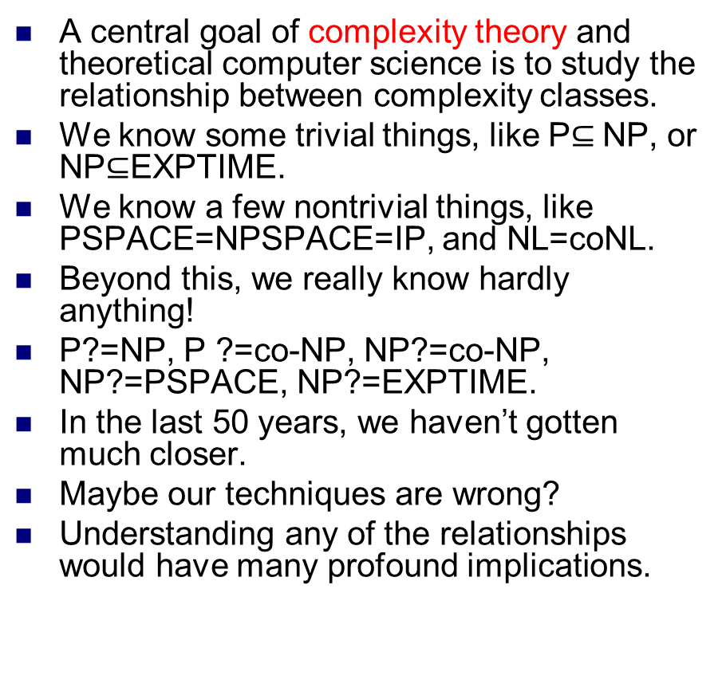
Complexity theory
A central goal of complexity theory and theoretical computer science is to study the relationship between complexity classes.
We know some trivial things, like P$⊆$NP, or NP$⊆$EXPTIME.
We know a few nontrivial things, like PSPACE=NPSPACE=IP, and NL=coNL.
Beyond this, we really know hardly anything!
P?=NP, P ?=co-NP, NP?=co-NP, NP?=PSPACE, NP?=EXPTIME.
In the last 50 years, we haven’t gotten much closer.
Maybe our techniques are wrong?
Understanding any of the relationships would have many profound implications.

