Slide 1
Tutorial of Bonus 2
Sifan Wang

Slide 2
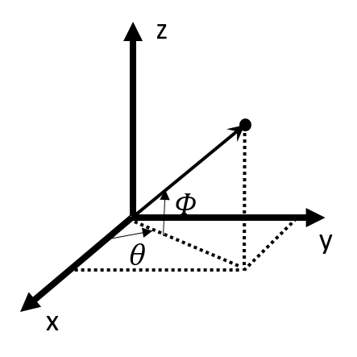
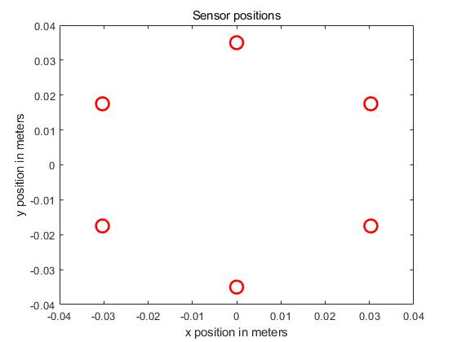
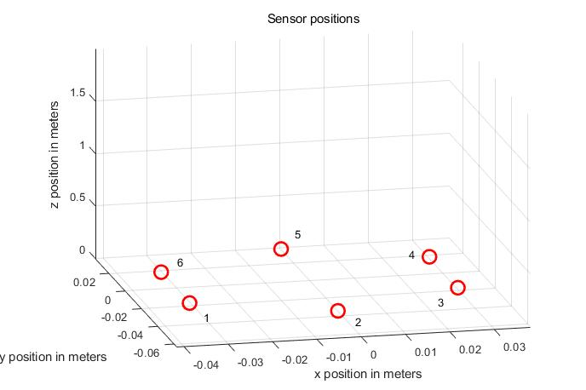
Circular array
θ

Slide 3
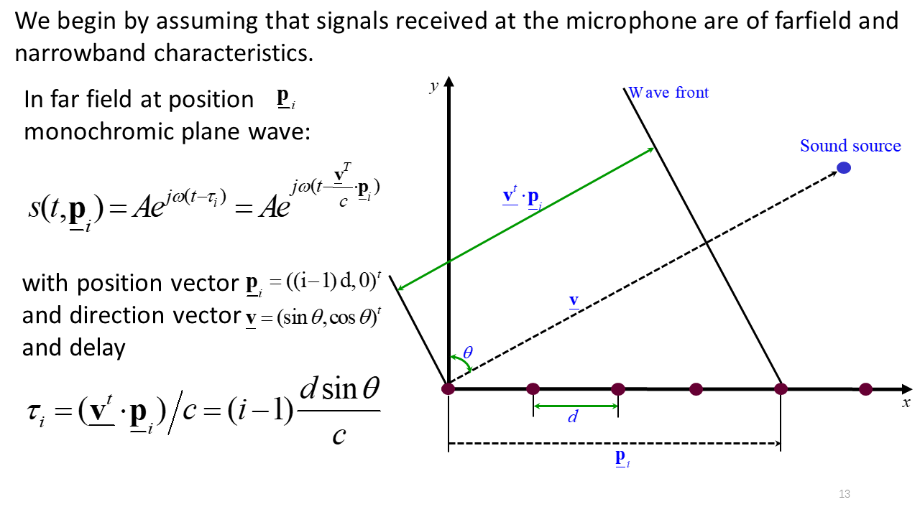
Recall linear array
-

Slide 4
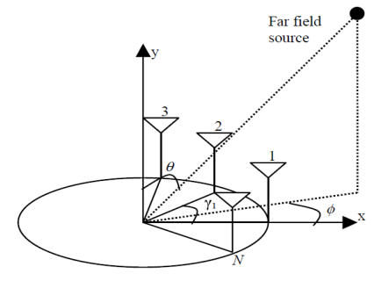
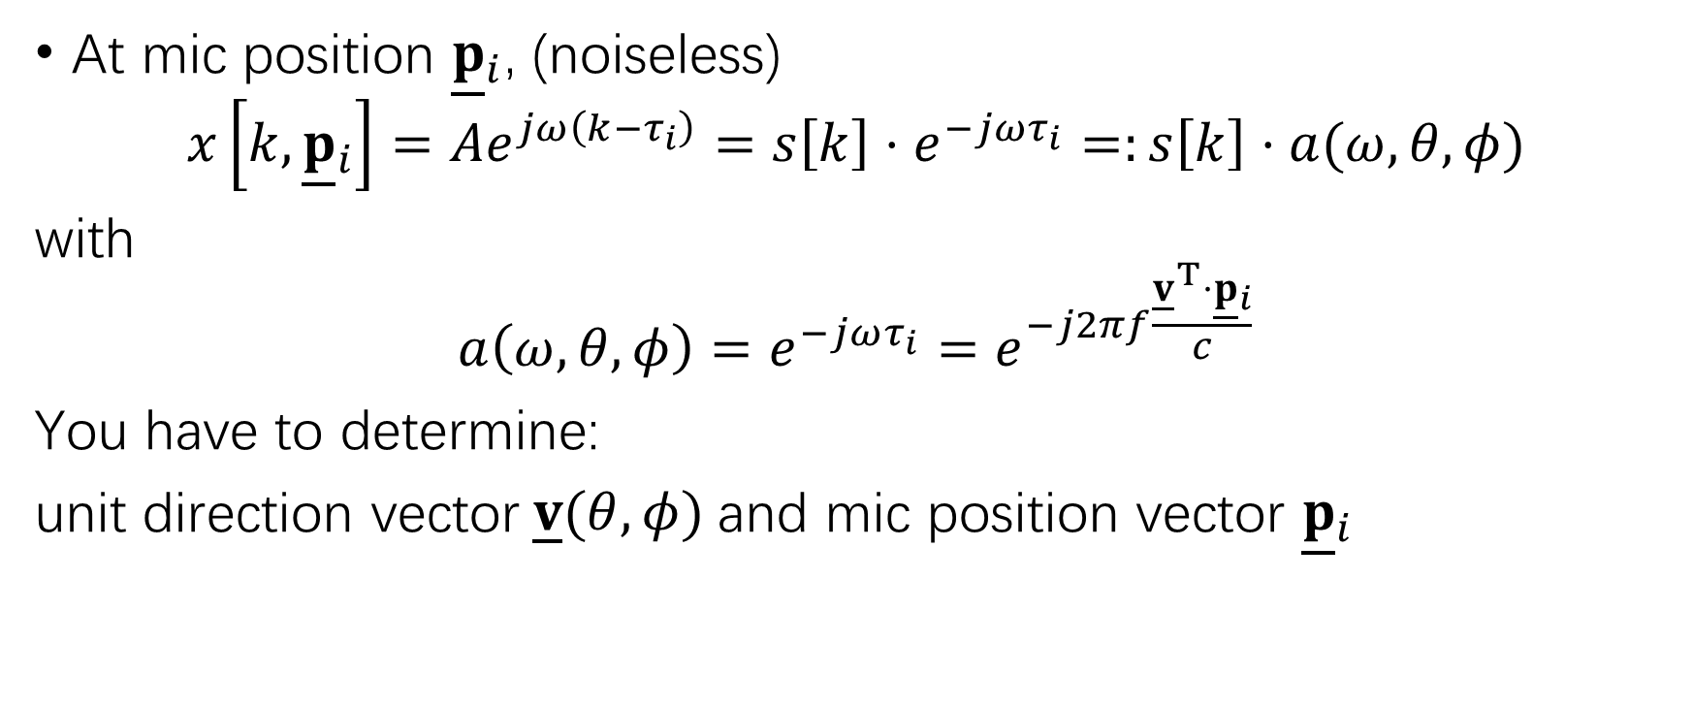
Circular array
At mic position ${\underline{p}}_{i}$, (noiseless)
$$x\left[k,{\underline{p}}_{i}\right]=Ae^{jω\left(k−τ_{i}\right)}=s\left[k\right]⋅e^{−jωτ_{i}}=:s\left[k\right]⋅a(ω,θ,φ)$$
with
$$a\left(ω,θ,φ\right)=e^{−jωτ_{i}}=e^{−j2πf\frac{{\underline{v}}^{T}{⋅\underline{p}}_{i}}{c}}$$
You have to determine:
unit direction vector$\underline{v}(θ,φ)$and mic position vector ${\underline{p}}_{i}$

Slide 5
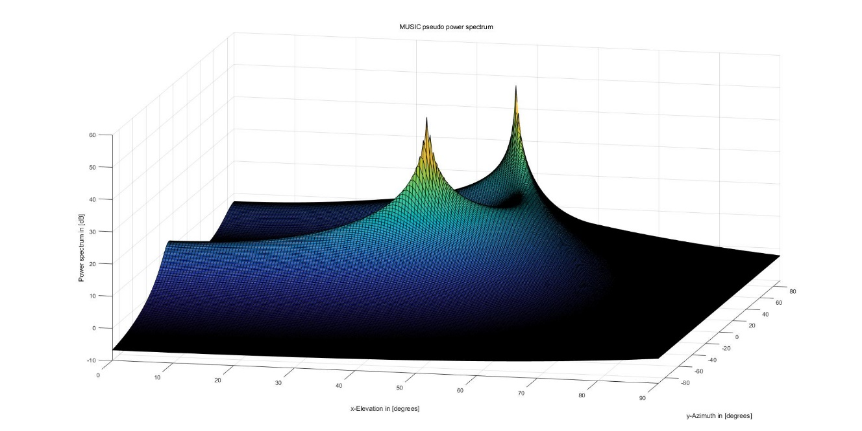

2D MUSIC algorithm
$$X = A s +n$$
$${\hat{R}}_{x}=\frac{1}{N}\sum_{k=1}^{N}{\underline{x}\left[k\right]{\underline{x}}^{h}\left[k\right]}$$
$$P_{music}\left(θ,φ\right)=\frac{1}{{\underline{a}}^{h}\left(θ,φ\right)U_{n}U_{n}^{h}\underline{a}\left(θ,φ\right)}$$

