Slide 1
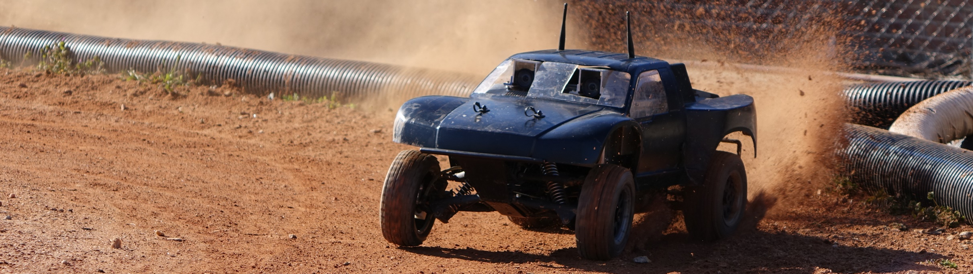
Autonomous RC (ARC)
Cierra Shawe, Tao Chen, Daniel Stoyer
Figure 1
Figure 1: image from https://autorally.github.io/
Notes:
Depends on how intelligent our system is: like a human driving a car doesn’t need to understand the steering ratio of the car. If the turning angle is too small, a human would just apply more steering. That requires a more sophisticated system.

Slide 2
Introduction
Winter Progress Report

Slide 3
Introduction
The purpose of the Autonomous RC (ARC) project is to determine if it is possible to build an autonomous RC vehicle using commodity components, meaning components that are relatively inexpensive and can be bought at places like Radio Shack®, Best Buy®, or on Amazon®.

Slide 4
Introduction
Our goal is to make an RC vehicle navigate autonomous to a given waypoint/location, preferably at a high rate of speed. Stretch goals are to make the vehicle drift around corners and parallel park.

Slide 5
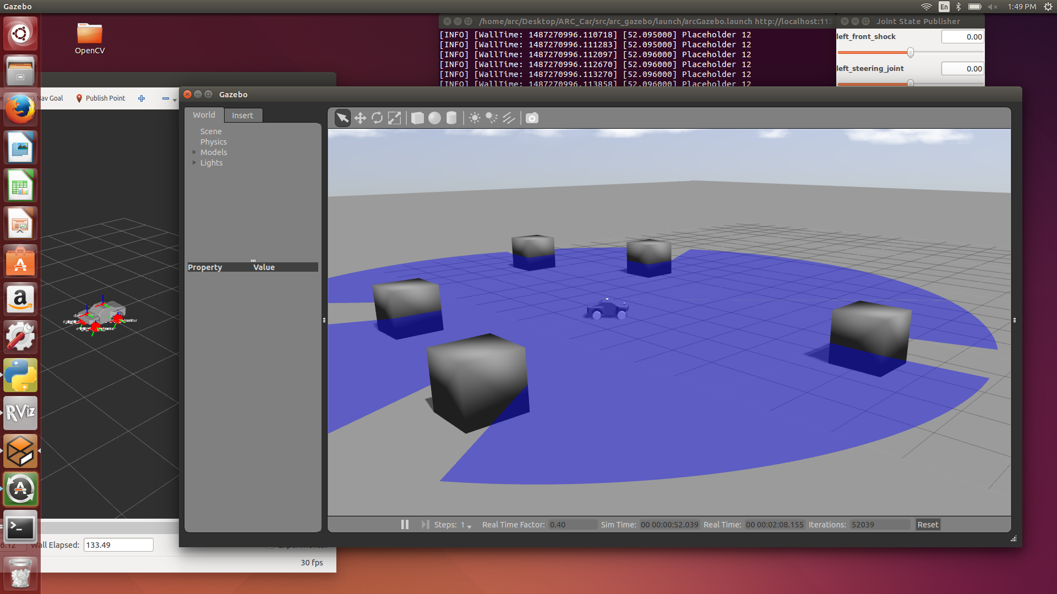
Simulation on Ros -Tao

Slide 6
Simulation on Ros -Tao
What simulation can do?
Visualization
Experimentation.
Testing

Slide 7
Simulation on Ros -Tao
Why simulation?
Makes development go faster.
Can avoid potential hazard.
Makes it easier for testing.
AutoRally already has a huge amount of code that we can use.

Slide 8
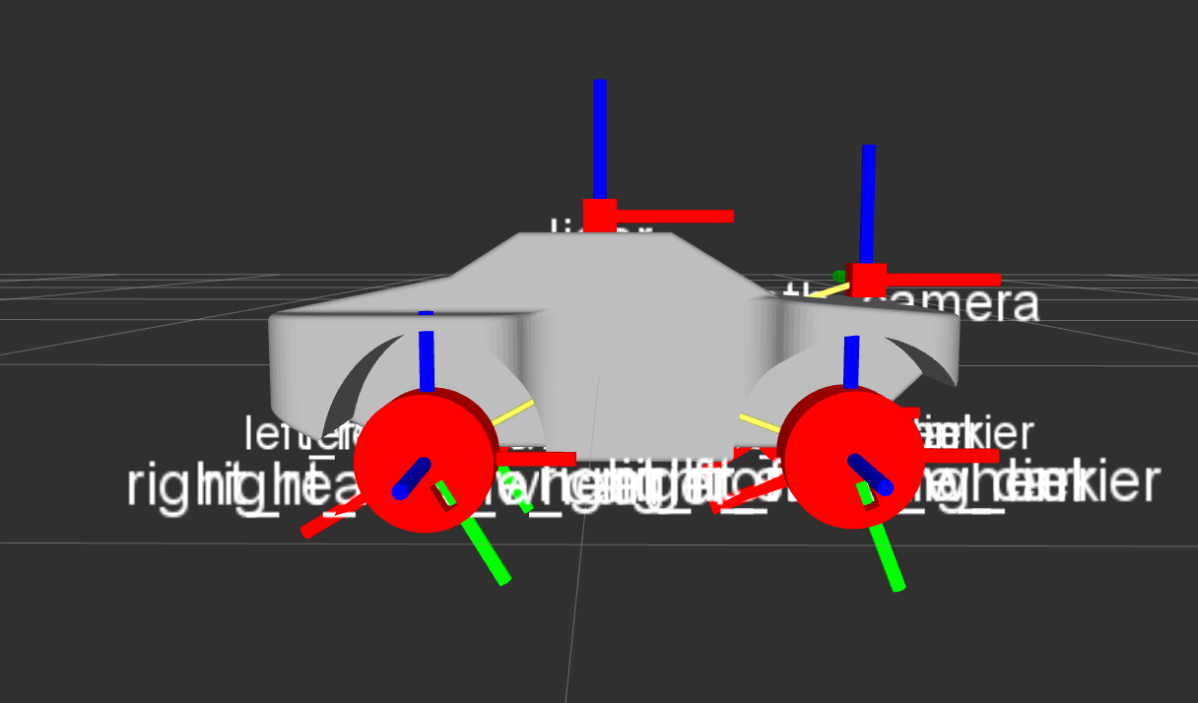
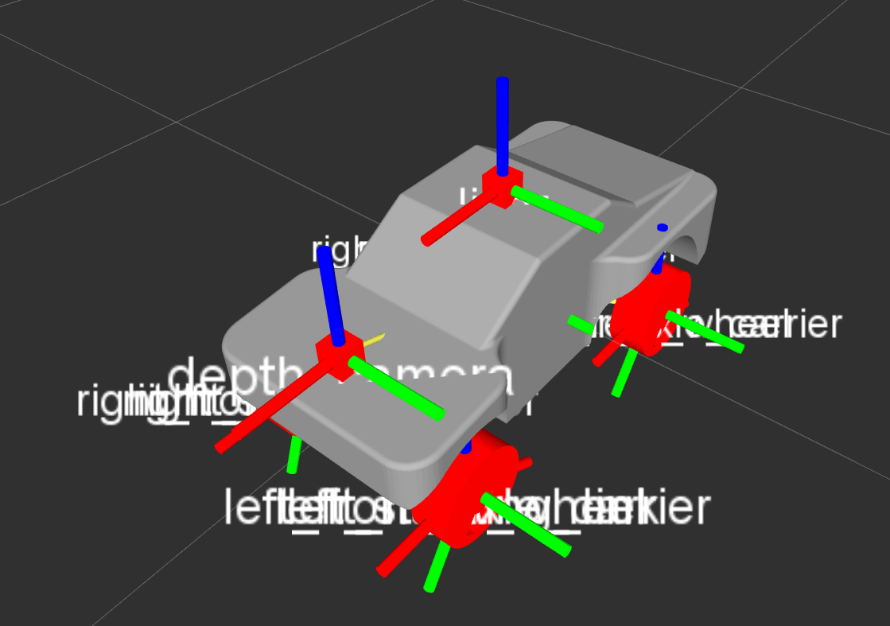
Simulation on Ros -Tao
The URDF model being displayed on Rviz

Slide 9
Simulation on Ros -Tao
Next
I need to get the car moving without using a controller
Integrate the state estimator, the waypoint follower and the constant speed controller from AutoRally.
Setup simple obstacle avoidance.

Slide 10
Dan

Slide 11
Cierra

