Slide 1
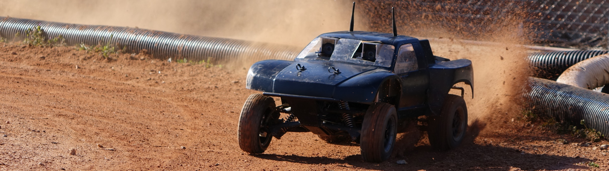
Autonomous RC (ARC)
Cierra Shawe, Tao Chen, Daniel Stoyer
Figure 1
Figure 1: image from https://autorally.github.io/
Notes:
Depends on how intelligent our system is: like a human driving a car doesn’t need to understand the steering ratio of the car. If the turning angle is too small, a human would just apply more steering. That requires a more sophisticated system.

Slide 2
Introduction
Winter Progress Report

Slide 3
Introduction
The purpose of the Autonomous RC (ARC) project is to determine if it is possible to build an autonomous RC vehicle using commodity components, meaning components that are relatively inexpensive and can be bought at places like Radio Shack®, Best Buy®, or on Amazon®.

Slide 4
Introduction
Our goal is to make an RC vehicle navigate autonomous to a given waypoint/location, preferably at a high rate of speed. Stretch goals are to make the vehicle drift around corners and parallel park.

Slide 5
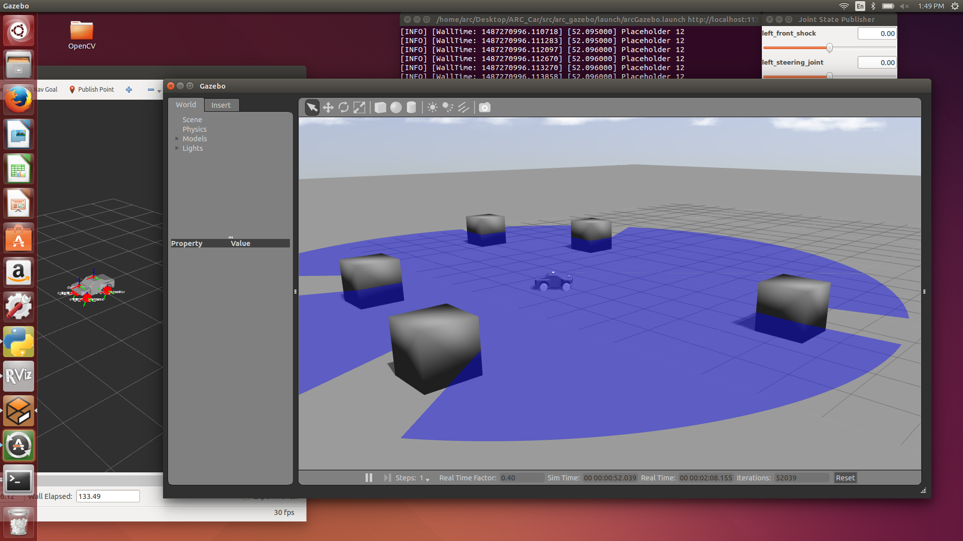
Simulation on Ros -Tao

Slide 6
Simulation on Ros -Tao
What simulation can do?
Visualization
Experimentation.
Testing

Slide 7
Simulation on Ros -Tao
Why simulation?
Makes development go faster.
Can avoid potential hazard.
Makes it easier for testing.
AutoRally already has a huge amount of code that we can use.

Slide 8
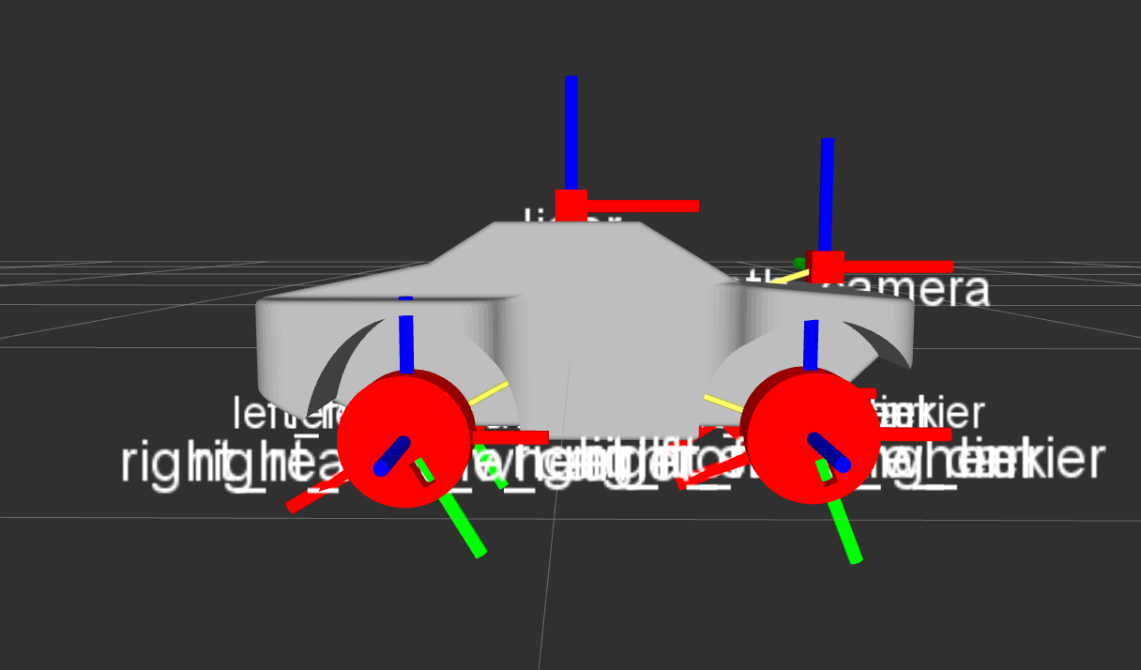
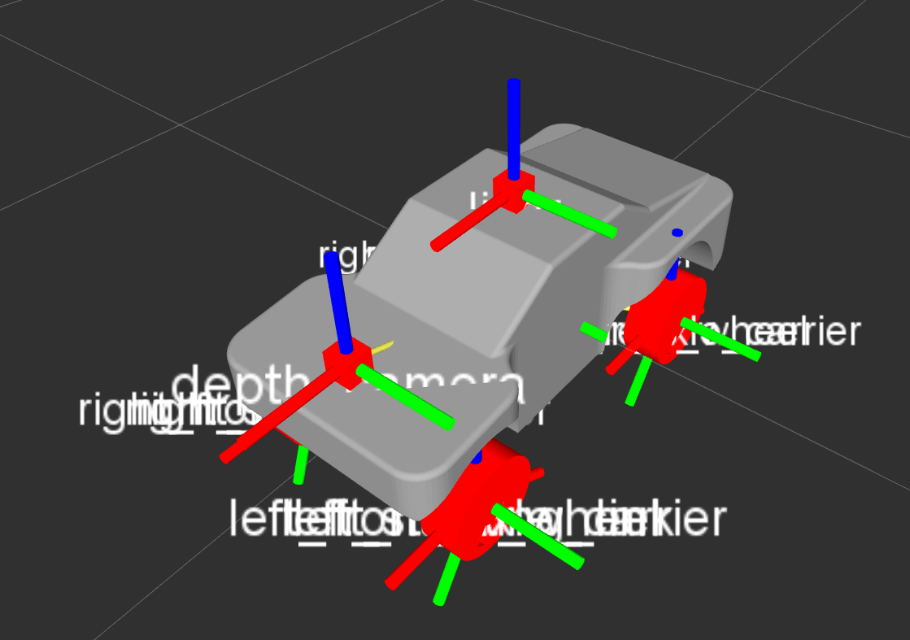
Simulation on Ros -Tao
The URDF model being displayed on Rviz

Slide 9
Simulation on Ros -Tao
Next
I need to get the car moving without using a controller
Integrate the state estimator, the waypoint follower and the constant speed controller from AutoRally.
Setup simple obstacle avoidance.

Slide 10
Environment Set Up - Dan
Computers to talking to each other directly over Ethernet.
Autopilot (Rasberry Pi 3 (RPi3) and PXFmini) talking with other computers.
ROS publisher/subscriber functionality.
PXFmini launched and armed!
RPi3 connected to the internet.

Slide 11
ROS publishing/subscribing - Dan
Ran python script publishing to a ROS topic.
Command line execution publishing and subscribing to ROS topics. ROS publisher/subscriber functionality.
ROS publisher/subscriber functionality.

Slide 12
AutoPilot (PXFmini)- Dan
Installed Erle image for Raspberry Pi 3
Delayed due to manufacturer.
First image was corrupted.
Took several attempts to correctly install.

Slide 13
AutoPilot (PXFmini)- Dan
Launches and Arms!
Sends IMU data.
Still need to get motors working.

Slide 14
What’s Next?- Dan
Now that our environment is nearly set up, I will start focusing on:
Image analysis
Use the information from Tao’s simulation work to start testing our environment mapping module.
Radio Communication
Transmit telemetry to our GCS and send commands to the RPi3
User Interface
Install a GUI for vehicle control (ArduPilot/QGroundControl) on the GCS.
Create custom python scripts for commands we will need to execute on a CLI.
Integrate all of the above to work toward autonomous RC navigation.

Slide 15
Cierra

