Slide 1
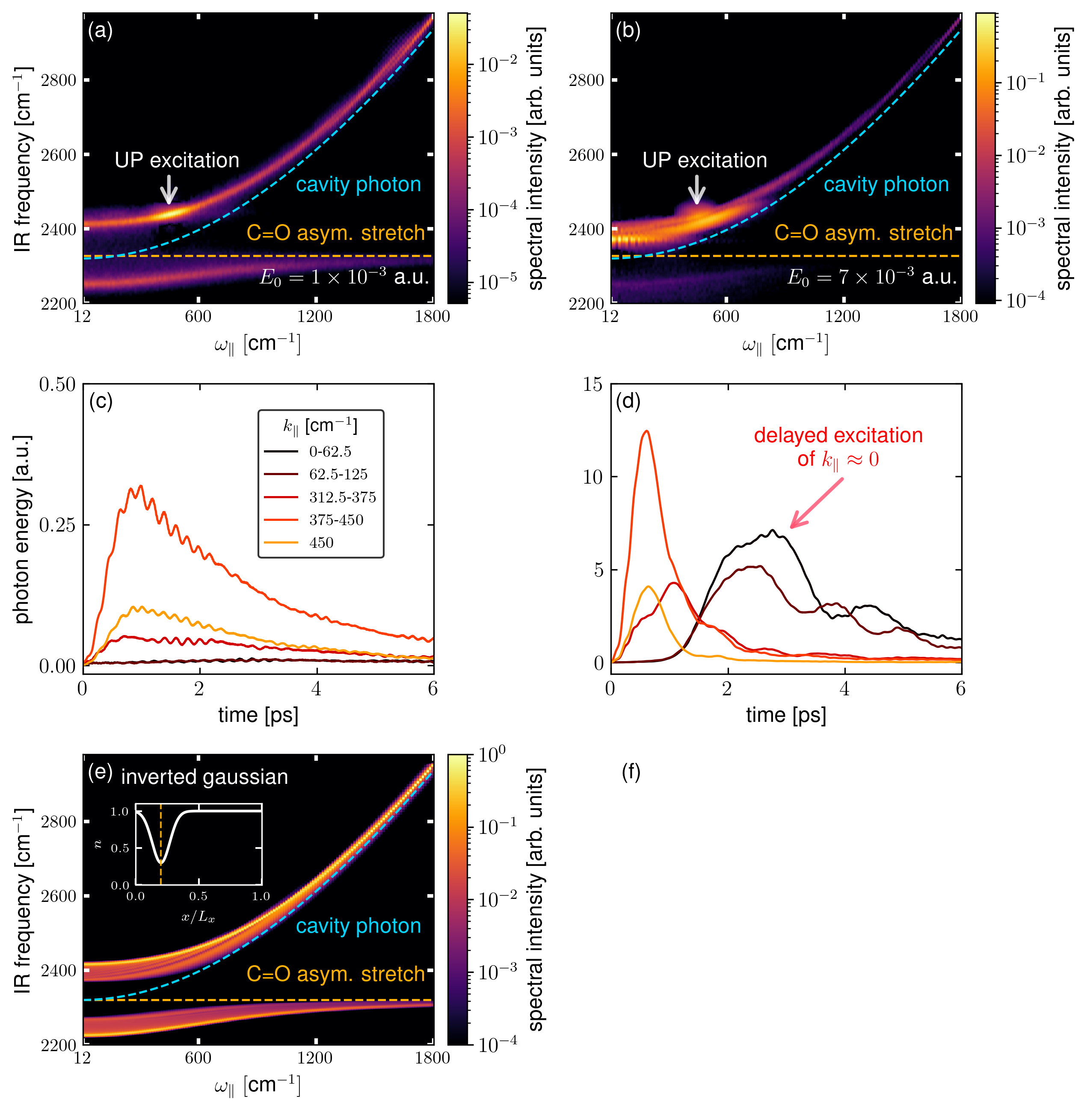

polariton
scattering
weak pumping
UP
decay to
dark states
IR frequency [cm⁻¹]
polariton
scattering
strong pumping
...
...
UP
decay to
dark states
$ω_{∥}$ [cm⁻¹]

