Slide 1
STFOYP
Benson Chien, Tao Jiang, John Hedrick

Slide 2
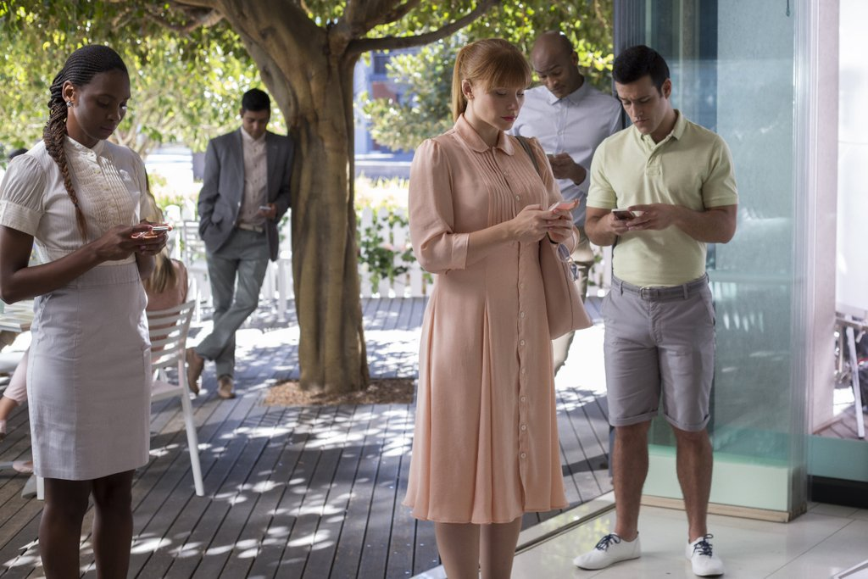
The Problem:
On average millennials are using their phones for 2-3 hours daily. Which is over 80 hours a month and 40 days in a year!
What are the reasons for this?
  Social media apps
  Mobile games
  Entertainment apps

Slide 3
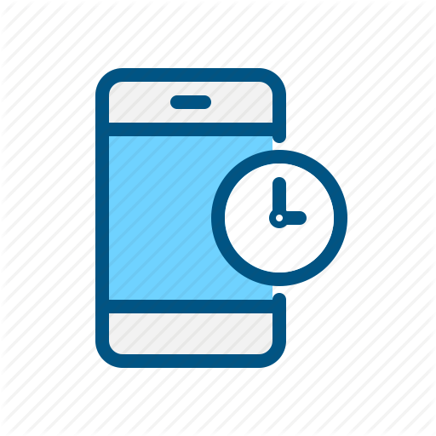
Solution:
How do we fix it?
  Keep users away from their damn phones!
We came up with an app that discourages and forces people from using their phone when used excessively.

Slide 4

STFOYP Feature #1
Built in timer for each app, that will cumulatively record how much time a user uses a certain app during a 24 hours period. Once the clock runs out, the app will be disabled until the end of the day.
The timer can be changed to user’s preference (e.g. 2 hours, 1 hour, 30 minutes, 15 minutes).

Slide 5

STFOYP Feature #2
Optional savage mode: Send messages to users that may or may not make them feel bad about their lives.
  Ex: Your current time spent on Netflix is 1 hour and 15 minutes today. You could be at the gym...getting fit...Just an idea!

Slide 6

STFOYP Feature #3
There will be a 5 second warning before the app shuts down.
The user can select which app they want have a a restriction set.
Parents mode

Slide 7
Marketing
Show statistics of phone usage and the health issues it can cause.
For people that want to reduce time spent on their phone. Free up time for other obligations and activities.
Spread the word on social media. (e.g. Facebook, reddit, etc.)

Slide 8
Target Market
This app is suitable for everyone who wants to use their time more productively in general.
It would be a great tool for parents to keep their kids from spending too much time on phones.
Good for students, teenagers, and working adults to manage their time more efficiently.

Slide 9
Financing and Pricing
It wouldn’t cost very much to develop the app because it would be relatively simple software.
In selling the app, it would be free. It would run with advertisements in order to achieve this.

Slide 10
Conclusion
Overall, this is a pretty effective idea for an app. It can appeal to many people. There is the opportunity here to have an original idea that we can put into the marketplace. If the app gets marketed well, there is also the possibility of raising the price. We believe this is a great app to pursue and has a lot of upside.

