Slide 1
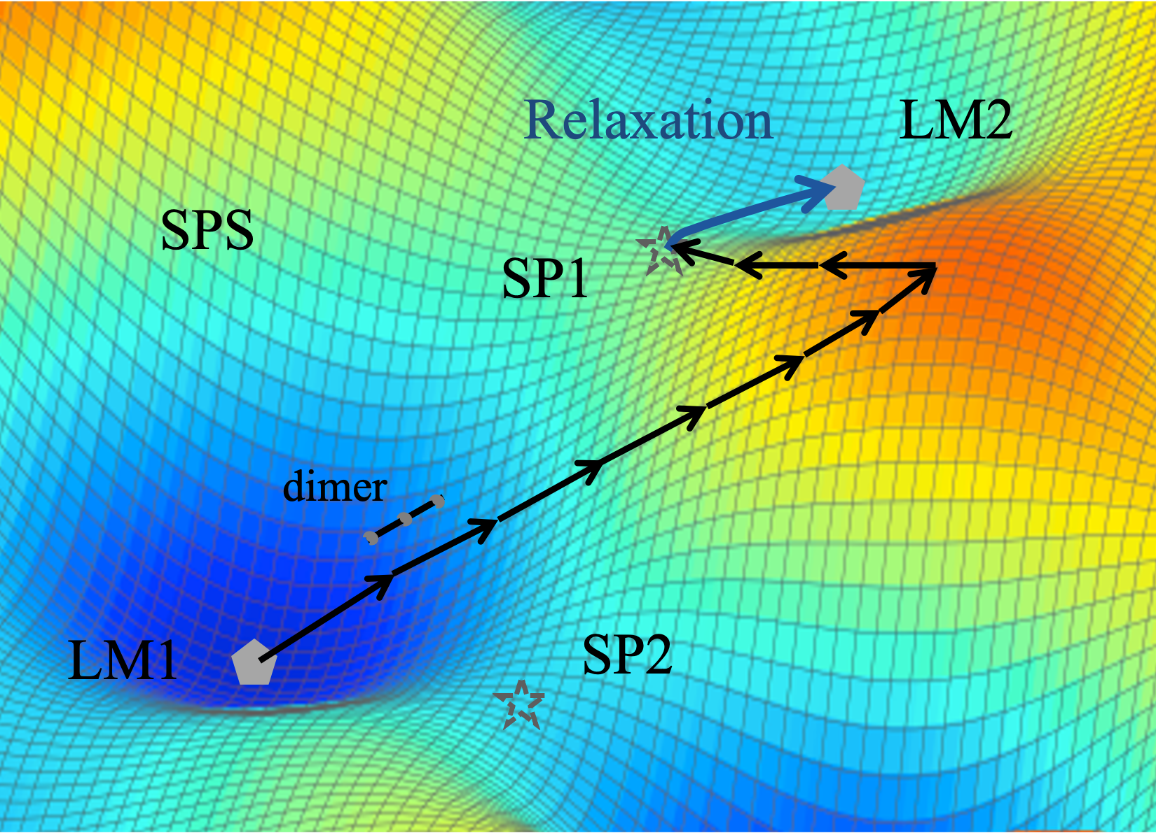
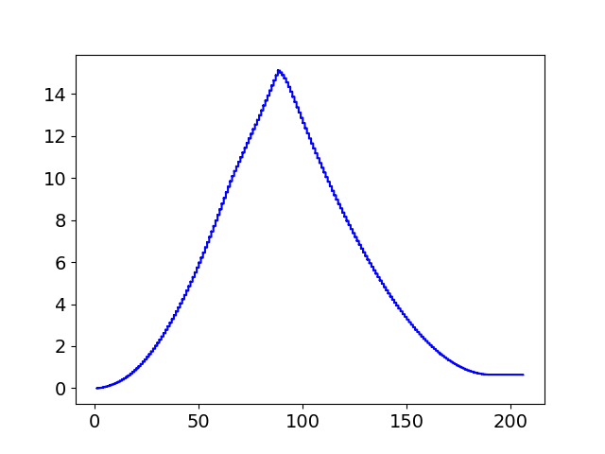
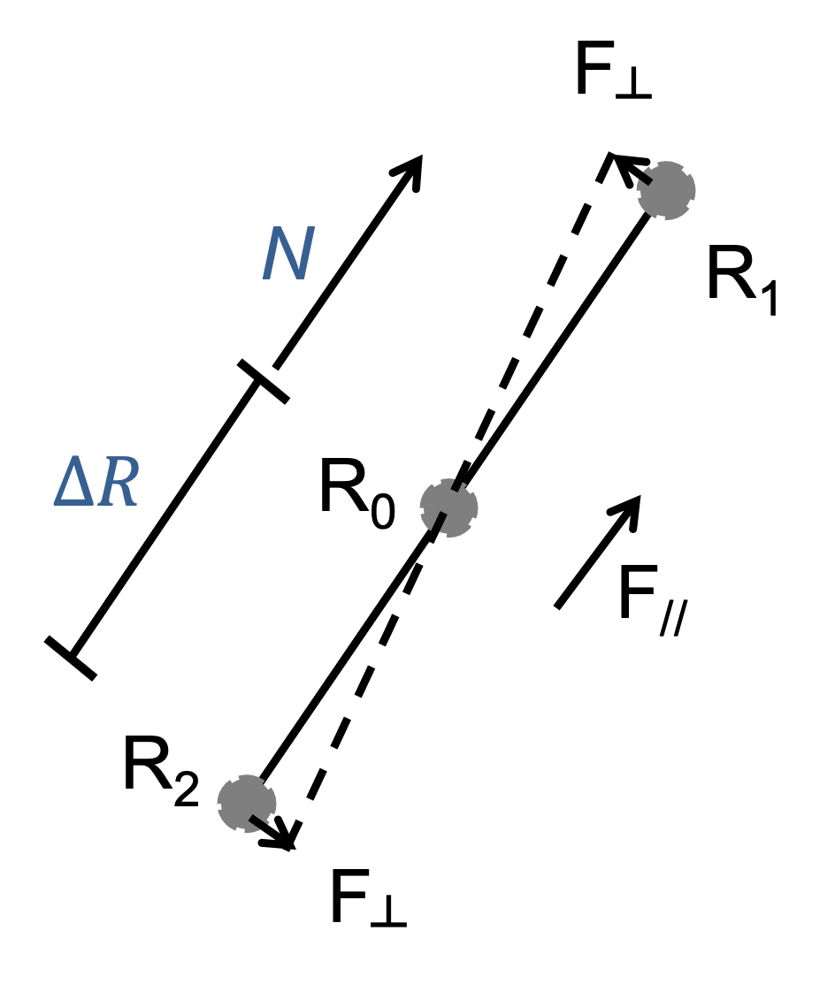
Dimer method
max
max
Elevation
Converging
Energy (eV)
A2
A1
0.64 eV
A4
A3
Translation steps
Elevation stage: dimer translates uphill
Converging stage: dimer translates downhill
Dimer axis (N): a unit vector of R₁ – R₂
G. Henkelman and H. Jonsson, JCP 111, (1999)
Notes:
No detail on dimer method
Highlight elevation / converging stages
A SP that is immediately connecting between initial and final states are a connected sp

Slide 2
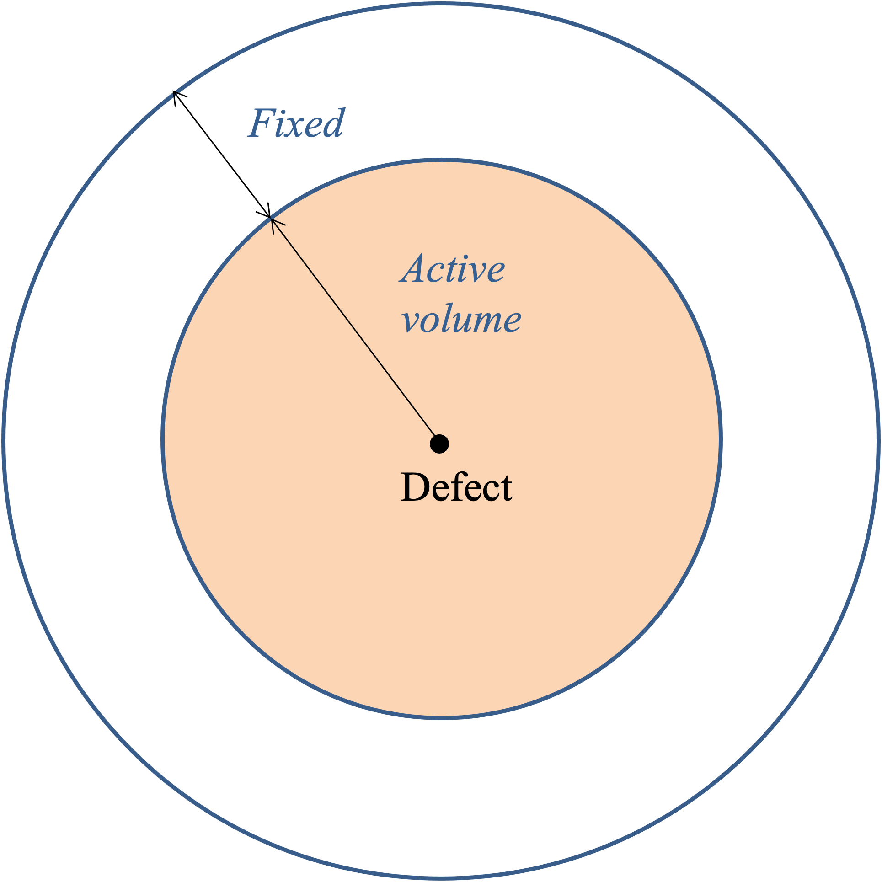
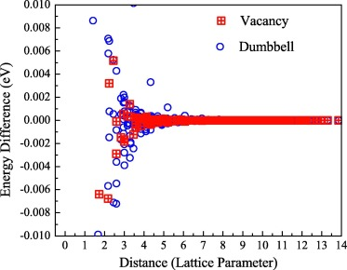
Active volume
Saddle points are often involved in localized region
Active volume (AV) is constructed according to presence of defects
Seakmc (self-evolving atomistic kinetic Monte Carlo)
H. Xu and et al, J. Phy.: Condensed Matter 24, (2012)
H. Xu and et al, Comput. Mat. Sci. 100, (2015)
Notes:
AV small enough to speed up sp
AV large enough that SP energy and positions are converged

Slide 3
One Vacancy one He (1V1He) in Fe
1V1He
AV
X_{t}
Energy
X_{t-1}
X₀
X_{T}
Reaction coordinates
Notes:
No detail on dimer method
Highlight elevation / converging stages
A SP that is immediately connecting between initial and final states are a connected sp

Slide 4
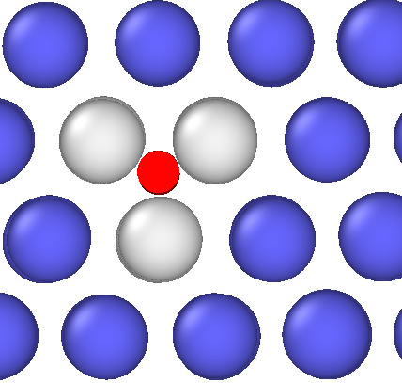
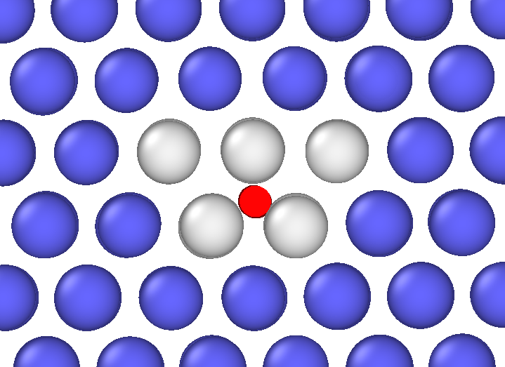
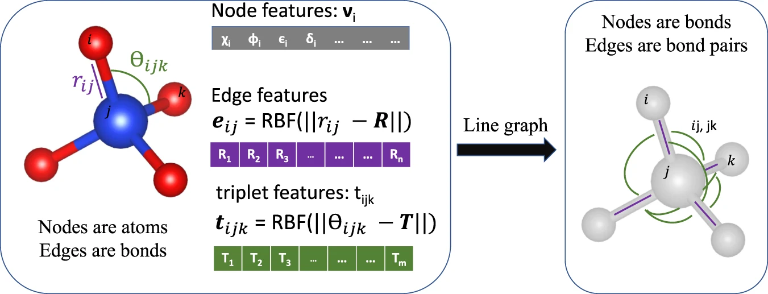
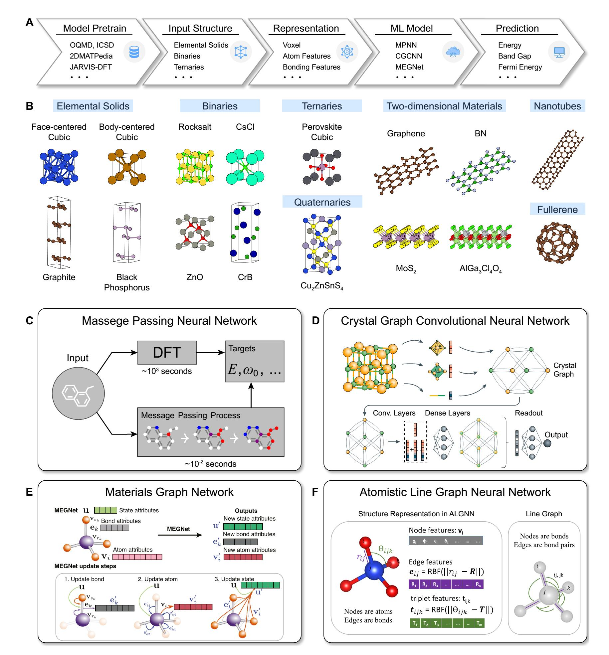


Initial state
Intermediate state
Intermediate state
Saddle point
Training database
SEAKMC
:Dislocations
Thorough SPS for representative defective systems with universal MLIPs
GNN
:Atom features
:Bond features
:Angle features
Nodes are atoms
Edges are bonds
Angles are included
$$q\left(X_{t}|X_{t−1}\right)$$
X₀
X_{t-1}
X_{t}
X_{T}
$$p_{θ}\left(X_{t−1}|X_{t}\right)$$
Geometric diffusion model
SEAKMC
Generated saddle points
Fine-tune on the generated saddle points

Slide 5
Initial state
Intermediate state
Intermediate state
Saddle point
SEAKMC
Training database
:Dislocations
Thorough SPS for representative defective systems with universal MLIPs
GNN
:Atom features
:Bond features
:Angle features
Nodes are atoms
Edges are bonds
Angles are included
$$q\left(X_{t}|X_{t−1}\right)$$
X₀
X_{t-1}
X_{t}
X_{T}
$$p_{θ}\left(X_{t−1}|X_{t}\right)$$
Geometric diffusion model
SEAKMC
Generated saddle points
Fine-tune on the generated saddle points

Slide 6
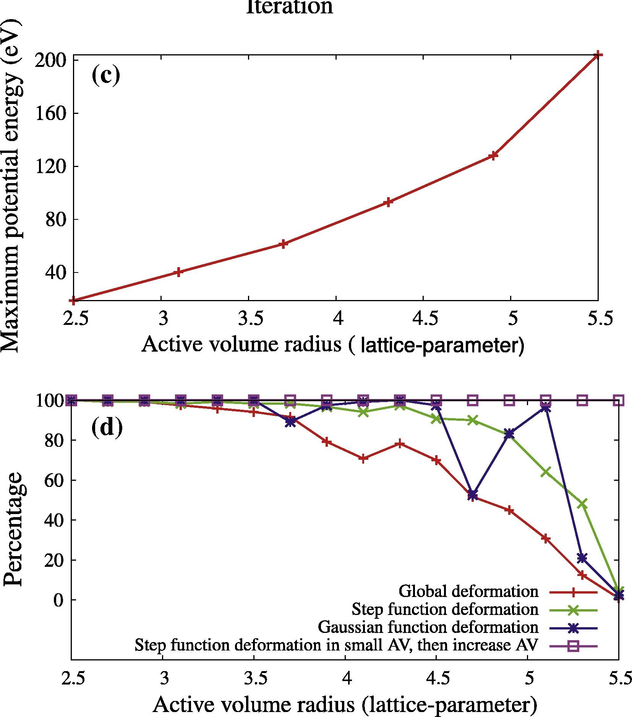
Existing challenges with saddle point search
vacancy
Max. potential energy increases with increasing size of AV
Probability of finding the saddle point decreases with increasing size of AV
vacancy
H. Xu and et al., Comput. Mat. Sci. 100, (2015)
Notes:
1) Max energy increases

