Slide 1
AI-powered Earthquake Data Denoising
Data Science Lab 2024
Challenge givers: Niko Dahmen, Men-Andrin Meier
ETH Zurich

Slide 2
Organisation
Intro: earthquakes and their recordings, key parameters
Swiss seismic network and earthquakes
Data set
Task & Evaluation

Slide 3
Organisation

Slide 4
Intro

Slide 5
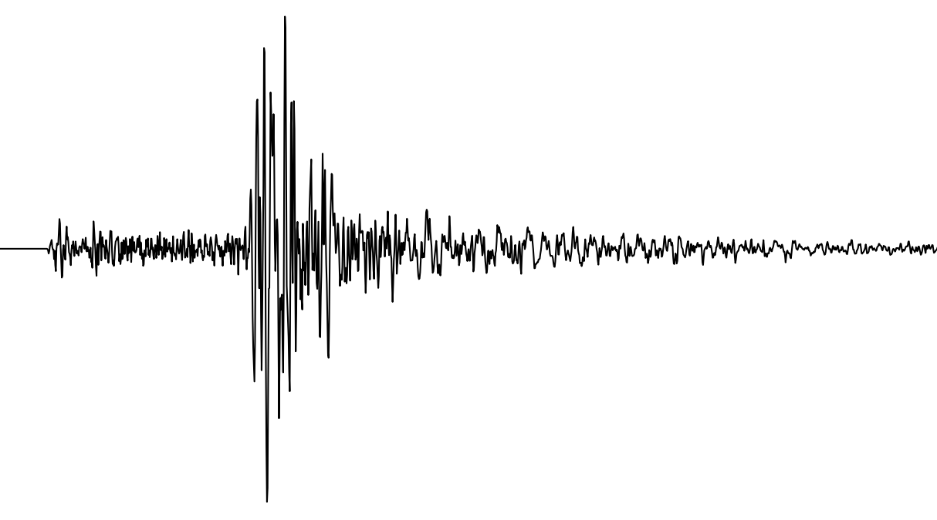
Earthquake data
Seismogram showing recorded ground motion over time

Slide 6
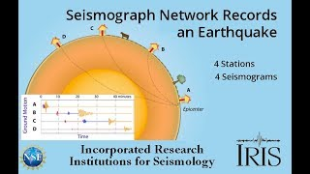
Earthquake recordings

Slide 7
Seismogram showing recorded ground motion over time
P wave
S wave
Time difference
→ distance
Peak amplitude of ground motion → magnitude (& distance)

Slide 8
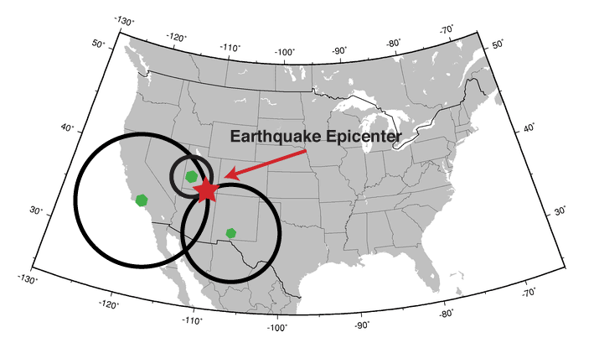
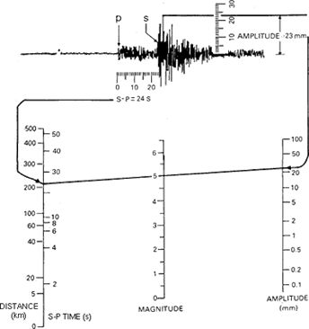
Earthquake - Key Parameters
Location (hypocentre) - triangulation using time difference of P and S arrivals from several stations
Strength (magnitude): estimated from recorded peak amplitude and distance to quake
(simple methods)
USGS
USGS

Slide 9
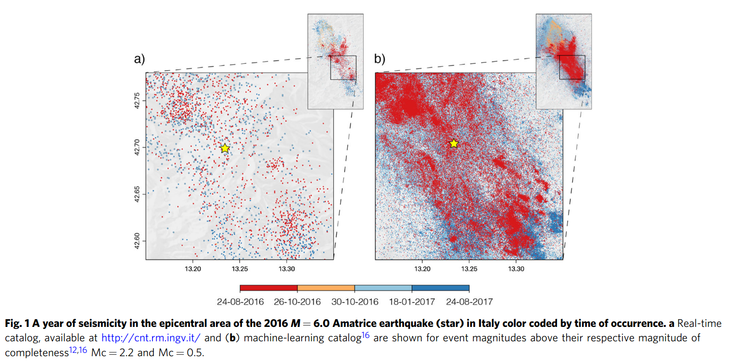
Improvements thanks to ML methods
Beroza et al. (2021)

Slide 10
Swiss seismic network and earthquake recordings

Slide 11
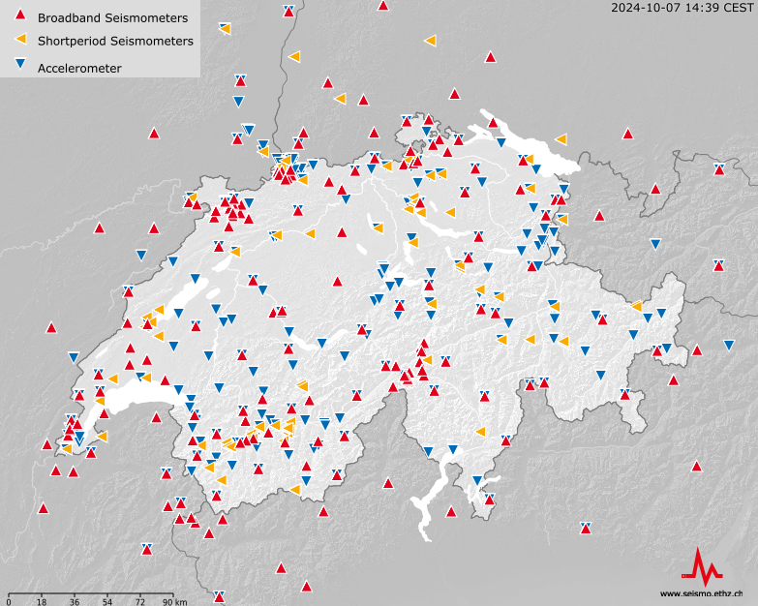
Swiss Seismic Network
http://seismo.ethz.ch/en/earthquakes/monitoring/national-seismic-network/overview/

Slide 12
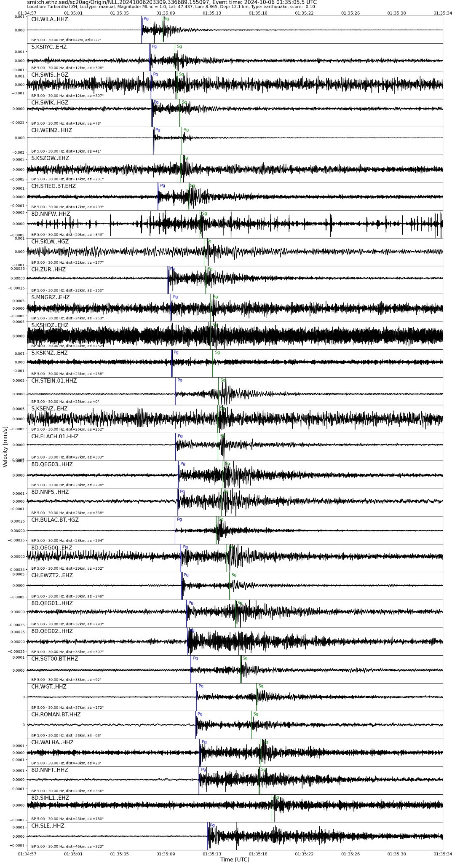
Typical Earthquake recording
Sorted by distance
Fig.:
SED/ETH
http://seismo.ethz.ch/en/earthquakes/monitoring/national-seismic-network/overview/

Slide 13
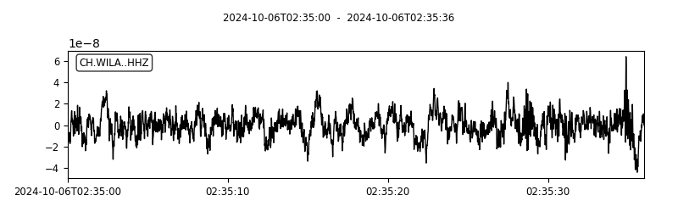
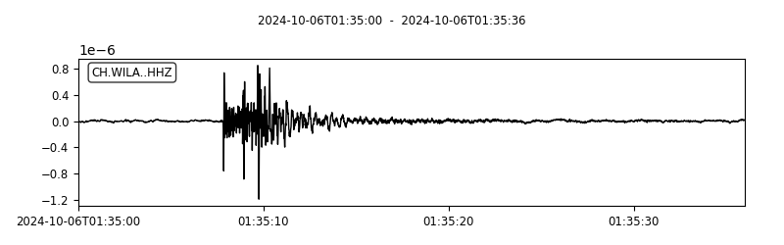
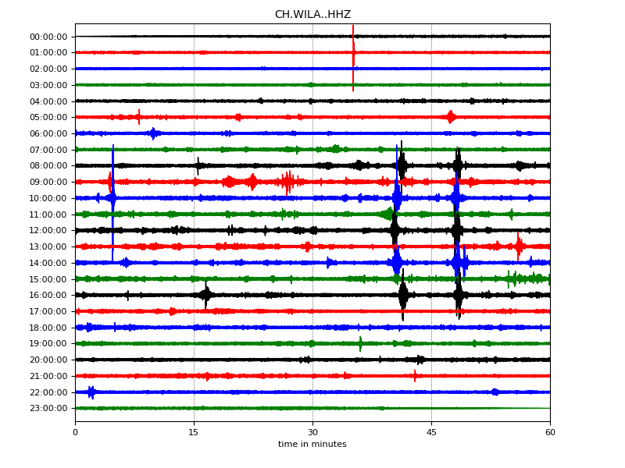
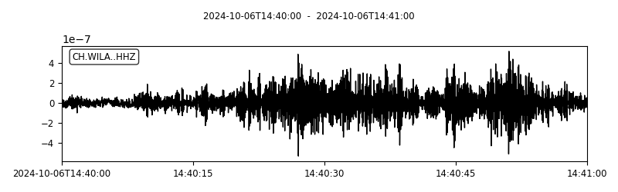
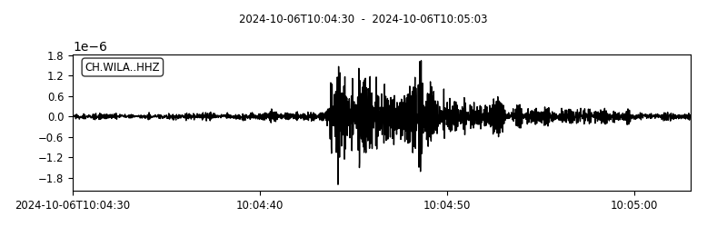
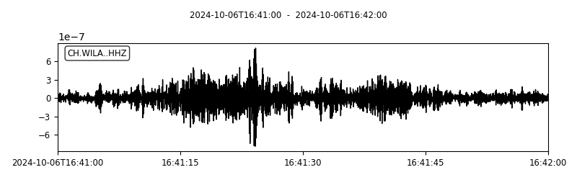
Continuous data
24 hours of data
1 Hz high pass filter

Slide 14
Data set

Slide 15
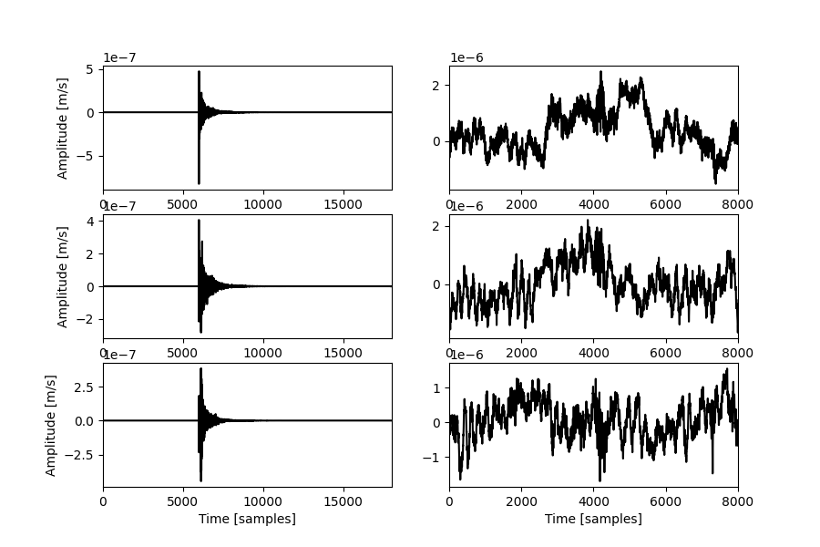
Data set
Event signals
(snippets of 180 seconds, 100 samples-per-second)
Noise signals
(snippets 80 seconds, 100 samples-per-second)
3 components:
Up-Down
North-South
East-West

Slide 16
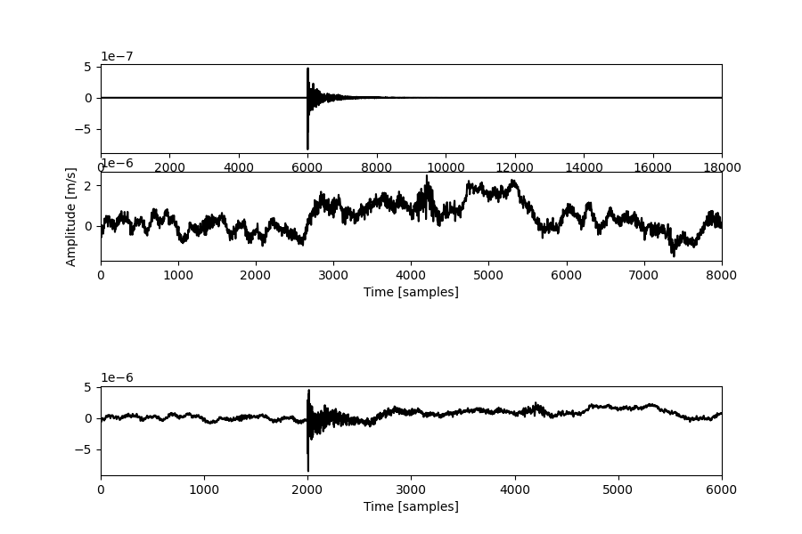
Data set
PROVIDED
Event signals
(snippets of 180 seconds, 100 samples-per-second, sps, P-wave always at 60s)
Noise signals
(snippets 80 seconds, 100 sps)
Noisy earthquake signal (e.g. 60 seconds snippet, 100 sps)
Clean earthquake signal
Noise signal
CREATE AS YOU LIKE
Noisy earthquake signal (EQ + noise signa)

Slide 17
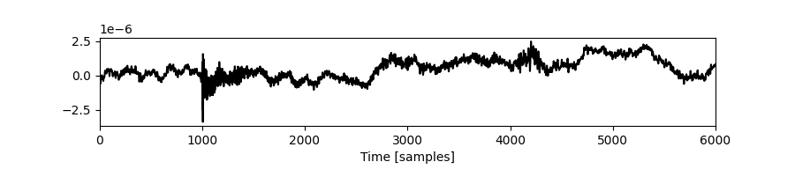
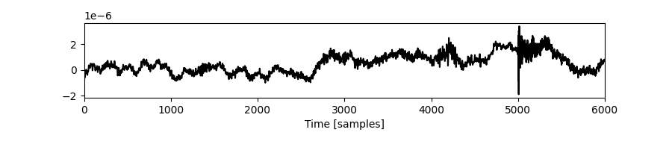
Data set
Clean earthquake signal
Event signals
~25k
Noise signals
>25k
Noisy earthquake signal
XX combinations of event and noise signals (with variations in signal-to-noise ratio = relative amplitude of earthquake and noise signals, position of EQ signal in time window,....)
Noise signal
…

Slide 18
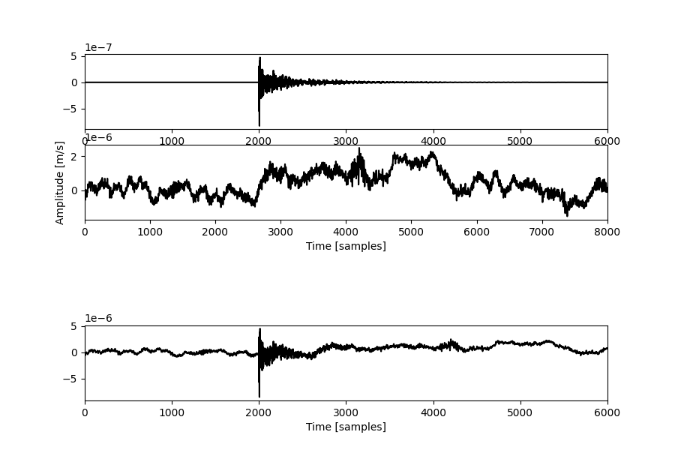
Task
Noisy earthquake signal
(EQ + noise signal)
Denoised earthquake signal
Noise signal

Slide 19
Evaluation - comparing denoised to true/clean EQ signal
Onset of EQ signal
Noisy earthquake signal
(EQ + noise signal)
Denoised earthquake signal
Noise signal
Waveform similarity
Peak amplitude
Benchmarking against conventional tools (digital filter) and existing DL denoiser

Slide 20
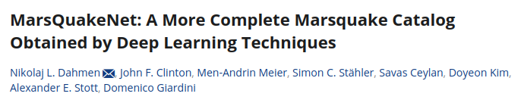

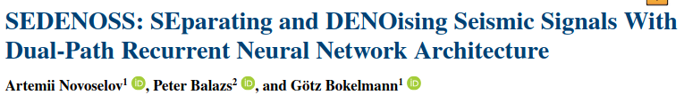
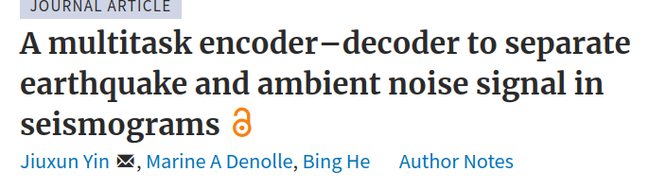
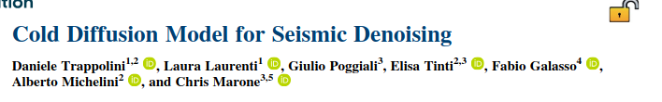
Where to start?
model available for baseline comparison
Approaches from other fields, time series decomposition?

Slide 21
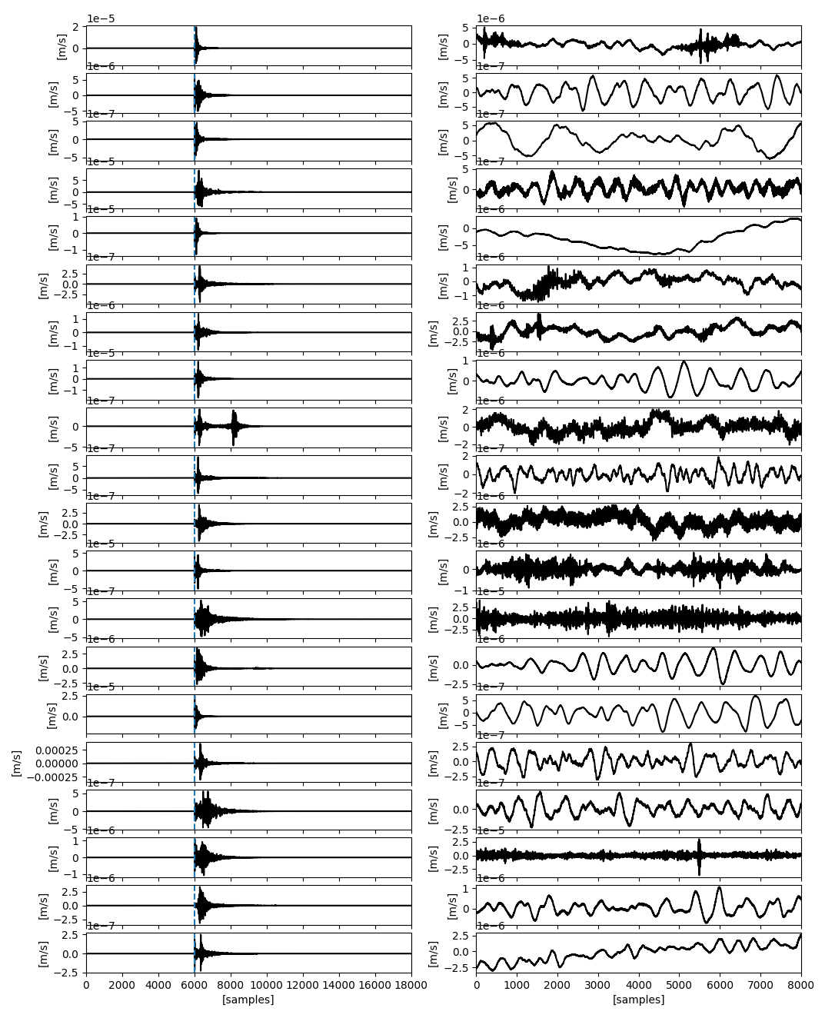

Slide 22
