Slide 1
J
JIMGAF
TRACEABILITY
COCOA TRACEABILITY FOR NIGERIAN LBAs
Every kilo, traced back to a registered farmer.
A digital register that turns a broker lot's weight and receipt range into a quota-respecting farmer list — certified, receipted, and export-ready in seconds.
PREPARED FOR LICENSED BUYING AGENTS · 2026

Slide 2
THE PROBLEM
Paper trails break exactly where buyers need proof
1
2
3
4
No digital evidence
Farmers get oversold
Hours lost to Excel
No audit trail
Certificates and lab results sit in folders and phones, not attached to the lots they belong to.
Two pending lots can each claim a farmer's full remaining quota — nobody notices until it's too late.
Season-end reconciliation means rebuilding the farmer register by hand, lot by lot.
When a buyer asks "who delivered this," the honest answer is often "we're not sure."
53 DAYS
until EUDR due-diligence rules take effect for cocoa (30 Dec 2026, large & medium operators)
JIMGAF Traceability
2

Slide 3
THE SOLUTION
One system. Every kilo accounted for.
JIMGAF sits between your weighbridge and your buyer: it turns raw delivery numbers into a certified, farmer-level record — automatically, and without ever letting a farmer be oversold.
1
2
3
4
5
Upload
Record
Allocate
Certify
Export
Your Excel farmer register — codes, names, potential volume.
A lot's total weight and receipt range as it arrives.
The system splits it across eligible farmers automatically — never past their potential.
Reviewer accepts with a certification: Cocoa Horizons, Rainforest Alliance or EUDR.
4-copy receipts, delivery slips and yield reports — ready for any buyer audit.
JIMGAF Traceability
3

Slide 4
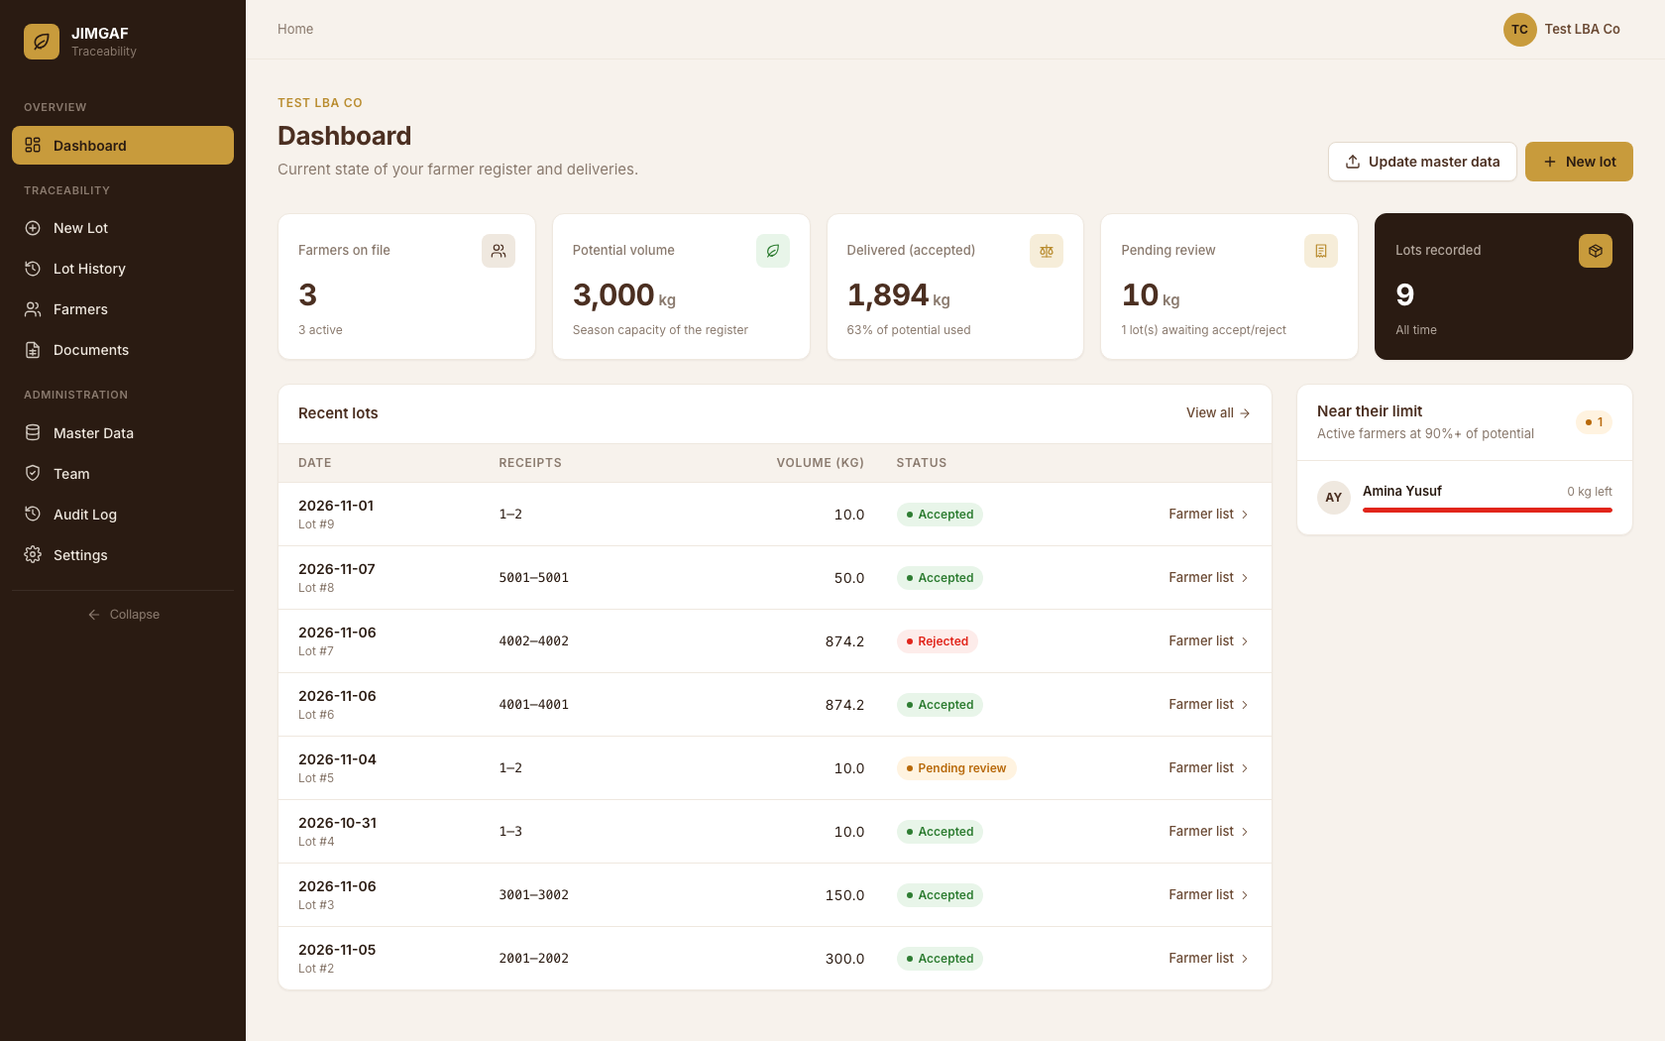
OVERVIEW
Your whole season, on one screen
Farmers on file, potential volume and delivered-to-date at a glance
Pending lots flagged separately from accepted ones
Farmers nearing their quota limit surfaced automatically
Recent lot activity with live status — no spreadsheet needed
JIMGAF Traceability — Dashboard
4

Slide 5
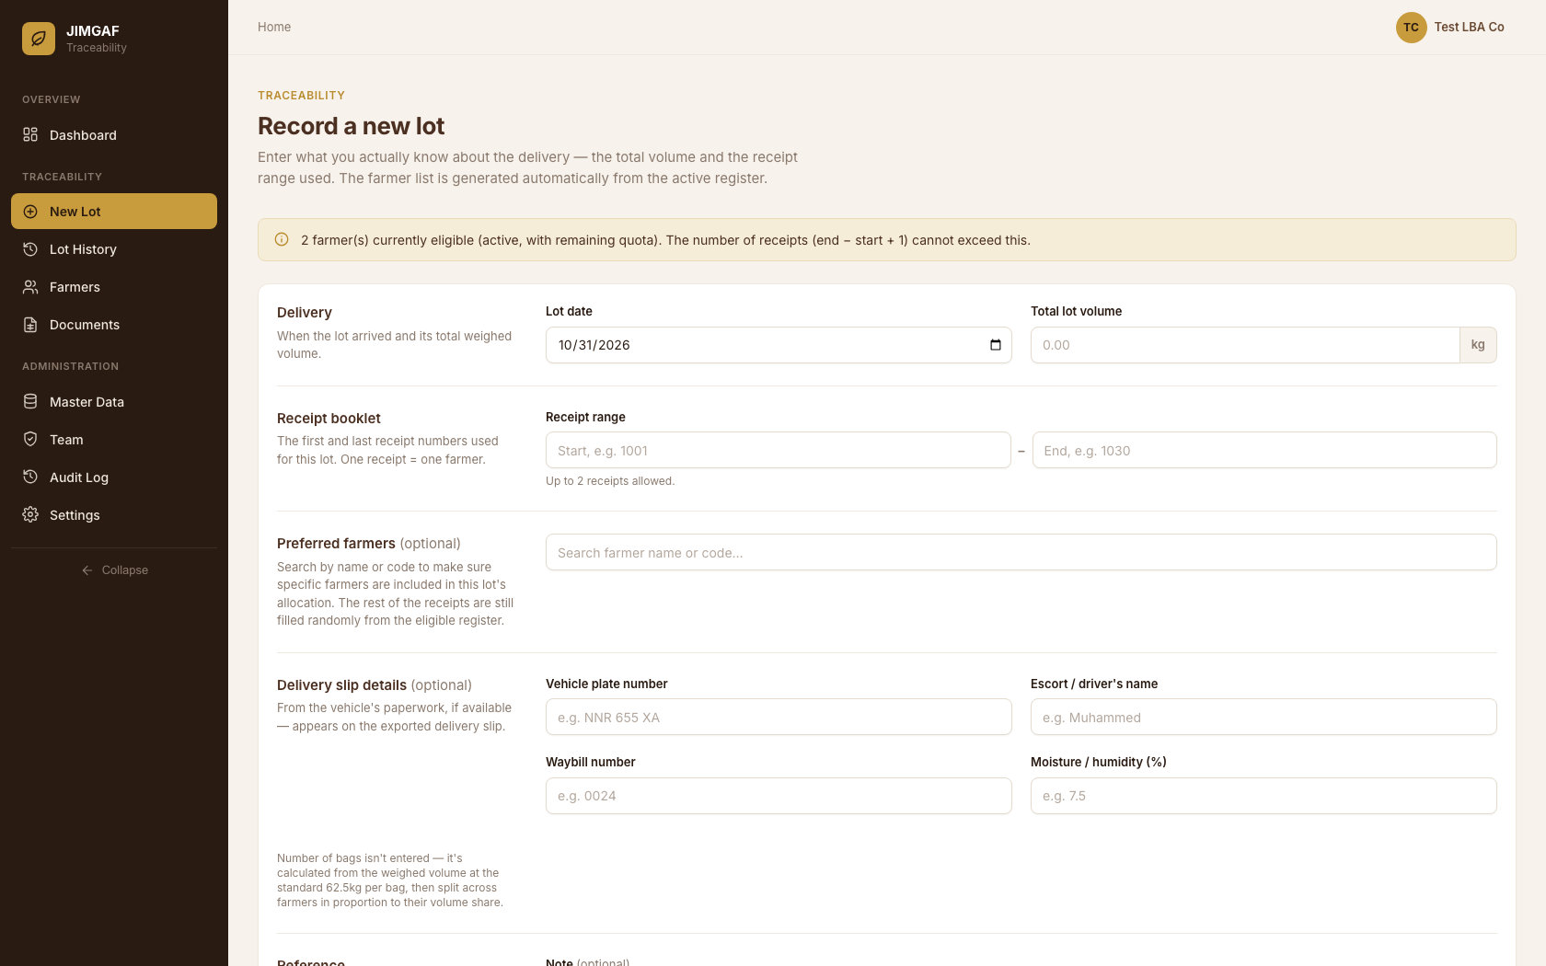
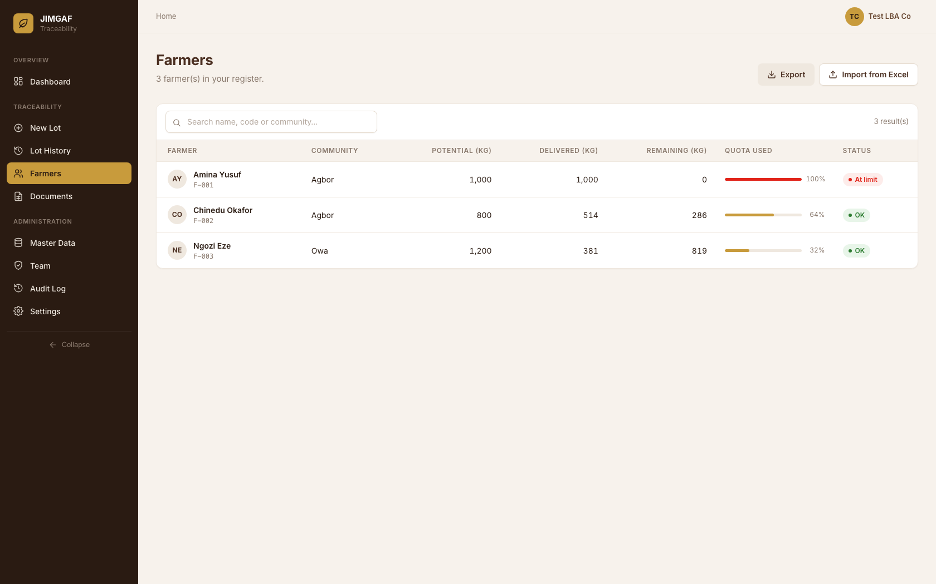
RECORDING A DELIVERY
Record what you know. The system protects the rest.
Your team enters the lot date, total weight and receipt range — optionally naming preferred farmers. JIMGAF fills in the rest from the active register, and a farmer's quota bar makes overselling visible before it happens.
New lot — preferred-farmer search
Farmer register — live quota tracking

Slide 6
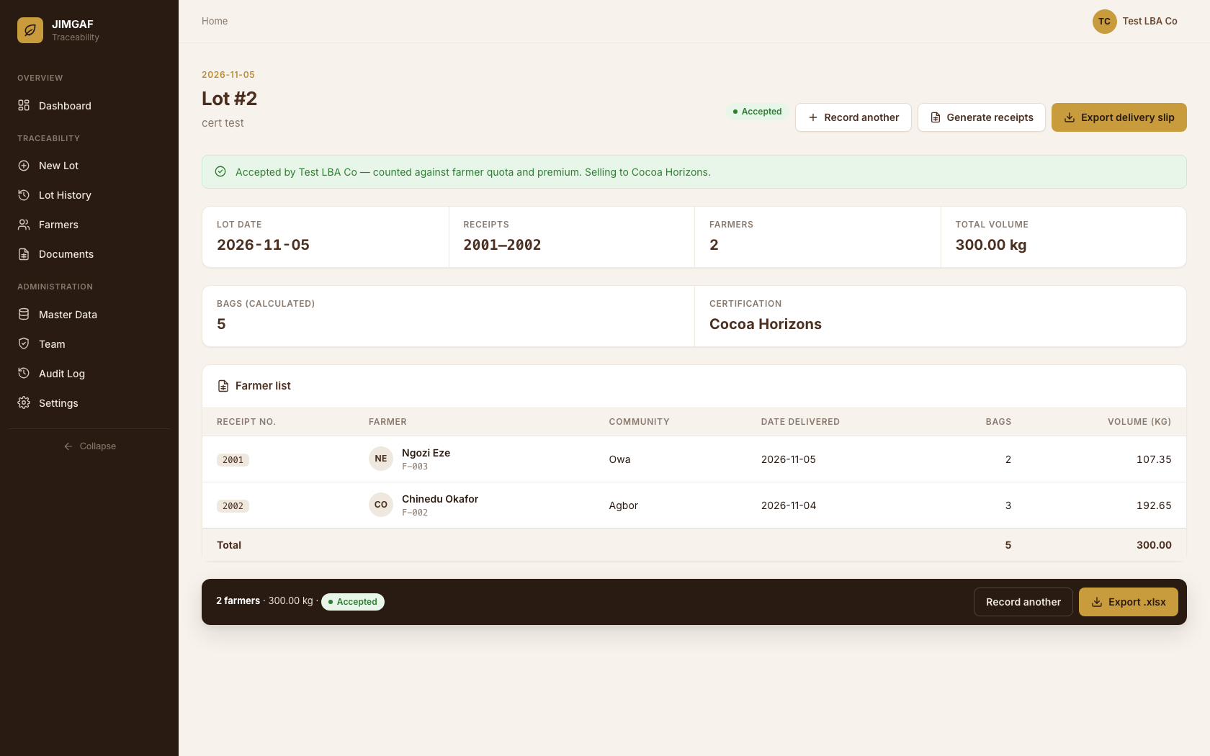
THE PROOF
One click: certified, receipted, provable.
Certification required to accept
Cocoa Horizons, Rainforest Alliance or EUDR — chosen before a lot can be accepted, never defaulted.
4-copy farmer receipts
One original and three duplicates, generated per lot the moment it is accepted.
Full farmer-level breakdown
Every receipt number, bag count and kilo traced to a named, registered farmer.
JIMGAF Traceability — Lot record
6

Slide 7
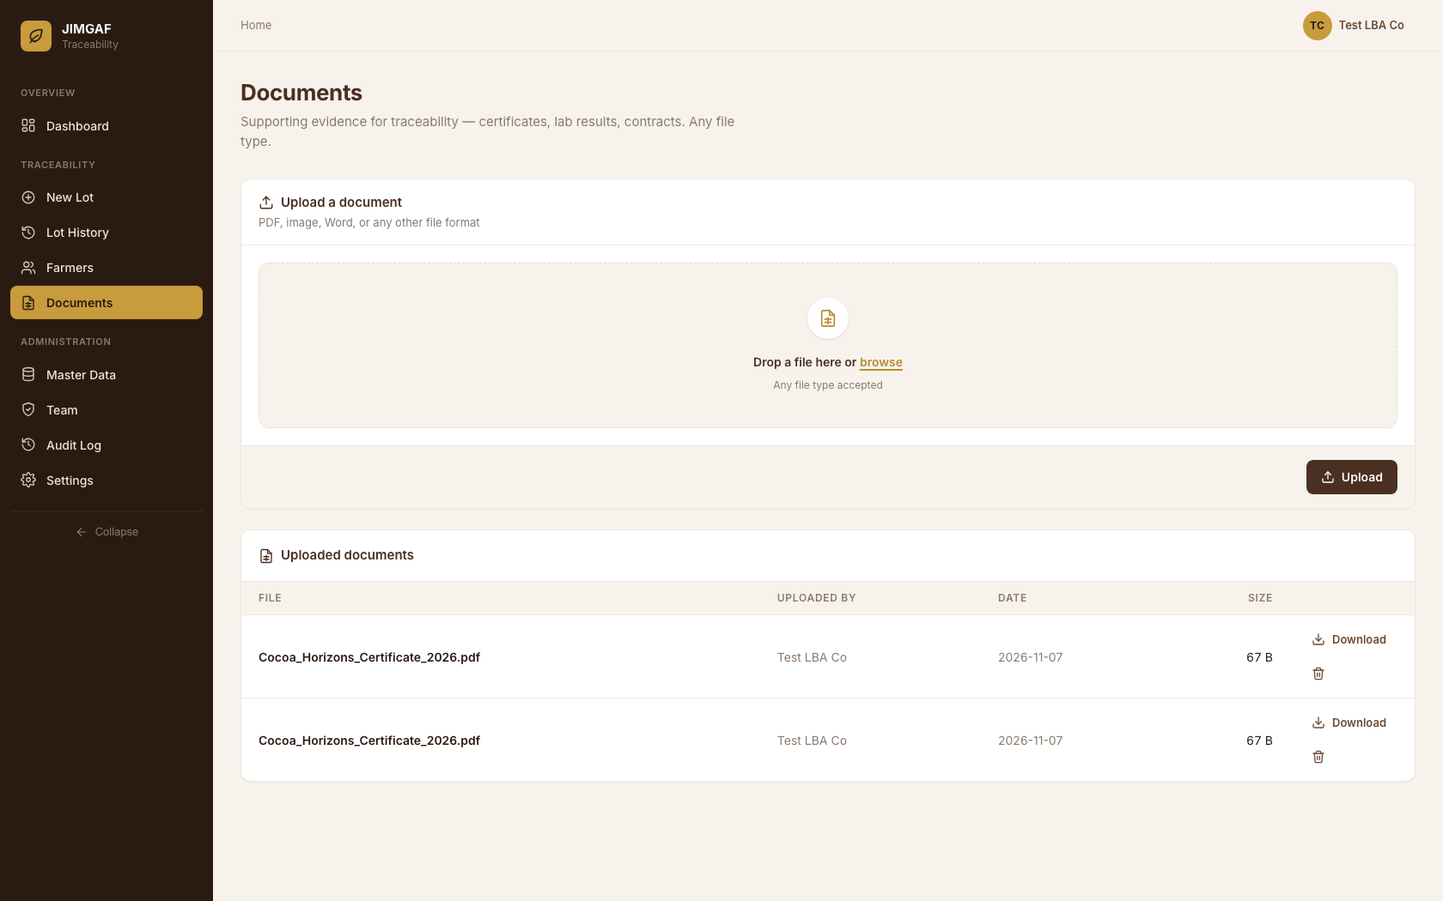
EVIDENCE, IN ONE PLACE
Every certificate, audit-ready
Upload any file type — PDF, image, Word, scanned certificate
Supports Cocoa Horizons, Rainforest Alliance and EUDR evidence
Attached to the LBA account, visible to your whole team
One download away when a buyer requests proof
JIMGAF Traceability — Documents
7

Slide 8
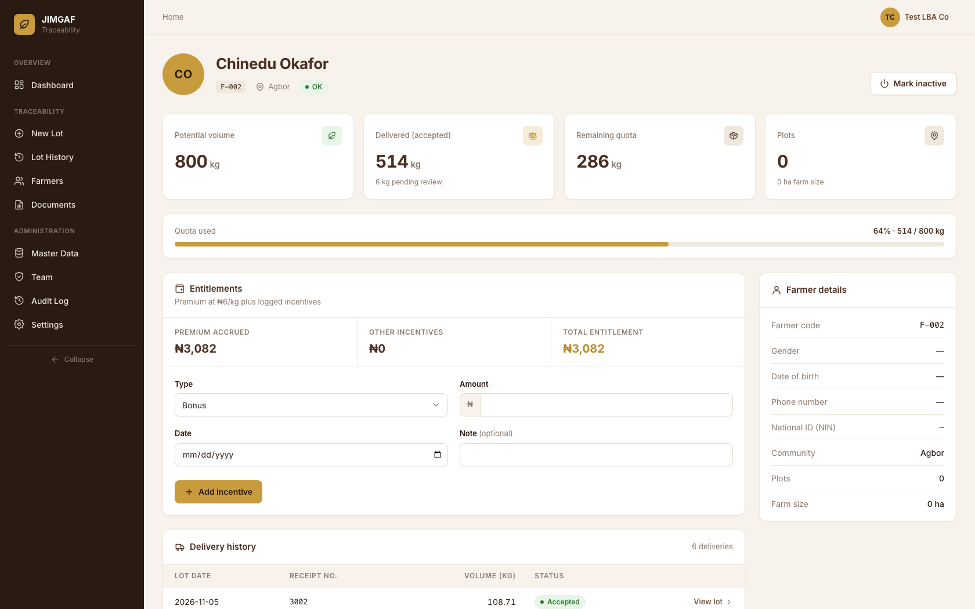
FAIR TO FARMERS
Transparent payment, farmer by farmer
Premium accrues automatically from delivered kilos
Incentives and bonuses logged against the right farmer
Full delivery history — every lot, date and volume
Builds the trust that keeps farmers selling to you first
JIMGAF Traceability — Farmer profile
8

Slide 9
THE BIGGER PICTURE
Why this matters beyond one LBA
For your business
For Nigerian cocoa
Close a season in hours, not weeks of manual reconciliation
Catch an oversold farmer before it becomes a dispute
Win and keep premium buyers who require digital proof
One account per LBA — your data is never shared with another company
EUDR-ready evidence ahead of the 30 Dec 2026 enforcement date
Verifiable support for Cocoa Horizons & Rainforest Alliance claims
A cleaner, farmer-level data trail across the national supply chain
Smallholder farmers paid accurately and on provable terms
JIMGAF Traceability
9

Slide 10
OWNERSHIP & TRUST
Your data. Your infrastructure. Your name.
JIMGAF is deployed as a dedicated, single-tenant stack for your LBA — not a shared multi-company platform. No other account can ever see your farmer register, your lots or your certificates.
●
●
●
Dedicated cloud stack
Role-based access
Full audit trail
Your own database and servers on secure cloud infrastructure — isolated from every other LBA.
Admins, Traceability Officers and Sourcing Managers each see only what their role needs.
Every user action — lot created, lot accepted, team member added — logged with who and when.
JIMGAF Traceability
10

Slide 11
LET’S GET YOUR SEASON EUDR-READY
Traceability your buyers can verify.
Farmers your records can prove.
Bring your Excel farmer register — JIMGAF handles allocation, certification and audit-ready evidence from day one.
JIMGAF TRACEABILITY
A product built for Licensed Buying Agents in Nigeria

