Slide 1
Robot Framework
Taoism LEE

Slide 2
Content
Definition
Core component
Installation
Working theory
Features
Demo

Slide 3
Definition
Robot Framework is a generic test automation framework for acceptance testing and acceptance test-driven development (ATDD). It has easy-to-use tabular test data syntax and it utilizes the keyword-driven testing approach. Its testing capabilities can be extended by test libraries implemented either with Python or Java, and users can create new higher-level keywords from existing ones using the same syntax that is used for creating test cases.
Robot Framework is operating system and application independent. The core framework is implemented using Python and runs also on Jython (JVM) and Iron Python (.NET).
Official Website: http://robotframework.org/
Home Page: https://github.com/robotframework/robotframework

Slide 4
Test automation framework
A set of tools for automation test
Define an unified style of writing and organizing test cases
Integrate different kinds of driven technologies
Control the executing process of test cases
Generate test report and logs

Slide 5
Robot framework IDE
Robot Framework package contains the core structure and a set of standard libraries
External libraries are provided by RF or Python communities
Different packages provide different service and can be used together
Libraries, Test cases, and resource file found the 3 layers of development

Slide 6
Possible Installation

Slide 7
Installation
python-2.7.9.msi
//Choose the version below 3.0 and Remember to configure the Path
Download: https://www.python.org/downloads/
robotframework-2.9.2.win32.exe
//Choose the proper version based on the Python version
Download: https://pypi.python.org/pypi/robotframework
wxPython2.8-win32-unicode-2.8.12.1-py27.exe
//Choose the version below 3.0 based on the Python version
Download: http://sourceforge.net/projects/wxpython/files/wxPython/
robotframework-ride-1.3.win32.exe
Download: https://pypi.python.org/pypi/robotframework-ride/

Slide 8
Installation
decorator
Download: https://pypi.python.org/pypi/decorator/4.0.4
selenium
Download: https://pypi.python.org/pypi/selenium/2.48.0
robotframework-selenium2library-1.5.0.win32.exe
Download: https://pypi.python.org/pypi/robotframework-selenium2library/
SUGGESTION:
Install these packages using “pip”
>pip install robotframework-selenium2library

Slide 9
History of automation framework

Slide 10
Working theory
Test Object : The system under test(SUT), how to locate it ?
Keyword-Driven
Actions: Simulate the actions user do, provided by all the libraries
Value: The parameter user provide
Theory:
Separate Actions, Objects, and Values as three kinds of keyword
Think of how we do functionalities manually, eg. Login procedure
Action act on an object, probably with(out) value →makes a step
A set of steps makes a test case

Slide 11
Locate test object
World Wide Web consortium(W3C) was founded 10, 1994 in MIT by Tim Berners-Lee
It focuses on Web standards and finally forms standard files called W3C Recommendations

Slide 12
Normal Document Stream
<html>
<head>
<title>….</title>
………….
</head>
<body>
………….
</body>
</html>
<body>
<p>…</p>
<img src=“” />
<a>…</a>
<table>…</table>
<form>
<input type=“” />
</form>
<select name=“”>
<option>…</option>
<option>…</option>
</select>
</body>
W3C official: http://www.w3.org/
Refer to: https://github.com/TaoismLEE/HTML-CSS

Slide 13
Locate test object - Locator
identifier
id
name
Xpath // http://www.w3school.com.cn/xpath/index.asp
CSS // know CSS selecter
DOM
link text
Usually use id, name, xpath, and CSS locator
Suggest to use id and CSS
Use CSS instead of xpath if testers familiar with HTML and CSS

Slide 14
Actions - Libraries
Selenium2Library
All action keywords, refer to link:
http://robotframework.org/Selenium2Library/doc/Selenium2Library.html

Slide 15
Feature
Tabular test data syntax:
****** Settings ******
Library Selenium2Library
******* Test Cases *****
Baidu
Open Browser https://www.baidu.com browser=IE

Slide 16
Feature
Customize higher-level keywords:
**** Settings **** //resource should also import used libraries
Library Selenium2Library
*** Keywords ***
key
Open Browser https://www.baidu.com browser=IE
**** Settings ****
Library Selenium2Library
Resource keyword.txt
*** Test Cases ***
baidu
key

Slide 17
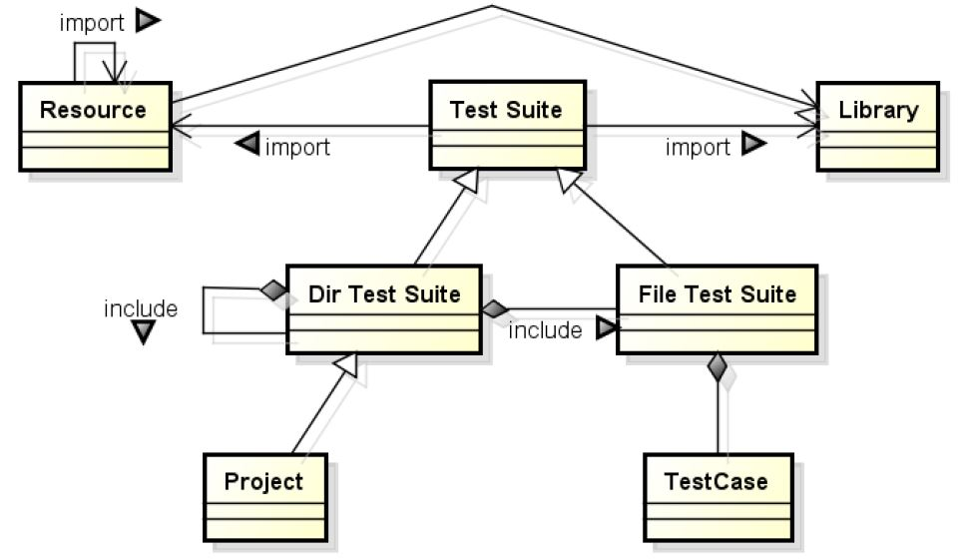
Feature
Structure chart:

Slide 18



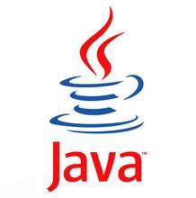
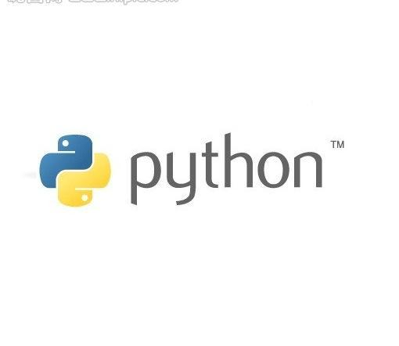



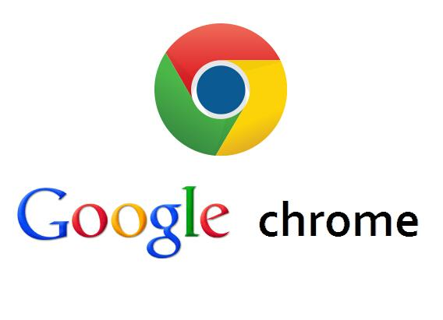

Feature
Across OS, platform, and application independent:

Slide 19
Feature
Using tags to choose what to execute:
*** Settings ***
Library Selenium2Library
*** Test Cases ***
open baidu using IE
[Tags] ie
Open Browser https://www.baidu.com IE
open baidu using chrome
[Tags] chrome
Open Browser https://www.baidu.com chrome
open baidu using firefox
[Tags] firefox
Open Browser https://www.baidu.com browser=firefox

Slide 20
Feature
Data-driven technology:
Rules:
Separate procedure and data
Through continuous abstraction to reduce redundancies and make test cases simple and easy to read
Better to found hierarchical structure

Slide 21
Feature
Test logs and Report:
Test logs are generated with tree structure, and can automatically capture the screenshot of failure
Report is also generated automatically, and distinguished by COLOR: Red means Fail, Green means Pass
Refer to generated logs and report

Slide 22
Demo

