Slide 1
j-th block
…
…
offset
scale
In the j-th block, I calculate the 1) maximum correlation, 2) the best scale factor and 3) best offset using an experimental curve and a theoretical unzipping curve of the j-th gene of the whole genome. A whole library of theoretical curves has been established using the [unzip_GPU](https://github.com/Taomihog/unzip_GPU)
int j = blockIdx.x;
float min_scale = 0.9, max_scale = 1.1;
float min_offset = -500, max_scale =500;
int j = threadIdx.x + blockIdx.x * blockDim.x;
int z = threadIdx.y + blockIdx.y * blockDim.y;

Slide 2
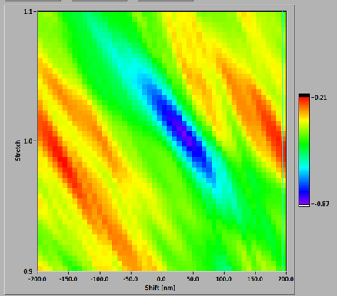
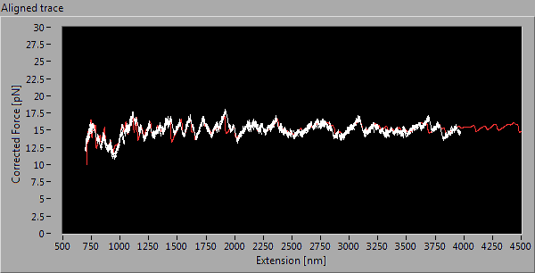


Cross-correlation, $r$
Trace aligned with theory by maximizing $r$
— experiment
— theory
Offset
…
Scaling
…
…
Theoretical predictions of all genes (= blockIdx.y)
…
…
…
…
…
…
Unzipping traces from high-throughput experiment (= blockIdx.x)

