Slide 1
Digital JukeBox

Slide 2
INSPIRATION
Bringing a traditional jukebox to the modern era.
Foster collaborative listening preferences to the traditional jukebox experience.
Enhance the accessibility of the traditional jukebox experience.
Environment covers the costs.
Isolate music trends to environment.

Slide 3
Tech Stack
Back-end = Node && Express with TypeScript
Front-end = React with Vite and TypeScript
Library = CORS, Socket.io for Websocket
Database = PostgreSQL
Version Control = Github
Web Service = Deezer API

Slide 4
Wireframes

Slide 5
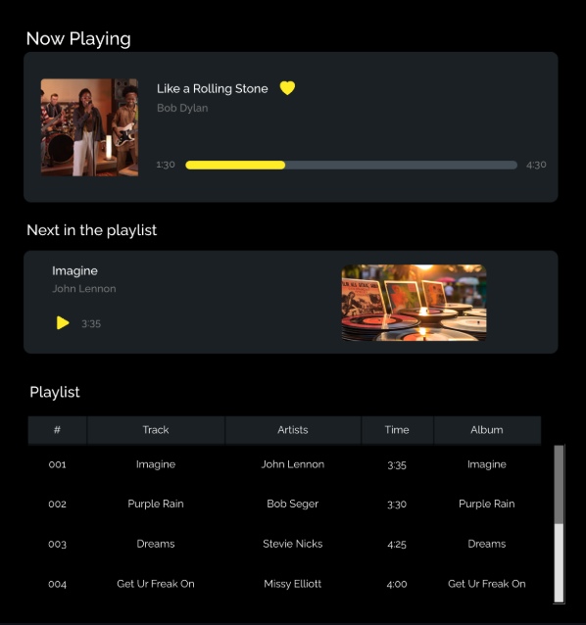

Slide 6
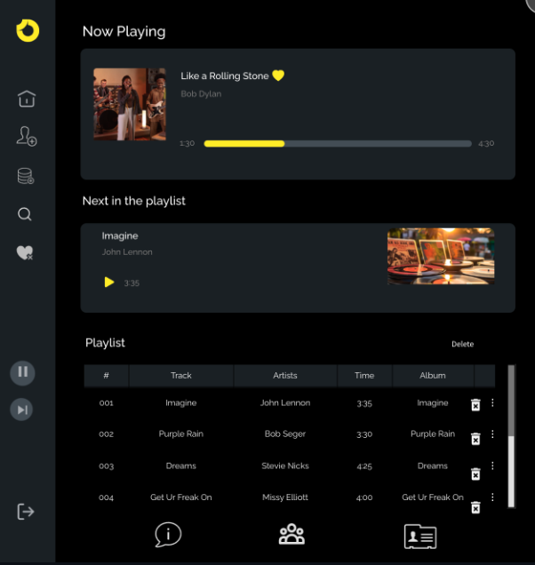

Slide 7
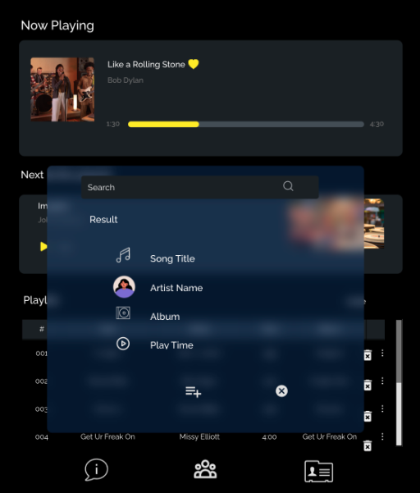

Slide 8
Digital JukeBox App – Mobile version

Slide 9
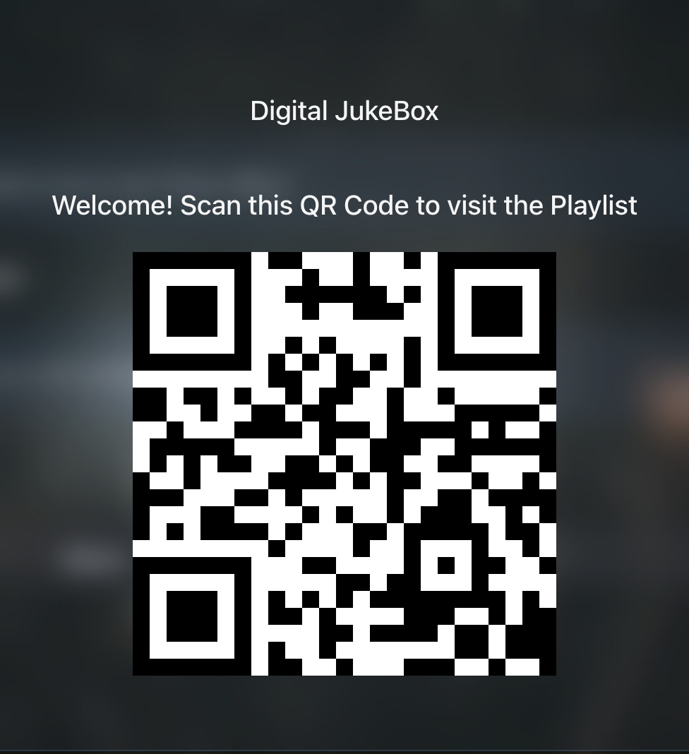

Slide 10
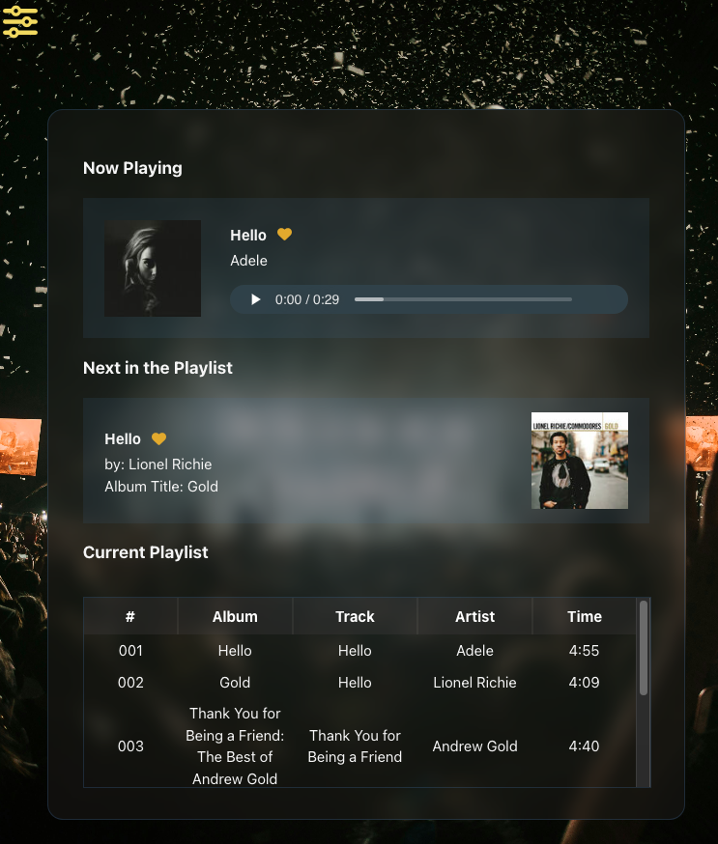
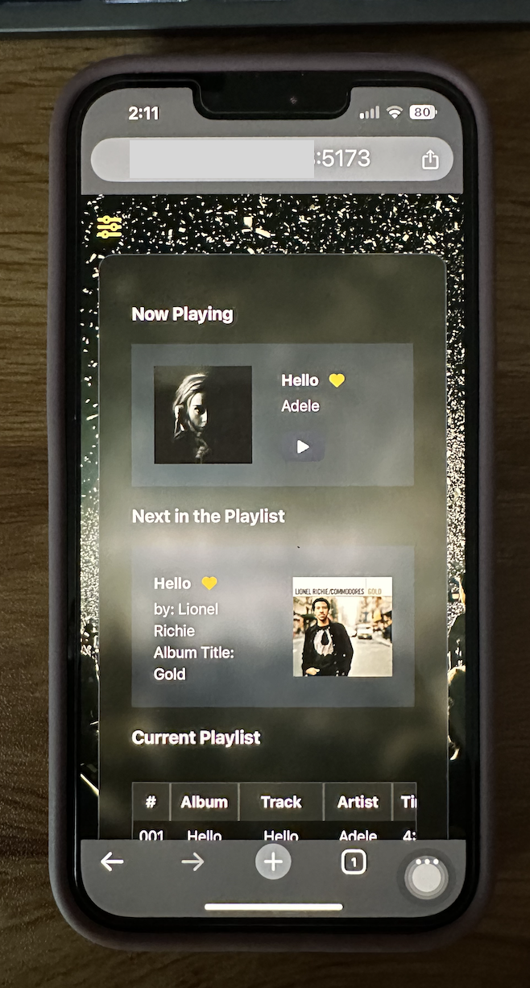
JukeBox Player
User Mobile Phone

Slide 11
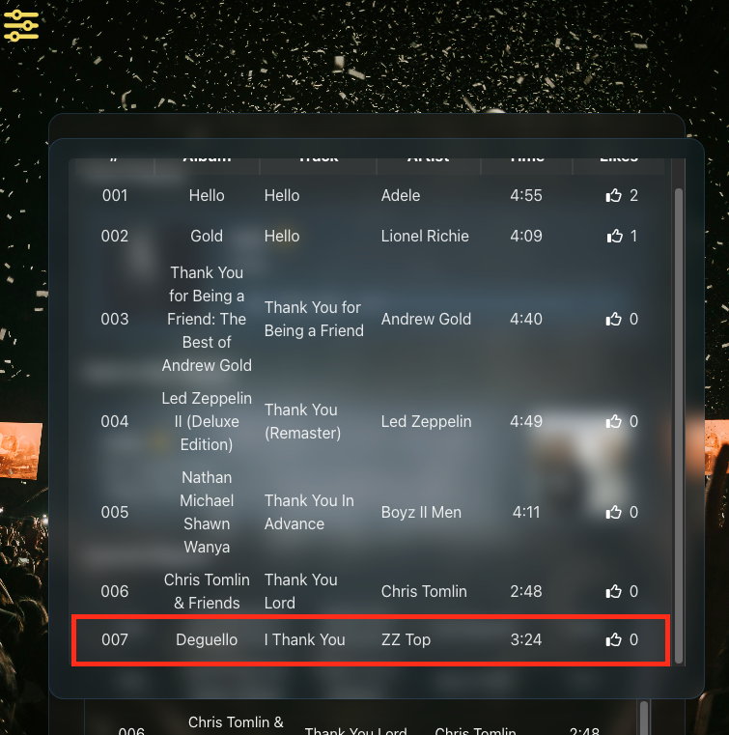
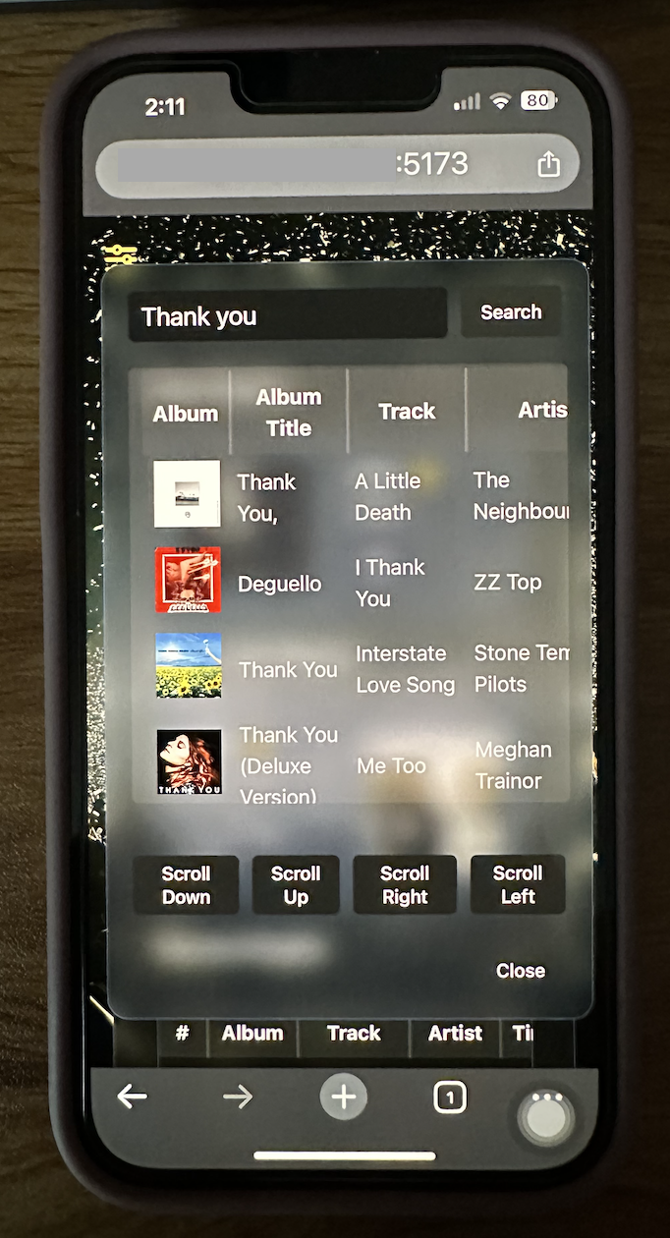
JukeBox Player
User Mobile Phone

Slide 12
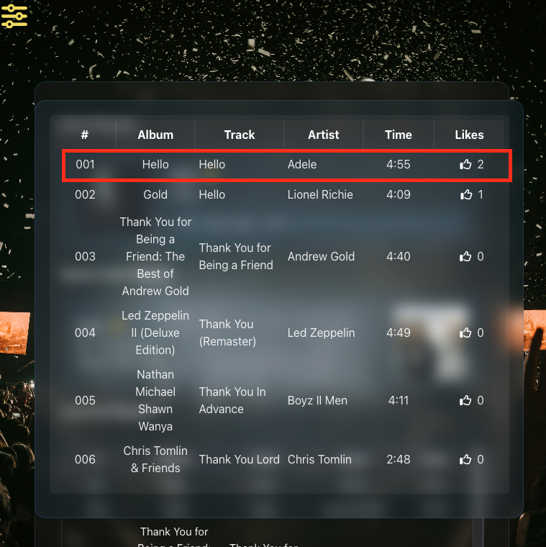
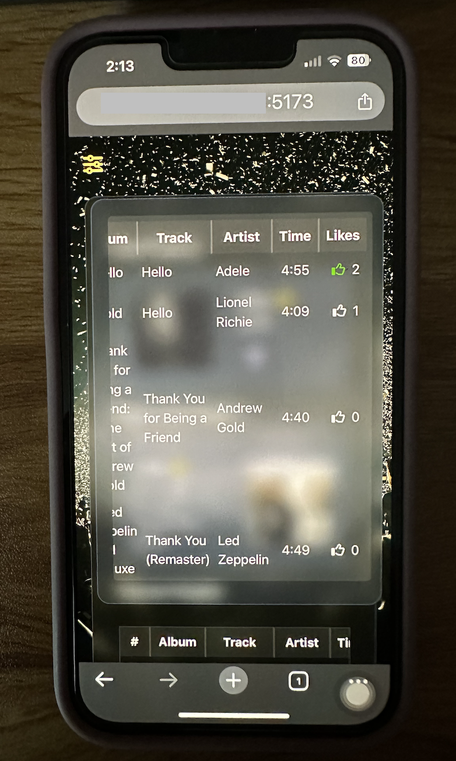
JukeBox Player
User Mobile Phone

Slide 13
Digital JukeBox App

Slide 14
Lesson Learned
Time Management
Cross-Platform Incompatibilities
UI/UX Design Implementation Difficulties
API Design Constraints
Cross-Origin Implementation Difficulties
Library Conflicts

Slide 15
Teamwork Specifics
Created Backup branches periodically.
Utilized two Github Repositories to track resources.
Utilized QA processes such as PR for every merge.
Separated focus to different parts of code-base.
Kept Branches active after merge as potential backup
Used Forked Branch as emergency backup.
Utilized Task Management tools for task tracking.

Slide 16
Future Plans
UI/UX design Improvements.
Bring Application Live.
Auto-Add Location Information Without Manually Entering Coordinates.
Auto-Play Songs.
Looping Video Background Implementation
Implement Feedback System (Question and Answer System)
Implement with native language for Android and iOS mobile devices.

Slide 17
Contact Details
Thank you!
Scott Peloquin
email: s_peloquin123@live.com
Rusgyn Magsanay
email: rusgynmagsanay@gmail.com

