Slide 1
Galago Tutorial #1 CS 6550
Tao Yang
IR lab @UU, 09/23/2021
Tutorial recording of 2020fall CS4960/6550 can be found at
https://www.youtube.com/watch?v=FRAZXL2289Q

Slide 2
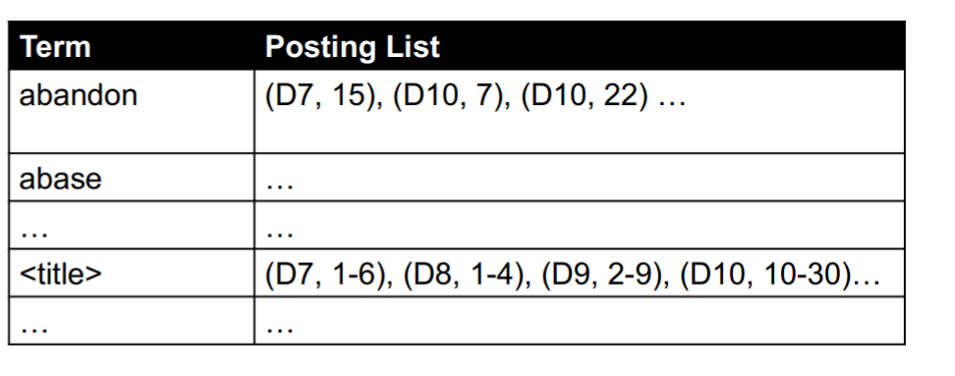
Recap of Inverted Index
data structure that directs you from a word to a document
Example,
Advantage,
Inverted index is to allow fast documents locating.
Steps,
Tokenization, Normalization, Stopping, Stemming.
Build Inverted Index.
“Abandon” is the 15th word in Document #7.
The fist six words in Document #7 are titles.

Slide 3
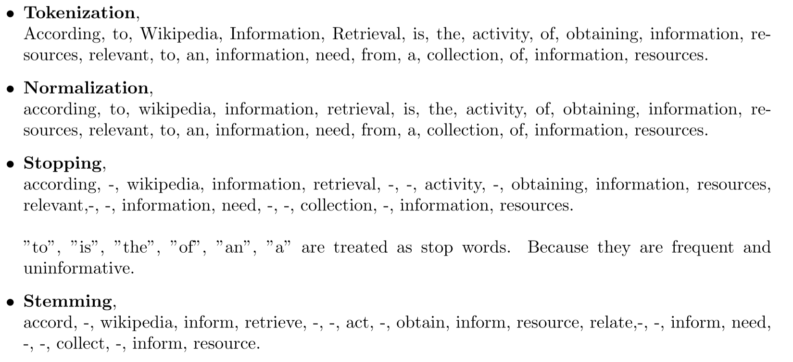
Recap of Inverted Index
According to Wikipedia, Information Retrieval is the activity of obtaining information resources
relevant to an information need from a collection of information resources.

Slide 4
Galago Intro
You can build invited index by yourself.
Here I will introduce Galago, an open source search engines
Galago can do Tokenization, Normalization, Stopping, Stemming and finally
build inverted index for us. Only one command line.
We can run basic retrieval model with command lines.
We can also run retrieval model with Java and Galago’ API.

Slide 5
Galago Build inidex
Corpus
Output folder
./galago/bin/galago build --inputPath=trecText_toy.gz --indexPath=./index/ --filetype=trectext --tokenizer/fields+text
Corpus type
Specify Tokenizer
Please refer following repo to install galago,
https://github.com/Taosheng-ty/CS_6550_galago_tutorial.git

Slide 6
Extracting Document Statistics
String pathIndexBase = "CS_6550_galago_tutorial\\index"; //path to index folder
Retrieval retrieval = RetrievalFactory.instance(pathIndexBase, Parameters.create());
//Extracting Document Statistics
Node n = new Node();
n.setOperator("lengths");
n.getNodeParameters().set("part", "lengths");
FieldStatistics stat = retrieval.getCollectionStatistics(n);
long documentCount = stat.documentCount;
long maxLength = stat.maxLength;
long minLength = stat.minLength;
double avgLength = stat.avgLength;
Extracting Document Statistics
Number of documents
Maximal document length
Minimal document length
Average document length

Slide 7
Extracting term Statistics
String query = “covid";
String field = “text";
Node node = StructuredQuery.parse( "#text:" + query + ":part=field." + field + "()" );
node.getNodeParameters().set("queryType", "count");
node = retrieval.transformQuery(node, Parameters.create());
NodeStatistics stat_node = retrieval.getNodeStatistics(node);
long maxCount = stat_node.maximumCount;
long nodeDocCount = stat_node.nodeDocumentCount;
long nodeFrequency = stat_node.nodeFrequency;
Extracting term Statistics (“covid”)
Maximal term count
number of document contain “covid”
Term frequency in all documents

Slide 8
Galago Tutorial
We also provide example
Find document of minimal length
Number of unique words with less than 10 characters.
Please refer,
https://github.com/Taosheng-ty/CS_6550_galago_tutorial.git

