Slide 1
Retrieval model on Galago
Tao Yang
IR lab @UU, 10/28/2021
Please refer,
https://github.com/Taosheng-ty/CS_6550_galago_tutorial.git

Slide 2
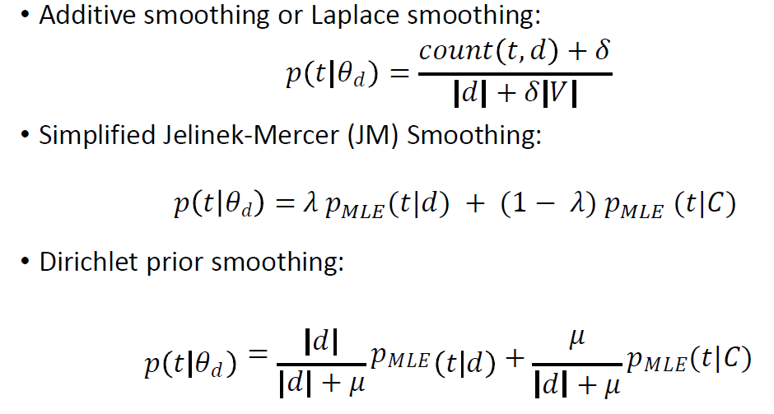
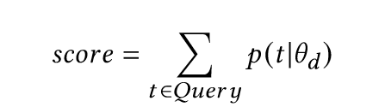
Recap of smoothing methods
Typically, we need
Document probability
Collection probability
Rank documents according to score

Slide 3
Galago retrieval model-----Command line
Typically, we can
Command line to do retrieval
galago batch-search --showNoResults=true --defaultTextPart=postings.krovetz --mu=2000 --scorer=dirichlet --verbose=false --requested=20 --index=../index/ --queryFormat=tsv --queries=query.titles.tsv >galago_dirichelet.txt
Stemmer
Parameters
Index folder
Query file

Slide 4
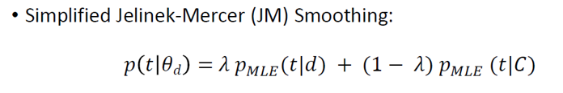
Galago retrieval model-----Java API
Typically, we can
Specify scorer.
How to input query. You need to know a little bit about Galago Query Language.
String inputQueryString = "#combine( apple )"; //query
Node queryTree = StructuredQuery.parse(inputQueryString); //change to query tree
Node transformedTree = retrieval.transformQuery(queryTree.clone(), queryParams) // apply traversals
List<ScoredDocument> results = retrieval.executeQuery(transformedTree, p).scoredDocuments; // issue the query!
Parameters p = new Parameters();
p.set("requested", 2000); // number of docs to retrieve
p.set("scorer", "jm"); // set JM smoothing method
p.set("lambda", 0.5); // set the parameters in JM method.

Slide 5
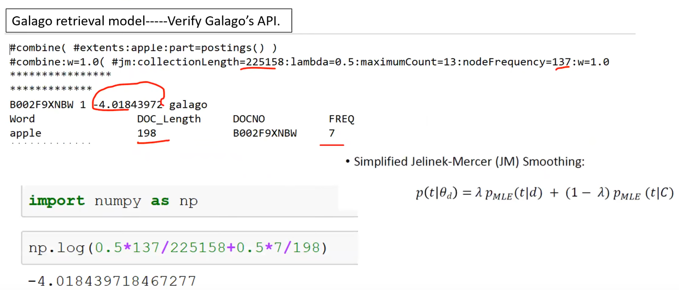

Slide 6
Galago Tutorial
We also provide example
Run basic retrieval model with command line.
Run basic retrieval model with Java API.
Please refer,
https://github.com/Taosheng-ty/CS_6550_galago_tutorial.git

