Slide 1
Radial reconstruction of magnetic
resonance images based on CNNs
Project executor:
Zhuang Yefan 18031018
Zhang Lu 18030878
Tao Sixian 18031021
Academic advisor:
Mrs.Liu

Slide 2
CONTENT
1
Introduction
2
Aim
3
Skills and Problems
4
Roles and responsibilities
5
Project Plan
6
Estimate

Slide 3
Introduction
01 Background
02 Principle
03
Existing-tech
04
Problems

Slide 4

“
Magnetic resonance imaging has the advantages of high spatial resolution, tissue resolution and no radiation damage, and it is a multi parameter imaging. Compared with computed tomography (CT), it can not only clearly display the anatomy, but also reflect various physiological states of human body.
Background
”

Slide 5
Introduction
Principle
In Magnetic Resonance Imaging(MRI), the MR data is acquired from k-space, named as Fourier space, from which the MR images are reconstructed.
K-space has always occupied an important position in MRI, which maps the original MRI sampling data in time domain to frequency domain. K-space track is the sampling track of MRI signal in the space domain. Generally, k-space is filled with rectangular signals. The reconstruction of image is to transform the k-space data into time-domain data by Fourier transform, so as to reconstruct the image.

Slide 6
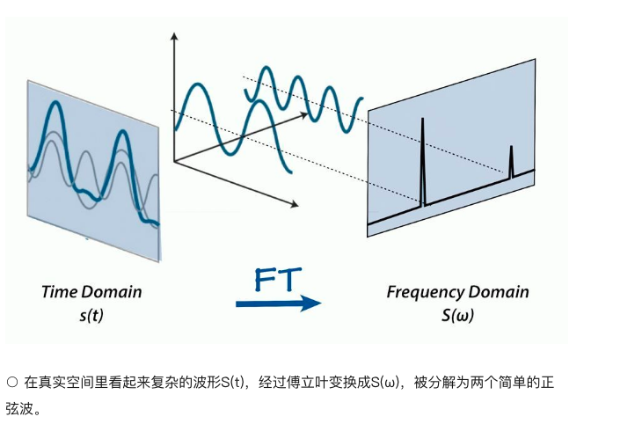
Fourier transform
Aperiodic function (the area under the function curve is limited) can also be expressed by sine or cosine times the integral of the weighted function, which is to convert a non periodic continuous signal in the time domain into a non periodic continuous signal in the frequency domain.
2
03
04
In real space, the complex waveform s (T), which is transformed into S (W) by Fourier
transform, is decomposed into two simple sine waves.

Slide 7
Fourier Transform
Fourier Transform

Slide 8
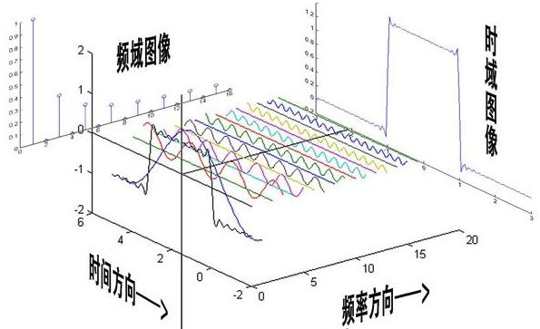
Fourier space
Fourier space
2
Time domain image
Frequency domain
image
03
Time
direction
04
Frequency
direction

Slide 9
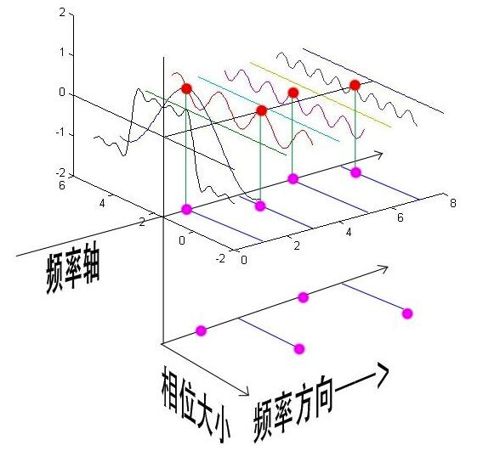
Fourier space
Fourier space
2
Frequency axis
03
Phase size
04
Frequency
direction

Slide 10
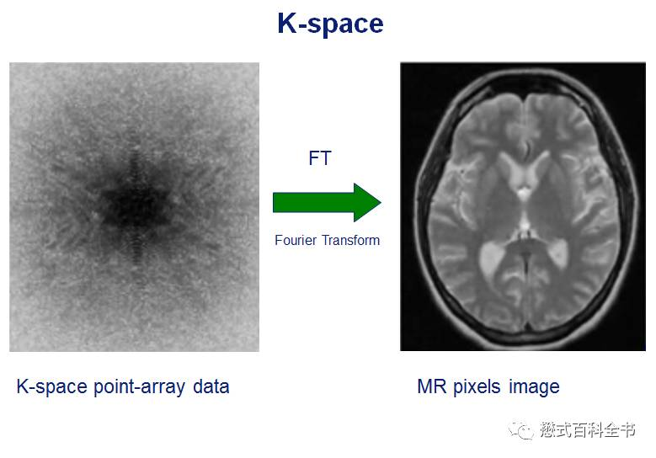
FT in MRI

Slide 11
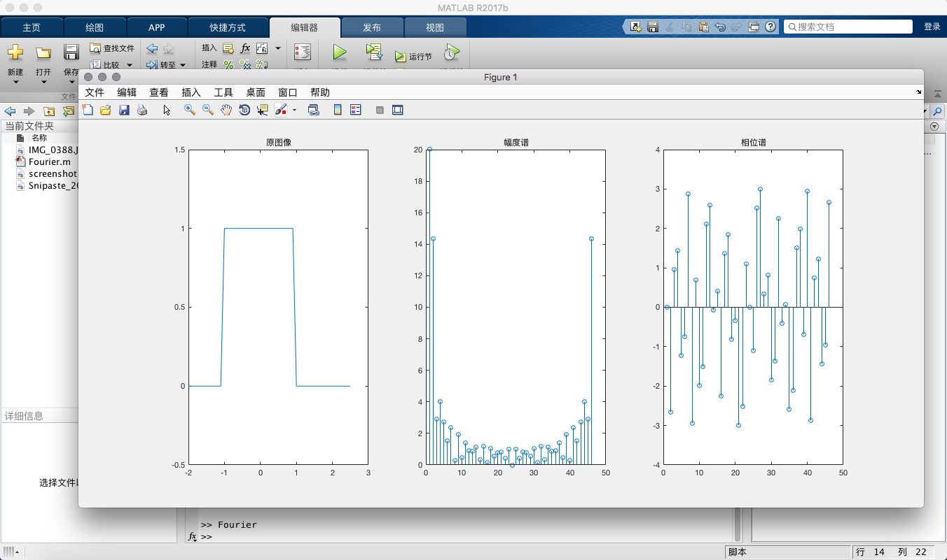
Simple realization of fast Fourier Transform with MATLAB
2
03
04

Slide 12
What is K-space?
K-space
K-space refers to the Fourier frequency-domain space composed of the collected MR data after phase coding and frequency coding. For a two-dimensional space plane, K space is a two-dimensional frequency space, K And K, respectively, represent two mutually perpendicular spatial frequencies. In MRI, the spatial frequency coordinate K And K,, corresponding to frequency coding direction coordinates and phase coding direction coordinates respectively.

Slide 13
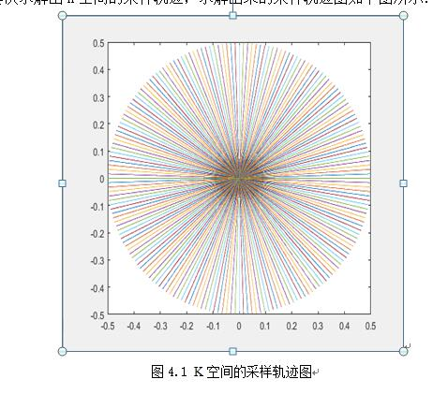
Sampling trace graph in K space

Slide 14
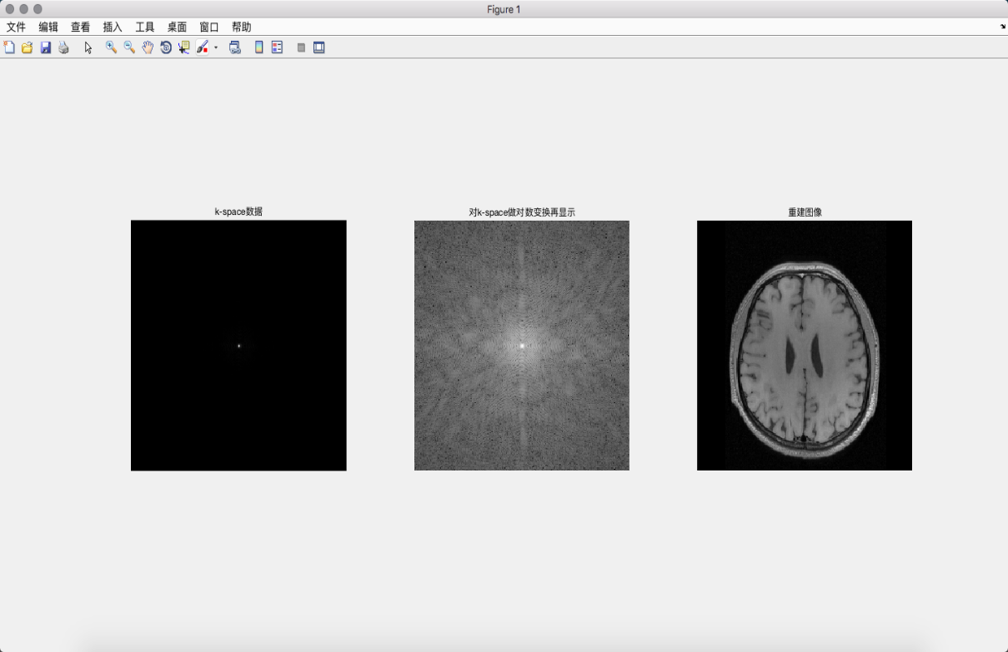
Sample using MATLAB

Slide 15
What is K-space?
Characters of K-space
In K space, the contribution of each data to image reconstruction is different. The main signals are concentrated in the data of the central area of k-space. Because the coding gradient and action time determine the position of sampling data in k-space together, the signal of the central area of k-space has low-frequency information with the largest amplitude. With the gradual increase of the absolute value of coordinates, the amplitude of the signal also decreases exponentially. Therefore, the data of the central area of k-space contains the strength of the main signals Degree, which contains most of the information of the image, mainly determines the contrast of the image; while k-space edge data has a higher spatial frequency, which contains more accurate positioning information, mainly determines the details of the image and the resolution of the image.

Slide 16
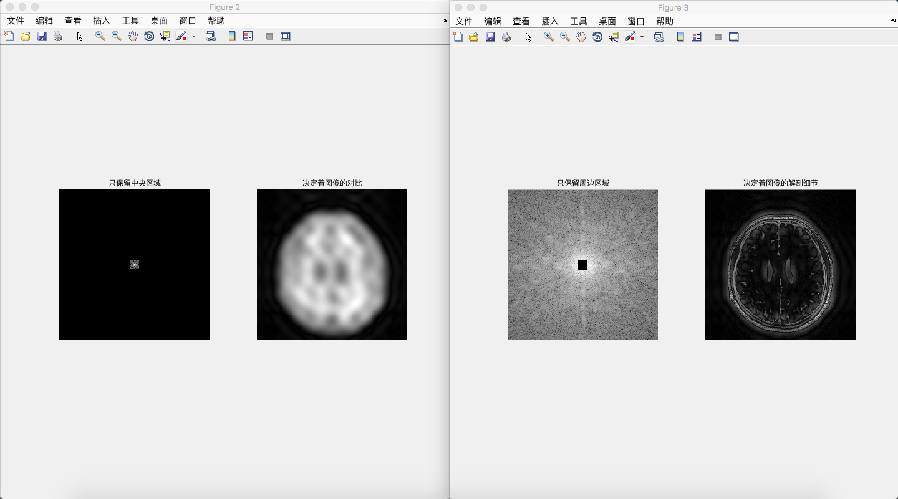
Two cases for illustration

Slide 17
What is K-space?
Existing technologies & Problems
Traditional MRI has a long imaging time, and there are artifacts in some fast moving parts. Its reconstruction method is simple, but line by line acquisition is very sensitive to motion artifacts.
The quality and the properties of reconstructed MR images depend on the k-space sampling patterns, and the Cartesian k-space trajectory is the most widely used sampling pattern. Compared to the Cartesian k-space trajectory, the radial k-space trajectory has many advantages , such as shorter echo times, insensitivity to motion and high temporal resolution, and is suitable for fast imaging and dynamic imaging. However, the MR images usually have streaking artifacts when reconstructed from radial k-space sampling patterns, even using Compressed Sensing(CS) for accelerated MRI.

Slide 18
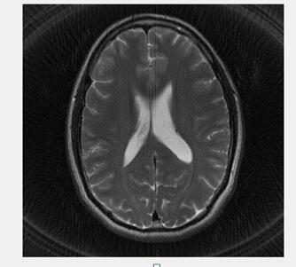
Neural network algorithm: steps
This is the image results using the traditional FFT algorithm. There will be trace artifacts !

Slide 19
Aim
01 Aim
02 How
03
Evaluation

Slide 20
Aim
Aim
Although the mathematical expression of compressed sensing is perfect, it seems difficult to apply it to MRI equipment. Deep learning turns the time of traditional iteration into training time and testing time, which often takes several days, but the time of reconstructing an image (testing time) can often reach 10ms, which can achieve real-time effect.
In the project, a MR reconstruction strategy based on convolutional neural networks is proposed.

Slide 21
How
How
Software: pcharm
Framework: tensorflow
After obtaining k-space data, we will design a numerical algorithm function for radial reconstruction of MR images. A multi-layer convolution neural network is designed to learn the corresponding parameters of this function. Finally, the trained neural network model is used to test the samples in the database. The quality of reconstructed image is analyzed. Compared with traditional Cartesian k-space trajectory and compressed sensing (CS) methods, the algorithm is modified and the parameters of neural network are adjusted.

Slide 22
Neural network algorithm: steps
Due to the limitation of the condition, it is impossible to obtain the original data by using the real NMR machine. We will obtain a full and complete MRI image database from the open source community, and carry out 2D Fourier transform for MRI images, and then deduce the corresponding k-space.
First of all, we expect to use the data in the data space of 256x256 as the input value of network training, and the output value is the parameter of the numerical algorithm function we will use, and then use this function to convert the value in the Fourier space into a gray-scale image.

Slide 23
Neural network algorithm: steps
Then, we design several methods that are expected to be tested:
1. In the early stage, we preprocess the data set of under fitting, so that the data distribution in K space is more uniform. Or map the known points to the surrounding space to get more available points.
2. According to the properties of k-space, multiple MR images with different features are reproduced, and the features of these images are extracted by neural network and then synthesized.
3. Segment the k-space data corresponding to an image, repeat the sampling for the missing part, and set up multiple control groups. The neural network is used to calculate the segmentation parameters in this operation.

Slide 24
Imaging quality criteria
Fringe artifacts between different images
Reconstruction time
Imaging contrast, whether there is high contrast soft tissue image

Slide 25
Possible difficulties
Find the
01
02
Find the difficulties of learning MRI
and MR imaging. Therefore, we need
to focus on the principle and
technology of MRI in the early stage
We have not learned Python language,
but we need to use Python to write code.
Our mathematical foundation is
weak, so it is difficult to analyze
and design a complex and
effective numerical algorithm.
Self study of neural network
and deep learning.
03
04

Slide 26
Division of labor
Zhang Lu
Zhuang Yefan
Tao Sixian
Algorithm comparison
(test network effect),
research model
parameter adjustment,
interface design,
graduation thesis
Data processing,
experimental testing,
interface design,
graduation thesis
Research algorithm,
graduation thesis

Slide 27
Time Management
2019.10-2020.02 Reading materials and documents, learning project background, reviewing MR image reconstruction, designing algorithm
Achievement: Understand the development history, complete the comparison with other traditional algorithms, and preliminarily design the model framework
2020.03-2020.04 Collect data, preliminarily test and modify code
Achievement: Grasp a implementation platform and the deep learning strategy

Slide 28
Time Management
2020.04-2020.05 Compare algorithms, evaluate and optimize algorithms, design visual interface, and write papers
Achievement: Accomplish the MR images reconstruction
2020.05-2020.06 Graduate Dissertation
Achievement: Score and evaluation

Slide 29
THANK YOU

