Slide 1
Dormathon
Retail decisions
with evidence
An operations workspace for connected exceptions
Track 1 Predictive Model Track / Taotern / 10 October 2026
01
Notes:
00:00–00:15. A regional operations lead sees a weather warning. Should a delivery plan change, and what would that protect? Dormathon makes that decision reviewable, from the source evidence to the remaining operational risk.
Three-minute pitch and two-minute Q&A. The six main slides provide a complete offline path if the live site is unavailable.
SOURCES
Approved Dormathon Product Specifications v0.4.1, 10 October 2026, S01–S11. Project source: docs/specs/Dormathon_Product_Specifications_v0.4.1_EN.md.
Project evidence: worker/mrdiy-event-evidence.js and mrdiy-event-scenarios.js; saved primary-source facts checked 10 October 2026, with explicit fictional mapping and total-delay confirmation.
Hosted product: https://dormathon-risk-private-20261007.liuyz8715.chatgpt.site/workbench.html. Site v76 with correctly labeled dated captures, published 10 October 2026.

Slide 2
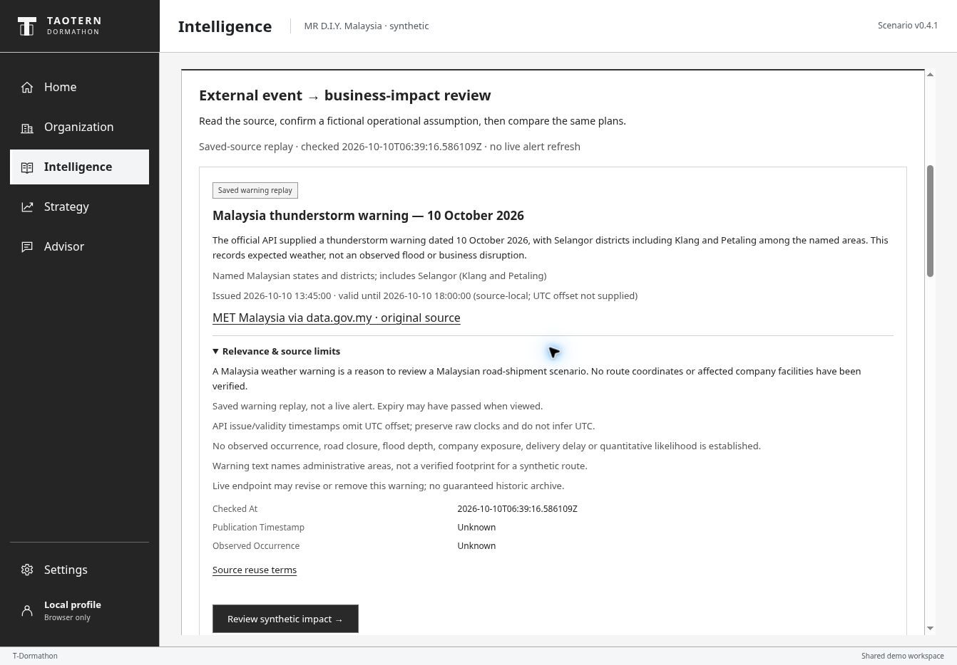
EVIDENCE BEFORE BUSINESS IMPACT
An official warning starts a review
Source fact
Thunderstorm warning
for named Malaysian areas
Open question
Does our shipment
actually have exposure?
Human-confirmed scenario
Fictional route + 4-day total delay
Saved MET warning replay, checked 10 Oct 2026. No live alert refresh or verified company disruption.
02
Notes:
00:15–00:45. Here is a saved official Malaysian weather warning. It is a reason to review a shipment, not proof that the company is disrupted. The lead explicitly maps it to a fictional route and confirms a four-day total delay. That number is an assumption entered for the replay; the warning does not supply it.
The source is MET Malaysia via data.gov.my, checked 06:39:16Z on 10 October 2026. Raw warning issue time 13:45 and expiry 18:00 are source-local strings without a UTC offset. This is a saved replay, potentially expired when presented, not an active alert. A warning records expected weather, not an observed flood, road closure or company delay.
SOURCES
MET Malaysia via data.gov.my. Saved official warning API facts checked 2026-10-10T06:39:16.586109Z. https://api.data.gov.my/weather/warning/?sort=-warning_issue__issued&limit=100 . Documentation: https://developer.data.gov.my/realtime-api/weather . Warning issue/validity clocks lack a UTC offset; preserve raw strings. No live refresh or verified business exposure.
Project evidence: worker/mrdiy-event-evidence.js and mrdiy-event-scenarios.js; saved primary-source facts checked 10 October 2026, with explicit fictional mapping and total-delay confirmation.
Hosted product: https://dormathon-risk-private-20261007.liuyz8715.chatgpt.site/workbench.html. Site v76 with correctly labeled dated captures, published 10 October 2026.

Slide 3
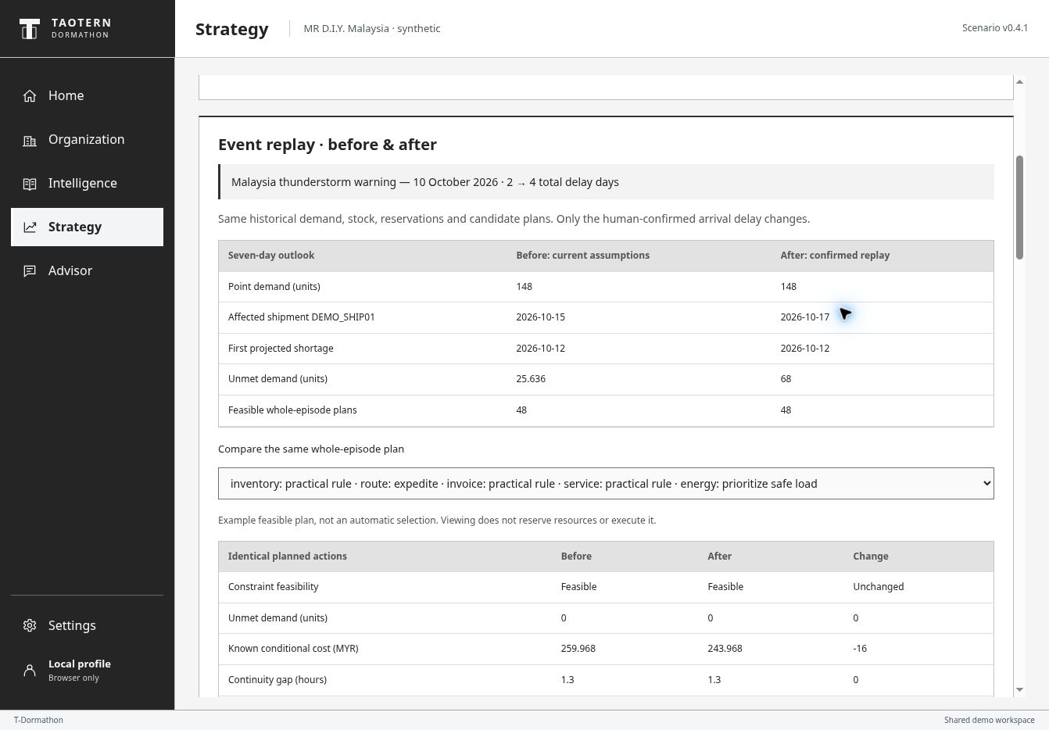
SAME DEMAND AND RESOURCES CHANGED ARRIVAL ASSUMPTION
The declared delay reveals a stock gap
68
units of modeled
unmet demand
12 October
first projected shortage
Synthetic operational history, stock and arrivals. A conditional no-change outcome, not an observed shortage.
03
Notes:
00:45–01:20. The calculation keeps demand, stock and candidate actions fixed. Only the confirmed arrival assumption changes. The affected shipment moves from October fifteenth to the seventeenth. The no-change path now leaves sixty-eight units unmet, with the first projected shortage on October twelfth. The product shows exactly which assumption produced that consequence.
The 196-day authored history produces 148 units of seven-day point demand before and after. Current total delay changes 2 to 4 days, replacing rather than adding to the previous delay. No-change unmet demand changes 25.636 to 68. Another declared 20-unit shipment still arrives 13 October. Weather is not converted into a demand shock. Legacy constant-demand 40-unit / MYR 496 / 61.6 results remain separate.
SOURCES
Project evidence: worker/mrdiy-event-evidence.js and mrdiy-event-scenarios.js; saved primary-source facts checked 10 October 2026, with explicit fictional mapping and total-delay confirmation.
Project evidence: docs/forecast-decision-expansion/README.md, joint-planner-contract.md, forecast-audit-report.v1.json; worker/mrdiy-demand-outlook.js and worker/mrdiy-joint-planner.js.
Hosted v76 desktop QA, 10 October 2026: demand outlook, bounded joint-plan comparison, resource accounting and missing-input behavior. Actual screenshots retained with capture version. Optional provider remains selected-case-only; no new paid request was required for expansion QA.
Hosted product: https://dormathon-risk-private-20261007.liuyz8715.chatgpt.site/workbench.html. Site v76 with correctly labeled dated captures, published 10 October 2026.

Slide 4
SHARED CONSTRAINTS ONE INSPECTED PACKAGE
A feasible response still leaves risk
Transfer buffer stock
and expedite the shipment
0
modeled unmet units
Invoice approval stays on hold.
Qualified service and safety-minimum
power use the same resource ledger.
1.3 h
remaining continuity gap
Conditional example under the confirmed four-day replay. Read-only comparison; no order, payment or facility action executes.
04
Notes:
01:20–01:55. One feasible package transfers a stock buffer and expedites the shipment, while planning invoice review, qualified service and safety-minimum power. Shared cash, stock, fuel and capacity constrain the package. It leaves zero modeled unmet demand, but a one-point-three-hour continuity gap remains. That is a concrete, inspectable trade-off. Viewing the plan executes nothing.
The replay compares 72 bounded package identities with 48 feasible under the default unreserved snapshot. The inspected after package includes practical inventory transfer, route expedite, invoice review, qualified service and safety-minimum energy. It is an example, not an automatic or globally optimal recommendation. Known conditional cost 243.9675 excludes unpriced consequences. This is a deterministic point-path comparison, separate from the later weighted sequential rehearsal.
SOURCES
Project evidence: worker/mrdiy-event-evidence.js and mrdiy-event-scenarios.js; saved primary-source facts checked 10 October 2026, with explicit fictional mapping and total-delay confirmation.
Project evidence: docs/forecast-decision-expansion/README.md, joint-planner-contract.md, forecast-audit-report.v1.json; worker/mrdiy-demand-outlook.js and worker/mrdiy-joint-planner.js.
Hosted v76 desktop QA, 10 October 2026: demand outlook, bounded joint-plan comparison, resource accounting and missing-input behavior. Actual screenshots retained with capture version. Optional provider remains selected-case-only; no new paid request was required for expansion QA.
Hosted product: https://dormathon-risk-private-20261007.liuyz8715.chatgpt.site/workbench.html. Site v76 with correctly labeled dated captures, published 10 October 2026.

Slide 5
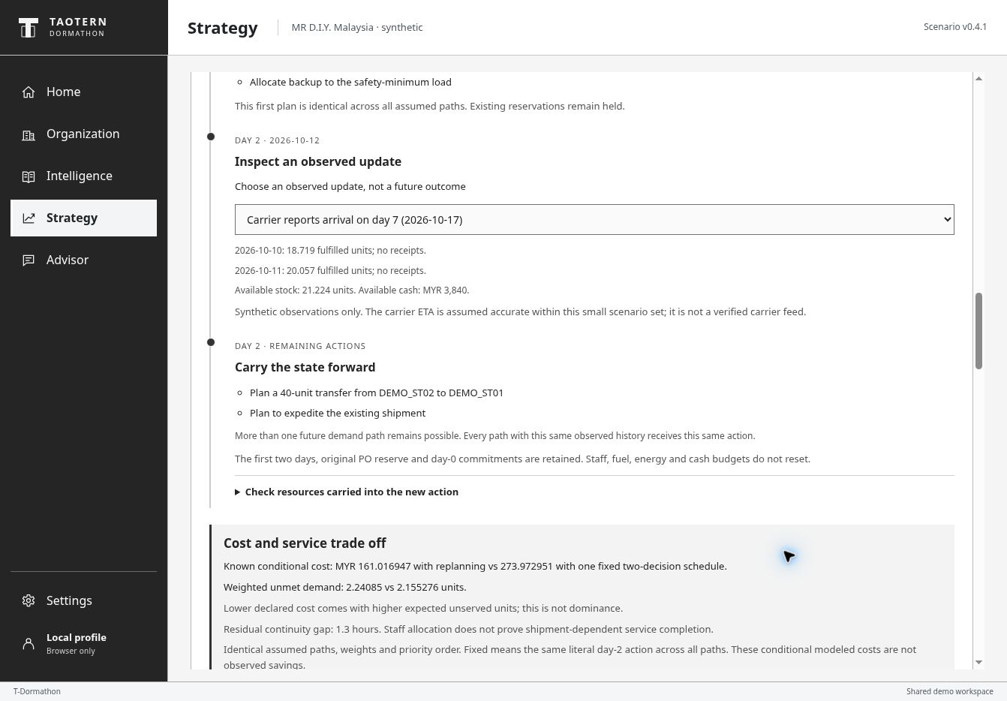
OPTIONAL TWO-DECISION REHEARSAL
A carrier update changes the next action
Day 0
One common first plan
Day 2
Use fulfilled sales, receipts
and the carrier report
Carry forward balances
and earlier commitments
Seven-day synthetic rehearsal. Assumed carrier update and scenario weights. A separate comparison, with no trained agent or execution.
05
Notes:
01:55–02:30. An optional rehearsal then asks what to do when new information arrives. The first plan is common across the assumed paths. On day two, the next action can use fulfilled sales, receipts and a carrier update. Paths with the same observed history receive the same action. Earlier commitments and resource usage carry forward. This demonstrates bounded replanning, not a trained autonomous agent.
This rehearsal starts its own two-decision comparison using the confirmed four-day assumption. It is not a simulation that executes or automatically continues the inspected static package. For the confirmed four-day replay, the delayed-ETA branch plans both a 40-unit transfer and route expedite; the earlier-ETA branch adds no inventory action. The two-day baseline adds a transfer only and must not be substituted for this replay. Future demand remains uncertain. The carrier update is assumed accurate within the authored set, not a verified feed. Show costs with service in the appendix; lower assumed expected cost has slightly higher unmet demand.
SOURCES
Project evidence: docs/sequential-contract.md; worker/mrdiy-sequential-planner.js; v76 hosted QA and the confirmed four-day replay. Seven-day, two-decision bounded synthetic rehearsal.
Project evidence: worker/mrdiy-event-evidence.js and mrdiy-event-scenarios.js; saved primary-source facts checked 10 October 2026, with explicit fictional mapping and total-delay confirmation.
Hosted v76 desktop QA, 10 October 2026: demand outlook, bounded joint-plan comparison, resource accounting and missing-input behavior. Actual screenshots retained with capture version. Optional provider remains selected-case-only; no new paid request was required for expansion QA.
Hosted product: https://dormathon-risk-private-20261007.liuyz8715.chatgpt.site/workbench.html. Site v76 with correctly labeled dated captures, published 10 October 2026.

Slide 6
DORMATHON
A working retail risk workspace
The lead can inspect
the decision before acting
Delivered
Evidence-linked review
Dated shortage outlook
Feasible plan comparison
Observed-history rehearsal
Source facts stay separate from assumptions.
Plans retain their constraints and remaining risk.
Next: validate against
observed operating outcomes
Real public evidence, explicit hypothetical exposure and synthetic operations. Human review remains required.
06
Notes:
02:30–03:00. Dormathon connects public evidence to an explicit operational assumption, a dated shortage, a feasible response and a revised choice after new information. The lead can inspect the basis and see what risk remains before acting. The next proof requires real operating observations. Today, the complete review workflow is working, and its boundaries stay visible.
SOURCES
Approved Dormathon Product Specifications v0.4.1, 10 October 2026, S01–S11. Project source: docs/specs/Dormathon_Product_Specifications_v0.4.1_EN.md.
Project evidence: worker/mrdiy-event-evidence.js and mrdiy-event-scenarios.js; saved primary-source facts checked 10 October 2026, with explicit fictional mapping and total-delay confirmation.
Project evidence: docs/sequential-contract.md; worker/mrdiy-sequential-planner.js; v76 hosted QA and the confirmed four-day replay. Seven-day, two-decision bounded synthetic rehearsal.
Hosted product: https://dormathon-risk-private-20261007.liuyz8715.chatgpt.site/workbench.html. Site v76 with correctly labeled dated captures, published 10 October 2026.

Slide 7
PRODUCT SCOPE
40 cases share one operating snapshot
40
16
Supply
10
Procurement
complete case workflows
08
Service
Inspect evidence and options.
Save and reopen a decision.
06
Energy security
SC01 / SC02 / SC17 / SC18 / SC27 / SC35
Same shipment, invoice, service task and resource pools
Synthetic MR D.I.Y. Malaysia workspace: 2 distribution clusters, 8 stores and 24 SKUs. Six cases form the deep demonstration.
07
Notes:
Forty selected-case workflows remain available: 16 supply, 10 procurement, 8 service and 6 energy-security. Event replay, bounded whole-episode enumeration and sequential rehearsal cover the six linked deep cases only. Existing saved choices remain selected-case records. All company operating records and incidents are synthetic.
SOURCES
Approved Dormathon Product Specifications v0.4.1, 10 October 2026, S01–S11. Project source: docs/specs/Dormathon_Product_Specifications_v0.4.1_EN.md.
Project evidence: docs/forecast-decision-expansion/README.md, joint-planner-contract.md, forecast-audit-report.v1.json; worker/mrdiy-demand-outlook.js and worker/mrdiy-joint-planner.js.
Project evidence: worker/mrdiy-event-evidence.js and mrdiy-event-scenarios.js; saved primary-source facts checked 10 October 2026, with explicit fictional mapping and total-delay confirmation.
Project evidence: docs/sequential-contract.md; worker/mrdiy-sequential-planner.js; v76 hosted QA and the confirmed four-day replay. Seven-day, two-decision bounded synthetic rehearsal.

Slide 8
APPENDIX DATA AND MODEL BOUNDARIES
Evidence and assumptions have different roles
Public source
Saved MET warning and attributed public reports
No verified route exposure, delay or business loss
Human confirmation
Fictional mapping and total delay for a replay
UI affirmation, not company acknowledgement
Operational calculation
Authored history, arrivals and shared constraints
Conditional shortage and plan trade-offs
Replanning observation
Synthetic fulfilled sales, receipts and carrier ETA
Future demand remains hidden and uncertain
The optional GPT-OSS 120B Advisor remains selected-case-only. It does not consume or approve event, joint or sequential plans.
08
Notes:
No live alert feed or weather-to-loss model. The MET source may expire and does not provide total delay, risk probability or company severity. Explicit fictional mapping is required. The LLM remains the pre-existing selected-case explanation service. No new paid request is required for event, joint, stress or sequential calculations. Lexical FTS5/BM25 retrieval remains separate from the bounded deterministic planner.
SOURCES
MET Malaysia via data.gov.my. Saved official warning API facts checked 2026-10-10T06:39:16.586109Z. https://api.data.gov.my/weather/warning/?sort=-warning_issue__issued&limit=100 . Documentation: https://developer.data.gov.my/realtime-api/weather . Warning issue/validity clocks lack a UTC offset; preserve raw strings. No live refresh or verified business exposure.
Project evidence: worker/mrdiy-event-evidence.js and mrdiy-event-scenarios.js; saved primary-source facts checked 10 October 2026, with explicit fictional mapping and total-delay confirmation.
Project evidence: docs/sequential-contract.md; worker/mrdiy-sequential-planner.js; v76 hosted QA and the confirmed four-day replay. Seven-day, two-decision bounded synthetic rehearsal.
Hosted QA: v71 SC01 comparison and selected-decision save/reopen, SC16 abstention and provider-response replays verified 10 October 2026. v70 live SovernStack GPT-OSS 120B verified for SC01 explanation and SC16 missing-input answer. No claim of all-case LLM validation.

Slide 9
APPENDIX CONFIRMED FOUR-DAY REPLAY
Replanning lowers assumed cost, with more unmet demand
Modeled outcome | Replanning | Fixed two-decision plan
Known conditional cost, MYR | 161.017 | 273.973
Weighted unmet demand, units | 2.241 | 2.155
Residual continuity gap, hours | 1.3 | 1.3
Lower cost does not dominate the service outcome
Same paths, weights, constraints and declared objective. Fixed means the same day-2 action across paths.
Expected values use assumed 0.5 / 0.3 / 0.2 scenario weights. Synthetic outcomes, not measured probabilities or company savings.
09
Notes:
Exact four-day replay metrics: replanned known conditional cost MYR 161.016947 versus fixed 273.972951. Weighted unmet demand 2.240850 versus 2.155276 units; both continuity gap 1.3 hours. The lower-cost plan has slightly higher unmet demand, so no dominance or service-improvement claim. Seven-day horizon, decisions at day 0 and day 2. The two-day baseline gives costs 71.016947 and 93.972951, with the same unmet-demand pair. Never use the baseline costs as the four-day replay result. The static joint example 243.9675 is a different point-path comparison. No causal savings or real MRDIY failure probability.
SOURCES
Project evidence: docs/sequential-contract.md; worker/mrdiy-sequential-planner.js; v76 hosted QA and the confirmed four-day replay. Seven-day, two-decision bounded synthetic rehearsal.
Hosted v76 desktop QA, 10 October 2026: demand outlook, bounded joint-plan comparison, resource accounting and missing-input behavior. Actual screenshots retained with capture version. Optional provider remains selected-case-only; no new paid request was required for expansion QA.

Slide 10
APPENDIX SEQUENTIAL METHOD
The next choice uses only the observed history
Day 0
Day 2 observation
Next admissible action
Common first choice
across every path
Fulfilled sales and receipts
Physical balances
Assumed carrier ETA
Same history, same action
Earlier choices remain irreversible
Stock, PO reserve, cash, fuel, staff hours and backup energy carry forward.
No resource reset and no future demand or scenario identity in the observation.
Bounded enumeration: at most 72 day-0 packages and six day-2 inventory/route choices. No RL, MCTS or high-fidelity process model.
10
Notes:
Day 0 and day 2 decisions occur before receipts and demand on those dates. Observation contains only fulfilled synthetic sales and receipts through day 1, current balances and an assumed accurate carrier ETA. Censored unserved latent demand is excluded. Three authored paths carry weights 0.5, 0.3, 0.2; the delayed branches remain indistinguishable with conditional weights 0.6/0.4. Objective order: minimize continuity gap, unallocated service and unplanned review, then weighted known conditional cost. No learned reward, global-optimality, MCTS, PINN, ODE/SDE or digital-twin fidelity claim. Existing constraints and finite action menus bound the result.
SOURCES
Project evidence: docs/sequential-contract.md; worker/mrdiy-sequential-planner.js; v76 hosted QA and the confirmed four-day replay. Seven-day, two-decision bounded synthetic rehearsal.

Slide 11
APPENDIX EXTERNAL ROLLING-ORIGIN RESULTS
Weekly error improved in an exploratory study
Seven-day total WAPE, percent
108.53%
selector daily WAPE
Same-fold weekly gain:
7.48 percentage points
No pristine holdout
No company validation
UCI Online Retail II. Eight 2011 folds on previously exposed prior-training periods. Lower WAPE is better; it is not accuracy.
11
Notes:
Separate exploratory rolling-origin external demand study. Selector weekly WAPE 69.7338146%, same-fold mean28 77.2116842%, selector daily WAPE 108.5262963%. Eight retrospective folds on prior training periods already exposed in earlier work. 89,324 weekly forecasts, 625,268 daily points. Descriptive 400-replicate paired SKU/fold interval for weekly selector minus mean28 is minus 11.63 to minus 3.71 percentage points. Not a pristine holdout, stockout calibration or company validation. No operational promotion. Fourteen fixed candidates selected from each preceding 28-day validation window; February–September 2011 test starts, 28 days each.
SOURCES
Project evidence: data/forecast-rolling-report.v1.json; docs/forecast-decision-expansion/portable-reproduction/protocol.json. Eight retrospective rolling folds on previously exposed prior-training periods. Exact isolated reproduction passed.
Chen, D. (2012). Online Retail II [Dataset]. UCI Machine Learning Repository. DOI 10.24432/C5CG6D. CC BY 4.0. https://archive.ics.uci.edu/dataset/502/online+retail+ii

Slide 12
EXTERNAL PREDICTIVE EVIDENCE
A reproducible benchmark, with high forecast error
Test mean absolute error, units
103.41%
retained mean test WAPE
Validation selected the mean.
The supervised ridge lost.
Accuracy is still weak.
UCI Online Retail II, UK non-store retailer. Known-SKU test: 11 Nov–8 Dec 2011. Precomputed study, separate from MR D.I.Y.
12
Notes:
Original frozen-split external study retained separately. Test 11 November–8 December 2011: mean28 MAE 6.974 and WAPE 103.41%; weekly-naive MAE 7.727; direct ridge MAE 7.607. Ridge loses to the mean. No direct mean-versus-naive CI or significance claim. Do not compare this old daily score with the new weekly rolling score as a before/after product accuracy gain.
SOURCES
Project evidence: docs/predictive-v0.4.1/artifacts/benchmark-report.v1.json and frozen-split.v1.json. Recomputed and checked 10 October 2026. Results are precomputed.
Chen, D. (2012). Online Retail II [Dataset]. UCI Machine Learning Repository. DOI 10.24432/C5CG6D. CC BY 4.0. https://archive.ics.uci.edu/dataset/502/online+retail+ii

Slide 13
APPENDIX TWO-MINUTE Q&A
Questions the demonstration can answer
Did the warning cause a company delay?
How is a better decision demonstrated?
No. A human explicitly confirms a fictional route analogy and an assumed total delay.
Compare the same inputs and constraints. Show cost, service and remaining risk together.
Is this a trained autonomous agent?
Can the system execute or save a joint plan?
No. Statistical forecasting and bounded scenario enumeration support human review.
No. Joint and sequential comparisons are read-only. Existing saved choices remain case-scoped.
All operational values are conditional on synthetic inputs. Real-world benefit and forecast quality require separate validation.
13
Notes:
Additional questions: Low/high live demand paths are empirical authored-history scenarios, not calibrated confidence intervals. Unknown required inputs abstain. Scenario weights are explicitly assumed. The fixed sequential comparator keeps the same literal day-2 action across paths, not a general practical policy. A forecast-driven static joint package is not the same experiment as the sequential expectation. Stress testing evaluates discrete tested points and cannot establish an exact continuous failure threshold or probability. No provider call is needed for the new calculations.
SOURCES
Project evidence: worker/mrdiy-event-evidence.js and mrdiy-event-scenarios.js; saved primary-source facts checked 10 October 2026, with explicit fictional mapping and total-delay confirmation.
Project evidence: docs/sequential-contract.md; worker/mrdiy-sequential-planner.js; v76 hosted QA and the confirmed four-day replay. Seven-day, two-decision bounded synthetic rehearsal.
Project evidence: docs/forecast-decision-expansion/README.md, joint-planner-contract.md, forecast-audit-report.v1.json; worker/mrdiy-demand-outlook.js and worker/mrdiy-joint-planner.js.
Project evidence: data/forecast-rolling-report.v1.json; docs/forecast-decision-expansion/portable-reproduction/protocol.json. Eight retrospective rolling folds on previously exposed prior-training periods. Exact isolated reproduction passed.

Slide 14
APPENDIX EVIDENCE REGISTER
Sources and scope remain traceable
Warning evidence
MET Malaysia via data.gov.my, checked 10 Oct 2026
Saved warning facts; no observed incident or verified exposure
Retail context
MR D.I.Y. FY2025 annual and sustainability reports
Public operating context; company internal records are synthetic
Operational model
Approved fixture plus event and sequential contracts
Bounded conditional comparisons with explicit assumptions
Forecast research
UCI Online Retail II, 2009–2011
Original daily study and exploratory rolling study remain separate
Track 1: detect, categorize, prioritize and explain. Owner-confirmed format: three-minute pitch and two-minute Q&A.
14
Notes:
MET API documentation https://developer.data.gov.my/realtime-api/weather and source API below. The saved record preserves raw source-local issuance 13:45 and expiry 18:00 without an offset; published and actual occurrence timestamps remain unknown. Source reuse: https://www.met.gov.my/en/info/data-terbuka/ . The optional historical GDACS reference is separate; a Vietnam event does not establish exposure for the fictional Malaysia route. Company FY2025 scope includes Malaysia and Brunei unless otherwise specified. No endorsement or company access implied. Timing: 19:00 MYT ready target and 20:00 review on 10 October 2026; 09:00 submission on 11 October 2026. Source snapshot v76, 10 October.
SOURCES
MET Malaysia via data.gov.my. Saved official warning API facts checked 2026-10-10T06:39:16.586109Z. https://api.data.gov.my/weather/warning/?sort=-warning_issue__issued&limit=100 . Documentation: https://developer.data.gov.my/realtime-api/weather . Warning issue/validity clocks lack a UTC offset; preserve raw strings. No live refresh or verified business exposure.
MR D.I.Y. Group (M) Berhad, Integrated Annual Report 2025. https://mrdiy.listedcompany.com/misc/ar/MRDIY_AR2025.pdf
MR D.I.Y. Group (M) Berhad, Sustainability Report 2025, printed pp2,33,37–40,47–49. https://corporate.mrdiy.com/misc/sustainability/MRDIY-Sustainability_Report_2025.pdf
Chen, D. (2012). Online Retail II [Dataset]. UCI Machine Learning Repository. DOI 10.24432/C5CG6D. CC BY 4.0. https://archive.ics.uci.edu/dataset/502/online+retail+ii
Approved Dormathon Product Specifications v0.4.1, 10 October 2026, S01–S11. Project source: docs/specs/Dormathon_Product_Specifications_v0.4.1_EN.md.
Project evidence: worker/mrdiy-event-evidence.js and mrdiy-event-scenarios.js; saved primary-source facts checked 10 October 2026, with explicit fictional mapping and total-delay confirmation.
Project evidence: docs/sequential-contract.md; worker/mrdiy-sequential-planner.js; v76 hosted QA and the confirmed four-day replay. Seven-day, two-decision bounded synthetic rehearsal.
Project evidence: data/forecast-rolling-report.v1.json; docs/forecast-decision-expansion/portable-reproduction/protocol.json. Eight retrospective rolling folds on previously exposed prior-training periods. Exact isolated reproduction passed.
Hosted product: https://dormathon-risk-private-20261007.liuyz8715.chatgpt.site/workbench.html. Site v76 with correctly labeled dated captures, published 10 October 2026.

Slide 15
OFFLINE FALLBACK SAVED V76 SCREEN
Saved official warning evidence
Official weather warning
Source checked and attributed
Business impact unverified
Saved v76 screen, 10 Oct 2026. Primary-source replay, not a live alert or verified company exposure.
15
Notes:
Saved hosted screen, not a live interaction. MET warning replay with explicit source and time limitations.
SOURCES
Hosted product: https://dormathon-risk-private-20261007.liuyz8715.chatgpt.site/workbench.html. Site v76 with correctly labeled dated captures, published 10 October 2026.
Project evidence: worker/mrdiy-event-evidence.js and mrdiy-event-scenarios.js; saved primary-source facts checked 10 October 2026, with explicit fictional mapping and total-delay confirmation.
Project evidence: docs/sequential-contract.md; worker/mrdiy-sequential-planner.js; v76 hosted QA and the confirmed four-day replay. Seven-day, two-decision bounded synthetic rehearsal.

Slide 16
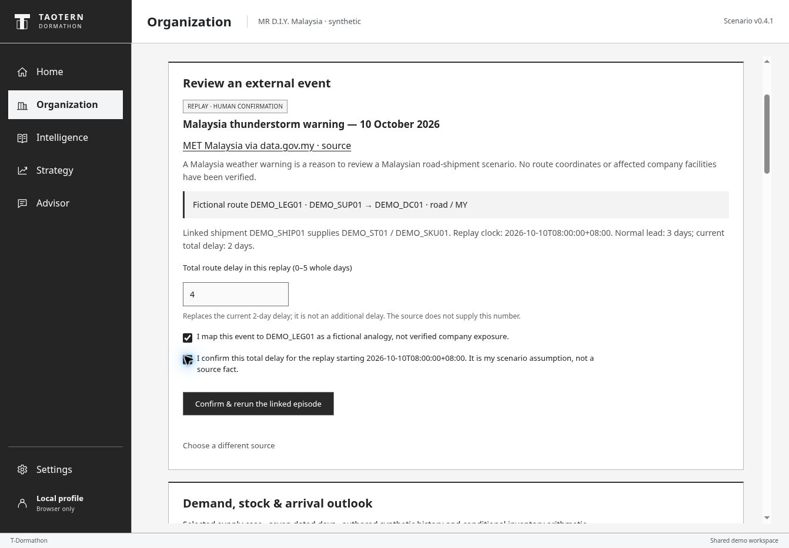
OFFLINE FALLBACK SAVED V76 SCREEN
Saved fictional impact confirmation
Fictional route
4-day total delay
User confirms both assumptions
Saved v76 screen, 10 Oct 2026. Explicit hypothetical route mapping and four-day total delay.
16
Notes:
Saved hosted screen, not a live interaction. Four days replaces the current two-day total delay. The warning does not supply this number.
SOURCES
Hosted product: https://dormathon-risk-private-20261007.liuyz8715.chatgpt.site/workbench.html. Site v76 with correctly labeled dated captures, published 10 October 2026.
Project evidence: worker/mrdiy-event-evidence.js and mrdiy-event-scenarios.js; saved primary-source facts checked 10 October 2026, with explicit fictional mapping and total-delay confirmation.
Project evidence: docs/sequential-contract.md; worker/mrdiy-sequential-planner.js; v76 hosted QA and the confirmed four-day replay. Seven-day, two-decision bounded synthetic rehearsal.

Slide 17
OFFLINE FALLBACK SAVED V76 SCREEN
Saved four-day replay comparison
68 unmet units
with no change
Inspected plan:
0 unmet, 1.3 h gap
Saved v76 screen, 10 Oct 2026. Same demand and resources; only the confirmed delay assumption changes.
17
Notes:
Saved hosted screen, not a live interaction. No-change point-path shortage 68; selected joint package transfer plus expedite has zero modeled shortage and 1.3-hour continuity gap. No external execution.
SOURCES
Hosted product: https://dormathon-risk-private-20261007.liuyz8715.chatgpt.site/workbench.html. Site v76 with correctly labeled dated captures, published 10 October 2026.
Project evidence: worker/mrdiy-event-evidence.js and mrdiy-event-scenarios.js; saved primary-source facts checked 10 October 2026, with explicit fictional mapping and total-delay confirmation.
Project evidence: docs/sequential-contract.md; worker/mrdiy-sequential-planner.js; v76 hosted QA and the confirmed four-day replay. Seven-day, two-decision bounded synthetic rehearsal.

Slide 18
OFFLINE FALLBACK SAVED V76 SCREEN
Saved observed-history replanning
Day-2 carrier report
Transfer + expedite
Lower assumed cost,
slightly more unmet demand
Saved v76 screen, 10 Oct 2026. Confirmed four-day replay. Synthetic observations and assumed scenario weights.
18
Notes:
Saved hosted screen, not a live interaction. Delayed four-day branch plans both 40-unit transfer and expedite. Replanning 161.016947 versus fixed 273.972951 known conditional MYR; unmet 2.240850 versus 2.155276; both 1.3-hour gap. These are synthetic assumed-weight expectations, not actual savings.
SOURCES
Hosted product: https://dormathon-risk-private-20261007.liuyz8715.chatgpt.site/workbench.html. Site v76 with correctly labeled dated captures, published 10 October 2026.
Project evidence: worker/mrdiy-event-evidence.js and mrdiy-event-scenarios.js; saved primary-source facts checked 10 October 2026, with explicit fictional mapping and total-delay confirmation.
Project evidence: docs/sequential-contract.md; worker/mrdiy-sequential-planner.js; v76 hosted QA and the confirmed four-day replay. Seven-day, two-decision bounded synthetic rehearsal.

