Slide 1
Dormathon
Retail decisions
with evidence
An operations workspace for connected exceptions
Track 1 Predictive Model Track / Taotern / 10 October 2026
01
Notes:
00:00–00:15. A disruption makes headlines. Which order is exposed, and which response is worth its cost? Dormathon connects real evidence to explicit exposure and constrained choices, then updates as observations arrive.
The six main slides form a complete three-minute pitch with actual saved v77 screens.
SOURCES
Verified real-event pack, events.json, as of 10 October 2026. Retailer exposure and delay are explicit hypothetical assumptions.
Hosted v77 product, published 10 October 2026. https://dormathon-risk-private-20261007.liuyz8715.chatgpt.site/workbench.html

Slide 2
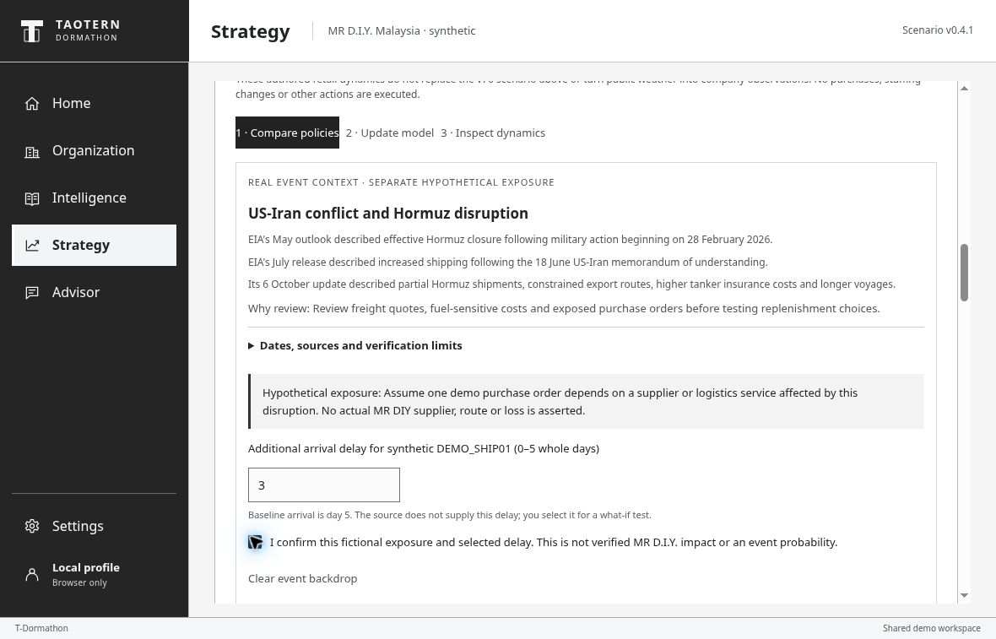
REAL EVENT EXPLICIT BUSINESS ASSUMPTION
US–Iran conflict and Hormuz disruption
Review the exposure
Does this order depend
on an affected service?
Assume +3 days
Apply the same delay
to every strategy
EIA update, 6 Oct 2026: partial flows and ongoing constraints. The hypothetical order exposure and delay are user-declared.
02
Notes:
00:15–00:50. Our example is the US–Iran conflict and Hormuz disruption. EIA’s October update describes partial flows and continuing constraints. A headline alone does not establish company exposure. Here, the user explicitly assumes a demo order is affected and adds three arrival days. Every strategy receives that same assumption.
Additional delay 3 moves the pending synthetic receipt from day 5 to day 8, outside decision days 0–6. It remains outstanding, not canceled. No Malaysia-bound shipment is automatically a Hormuz transit. This is a new daily-model sensitivity run, separate from the prior MET four-day-total-delay replay. Do not state current complete closure.
SOURCES
EIA October 2026 Short-Term Energy Outlook, published 6 October, forecast completed 1 October, checked 10 October 08:23:27 UTC. Partial Hormuz flows and ongoing route constraints. https://www.eia.gov/outlooks/steo/report/global_oil.php . May historical closure: https://www.eia.gov/outlooks/steo/archives/may26.pdf . July update: https://www.eia.gov/pressroom/releases/press590.php
Verified real-event pack, events.json, as of 10 October 2026. Retailer exposure and delay are explicit hypothetical assumptions.
Hosted v77 product, published 10 October 2026. https://dormathon-risk-private-20261007.liuyz8715.chatgpt.site/workbench.html

Slide 3
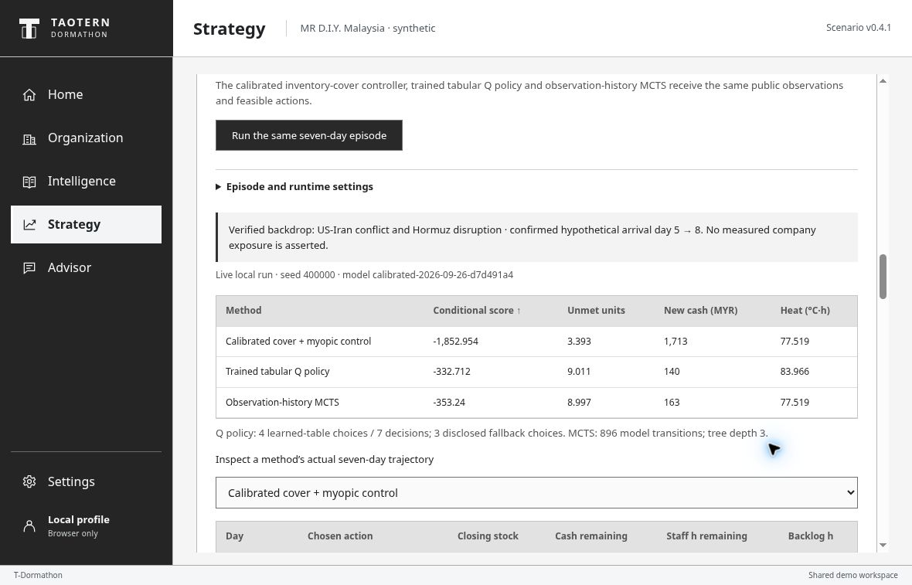
THIS SELECTED STRESS EPISODE
The same delayed order, compared fairly
Learned-policy example
4 learned / 3 fallback choices
MYR 140
new modeled commitments
9.0 units
unmet demand remains
Heat exposure is higher, too
One displayed seed, one confirmed delay. Illustrative synthetic outcomes, not the held-out study or measured company savings.
03
Notes:
00:50–01:35. We compare a practical controller, a trained policy and search in the same seven-day model. They share observations, feasible actions and resources. This displayed learned-policy run commits one hundred and forty ringgit in modeled new spending, while about nine units remain unmet. The controller protects more service and has lower heat exposure here, but spends more. The product makes that trade-off inspectable.
Actual v77 run: seed 400000, MCTS 32, initial model calibrated-2026-09-26-d7d491a4, Hormuz assumed additional delay 3. Controller score −1852.954, unmet 3.393 units, new cash MYR1713 and heat 77.519 degree-hours. Q score −332.712, unmet 9.011, new cash MYR140 and heat 83.966. MCTS score −353.24, unmet 8.997, cash MYR163 and heat 77.519. Q uses 4 learned-table choices and 3 fallback choices. This is one selected stress episode, not the frozen 96-seed mean conclusion. Q and MCTS do not beat the stronger controller on mean heldout score.
SOURCES
Verified real-event pack, events.json, as of 10 October 2026. Retailer exposure and delay are explicit hypothetical assumptions.
Frozen corrected study: retail-heldout-protocol2-evaluation.json, retail-protocol2-summary.csv and evaluation-findings.md. Prespecified controller and fresh 96-seed block 400000–400095. Primary seed41 fixed before training. Manifest 09b37d3ff020d3b2122fe2b3263cadcf57cb2425008d37abe7cf5c116b1a5476.
Hosted v77 product, published 10 October 2026. https://dormathon-risk-private-20261007.liuyz8715.chatgpt.site/workbench.html

Slide 4
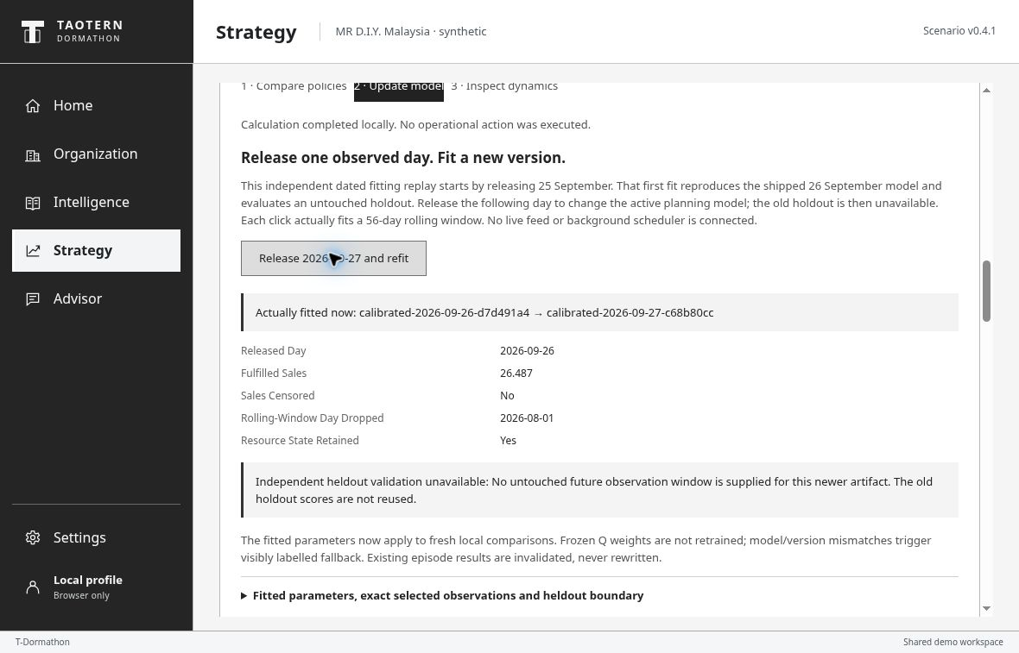
DATED UPDATE VERSIONED ASSUMPTIONS
New observations revise the active model
Release one dated day
Refit the rolling window
Record the new version
Old Q policy
Use its disclosed fallback
when the model changes
Authored synthetic sales and thermometer observations. The refit changes model parameters; it does not retrain the frozen Q policy.
04
Notes:
01:35–02:10. Next, release a dated sales and temperature observation. The system actually refits the rolling window and records a new active model. It never rewrites earlier results or resets resource commitments. The old trained policy is not silently treated as current: a changed model triggers its disclosed fallback. Updating the model is different from retraining the policy.
Releasing 25 September reproduces the shipped 26 September model and evaluates on the same later untouched interval. Releasing 26 September installs a genuinely newer 27 September model; the old holdout is then consumed and its before/after score is withheld. Controller and MCTS receive the fitted calibration; Q weights stay frozen. No background feed, automatic daily scheduler or new online RL training.
SOURCES
Runnable synthetic dynamics: docs/portable-contract.md; dynamics-heldout-evaluation.json; dynamics-demo-output.json; dynamics-thermal-pinn-v1.json. Frozen manifest 7ed2364dbe1788750bc09dc59496c4a3fd82e815c85e953c5da737009b8f8014.
Frozen corrected study: retail-heldout-protocol2-evaluation.json, retail-protocol2-summary.csv and evaluation-findings.md. Prespecified controller and fresh 96-seed block 400000–400095. Primary seed41 fixed before training. Manifest 09b37d3ff020d3b2122fe2b3263cadcf57cb2425008d37abe7cf5c116b1a5476.
Independent learning adoption audit, 10 October 2026: 29 focused checks, complete primary 20,000-episode reproduction and 1,440 evaluation rows reconciled. Implementation/reproducibility evidence, not business validity.
Hosted v77 product, published 10 October 2026. https://dormathon-risk-private-20261007.liuyz8715.chatgpt.site/workbench.html

Slide 5
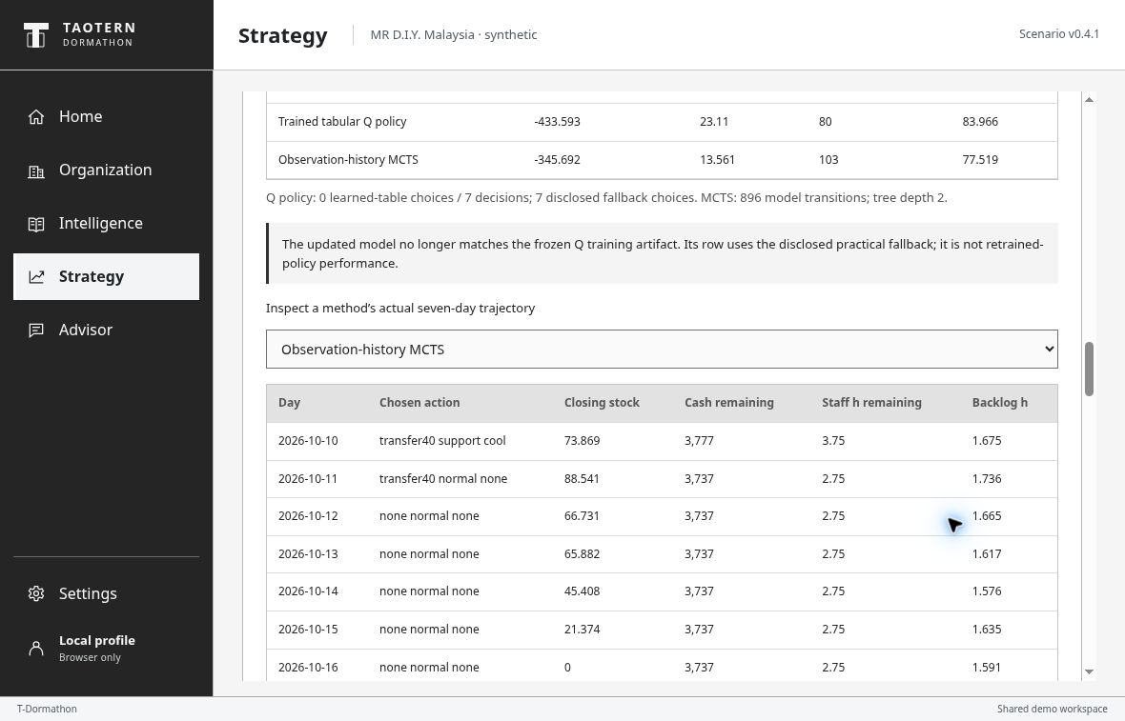
AFTER THE REFIT MCTS DAILY TRACE
Each action has a visible resource consequence
Inspect the daily choice
Stock moves between sites.
Cash and capacity are used.
Outstanding receipts stay visible.
No resource reset
All operating states, capacities and trajectories are synthetic. No purchase, dispatch, staff change or facility control executes.
05
Notes:
02:10–02:40. Open the daily trace to see the chosen action and its resource consequences. Transfers debit source stock. Orders reserve cash once. Staff, fuel and backup energy remain constrained, and receipts beyond the horizon remain outstanding. We keep shortages and other consequences visible. The lead can review the choice before any real action.
SOURCES
Runnable synthetic dynamics: docs/portable-contract.md; dynamics-heldout-evaluation.json; dynamics-demo-output.json; dynamics-thermal-pinn-v1.json. Frozen manifest 7ed2364dbe1788750bc09dc59496c4a3fd82e815c85e953c5da737009b8f8014.
Frozen corrected study: retail-heldout-protocol2-evaluation.json, retail-protocol2-summary.csv and evaluation-findings.md. Prespecified controller and fresh 96-seed block 400000–400095. Primary seed41 fixed before training. Manifest 09b37d3ff020d3b2122fe2b3263cadcf57cb2425008d37abe7cf5c116b1a5476.
Hosted v77 product, published 10 October 2026. https://dormathon-risk-private-20261007.liuyz8715.chatgpt.site/workbench.html

Slide 6
DORMATHON
A working review loop for retail decisions
Evidence that leads
to an inspectable choice
Working today
Sourced cases
Runnable comparisons
Versioned model updates
Connect the event to an explicit exposure.
Compare constrained responses.
Revise the model as observations arrive.
Next proof:
observed operating outcomes
Real external evidence. Explicit hypothetical exposure. Synthetic decision experiments. Human review remains required.
06
Notes:
02:40–03:00. Dormathon connects real external evidence to explicit business exposure and resource-constrained choices, then updates with new observations. That review loop is working today. The next proof is measured operating performance with real company data, not a stronger claim from the same simulation.
SOURCES
Verified real-event pack, events.json, as of 10 October 2026. Retailer exposure and delay are explicit hypothetical assumptions.
Runnable synthetic dynamics: docs/portable-contract.md; dynamics-heldout-evaluation.json; dynamics-demo-output.json; dynamics-thermal-pinn-v1.json. Frozen manifest 7ed2364dbe1788750bc09dc59496c4a3fd82e815c85e953c5da737009b8f8014.
Frozen corrected study: retail-heldout-protocol2-evaluation.json, retail-protocol2-summary.csv and evaluation-findings.md. Prespecified controller and fresh 96-seed block 400000–400095. Primary seed41 fixed before training. Manifest 09b37d3ff020d3b2122fe2b3263cadcf57cb2425008d37abe7cf5c116b1a5476.
Hosted v77 product, published 10 October 2026. https://dormathon-risk-private-20261007.liuyz8715.chatgpt.site/workbench.html

Slide 7
APPENDIX EVENT SCOPE
Real events lead to different review questions
Hormuz 2026
Partial flows and continuing constraints
Verify the order’s actual supplier or logistics exposure
Noto earthquake 2024
Historical JMA record, 1 January
Check the assumed supplier’s regional link
Red Sea rerouting 2024
Maersk’s 5 January carrier decision
Check the relevant service, not every Asian shipment
Kimi funding / enterprise AI
Dated reported funding and official program
Review vendor requirements; no physical supply shock
The existing 40 selected-case workflows remain. Three sourced events allow an explicit delay test; Kimi stays strategic context only.
07
Notes:
Forty case workflows: 16 supply, 10 procurement, 8 service and 6 energy security. Six deep cases remain SC01/02/17/18/27/35. The new learning model is separate. Noto is a dated JMA magnitude 7.6 event, not a current warning or a verified supplier link. Red Sea refers specifically to Maersk update 07 on 5 January 2024. Kimi funding is the 7 May SCMP report citing an adviser. The official 10 September enterprise program supports strategic context only. Neither funding nor a headline trains the retail model.
SOURCES
Verified real-event pack, events.json, as of 10 October 2026. Retailer exposure and delay are explicit hypothetical assumptions.
EIA October 2026 Short-Term Energy Outlook, published 6 October, forecast completed 1 October, checked 10 October 08:23:27 UTC. Partial Hormuz flows and ongoing route constraints. https://www.eia.gov/outlooks/steo/report/global_oil.php . May historical closure: https://www.eia.gov/outlooks/steo/archives/may26.pdf . July update: https://www.eia.gov/pressroom/releases/press590.php
https://www.jma.go.jp/jma/menu/20240101_noto_jishin.html
https://www.maersk.com/news/articles/2023/12/15/maersk-operations-through-red-sea-gulf-of-aden
https://www.scmp.com/tech/article/3352751/kimi-developer-moonshot-ai-valued-us20b-it-navigates-chinas-new-ipo-rules
https://www.kimi.com/news/kimi-enterprise-partner-program

Slide 8
APPENDIX MODEL CONTRACT
The simulator couples demand, capacity and resources
Demand uncertainty
Mean-reverting log-demand SDE
Fitted from uncensored synthetic sales
Thermal capacity
One-zone RC ODE and optional PINN
Fitted thermal coefficients; exact solver retained
Service and fatigue
Positive queue and utilization dynamics
Authored coefficients, not fitted company behavior
Resource accounting
Stock, receipts, cash, fuel, staff and energy
Conservation and feasible-action masks at every step
Seven daily decisions, 12 declared actions. Compact assumed dynamics, not a high-fidelity model of a real retailer.
08
Notes:
Demand dZ=−kappa Z dt+sigma dW, exact daily OU transition. Thermal dT/dh=k(Tout−T)−g Pcool. Fatigue df/dh=build*u*(1−f)−recovery*(1−u)*f; service queue dB/dh=intake−lambda B. Exact positive constant-forcing substeps, overnight thermal/fatigue treatment and bounds disclosed. Public observations exclude hidden demand, RNG, future events, reward and cumulative hidden-demand cost. Twelve actions combine retain/transfer40/order100, normal/support staffing and retain/cool. A six-hour aggregate staff pool is an authored approximation, not validated role interchangeability.
SOURCES
Runnable synthetic dynamics: docs/portable-contract.md; dynamics-heldout-evaluation.json; dynamics-demo-output.json; dynamics-thermal-pinn-v1.json. Frozen manifest 7ed2364dbe1788750bc09dc59496c4a3fd82e815c85e953c5da737009b8f8014.
Independent learning adoption audit, 10 October 2026: 29 focused checks, complete primary 20,000-episode reproduction and 1,440 evaluation rows reconciled. Implementation/reproducibility evidence, not business validity.

Slide 9
APPENDIX CHRONOLOGICAL SYNTHETIC EVALUATION
Dated fitting recovers an authored demand change
Demand mean absolute error, units per day
56 days
past-only fitting window
A newer fit consumes
the old test period.
Its old holdout score
is then withheld.
Same 26 Sep–9 Oct holdout: 13 uncensored sales rows, 56 thermal rows. Small synthetic study with an authored regime change.
09
Notes:
Frozen models before 3 August, 25 September and 26 September use the same 26 September–9 October holdout. Demand MAE: 7.1335237687, 1.8429529167 and 1.6896381706 units/day. August to September thermal RMSE: 0.0429634771 to 0.0418370851°C. The holdout has 13 uncensored sales rows and 56 thermal rows. The authored generator includes a demand level shift. A 56-day past-only window excludes censored sales. Future-label poisoning leaves the fit unchanged. The forecast is a weekday lognormal median/level. The later 26 September release produces a 27 September model and consumes the old test period, so its old holdout score is withheld.
SOURCES
Runnable synthetic dynamics: docs/portable-contract.md; dynamics-heldout-evaluation.json; dynamics-demo-output.json; dynamics-thermal-pinn-v1.json. Frozen manifest 7ed2364dbe1788750bc09dc59496c4a3fd82e815c85e953c5da737009b8f8014.
Independent learning adoption audit, 10 October 2026: 29 focused checks, complete primary 20,000-episode reproduction and 1,440 evaluation rows reconciled. Implementation/reproducibility evidence, not business validity.

Slide 10
APPENDIX SCALAR THERMAL SURROGATE
The PINN is trained, and the exact solver is stronger
Evidence | Verified result
Training | 37 parameters, 8,000 Adam steps
Equation and data | ODE residual + 4 exact synthetic data points
Validation | 100 distinct off-grid locations
Decay RMSE | 0.0000626
Frozen seven-day comparison | Maximum daily mean 0.0001488°C
Exact RC remains the reference and fallback
A bounded neural approximation to an assumed RC equation. No speedup, greater physical fidelity or planning advantage is claimed.
10
Notes:
One 12-unit tanh hidden layer with 37 parameters. A hard initial condition uses y=1+xN(x), and the governing scalar equation is dy/dx+y=0 with x=k*t. Training uses 41 collocation points, 4 exact synthetic labels and 8,000 Adam steps. All 37 gradients were independently checked. The 100 validation positions exclude training locations. Maximum decay error is 0.00014878485 and residual RMSE is 0.00042072357. The frozen fixed-schedule comparison uses 224 neural workday segments and has maximum daily mean temperature discrepancy 0.00014882417°C. The hosted comparison after the newer refit shows 0.000158134°C, a different calibration. Overnight and domain fallback remain exact. The separate solver inspection does not inherit the event delay.
SOURCES
Runnable synthetic dynamics: docs/portable-contract.md; dynamics-heldout-evaluation.json; dynamics-demo-output.json; dynamics-thermal-pinn-v1.json. Frozen manifest 7ed2364dbe1788750bc09dc59496c4a3fd82e815c85e953c5da737009b8f8014.
Independent learning adoption audit, 10 October 2026: 29 focused checks, complete primary 20,000-episode reproduction and 1,440 evaluation rows reconciled. Implementation/reproducibility evidence, not business validity.
Raissi et al., physics-informed neural residual method. https://arxiv.org/abs/1711.10561

Slide 11
APPENDIX FRESH 96-SEED POLICY TEST
The stronger controller wins on mean score
Declared penalty score, lower is better
Q reduces shortages
7.67 to 3.42 units
New commitments rise
MYR 89.25 to 144.21
No overall score gain
Synthetic held-out seeds in one model family. Primary Q fixed in advance. This is separate from the displayed Hormuz stress run.
11
Notes:
Penalty is negative declared reward. Controller reward: −266.649687. Primary Q: −271.243845. MCTS 32: −317.679240. MCTS 128: −304.803442. Q minus controller is −4.594158, with descriptive paired 95% interval −14.96845 to +5.780135. Q loses 58 of 96 episodes. Q mean unmet demand is 3.418055 versus 7.665113 units; new cash commitments 144.208333 versus 89.25 MYR; heat 66.821845 versus 63.935562 degree-hours. MCTS loses 87 and 82 episodes respectively. More search improves this sample but still trails the controller. No business savings or real-event probability is established. Do not switch the primary trained seed after testing.
SOURCES
Frozen corrected study: retail-heldout-protocol2-evaluation.json, retail-protocol2-summary.csv and evaluation-findings.md. Prespecified controller and fresh 96-seed block 400000–400095. Primary seed41 fixed before training. Manifest 09b37d3ff020d3b2122fe2b3263cadcf57cb2425008d37abe7cf5c116b1a5476.
Independent learning adoption audit, 10 October 2026: 29 focused checks, complete primary 20,000-episode reproduction and 1,440 evaluation rows reconciled. Implementation/reproducibility evidence, not business validity.

Slide 12
APPENDIX LEARNING AND EVALUATION PROTOCOL
The implementation and its failures are reproducible
Component | Evidence and limitation
Tabular Q-learning | 3 seeds × 20,000 seven-day training episodes
Primary reproduction | Complete Q table and visit counts match exactly
Observation-history UCT | Selection, expansion, rollout and return backup
Corrected comparison | New 96-seed block; same world, observations and masks
Failure disclosure | Primary Q 7/672 fallback decisions; 58/96 score losses
The first passive baseline remains disclosed
Implementation evidence supports that the methods run. It does not validate real-company outcomes or guarantee global optimality.
12
Notes:
Primary seed 41 was prespecified. Each of three training runs has 20,000 episodes and 140,000 interaction updates. Standard Bellman targets include unvisited feasible actions initialized at zero, and terminal targets do not bootstrap. Exact primary reproduction matched the table and visits. The first practical rule was identical to no action across all 96 seeds. A stronger controller and fresh 400000–400095 test block were therefore frozen separately. Primary Q fallback is 7 of 672 decisions, or 1.04%. Other seeds and severe failures remain disclosed. Offline Q training is not included as equal online compute. Finite-pool belief search and coarse tabular bins limit robustness. A separate two-day, three-path exact reference is not a seven-day or global oracle.
SOURCES
Frozen corrected study: retail-heldout-protocol2-evaluation.json, retail-protocol2-summary.csv and evaluation-findings.md. Prespecified controller and fresh 96-seed block 400000–400095. Primary seed41 fixed before training. Manifest 09b37d3ff020d3b2122fe2b3263cadcf57cb2425008d37abe7cf5c116b1a5476.
Independent learning adoption audit, 10 October 2026: 29 focused checks, complete primary 20,000-episode reproduction and 1,440 evaluation rows reconciled. Implementation/reproducibility evidence, not business validity.

Slide 13
APPENDIX EXTERNAL ROLLING-ORIGIN RESULTS
Weekly error improved in an exploratory study
Seven-day total WAPE, percent
108.53%
selector daily WAPE
Same-fold weekly gain:
7.48 percentage points
No pristine holdout
No company validation
UCI Online Retail II. Eight 2011 folds on previously exposed prior-training periods. Lower WAPE is better; it is not accuracy.
13
Notes:
Separate exploratory external UCI study, not the new synthetic model-update evaluation. Weekly WAPE 69.7338% versus mean28 77.2117%, with daily WAPE 108.5263%. Eight previously exposed 2011 folds include 89,324 weekly and 625,268 daily points. Descriptive 400-resample paired weekly difference interval: −11.63 to −3.71 percentage points. No pristine holdout or company validation. These are not RL scores.
SOURCES
Separate external exploratory UCI rolling-origin study: eight retrospective folds, previously exposed periods. data/forecast-rolling-report.v1.json.
Chen, D. (2012). Online Retail II [Dataset]. UCI. DOI 10.24432/C5CG6D. CC BY 4.0. https://archive.ics.uci.edu/dataset/502/online+retail+ii

Slide 14
EXTERNAL PREDICTIVE EVIDENCE
A reproducible benchmark, with high forecast error
Test mean absolute error, units
103.41%
retained mean test WAPE
Validation selected the mean.
The supervised ridge lost.
Accuracy is still weak.
UCI Online Retail II, UK non-store retailer. Known-SKU test: 11 Nov–8 Dec 2011. Precomputed study, separate from MR D.I.Y.
14
Notes:
Separate original UCI daily test, 11 November–8 December 2011. Mean28 MAE 6.974 and WAPE 103.41%. Weekly naive MAE 7.727 and ridge MAE 7.607. Ridge loses. Different targets and periods prevent a before/after accuracy claim. No stockout calibration or company validation.
SOURCES
Separate original external UCI test, 11 Nov–8 Dec 2011. benchmark-report.v1.json and frozen-split.v1.json.
Chen, D. (2012). Online Retail II [Dataset]. UCI. DOI 10.24432/C5CG6D. CC BY 4.0. https://archive.ics.uci.edu/dataset/502/online+retail+ii

Slide 15
APPENDIX TWO-MINUTE Q&A
Questions the evidence can answer
Does a headline change the model?
Is the reinforcement learning real?
Only an explicit user-selected receipt delay changes the new episode.
Yes. Interaction-trained tabular Q weights are saved and independently reproduced.
Does the learned policy beat the baseline?
Does a refit retrain the policy?
Not on mean score against the stronger controller. It trades spending for fewer shortages.
No. New calibration updates the model; incompatible frozen Q uses a disclosed fallback.
Real sources ground the event. Synthetic exposures, operating observations and reward weights still bound every model conclusion.
15
Notes:
Other likely questions: operating data are authored synthetic records, with public retail context. The compact ODE/SDE model and scalar PINN have no validated company physical fidelity. All new experiments are read-only. Kimi is strategic vendor context only. Updates are actual dated rolling fits, with no live company feed or background training scheduler. The existing LLM explains selected-case facts only and does not consume these new plans. All policy comparisons use the same public observations, feasible masks and declared objective, but training and online compute budgets are disclosed separately.
SOURCES
Verified real-event pack, events.json, as of 10 October 2026. Retailer exposure and delay are explicit hypothetical assumptions.
Runnable synthetic dynamics: docs/portable-contract.md; dynamics-heldout-evaluation.json; dynamics-demo-output.json; dynamics-thermal-pinn-v1.json. Frozen manifest 7ed2364dbe1788750bc09dc59496c4a3fd82e815c85e953c5da737009b8f8014.
Frozen corrected study: retail-heldout-protocol2-evaluation.json, retail-protocol2-summary.csv and evaluation-findings.md. Prespecified controller and fresh 96-seed block 400000–400095. Primary seed41 fixed before training. Manifest 09b37d3ff020d3b2122fe2b3263cadcf57cb2425008d37abe7cf5c116b1a5476.
Independent learning adoption audit, 10 October 2026: 29 focused checks, complete primary 20,000-episode reproduction and 1,440 evaluation rows reconciled. Implementation/reproducibility evidence, not business validity.
Hosted v77 product, published 10 October 2026. https://dormathon-risk-private-20261007.liuyz8715.chatgpt.site/workbench.html

Slide 16
APPENDIX EVIDENCE REGISTER
Sources and model boundaries remain traceable
Real-world events
EIA, JMA, Maersk and dated Kimi sources
Dates and exposure limits travel with each card
Operating context
MR D.I.Y. FY2025 public company reports
Internal records and company exposure remain synthetic
New learning model
Frozen dynamics, policy and audit artifacts
Distinct from the retained v76 MET/joint/sequential model
External forecast research
UCI Online Retail II, 2009–2011
Distinct original and exploratory rolling studies
Track 1: detect, categorize, prioritize and explain. Three-minute pitch, two-minute Q&A. No company endorsement or execution.
16
Notes:
Sources appear below and on relevant slides. Site v77 source: 529f4cb3ecb5e9d0d26f99eb5ed681770d9d5aa8. The prior v76 MET comparison with 68 no-change unmet units, a zero-shortage static package and a 1.3-hour gap belongs to a different model. Its 161.016947 versus 273.972951 two-decision costs are also not new RL results. The older 40-unit / MYR496 / MYR61.6 example uses another legacy assumption. Keep the v76 package as an independent fallback. Owner timing: ready 19:00 and review 20:00 MYT on 10 October; submission 09:00 on 11 October.
SOURCES
EIA October 2026 Short-Term Energy Outlook, published 6 October, forecast completed 1 October, checked 10 October 08:23:27 UTC. Partial Hormuz flows and ongoing route constraints. https://www.eia.gov/outlooks/steo/report/global_oil.php . May historical closure: https://www.eia.gov/outlooks/steo/archives/may26.pdf . July update: https://www.eia.gov/pressroom/releases/press590.php
Verified real-event pack, events.json, as of 10 October 2026. Retailer exposure and delay are explicit hypothetical assumptions.
Runnable synthetic dynamics: docs/portable-contract.md; dynamics-heldout-evaluation.json; dynamics-demo-output.json; dynamics-thermal-pinn-v1.json. Frozen manifest 7ed2364dbe1788750bc09dc59496c4a3fd82e815c85e953c5da737009b8f8014.
Frozen corrected study: retail-heldout-protocol2-evaluation.json, retail-protocol2-summary.csv and evaluation-findings.md. Prespecified controller and fresh 96-seed block 400000–400095. Primary seed41 fixed before training. Manifest 09b37d3ff020d3b2122fe2b3263cadcf57cb2425008d37abe7cf5c116b1a5476.
Independent learning adoption audit, 10 October 2026: 29 focused checks, complete primary 20,000-episode reproduction and 1,440 evaluation rows reconciled. Implementation/reproducibility evidence, not business validity.
Chen, D. (2012). Online Retail II [Dataset]. UCI. DOI 10.24432/C5CG6D. CC BY 4.0. https://archive.ics.uci.edu/dataset/502/online+retail+ii
https://mrdiy.listedcompany.com/misc/ar/MRDIY_AR2025.pdf
https://corporate.mrdiy.com/misc/sustainability/MRDIY-Sustainability_Report_2025.pdf
Hosted v77 product, published 10 October 2026. https://dormathon-risk-private-20261007.liuyz8715.chatgpt.site/workbench.html

Slide 17
OFFLINE FALLBACK SAVED V77 SCREEN
Saved Hormuz exposure confirmation
Dated EIA context
Fictional order exposure
User chooses +3 days
Actual v 77 screen, 10 Oct 2026. Sourced event facts and an explicitly hypothetical three-day additional delay.
17
Notes:
Saved actual v77 screen. The current source describes partial flows and constraints. Delay is not source-derived.
SOURCES
Hosted v77 product, published 10 October 2026. https://dormathon-risk-private-20261007.liuyz8715.chatgpt.site/workbench.html
Verified real-event pack, events.json, as of 10 October 2026. Retailer exposure and delay are explicit hypothetical assumptions.
Runnable synthetic dynamics: docs/portable-contract.md; dynamics-heldout-evaluation.json; dynamics-demo-output.json; dynamics-thermal-pinn-v1.json. Frozen manifest 7ed2364dbe1788750bc09dc59496c4a3fd82e815c85e953c5da737009b8f8014.
Frozen corrected study: retail-heldout-protocol2-evaluation.json, retail-protocol2-summary.csv and evaluation-findings.md. Prespecified controller and fresh 96-seed block 400000–400095. Primary seed41 fixed before training. Manifest 09b37d3ff020d3b2122fe2b3263cadcf57cb2425008d37abe7cf5c116b1a5476.

Slide 18
OFFLINE FALLBACK SAVED V77 SCREEN
Saved same-episode policy comparison
Same episode
Same feasible actions
Spending and service together
Actual v 77 screen. Initial shipped model,seed 400000,MCTS 32 and confirmed Hormuz +3-day assumption.
18
Notes:
Saved actual v77 screen. Initial Q run has 4 learned choices and 3 fallbacks; it is not the 96-seed heldout mean.
SOURCES
Hosted v77 product, published 10 October 2026. https://dormathon-risk-private-20261007.liuyz8715.chatgpt.site/workbench.html
Verified real-event pack, events.json, as of 10 October 2026. Retailer exposure and delay are explicit hypothetical assumptions.
Runnable synthetic dynamics: docs/portable-contract.md; dynamics-heldout-evaluation.json; dynamics-demo-output.json; dynamics-thermal-pinn-v1.json. Frozen manifest 7ed2364dbe1788750bc09dc59496c4a3fd82e815c85e953c5da737009b8f8014.
Frozen corrected study: retail-heldout-protocol2-evaluation.json, retail-protocol2-summary.csv and evaluation-findings.md. Prespecified controller and fresh 96-seed block 400000–400095. Primary seed41 fixed before training. Manifest 09b37d3ff020d3b2122fe2b3263cadcf57cb2425008d37abe7cf5c116b1a5476.

Slide 19
OFFLINE FALLBACK SAVED V77 SCREEN
Saved newer model after dated refit
A new fitted version
Old holdout withheld
Frozen Q is not retrained
Actual v 77 screen. Releasing 26 Sep installs 27 Sep calibration; consumed holdout results are withheld.
19
Notes:
Saved actual v77 screen. calibrated-2026-09-27-c 68b 80cc replaces the shipped 26 Sep model. Existing runs are invalidated, not rewritten.
SOURCES
Hosted v77 product, published 10 October 2026. https://dormathon-risk-private-20261007.liuyz8715.chatgpt.site/workbench.html
Verified real-event pack, events.json, as of 10 October 2026. Retailer exposure and delay are explicit hypothetical assumptions.
Runnable synthetic dynamics: docs/portable-contract.md; dynamics-heldout-evaluation.json; dynamics-demo-output.json; dynamics-thermal-pinn-v1.json. Frozen manifest 7ed2364dbe1788750bc09dc59496c4a3fd82e815c85e953c5da737009b8f8014.
Frozen corrected study: retail-heldout-protocol2-evaluation.json, retail-protocol2-summary.csv and evaluation-findings.md. Prespecified controller and fresh 96-seed block 400000–400095. Primary seed41 fixed before training. Manifest 09b37d3ff020d3b2122fe2b3263cadcf57cb2425008d37abe7cf5c116b1a5476.

Slide 20
OFFLINE FALLBACK SAVED V77 SCREEN
Saved daily response after the refit
Chosen daily action
Stock and cash ledger
Capacity carries forward
Actual v 77 screen. New 27 Sep model, same Hormuz assumption and seed. This is the MCTS trace after rerunning.
20
Notes:
Saved actual v77 screen. Refitted MCTS run has 13.561 unmet units and MYR 103 new commitments. Do not mix with initial Q row.
SOURCES
Hosted v77 product, published 10 October 2026. https://dormathon-risk-private-20261007.liuyz8715.chatgpt.site/workbench.html
Verified real-event pack, events.json, as of 10 October 2026. Retailer exposure and delay are explicit hypothetical assumptions.
Runnable synthetic dynamics: docs/portable-contract.md; dynamics-heldout-evaluation.json; dynamics-demo-output.json; dynamics-thermal-pinn-v1.json. Frozen manifest 7ed2364dbe1788750bc09dc59496c4a3fd82e815c85e953c5da737009b8f8014.
Frozen corrected study: retail-heldout-protocol2-evaluation.json, retail-protocol2-summary.csv and evaluation-findings.md. Prespecified controller and fresh 96-seed block 400000–400095. Primary seed41 fixed before training. Manifest 09b37d3ff020d3b2122fe2b3263cadcf57cb2425008d37abe7cf5c116b1a5476.

