Slide 1
Dormathon
Retail decisions
with evidence
An operations workspace for connected exceptions
Track 1 Predictive Model Track / Taotern / 10 October 2026
01
Notes:
00:00–00:15. A regional operations lead sees a delivery arriving late. Protecting service may need another store’s stock, invoice review or a different receiving window. Dormathon connects those exceptions to the evidence behind a response.
Primary format: 3-minute pitch and 2-minute Q&A. Owner-confirmed ready target: 19:00 MYT on 10 October 2026, review at 20:00, submission on 11 October at 09:00.
SOURCES
Approved Dormathon Product Specifications v0.4.1, 10 October 2026, S01–S11. Project source: docs/specs/Dormathon_Product_Specifications_v0.4.1_EN.md.
Hosted product: https://dormathon-risk-private-20261007.liuyz8715.chatgpt.site/workbench.html. Site v74 with captured v73/v74 evidence, published 10 October 2026.

Slide 2
THE OPERATING PROBLEM
A delayed delivery changes more than stock
The user
Regional
operations lead
Supply
Which stock covers the gap?
Procurement
Can the invoice pass review?
One decision can create a new constraint for another team.
Service
Which promise depends on that stock?
Continuity
Can receiving safely keep running?
MR D.I.Y. public disclosures describe existing analytics, automation and service systems. Our incidents are hypothetical.
02
Notes:
00:15–00:40. These decisions compete for the same resources. Our MR D.I.Y. Malaysia demonstration uses public operating context and explicitly synthetic internal data. Forty cases cover supply, procurement, service and energy security. Six cases follow one linked replenishment episode, so a fix in one team cannot silently consume another team’s capacity.
SOURCES
Approved Dormathon Product Specifications v0.4.1, 10 October 2026, S01–S11. Project source: docs/specs/Dormathon_Product_Specifications_v0.4.1_EN.md.
MR D.I.Y. Group (M) Berhad, Sustainability Report 2025, printed pp2,33,37–40,47–49. https://corporate.mrdiy.com/misc/sustainability/MRDIY-Sustainability_Report_2025.pdf
MR D.I.Y. Group (M) Berhad, Integrated Annual Report 2025. https://mrdiy.listedcompany.com/misc/ar/MRDIY_AR2025.pdf
Project evidence: docs/forecast-decision-expansion/README.md, joint-planner-contract.md, forecast-audit-report.v1.json; worker/mrdiy-demand-outlook.js and worker/mrdiy-joint-planner.js.

Slide 3
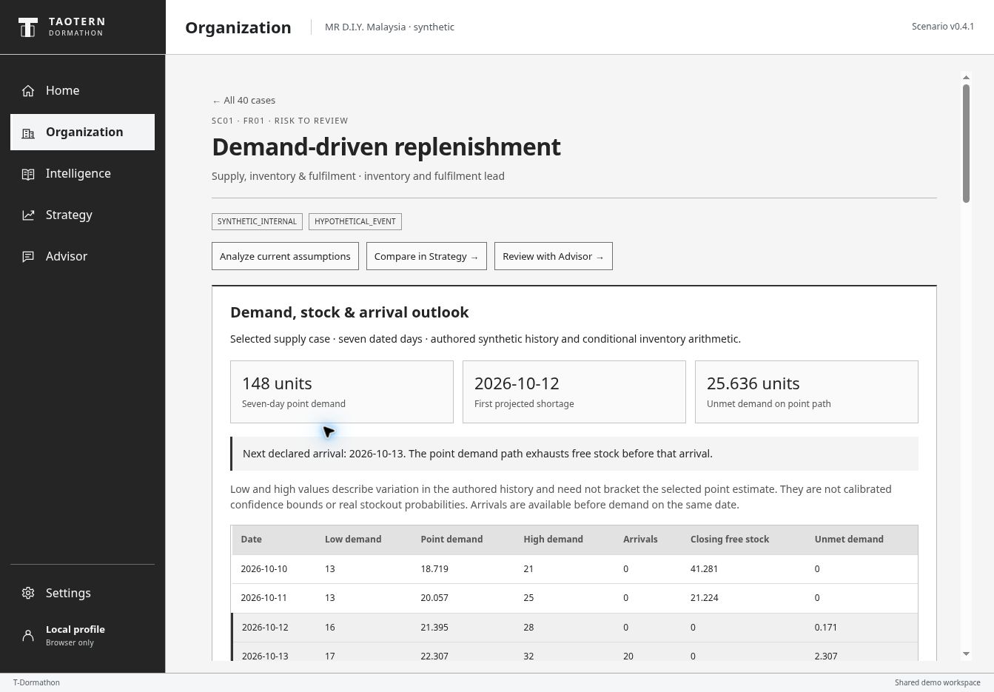
SC01 DEMAND AND ARRIVAL OUTLOOK
Shortage appears before the next arrival
148
units of seven-day demand
25.636
units unmet with no change
196 authored synthetic history days. Conditional point path. Low/high are not calibrated confidence limits. Saved v73 screen.
03
Notes:
00:40–01:15. The outlook uses 196 days of authored synthetic sales history. It generates 148 units of demand across the next seven days and reconciles every declared arrival. Here, free stock runs out on October twelfth, before the next arrival on the thirteenth. The no-change path leaves 25.636 units unmet. These are conditional scenario results, not observed company shortages.
LIVE cue: use the preloaded SC01 Organization outlook, then Compare in Strategy. Alternatively stay on this real saved screenshot. History, stock and arrival inputs are synthetic. Original selected-case arithmetic uses a different constant-demand basis and must not be mixed with these figures.
SOURCES
Project evidence: docs/forecast-decision-expansion/README.md, joint-planner-contract.md, forecast-audit-report.v1.json; worker/mrdiy-demand-outlook.js and worker/mrdiy-joint-planner.js.
Hosted v73/v74 desktop QA, 10 October 2026: demand outlook, bounded joint-plan comparison, resource accounting and missing-input behavior. Actual screenshots retained with capture version. Optional provider remains selected-case-only; no new paid request was required for expansion QA.
Hosted product: https://dormathon-risk-private-20261007.liuyz8715.chatgpt.site/workbench.html. Site v74 with captured v73/v74 evidence, published 10 October 2026.

Slide 4
SIX LINKED CASES WHOLE-EPISODE COMPARISON
A feasible package can still carry risk
72
48
24
packages checked
feasible
blocked
Whole-episode package | Modeled unmet demand | Continuity gap
No change | 25.636 units | 4.0 hours
One frontier example | 0 units | 1.3 hours
Buffer transfer + invoice review + qualified service + safety-minimum power
Default synthetic snapshot, no additional session reservations. Bounded comparison only. No learned or globally optimal policy.
04
Notes:
01:15–01:55. Strategy compares seventy-two bounded packages across six linked cases. Forty-eight satisfy the declared shared constraints. One frontier example transfers a stock buffer, plans invoice review and qualified service, and protects safety-minimum power. It removes modeled unmet demand, while a one-point-three-hour continuity gap remains visible. That residual matters: feasible does not mean risk-free. This comparison executes nothing.
LIVE cue: point to the default frontier card. If needed choose No-change reference once, then return to the frontier. The known conditional cost is MYR63.968 versus MYR323.583 under no change. These costs exclude unpriced energy, service and review consequences. They are not whole-business value or realized savings. No route expedite is needed in this example.
SOURCES
Project evidence: docs/forecast-decision-expansion/README.md, joint-planner-contract.md, forecast-audit-report.v1.json; worker/mrdiy-demand-outlook.js and worker/mrdiy-joint-planner.js.
Hosted v73/v74 desktop QA, 10 October 2026: demand outlook, bounded joint-plan comparison, resource accounting and missing-input behavior. Actual screenshots retained with capture version. Optional provider remains selected-case-only; no new paid request was required for expansion QA.
Hosted product: https://dormathon-risk-private-20261007.liuyz8715.chatgpt.site/workbench.html. Site v74 with captured v73/v74 evidence, published 10 October 2026.

Slide 5
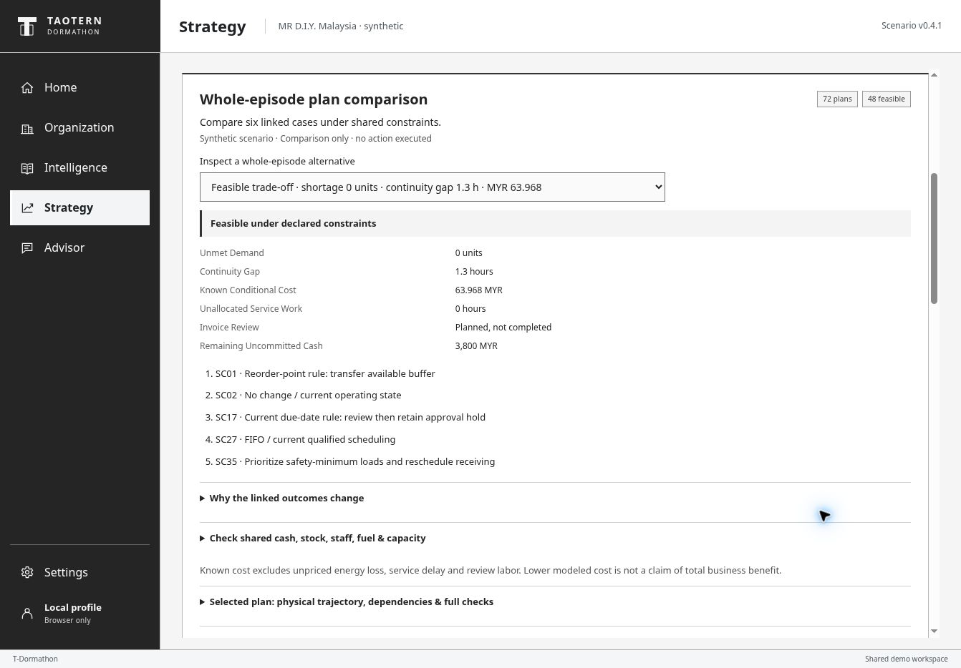
WORKING PRODUCT SHARED RESOURCE ACCOUNTING
Every comparison retains its evidence
One ledger
Cash, stock, fuel, staff,
transport, storage and energy
Human control
No whole-plan save
or execution
LLM explains selected
cases only
Actual v74 screen, 10 Oct 2026. Synthetic operations. Joint plans are read-only; selected-case records remain separate.
05
Notes:
01:55–02:30. This is the working plan view. One resource ledger prevents the same stock, cash or capacity from being counted twice. Inputs and unmet requirements remain inspectable. Missing lead time produces an abstention. The existing GPT-OSS Advisor explains selected cases only; it does not consume or endorse these joint plans. Saved human choices also remain case-scoped, and no order, payment or facility action executes.
SOURCES
Project evidence: docs/forecast-decision-expansion/README.md, joint-planner-contract.md, forecast-audit-report.v1.json; worker/mrdiy-demand-outlook.js and worker/mrdiy-joint-planner.js.
Hosted v73/v74 desktop QA, 10 October 2026: demand outlook, bounded joint-plan comparison, resource accounting and missing-input behavior. Actual screenshots retained with capture version. Optional provider remains selected-case-only; no new paid request was required for expansion QA.
Hosted product: https://dormathon-risk-private-20261007.liuyz8715.chatgpt.site/workbench.html. Site v74 with captured v73/v74 evidence, published 10 October 2026.
Hosted QA: v71 SC01 comparison and selected-decision save/reopen, SC16 abstention and provider-response replays verified 10 October 2026. v70 live SovernStack GPT-OSS 120B verified for SC01 explanation and SC16 missing-input answer. No claim of all-case LLM validation.

Slide 6
DORMATHON
A working retail decision workspace
See the shortage.
Compare a feasible response.
Evidence today
69.73% weekly WAPE
Exploratory external study
Daily WAPE 108.53%
No company validation
Dated outlooks, shared constraints
and visible residual risk
Next: observed stock, arrivals
and warning outcomes
Public MR D.I.Y. context. Synthetic operations and conditional simulations. Human review remains required.
06
Notes:
02:30–03:00. The result is a working decision workspace with visible trade-offs. A separate exploratory study achieved sixty-nine-point-seven-three percent weekly WAPE against seventy-seven-point-two-one for the same-fold mean baseline. Daily error remains high, and the data had prior exposure. We make no company-accuracy claim. The next proof needs observed stock, arrivals and warning outcomes. Dormathon already lets a lead inspect the consequence before acting.
SOURCES
Project evidence: docs/forecast-decision-expansion/README.md, joint-planner-contract.md, forecast-audit-report.v1.json; worker/mrdiy-demand-outlook.js and worker/mrdiy-joint-planner.js.
Project evidence: data/forecast-rolling-report.v1.json; docs/forecast-decision-expansion/portable-reproduction/protocol.json. Eight retrospective rolling folds on previously exposed prior-training periods. Exact isolated reproduction passed.
Chen, D. (2012). Online Retail II [Dataset]. UCI Machine Learning Repository. DOI 10.24432/C5CG6D. CC BY 4.0. https://archive.ics.uci.edu/dataset/502/online+retail+ii
Hosted product: https://dormathon-risk-private-20261007.liuyz8715.chatgpt.site/workbench.html. Site v74 with captured v73/v74 evidence, published 10 October 2026.

Slide 7
PRODUCT SCOPE
40 cases share one operating snapshot
40
16
Supply
10
Procurement
complete case workflows
08
Service
Inspect evidence and options.
Save and reopen a decision.
06
Energy security
SC01 / SC02 / SC17 / SC18 / SC27 / SC35
Same shipment, invoice, service task and resource pools
Synthetic MR D.I.Y. Malaysia workspace: 2 distribution clusters, 8 stores and 24 SKUs. Six cases form the deep demonstration.
07
Notes:
Q&A: Forty complete case workflows: sixteen supply, ten procurement, eight service and six energy-security cases. Bounded whole-episode enumeration covers the six deep cases SC01/02/17/18/27/35 only. Selected-case decisions remain saved/reopenable. No all-forty-case joint optimization or forecast-quality claim.
SOURCES
Approved Dormathon Product Specifications v0.4.1, 10 October 2026, S01–S11. Project source: docs/specs/Dormathon_Product_Specifications_v0.4.1_EN.md.
Project evidence: docs/forecast-decision-expansion/README.md, joint-planner-contract.md, forecast-audit-report.v1.json; worker/mrdiy-demand-outlook.js and worker/mrdiy-joint-planner.js.
Hosted v73/v74 desktop QA, 10 October 2026: demand outlook, bounded joint-plan comparison, resource accounting and missing-input behavior. Actual screenshots retained with capture version. Optional provider remains selected-case-only; no new paid request was required for expansion QA.

Slide 8
APPENDIX EVIDENCE AND MODEL ROLES
Different evidence serves different decisions
Public context
Official reports and lexical retrieval
Context and traceable source records
Synthetic outlook
Authored history and statistical selector
Dated demand, stock and arrival arithmetic
Joint comparison
72 bounded action combinations
Hard constraints and residual trade-offs
Optional LLM
GPT-OSS 120B via SovernStack
Selected-case explanation only
No public headline alone establishes company exposure. No external retailer score validates this synthetic company scenario.
08
Notes:
Architecture boundaries: the outlook uses one synthetic series and its own past-validation selector. The external rolling report uses a global model selected per fold across eligible SKUs; it is not operationally promoted. FTS5/BM25 is lexical retrieval, with no blanket semantic/cross-language coverage claim. Joint comparison is deterministic bounded enumeration, no RL. Optional provider output cannot overwrite numeric rule facts or act. No new expansion plan content is sent to the paid provider.
SOURCES
Project evidence: docs/forecast-decision-expansion/README.md, joint-planner-contract.md, forecast-audit-report.v1.json; worker/mrdiy-demand-outlook.js and worker/mrdiy-joint-planner.js.
Project evidence: data/forecast-rolling-report.v1.json; docs/forecast-decision-expansion/portable-reproduction/protocol.json. Eight retrospective rolling folds on previously exposed prior-training periods. Exact isolated reproduction passed.
Approved Dormathon Product Specifications v0.4.1, 10 October 2026, S01–S11. Project source: docs/specs/Dormathon_Product_Specifications_v0.4.1_EN.md.
Hosted QA: v71 SC01 comparison and selected-decision save/reopen, SC16 abstention and provider-response replays verified 10 October 2026. v70 live SovernStack GPT-OSS 120B verified for SC01 explanation and SC16 missing-input answer. No claim of all-case LLM validation.

Slide 9
APPENDIX EXTERNAL ROLLING-ORIGIN RESULTS
Weekly error improved in an exploratory study
Seven-day total WAPE, percent
108.53%
selector daily WAPE
Same-fold weekly gain:
7.48 percentage points
No pristine holdout
No company validation
UCI Online Retail II. Eight 2011 folds on previously exposed prior-training periods. Lower WAPE is better; it is not accuracy.
09
Notes:
Exact aggregate weekly WAPE: adaptive_past_validation 0.697338146015352; mean_28 0.7721168424858152. Difference: minus 7.477869647 percentage points. The descriptive paired 400-replicate two-way SKU/fold bootstrap interval for selector minus mean28 is minus 11.63 to minus 3.71 percentage points. Only eight time blocks, one retailer and prior exposure limit confirmation. Selector daily WAPE: 1.0852629627506531. There are 89,324 nonoverlapping weekly forecasts and 625,268 daily prediction points. Do not compare weekly 69.73% directly to original daily 103.41% as if they used the same target and split. The post-test best candidate is not substituted for the predeclared past-validation selector.
SOURCES
Chen, D. (2012). Online Retail II [Dataset]. UCI Machine Learning Repository. DOI 10.24432/C5CG6D. CC BY 4.0. https://archive.ics.uci.edu/dataset/502/online+retail+ii
Project evidence: data/forecast-rolling-report.v1.json; docs/forecast-decision-expansion/portable-reproduction/protocol.json. Eight retrospective rolling folds on previously exposed prior-training periods. Exact isolated reproduction passed.

Slide 10
APPENDIX EVALUATION PROTOCOL
The new study uses eight rolling folds
Design | Declared rule
Eight test windows | 28 days each, starting Feb through Sep 2011
Each fold selects from past data | 28 validation days precede its test
14 fixed point candidates | Lowest validation seven-day total WAPE
Evaluation and uncertainty | 4 weekly origins per fold; 400 paired resamples
Target: positive recorded sales
A demand proxy. No actual stockout labels, inventory or operational calibration.
A predeclared new analysis of previously exposed data. Temporal safeguards do not turn it into an untouched holdout.
10
Notes:
Fold test windows start on the first of each month from February through September 2011. Eligibility uses at least 180 calendar days and 26 nonzero training days strictly before validation. The matrix preserves 4,707 qualifying product IDs before per-fold eligibility. No future inactivity filters. Weekly targets are disjoint within each 28-day window; earlier folds may enter later history. Original October–December periods are not scored. Future-perturbation invariance, independent formulas and exact isolated rerun passed. Missing SKU dates count as zero recorded sales only under the source-declared complete-ledger assumption. Unknown engine inputs remain unknown.
SOURCES
Project evidence: data/forecast-rolling-report.v1.json; docs/forecast-decision-expansion/portable-reproduction/protocol.json. Eight retrospective rolling folds on previously exposed prior-training periods. Exact isolated reproduction passed.
Project evidence: docs/forecast-decision-expansion/README.md, joint-planner-contract.md, forecast-audit-report.v1.json; worker/mrdiy-demand-outlook.js and worker/mrdiy-joint-planner.js.
Chen, D. (2012). Online Retail II [Dataset]. UCI Machine Learning Repository. DOI 10.24432/C5CG6D. CC BY 4.0. https://archive.ics.uci.edu/dataset/502/online+retail+ii

Slide 11
APPENDIX Q&A
Questions the evidence can answer
Is the forecast real company data?
What does the frontier mean?
No. The 196-day history is authored synthetic data. Public reports supply operating context.
Within this catalog, no feasible alternative improves one displayed objective without worsening another.
Can it save or execute a joint plan?
Is this RL or global optimization?
No. Joint plans are read-only comparisons. Existing saved choices remain selected-case-only.
No. It enumerates a bounded action catalog with explicit constraints. Human review remains.
Synthetic scenarios demonstrate calculation and integration. Real operating outcomes remain to be measured.
11
Notes:
MYR 63.968 is known conditional cost, excludes unpriced energy, service and review effects, and is not realized profit. The 1.3-hour energy gap does not imply a known receiving delay; no conversion rule supplies it. Low/high authored-history scenarios are uncalibrated. The selected-case LLM does not receive or endorse joint plans. The old 40-unit gap and MYR 496 / 61.6 metrics belong to retained original selected-case assumptions. They are collapsed separately and are not comparable with the new 148-unit, all-arrivals outlook. Missing lead_days produces an abstention.
SOURCES
Project evidence: docs/forecast-decision-expansion/README.md, joint-planner-contract.md, forecast-audit-report.v1.json; worker/mrdiy-demand-outlook.js and worker/mrdiy-joint-planner.js.
Hosted v73/v74 desktop QA, 10 October 2026: demand outlook, bounded joint-plan comparison, resource accounting and missing-input behavior. Actual screenshots retained with capture version. Optional provider remains selected-case-only; no new paid request was required for expansion QA.
Project evidence: data/forecast-rolling-report.v1.json; docs/forecast-decision-expansion/portable-reproduction/protocol.json. Eight retrospective rolling folds on previously exposed prior-training periods. Exact isolated reproduction passed.

Slide 12
EXTERNAL PREDICTIVE EVIDENCE
A reproducible benchmark, with high forecast error
Test mean absolute error, units
103.41%
retained mean test WAPE
Validation selected the mean.
The supervised ridge lost.
Accuracy is still weak.
UCI Online Retail II, UK non-store retailer. Known-SKU test: 11 Nov–8 Dec 2011. Precomputed study, separate from MR D.I.Y.
12
Notes:
Original frozen-split study retained unchanged. UCI Online Retail II, known-SKU primary test: 11 November–8 December 2011. Validation selected the 28-day mean. Test MAE: 6.9739845587935525, versus weekly naive 7.726607499588001 and ridge 7.606658118018797. Mean test WAPE: 103.4135708%, high absolute error. No direct mean-versus-naive confidence interval or significance claim. This daily target and split remain separate from the new exploratory weekly rolling study. The data was subsequently exposed; never represent it as a new untouched test.
SOURCES
Chen, D. (2012). Online Retail II [Dataset]. UCI Machine Learning Repository. DOI 10.24432/C5CG6D. CC BY 4.0. https://archive.ics.uci.edu/dataset/502/online+retail+ii
Project evidence: docs/predictive-v0.4.1/artifacts/benchmark-report.v1.json and frozen-split.v1.json. Recomputed and checked 10 October 2026. Results are precomputed.

Slide 13
APPENDIX EVIDENCE REGISTER
Sources and claim boundaries
Company context
MR D.I.Y. FY2025 annual and sustainability reports
Real public disclosures, not company operational records
Operational scenarios
Approved v0.4.1 fixture plus v0.4.2 expansion
Authored history, frozen resources and conditional outcomes
Forecast study
UCI Online Retail II; original and rolling reports
Separate study designs, targets and exposure limitations
Hosted product
Site v74 with v73/v74 captures, 10 October 2026
Verified screens and paths; no generalized behavior guarantee
Owner-confirmed event format: 3-minute pitch and 2-minute Q&A. No company endorsement or access is implied.
13
Notes:
MR D.I.Y. FY2025 group reporting includes Malaysia and Brunei unless otherwise specified. The Malaysia demo workspace is separate. Owner-confirmed schedule: 10 October 2026, 19:00 MYT ready target, 20:00 review, and 11 October 09:00 submission. Official Track 1 asks for detection, categorization, prioritization, explanation and proof of a better decision. The supplied images include no weighted rubric or timing. Source references are below. Screens in this edition are labeled by their captured Site version.
SOURCES
MR D.I.Y. Group (M) Berhad, Integrated Annual Report 2025. https://mrdiy.listedcompany.com/misc/ar/MRDIY_AR2025.pdf
MR D.I.Y. Group (M) Berhad, Sustainability Report 2025, printed pp2,33,37–40,47–49. https://corporate.mrdiy.com/misc/sustainability/MRDIY-Sustainability_Report_2025.pdf
Chen, D. (2012). Online Retail II [Dataset]. UCI Machine Learning Repository. DOI 10.24432/C5CG6D. CC BY 4.0. https://archive.ics.uci.edu/dataset/502/online+retail+ii
Approved Dormathon Product Specifications v0.4.1, 10 October 2026, S01–S11. Project source: docs/specs/Dormathon_Product_Specifications_v0.4.1_EN.md.
Project evidence: docs/forecast-decision-expansion/README.md, joint-planner-contract.md, forecast-audit-report.v1.json; worker/mrdiy-demand-outlook.js and worker/mrdiy-joint-planner.js.
Project evidence: data/forecast-rolling-report.v1.json; docs/forecast-decision-expansion/portable-reproduction/protocol.json. Eight retrospective rolling folds on previously exposed prior-training periods. Exact isolated reproduction passed.
Hosted v73/v74 desktop QA, 10 October 2026: demand outlook, bounded joint-plan comparison, resource accounting and missing-input behavior. Actual screenshots retained with capture version. Optional provider remains selected-case-only; no new paid request was required for expansion QA.
Hosted product: https://dormathon-risk-private-20261007.liuyz8715.chatgpt.site/workbench.html. Site v74 with captured v73/v74 evidence, published 10 October 2026.

Slide 14
OFFLINE FALLBACK SAVED V73 SCREEN
Saved demand and arrival outlook
148 units forecast
25.636 units unmet
First shortage: 12 Oct
Saved v73 hosted screen, 10 Oct 2026. Synthetic operations. Use the same narrative if the live site is unavailable.
14
Notes:
OFFLINE FALLBACK. Saved screen, not a live interaction. Default authored synthetic history. Next declared arrival13October. Separate from original selected-case baseline.
SOURCES
Hosted product: https://dormathon-risk-private-20261007.liuyz8715.chatgpt.site/workbench.html. Site v74 with captured v73/v74 evidence, published 10 October 2026.
Hosted v73/v74 desktop QA, 10 October 2026: demand outlook, bounded joint-plan comparison, resource accounting and missing-input behavior. Actual screenshots retained with capture version. Optional provider remains selected-case-only; no new paid request was required for expansion QA.

Slide 15
OFFLINE FALLBACK SAVED V74 SCREEN
Saved whole-episode plan comparison
72 checked
48 feasible
0 unmet demand
1.3-hour residual gap
Saved v74 hosted screen, 10 Oct 2026. Synthetic operations. Use the same narrative if the live site is unavailable.
15
Notes:
OFFLINE FALLBACK. Saved screen, not a live interaction. Cleaner v74 panel. Same bounded comparison values. Five action slots, six linked cases. Read-only, no resources actually reserved.
SOURCES
Hosted product: https://dormathon-risk-private-20261007.liuyz8715.chatgpt.site/workbench.html. Site v74 with captured v73/v74 evidence, published 10 October 2026.
Hosted v73/v74 desktop QA, 10 October 2026: demand outlook, bounded joint-plan comparison, resource accounting and missing-input behavior. Actual screenshots retained with capture version. Optional provider remains selected-case-only; no new paid request was required for expansion QA.

Slide 16
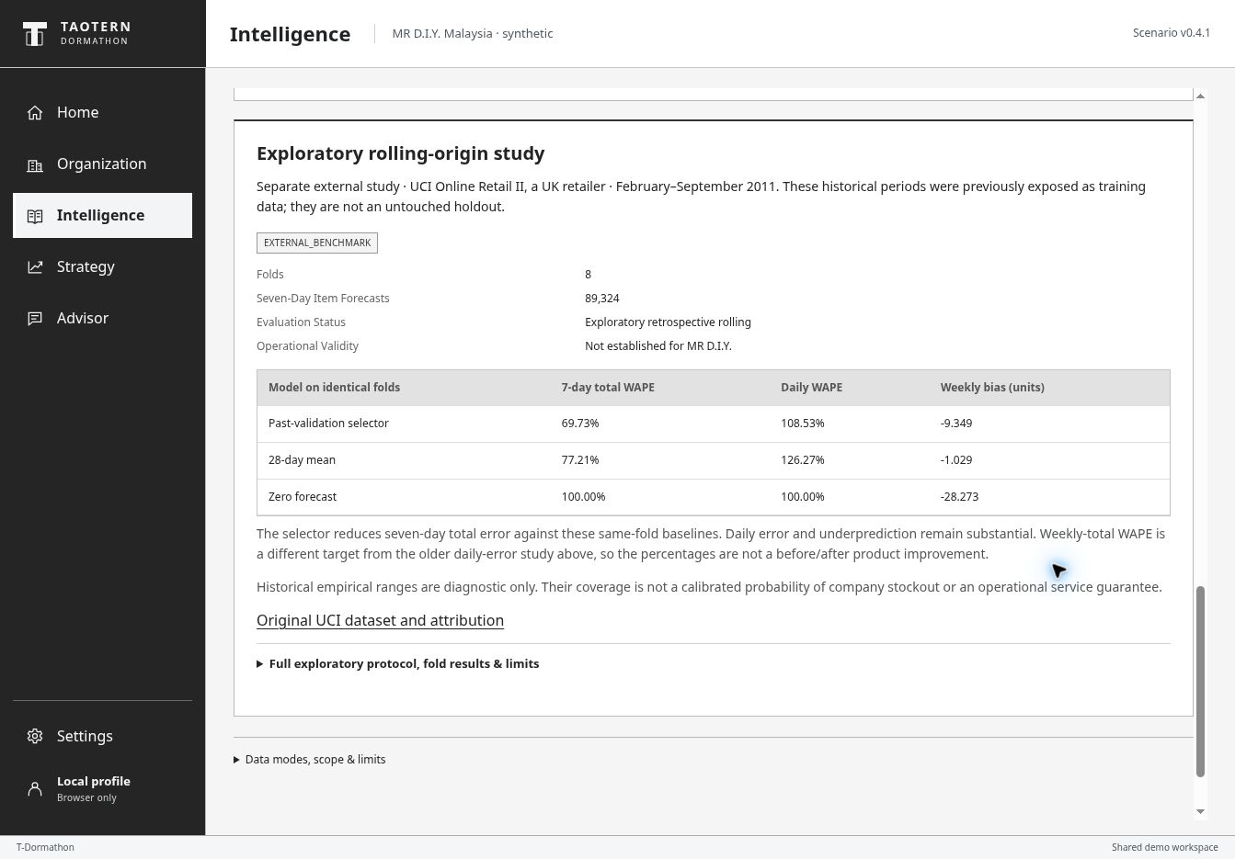
OFFLINE FALLBACK SAVED V73 SCREEN
Saved external rolling study
69.73% weekly WAPE
108.53% daily WAPE
Exploratory, prior exposure
Saved v73 hosted screen, 10 Oct 2026. External UCI study. Previously exposed data. No company validation.
16
Notes:
OFFLINE FALLBACK. Saved screen, not a live interaction. Independent external UCI study. Targets and limitations remain visible. No company validation.
SOURCES
Hosted product: https://dormathon-risk-private-20261007.liuyz8715.chatgpt.site/workbench.html. Site v74 with captured v73/v74 evidence, published 10 October 2026.
Hosted v73/v74 desktop QA, 10 October 2026: demand outlook, bounded joint-plan comparison, resource accounting and missing-input behavior. Actual screenshots retained with capture version. Optional provider remains selected-case-only; no new paid request was required for expansion QA.

Slide 17
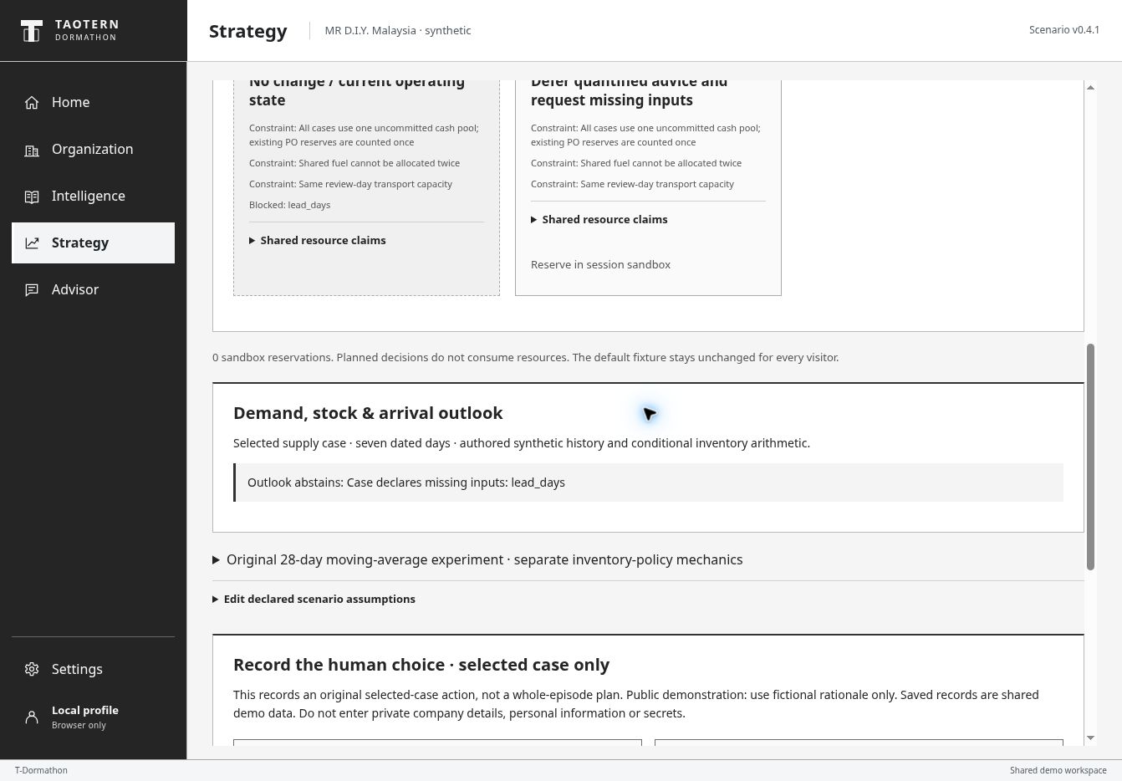
OFFLINE FALLBACK SAVED V73 SCREEN
Saved missing-input abstention
Missing lead_days
Outlook abstains
No invented quantity
Saved v73 hosted screen, 10 Oct 2026. Synthetic operations. Use the same narrative if the live site is unavailable.
17
Notes:
OFFLINE FALLBACK. Saved screen, not a live interaction. Selected case SC16 lacks required lead time. No unrelated joint plan appears. Existing selected-case controls remain separate.
SOURCES
Hosted product: https://dormathon-risk-private-20261007.liuyz8715.chatgpt.site/workbench.html. Site v74 with captured v73/v74 evidence, published 10 October 2026.
Hosted v73/v74 desktop QA, 10 October 2026: demand outlook, bounded joint-plan comparison, resource accounting and missing-input behavior. Actual screenshots retained with capture version. Optional provider remains selected-case-only; no new paid request was required for expansion QA.

