Slide 1
Dormathon
Retail decisions
with evidence
An operations workspace for connected exceptions
Track 1 Predictive Model Track / Taotern / 10 October 2026
01
Notes:
00:00–00:15. A regional operations lead sees a delivery arriving late. Protecting service may require stock from another store, invoice review or a different receiving window. Dormathon brings the connected exceptions and their evidence into one decision workspace.
Primary format: 3-minute pitch and 2-minute Q&A, confirmed by owner. Review-ready target 20:00 Malaysia time on 10 October 2026; submission deadline 09:00 Malaysia time on 11 October 2026.
SOURCES
Approved Dormathon Product Specifications v0.4.1, 10 October 2026, S01–S11. Project source: docs/specs/Dormathon_Product_Specifications_v0.4.1_EN.md.
Hosted product: https://dormathon-risk-private-20261007.liuyz8715.chatgpt.site/workbench.html. Site v71, source 7ab8622d73c9fc916573e9e74da47b110abc31fd, published 10 October 2026.

Slide 2
THE OPERATING PROBLEM
A delayed delivery changes more than stock
The user
Regional
operations lead
Supply
Which stock covers the gap?
Procurement
Can the invoice pass review?
One decision can create a new constraint for another team.
Service
Which promise depends on that stock?
Continuity
Can receiving safely keep running?
MR D.I.Y. public disclosures describe existing analytics, automation and service systems. Our incidents are hypothetical.
02
Notes:
00:15–00:40. Those choices compete for shared resources. Our MR D.I.Y. Malaysia demonstration uses public operating context and explicitly synthetic internal data. It contains forty linked cases across supply, procurement, service and energy security. Six deep cases follow one replenishment episode.
Primary format: 3-minute pitch and 2-minute Q&A, confirmed by owner. Review-ready target 20:00 Malaysia time on 10 October 2026; submission deadline 09:00 Malaysia time on 11 October 2026.
SOURCES
MR D.I.Y. Group (M) Berhad, Sustainability Report 2025, printed pp2,33,37–40,47–49. https://corporate.mrdiy.com/misc/sustainability/MRDIY-Sustainability_Report_2025.pdf
MR D.I.Y. Group (M) Berhad, Integrated Annual Report 2025. https://mrdiy.listedcompany.com/misc/ar/MRDIY_AR2025.pdf
Approved Dormathon Product Specifications v0.4.1, 10 October 2026, S01–S11. Project source: docs/specs/Dormathon_Product_Specifications_v0.4.1_EN.md.

Slide 3
SC01 CONDITIONAL COMPARISON
A 40-unit gap, with a feasible response
60
20
5
40
available units
units per day
days to arrival
uncovered units
Action | Shortage | Scenario cost
No change | 40 units | MYR 496.00
Transfer 40 available units | 0 units | MYR 61.60
Expedite the inbound shipment | 0 units | MYR 206.40
Seven-day synthetic scenario. MYR costs include declared shortage, holding and action costs. They are not observed savings.
03
Notes:
00:40–01:20. Here, sixty available units cover three days, but delivery takes five. That leaves forty units uncovered. Under identical seven-day assumptions, no change costs MYR 496. A feasible forty-unit transfer costs MYR 61.60 with no simulated shortage. These are conditional scenario costs, not measured company savings. LIVE: show the preloaded SC01 comparison while speaking. Use fallback slide14 if needed.
Primary format: 3-minute pitch and 2-minute Q&A, confirmed by owner. Review-ready target 20:00 Malaysia time on 10 October 2026; submission deadline 09:00 Malaysia time on 11 October 2026.
SOURCES
Project evidence: worker/mrdiy-operations.js and worker/mrdiy-fixture.js, operation version 0.4.1.1. SC01 compared directly from the approved frozen fixture on 10 October 2026.
Hosted product: https://dormathon-risk-private-20261007.liuyz8715.chatgpt.site/workbench.html. Site v71, source 7ab8622d73c9fc916573e9e74da47b110abc31fd, published 10 October 2026.

Slide 4
DECISION INTEGRITY
Shared constraints keep the plan feasible
30 L
Saved human decision
shared fleet fuel
Choice and rationale stay attached
to the exact decision basis
SC01 expedite reserves 18 L
12 L remains
SC02 request for 18 L is blocked
Sources and assumptions
Frozen stock and shared resources
Model or policy version and baseline
Session reservations are a sandbox. A saved decision records a human plan or rejection and executes no external action.
04
Notes:
01:20–01:50. Every case draws from shared stock, cash and capacity. An option can fail when another case reserves the resource. The human can choose or reject an action, then reopen its frozen evidence. Unknown lead time produces an abstention. GPT-OSS 120B explains the governed case facts and executes no decision. LIVE: show the existing saved selected transfer. Use fallback slide15 if needed. Keep the fuel interaction for Q&A.
Primary format: 3-minute pitch and 2-minute Q&A, confirmed by owner. Review-ready target 20:00 Malaysia time on 10 October 2026; submission deadline 09:00 Malaysia time on 11 October 2026.
SOURCES
Project evidence: worker/mrdiy-operations.js and worker/mrdiy-fixture.js, operation version 0.4.1.1. SC01 compared directly from the approved frozen fixture on 10 October 2026.
Hosted QA: v71 SC01 comparison and selected-decision save/reopen, SC16 abstention and provider-response replays verified 10 October 2026. v70 live SovernStack GPT-OSS 120B verified for SC01 explanation and SC16 missing-input answer. No claim of all-case LLM validation.
Hosted product: https://dormathon-risk-private-20261007.liuyz8715.chatgpt.site/workbench.html. Site v71, source 7ab8622d73c9fc916573e9e74da47b110abc31fd, published 10 October 2026.

Slide 5
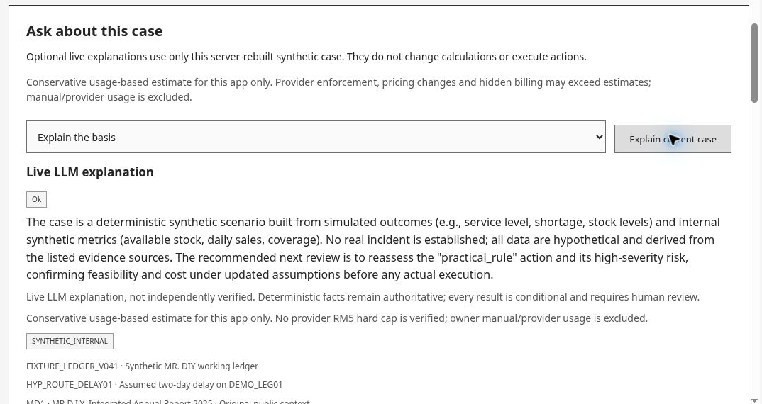
VERIFIED PRODUCT ADVISOR
A working product with traceable explanations
Case facts and sources
GPT-OSS 120B explanation
Human decision retained
Saved v71 screen, 10 Oct 2026. Provider-response replay. Synthetic inputs and rule-based calculations. No action executes.
External UCI benchmark: test WAPE 103.41%, high error. No MR D.I.Y. predictive validation.
05
Notes:
01:50–02:35. This is the working Advisor. It explains the case using its sources and declared assumptions. Calculations remain authoritative, and missing inputs produce an abstention. We verified a normal explanation and a missing-lead-time case. The screenshot shows a replay of an earlier live request. Our external forecasting study remains separate and weak, with test WAPE of 103.41 percent. We make no company-accuracy claim. Full benchmark results are in appendix16.
Primary format: 3-minute pitch and 2-minute Q&A, confirmed by owner. Review-ready target 20:00 Malaysia time on 10 October 2026; submission deadline 09:00 Malaysia time on 11 October 2026.
SOURCES
Hosted product: https://dormathon-risk-private-20261007.liuyz8715.chatgpt.site/workbench.html. Site v71, source 7ab8622d73c9fc916573e9e74da47b110abc31fd, published 10 October 2026.
Hosted QA: v71 SC01 comparison and selected-decision save/reopen, SC16 abstention and provider-response replays verified 10 October 2026. v70 live SovernStack GPT-OSS 120B verified for SC01 explanation and SC16 missing-input answer. No claim of all-case LLM validation.

Slide 6
WHAT THIS PROTOTYPE ESTABLISHES
A working retail decision workspace
Inspect a choice.
Reopen its exact basis.
Next validation
Observed operational labels
Warning quality and useful lead time
Decision costs in a controlled pilot
Connected cases, explicit trade-offs,
hard constraints and a saved human choice
Functional prototype and bounded empirical study. No company endorsement, causal savings claim or autonomous execution.
06
Notes:
02:35–03:00. Dormathon is a working retail decision workspace: connected cases, feasible comparisons and a human choice that can be reopened. A scoped pilot would measure warning quality and decision cost using observed operational labels. The immediate value is a decision the lead can inspect before acting and review afterward.
Primary format: 3-minute pitch and 2-minute Q&A, confirmed by owner. Review-ready target 20:00 Malaysia time on 10 October 2026; submission deadline 09:00 Malaysia time on 11 October 2026.
SOURCES
Approved Dormathon Product Specifications v0.4.1, 10 October 2026, S01–S11. Project source: docs/specs/Dormathon_Product_Specifications_v0.4.1_EN.md.
Project evidence: docs/predictive-v0.4.1/artifacts/benchmark-report.v1.json and frozen-split.v1.json. Recomputed and checked 10 October 2026. Results are precomputed.
Hosted product: https://dormathon-risk-private-20261007.liuyz8715.chatgpt.site/workbench.html. Site v71, source 7ab8622d73c9fc916573e9e74da47b110abc31fd, published 10 October 2026.

Slide 7
PRODUCT SCOPE
40 cases share one operating snapshot
40
16
Supply
10
Procurement
complete case workflows
08
Service
Inspect evidence and options.
Save and reopen a decision.
06
Energy security
SC01 / SC02 / SC17 / SC18 / SC27 / SC35
Same shipment, invoice, service task and resource pools
Synthetic MR D.I.Y. Malaysia workspace: 2 distribution clusters, 8 stores and 24 SKUs. Six cases form the deep demonstration.
07
Notes:
Q&A appendix: forty-case scope. 0:50–1:20. The product has forty working cases: sixteen supply, ten procurement, eight service and six energy-security cases. Six deep cases follow one replenishment episode. They share business identifiers and one resource snapshot, so the same stock and fuel cannot appear as independent supplies. The other cases include normal, action-needed, risk and insufficient-data paths.
SOURCES
Approved Dormathon Product Specifications v0.4.1, 10 October 2026, S01–S11. Project source: docs/specs/Dormathon_Product_Specifications_v0.4.1_EN.md.
Project operational package: docs/mrdiy-v0.4.1/README.md.
Hosted QA: v71 SC01 comparison and selected-decision save/reopen, SC16 abstention and provider-response replays verified 10 October 2026. v70 live SovernStack GPT-OSS 120B verified for SC01 explanation and SC16 missing-input answer. No claim of all-case LLM validation.

Slide 8
EVIDENCE AND AI
Every answer has a visible evidence boundary
Official sources and immutable versions
Exposure requires an explicit matching key
Public evidence
Synthetic operations and declared assumptions
Deterministic calculations own the numeric facts
Scenario and rules
The model explains the case and its limitations
Missing lead time produces an abstention
Advisor explanation
The human retains the decision
GPT-OSS 120B through SovernStack: two live scenarios verified. Generated explanations still require review.
08
Notes:
Q&A appendix: evidence and AI architecture. 2:50–3:25. Intelligence retains source versions and supports lexical retrieval. A country headline alone cannot establish company exposure. Scenario arithmetic and constraints remain authoritative. The live GPT-OSS 120B Advisor explains those facts, with their sources and limitations. We verified a normal explanation and a missing-lead-time case. The model can help the user understand the decision, but it cannot invent a probability or execute an action.
The retrieval baseline is lexical FTS5/BM25, not verified general semantic or cross-language search. Public data does not establish real company incidents. Two live cases do not establish all-case explanation accuracy.
SOURCES
Approved Dormathon Product Specifications v0.4.1, 10 October 2026, S01–S11. Project source: docs/specs/Dormathon_Product_Specifications_v0.4.1_EN.md.
Project retrieval contract: contracts/retrieval-v1.md.
Hosted QA: v71 SC01 comparison and selected-decision save/reopen, SC16 abstention and provider-response replays verified 10 October 2026. v70 live SovernStack GPT-OSS 120B verified for SC01 explanation and SC16 missing-input answer. No claim of all-case LLM validation.
Hosted product: https://dormathon-risk-private-20261007.liuyz8715.chatgpt.site/workbench.html. Site v71, source 7ab8622d73c9fc916573e9e74da47b110abc31fd, published 10 October 2026.

Slide 9
APPENDIX A EVALUATION PROTOCOL
The forecasting study keeps the test separate
Partition | Dates | Purpose
Training | 1 Dec 2009–13 Oct 2011 | Eligibility and model fitting
Validation | 14 Oct–10 Nov 2011 | Model and threshold choice
Primary test | 11 Nov–8 Dec 2011 | Frozen final comparison
3,231
497,574
7
known SKUs
forecast tasks with overlapping horizons
daily horizons
Retrospective transaction-time availability assumption. Historical acquisition logs and true latent demand are unavailable.
09
Notes:
Appendix reference. 1,067,371 raw transaction rows across the two workbook sheets. Global exact duplicates removed with frozen row rules. 3,231 eligible known SKUs require at least 26 positive training days; 1,476 excluded using training alone. All eligible items stay in the test. Twenty-two origins times seven horizons times 3,231 items = 497,574 tasks, versus 90,468 unique item-days. Positive recorded sales are a demand proxy. Missing interior SKU-date means zero recorded sales only under the source-declared complete-ledger assumption. All 135 transaction-free dates are disclosed. Maximum transaction date 9 Dec 2011 excluded as incomplete. No customer modeling. No cold-start or cross-company claim. Original dataset licensed CC BY 4.0.
SOURCES
Chen, D. (2012). Online Retail II [Dataset]. UCI Machine Learning Repository. DOI 10.24432/C5CG6D. CC BY 4.0. https://archive.ics.uci.edu/dataset/502/online+retail+ii
Project evidence: docs/predictive-v0.4.1/artifacts/benchmark-report.v1.json and frozen-split.v1.json. Recomputed and checked 10 October 2026. Results are precomputed.

Slide 10
APPENDIX B SCENARIO ARITHMETIC
SC01 cost is conditional on declared assumptions
Cost component, MYR | No change | Transfer 40
Shortage at MYR 12 / unit | 480.00 | 0.00
Holding at MYR 0.04 / unit / day | 16.00 | 21.60
Transfer at MYR 1 / unit | 0.00 | 40.00
Total | 496.00 | 61.60
Key assumptions
Lost sales, day-5 inbound receipt, no terminal stock value.
Existing purchase-order costs are common commitments.
Synthetic cost comparison. Identical 7-day horizon and exogenous path. Costs and service effects are simulated.
10
Notes:
No-change cost: 40 unmet units × MYR12 + MYR16 holding = MYR496. Transfer: 40 units × MYR1 + MYR21.60 holding = MYR61.60. Difference MYR434.40 is an illustrative cost delta, not observed savings or an ROI estimate. Demand 20 units/day; initial physical80, reserved20, usable60. A40-unit transfer is available from another synthetic store at day0. Inbound200 units arrive at day5. New replenishment costs MYR851.40 under these same assumptions. Expediting costs MYR206.40. Existing PO cash commitments remain reserved once. Parameter ranges are explicit. Change delay or shortage penalty to show sensitivity. Do not claim the transfer action was selected by a novel learned policy.
SOURCES
Project evidence: worker/mrdiy-operations.js and worker/mrdiy-fixture.js, operation version 0.4.1.1. SC01 compared directly from the approved frozen fixture on 10 October 2026.

Slide 11
APPENDIX C Q&A
Questions the evidence can answer
Is this real company data?
What does AI do?
Public reports provide context. Internal records, counterparties and incidents are synthetic.
Statistical forecasting runs separately. GPT-OSS 120B explains case facts from the governed context.
Where is reinforcement learning?
Why trust a weak forecast?
RL is optional and unimplemented. Current action comparisons use explicit rules and simulation.
The report exposes the failure. Decisions retain constraints and assumptions. The model needs better evidence.
All responses describe the verified 10 October 2026 snapshot. Generalized business performance remains unproven.
11
Notes:
Additional Q&A: No payments, orders, staff assignments or electrical control execute from a saved plan. The source corpus is real but incomplete and heterogeneous. It cannot substitute for company operational labels. Lexical FTS5/BM25 is the retrieval baseline; no blanket semantic search claim. Two live LLM cases have passed, not all forty. The provider explanation is not independently factual certification. A zero-sales posthoc diagnostic has WAPE100%; it helps explain how sparse data can reward unusable zero forecasts and was not used to reselect the model. Real pilot access, privacy controls and operating labels remain future requirements.
SOURCES
Approved Dormathon Product Specifications v0.4.1, 10 October 2026, S01–S11. Project source: docs/specs/Dormathon_Product_Specifications_v0.4.1_EN.md.
Project evidence: docs/predictive-v0.4.1/artifacts/benchmark-report.v1.json and frozen-split.v1.json. Recomputed and checked 10 October 2026. Results are precomputed.
Hosted QA: v71 SC01 comparison and selected-decision save/reopen, SC16 abstention and provider-response replays verified 10 October 2026. v70 live SovernStack GPT-OSS 120B verified for SC01 explanation and SC16 missing-input answer. No claim of all-case LLM validation.

Slide 12
APPENDIX D EVIDENCE REGISTER
Sources and claim boundaries
Company context
MR D.I.Y. FY2025 annual and sustainability reports
Existing systems and group context only
Operational comparison
Approved v0.4.1 synthetic fixture, mechanics v0.4.1.1
Functional arithmetic and constrained actions
Forecast evaluation
UCI Online Retail II and frozen benchmark report
Known-SKU retrospective external study
Hosted implementation
Site v71 and dated journey / live-LLM QA
Verified paths only, not all possible behaviors
Official task: detect, categorize, prioritize and explain. Owner-confirmed format: 3-minute pitch and 2-minute Q&A.
12
Notes:
Full source links are included below and in the presenter runbook. MR D.I.Y. Group (M) Berhad FY2025 reported group scope includes Malaysia and Brunei unless otherwise specified. The operational demo is a separately marked Malaysia hardware/household synthetic workspace. No partnership or endorsement. Official owner-supplied task images: 20261010-022036, 022037, 022038. Their guidance is not a weighted rubric. Owner confirmed pitch 3 minutes, Q&A 2 minutes, review-ready 20:00 Malaysia on 10 October 2026, and submission 09:00 Malaysia on 11 October 2026. These timing details come from the owner, not the supplied slides.
SOURCES
MR D.I.Y. Group (M) Berhad, Integrated Annual Report 2025. https://mrdiy.listedcompany.com/misc/ar/MRDIY_AR2025.pdf
MR D.I.Y. Group (M) Berhad, Sustainability Report 2025, printed pp2,33,37–40,47–49. https://corporate.mrdiy.com/misc/sustainability/MRDIY-Sustainability_Report_2025.pdf
Chen, D. (2012). Online Retail II [Dataset]. UCI Machine Learning Repository. DOI 10.24432/C5CG6D. CC BY 4.0. https://archive.ics.uci.edu/dataset/502/online+retail+ii
Approved Dormathon Product Specifications v0.4.1, 10 October 2026, S01–S11. Project source: docs/specs/Dormathon_Product_Specifications_v0.4.1_EN.md.
Project evidence: worker/mrdiy-operations.js and worker/mrdiy-fixture.js, operation version 0.4.1.1. SC01 compared directly from the approved frozen fixture on 10 October 2026.
Project evidence: docs/predictive-v0.4.1/artifacts/benchmark-report.v1.json and frozen-split.v1.json. Recomputed and checked 10 October 2026. Results are precomputed.
Hosted QA: v71 SC01 comparison and selected-decision save/reopen, SC16 abstention and provider-response replays verified 10 October 2026. v70 live SovernStack GPT-OSS 120B verified for SC01 explanation and SC16 missing-input answer. No claim of all-case LLM validation.
Hosted product: https://dormathon-risk-private-20261007.liuyz8715.chatgpt.site/workbench.html. Site v71, source 7ab8622d73c9fc916573e9e74da47b110abc31fd, published 10 October 2026.

Slide 13
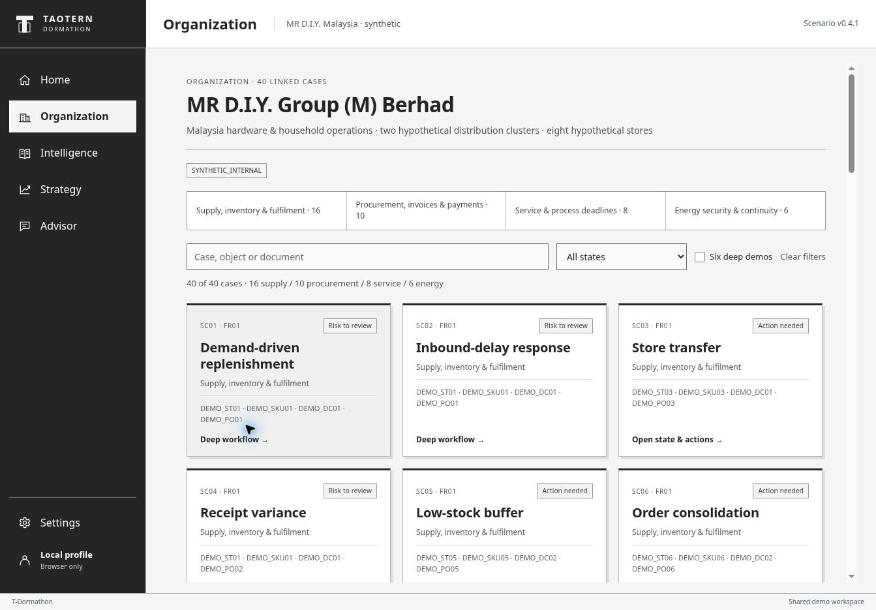
OFFLINE FALLBACK SAVED SCREEN
The regional lead opens a connected case
40 linked cases
One organization
One frozen scenario
Saved screen from hosted Site v71, 10 October 2026. This is a synthetic operations workspace.
13
Notes:
OFFLINE FALLBACK. This is a saved screenshot, not a live interaction. Fallback step 1. Show the organization and synthetic data labels. Select SC01 during the live version.
SOURCES
Hosted product: https://dormathon-risk-private-20261007.liuyz8715.chatgpt.site/workbench.html. Site v71, source 7ab8622d73c9fc916573e9e74da47b110abc31fd, published 10 October 2026.
Hosted QA: v71 SC01 comparison and selected-decision save/reopen, SC16 abstention and provider-response replays verified 10 October 2026. v70 live SovernStack GPT-OSS 120B verified for SC01 explanation and SC16 missing-input answer. No claim of all-case LLM validation.

Slide 14
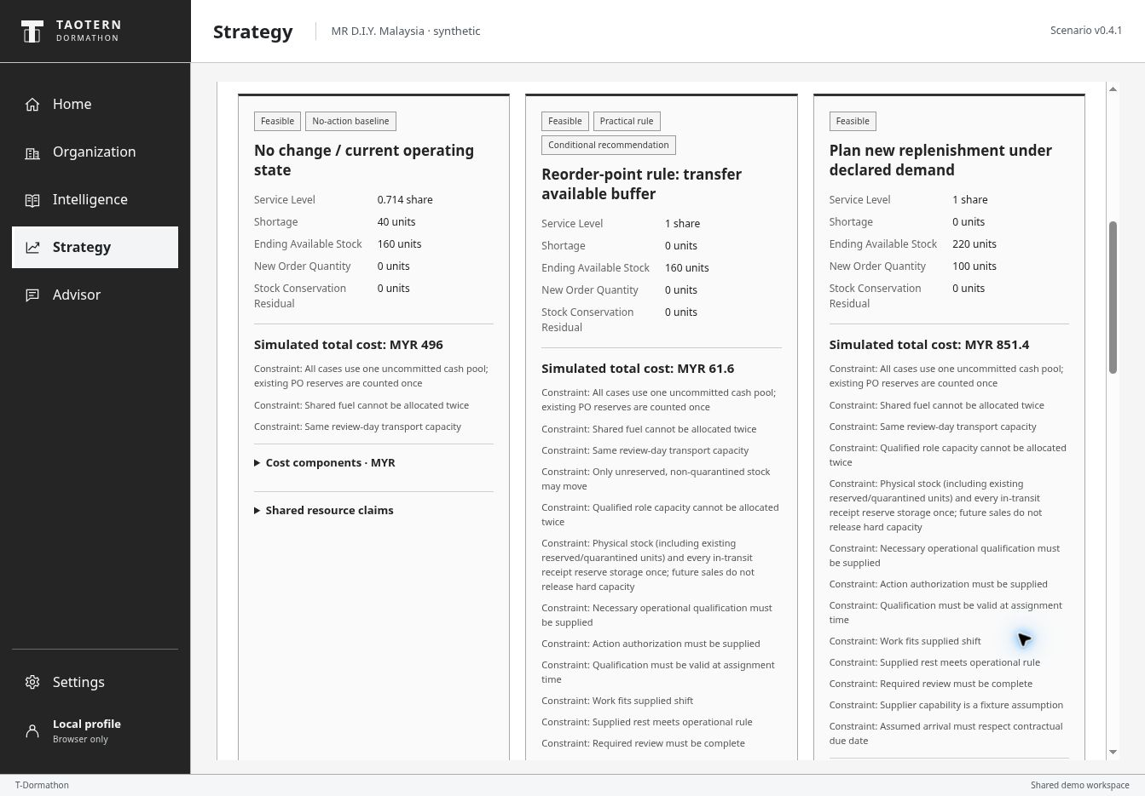
OFFLINE FALLBACK SAVED SCREEN
SC01 compares actions under the same assumptions
40 units uncovered
MYR 496.00
no change
MYR 61.60
transfer rule
Saved screen from hosted Site v71, 10 October 2026. Scenario costs and shortages are simulated.
14
Notes:
OFFLINE FALLBACK. This is a saved screenshot, not a live interaction. Fallback step 2. No-change shortage40 versus transfer-rule shortage0. Cost comparison is conditional synthetic arithmetic, not observed company savings.
SOURCES
Hosted product: https://dormathon-risk-private-20261007.liuyz8715.chatgpt.site/workbench.html. Site v71, source 7ab8622d73c9fc916573e9e74da47b110abc31fd, published 10 October 2026.
Hosted QA: v71 SC01 comparison and selected-decision save/reopen, SC16 abstention and provider-response replays verified 10 October 2026. v70 live SovernStack GPT-OSS 120B verified for SC01 explanation and SC16 missing-input answer. No claim of all-case LLM validation.

Slide 15
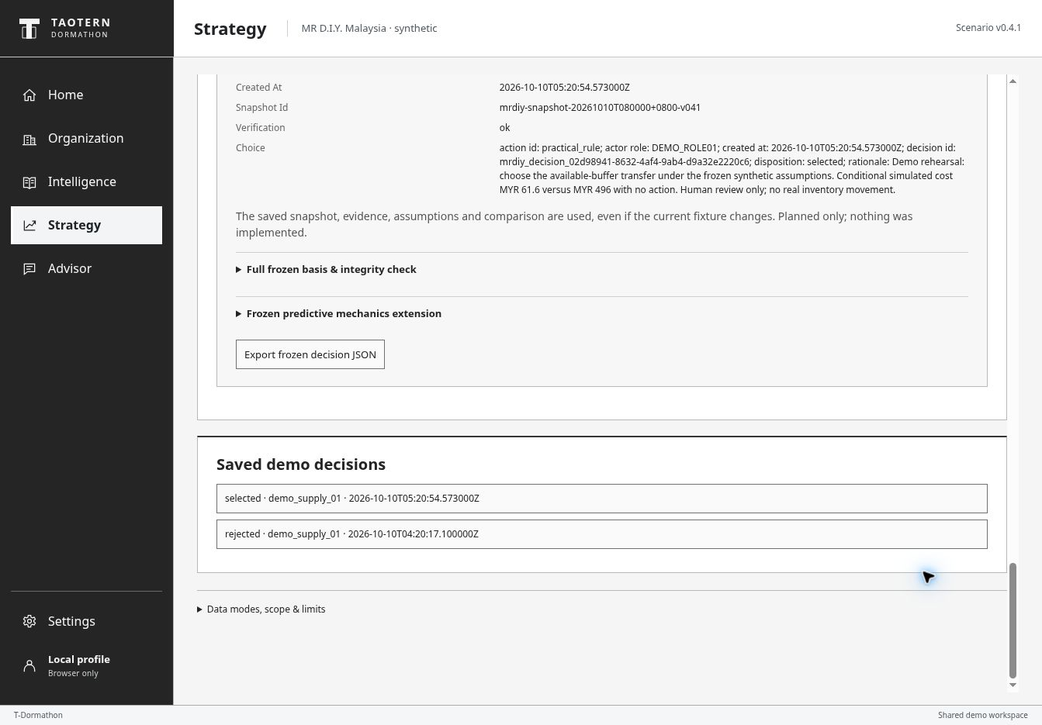
OFFLINE FALLBACK SAVED SCREEN
The human choice reopens with its frozen basis
Selected transfer
Rationale retained
Verification: ok
Saved screen from hosted Site v71, 10 October 2026. Planned choice only. No inventory moved.
15
Notes:
OFFLINE FALLBACK. This is a saved screenshot, not a live interaction. Fallback step 3. Selected practical_rule decision saved at2026-10-10T05:20:54.573000Z. Hosted reopen shows choice, rationale and verification ok. The record is a synthetic human plan with no external action.
SOURCES
Hosted product: https://dormathon-risk-private-20261007.liuyz8715.chatgpt.site/workbench.html. Site v71, source 7ab8622d73c9fc916573e9e74da47b110abc31fd, published 10 October 2026.
Hosted QA: v71 SC01 comparison and selected-decision save/reopen, SC16 abstention and provider-response replays verified 10 October 2026. v70 live SovernStack GPT-OSS 120B verified for SC01 explanation and SC16 missing-input answer. No claim of all-case LLM validation.

Slide 16
EXTERNAL PREDICTIVE EVIDENCE
A reproducible benchmark, with high forecast error
Test mean absolute error, units
103.41%
retained mean test WAPE
Validation selected the mean.
The supervised ridge lost.
Accuracy is still weak.
UCI Online Retail II, UK non-store retailer. Known-SKU test: 11 Nov–8 Dec 2011. Precomputed study, separate from MR D.I.Y.
16
Notes:
3:25–4:15. We evaluated forecasting separately on UCI Online Retail II, a UK retailer, using a frozen chronological split. Validation selected the trailing twenty-eight-day mean. Its test mean absolute error was 6.974 units, compared with 7.727 for the weekly naive baseline. The supervised ridge model performed worse than the mean. Absolute error remains high: the retained mean has test WAPE of 103.41 percent. This is a reproducible result with a clear limitation. It does not establish MR D.I.Y. accuracy, real stockout detection or cross-company generalization.
Point comparison only: mean MAE is about 9.74% lower than weekly naive. No direct mean-versus-naive bootstrap interval was in the retained report, so the deck makes no significance claim. The fitted ridge candidate has test MAE 7.606658118018797. WAPE sums absolute error / actual units over forecast tasks. It is not one minus accuracy.
SOURCES
Chen, D. (2012). Online Retail II [Dataset]. UCI Machine Learning Repository. DOI 10.24432/C5CG6D. CC BY 4.0. https://archive.ics.uci.edu/dataset/502/online+retail+ii
Project evidence: docs/predictive-v0.4.1/artifacts/benchmark-report.v1.json and frozen-split.v1.json. Recomputed and checked 10 October 2026. Results are precomputed.

Slide 17
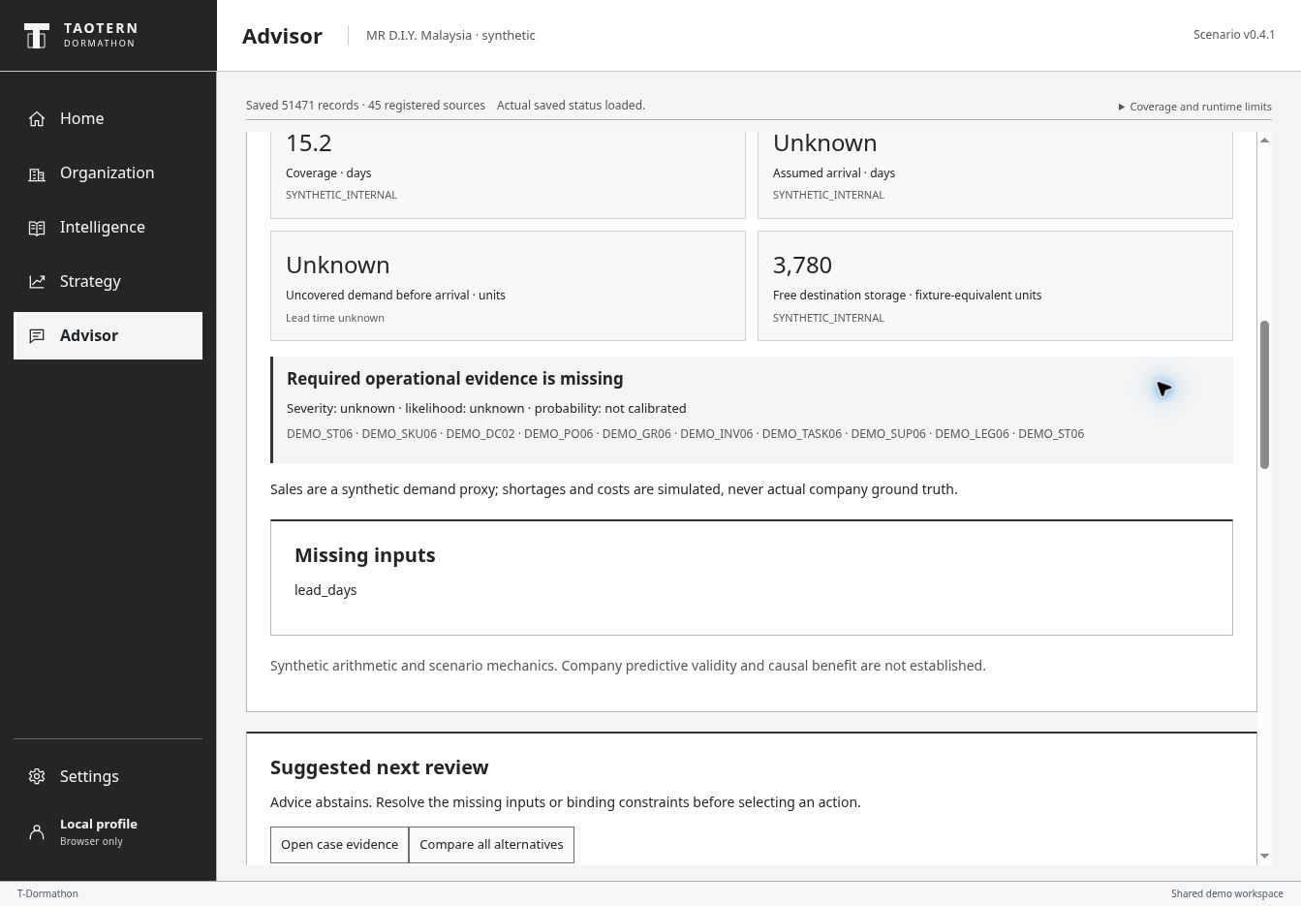
OFFLINE FALLBACK SAVED SCREEN
Missing lead time stops a quantified recommendation
SC16
lead_days missing
Advice abstains
Saved screen from hosted Site v71, 10 October 2026. Unknown values remain unknown.
17
Notes:
OFFLINE FALLBACK. This is a saved screenshot, not a live interaction. Fallback step 5. Show missing lead_days, unknown uncovered demand and explicit abstention. A missing input cannot become a invented forecast, calibrated probability or recommendation.
SOURCES
Hosted product: https://dormathon-risk-private-20261007.liuyz8715.chatgpt.site/workbench.html. Site v71, source 7ab8622d73c9fc916573e9e74da47b110abc31fd, published 10 October 2026.
Hosted QA: v71 SC01 comparison and selected-decision save/reopen, SC16 abstention and provider-response replays verified 10 October 2026. v70 live SovernStack GPT-OSS 120B verified for SC01 explanation and SC16 missing-input answer. No claim of all-case LLM validation.

