Slide 1
Group 14074
Taoufiq OUEDRAOGO taoufiq.ouedraogo@outlook.com
Wickliff Siriga OGARI wycliffeogari@gmail.com
Notes:
This project was carried out within Group 14074. My group partner is Wickliff Siriga OGARI

Slide 2

Government Issued Photo ID
3
1
2
Notes:
The ID document I submitted during my enrollment has since expired. I am therefore providing updated identification documents, including my current ID, for your records.

Slide 3
Systematic Credit Risk Modeling under Macroeconomic Regimes
MScFE Capstone Project - WorldQuant University
Taoufiq OUEDRAOGO
June 2026
Notes:
Good morning. My name is Taoufiq OUEDRAOGO, and I am presenting the Capstone Project I work on. The project is titled Systematic Credit Risk Modeling under Macroeconomic Regimes. So I will walk you through the problem we set out to solve

Slide 4
Project Goal
Build credit risk model that enhances probability of default (PD) with:
Borrower-level financial characteristics
Macroeconomic conditions
Latent economic regimes inferred from data
Check whether macroeconomic regimes improve accuracy during stress periods
Notes:
The central objective of this project was to build a comprehensive credit risk modeling by integrating 3 complementary layers of info:
- borrower-level characteristics, macroeconomic conditions and latent economic regimes inferred from macro data

Slide 5
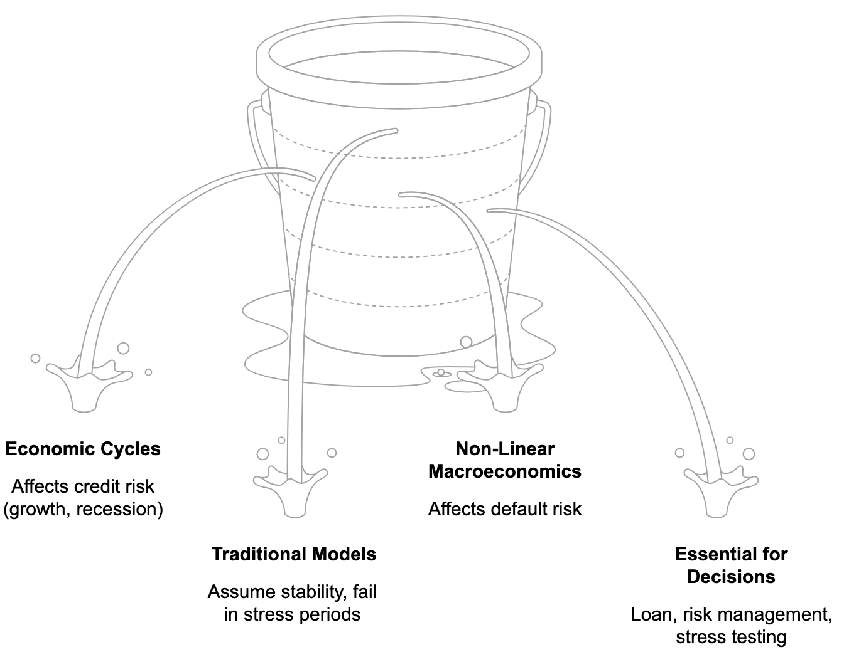
Project Importance - Credit Risk: A Complex Challenge
Notes:
Credit risk is a complex and time-varying challenge, which makes this project particularly important:
- it evolves across economic cycles, while traditional models often rely on stability assumptions that break down in stressed periods.
- Macroeconomic conditions also have significant but non-linear impact on default risk. This is especially critical because credit risk directly influences financial decision-making and has broader consequences for real economy

Slide 6
Literature Review
Traditional Models
ML in Credit Risk
assume stable relationships over time + struggle during economic shifts
Altman (1968): Z-score for bankruptcy prediction
Merton (1974): structural model of credit risk
improve predictive power but often ignore economic structure
Lessmann et al. (2015): ML models improve accuracy
Brown & Mues (2012): boosting methods handle feature interactions better
Macro Conditioning
improve default prediction, but often in a limited way
Wilson (1997): links PD to macro factors
Figlewski et al. (2012): unemployment and macro variables affect default rates
Notes:
The academic literature on credit risk can be grouped into 3 main streams.
Traditional models assume that borrowers with similar characteristics will behave similarly regardless of the economic environment
Machine learning approaches significantly improve predictive performance, but still exhibit a structural limitation: they do not explicitly incorporate macroeconomic conditions
A third stream introduces macro-conditioned models, where PD is linked to macro variables. However, this remain linear and fail to capture economic regimes that can evolve over time. This is precisely the gap addressed by this project

Slide 7
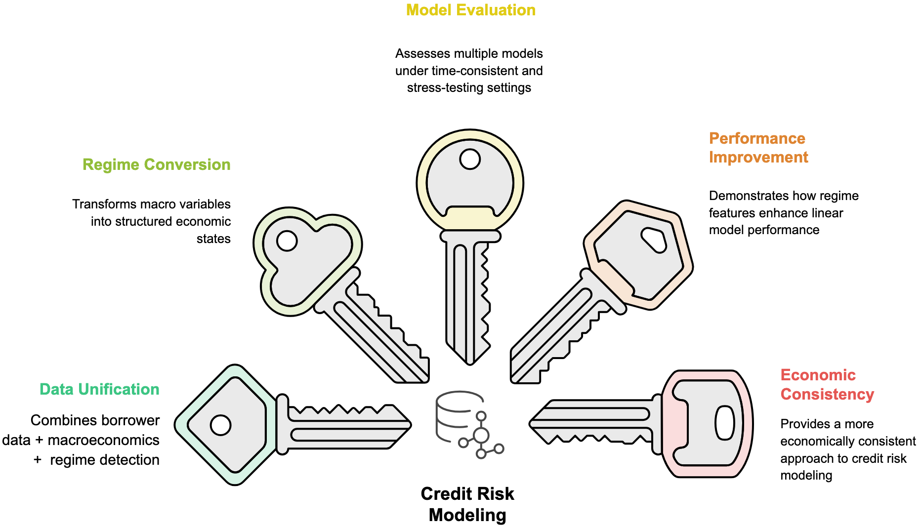
Contribution
Notes:
Our contribution sits at the intersection of the 3 main strands of the literature.
First, we combine borrower-level loan characteristics with macroeconomic variables within a unified framework.
Rather than using raw macro indicators directly, we transform them into discrete economic regimes
We then evaluate four model families—logistic regression, decision trees, random forests, and XGBoost—under time-consistent validation settings.
This enables us to identify which model architectures benefit most from regime information.
Overall, the objective is to move toward a more economically consistent and robust framework for credit risk

Slide 8
Assumptions
Past Default Rates
Historical Borrower
Behavior
Loan Performance
Time Lagged
Macroeconomic
Variables
Default Risk impact
Clusterized
Economic Regimes
Macro Indicators proxies
Time-variable
Variable
Relationships
Learnable from Data
Notes:
The study is based on a few key assumptions.
First, past loan performance provides useful information for predicting future default risk.
Second, only information available at the time of loan origination is used, especially macroeconomic conditions.
Third, the economy can be described through distinct regimes that can be learned from macro data.
Finally, the relationship between credit risk and its drivers changes over time and across economic conditions.

Slide 9
Methodology: Data & Frameworks
THREE-TIER MODEL HIERARCHY
Baseline
DATA SOURCES
Framework 1
Borrower features only
Lending Club Dataset (Kaggle)
500K loans data, with key borrower features (loan grade, income, ratios, …)
Macro-Augmented
Framework 2
Borrower + macroeconomic variables (FRED series)
FRED API
Macroeconomic Data (rates, unemployment, inflation, GDP, bond yields, ...)
Regime-Dependent
Framework 3
Borrower + Macro + Latent Regime
Notes:
To conduct this study, we rely on the Lending Club dataset from Kaggle, which provides detailed borrower-level features, as well as macroeconomic indicators retrieved via the FRED API.
The methodology is structured into a three-level framework. The first is a baseline model using only borrower characteristics. The second extends this by incorporating macroeconomic variables. The third further adds latent economic regimes on top of both borrower and macro information. Each step builds incrementally on the previous one to assess the added value of macro and regime-based information.

Slide 10
Choice of Technology
Python
Main language for implementation
Pandas & NumPy
Data cleaning and preprocessing
Scikit-learn
ML models and evaluation
Matplotlib / Seaborn
Data visualization
Jupyter Notebook
Experimentation and workflow
GitHub
Version control and organization
Notes:
We use solely python for programming, with its various packages (data manipulation, visualization, modeling)
Github for versioning and code management

Slide 11
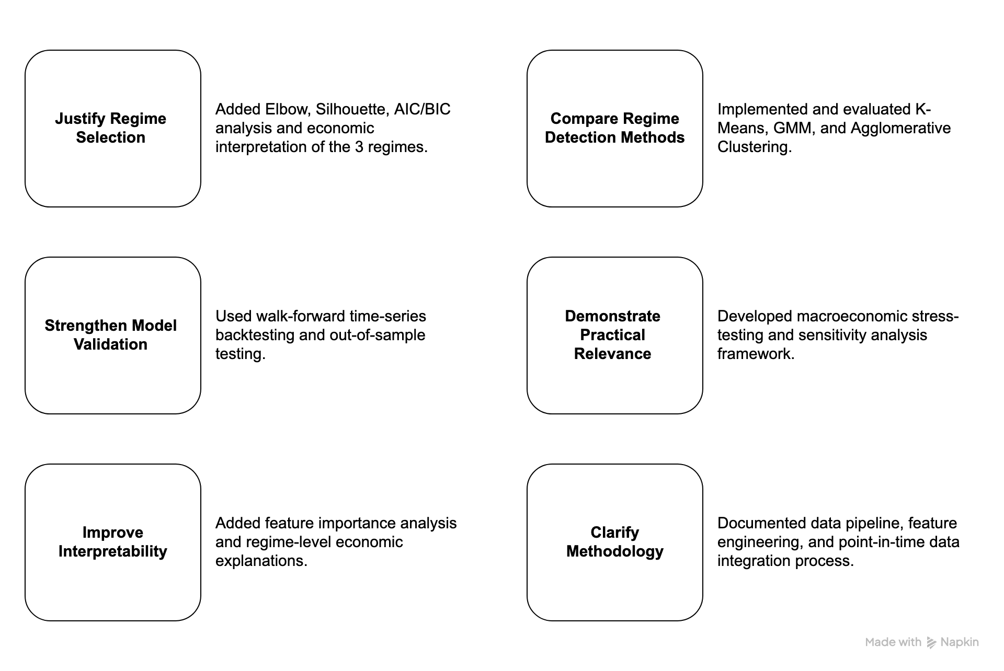
Peer Review Feedback
Notes:
The peer review significantly improved the project. Six key points were raised and all were addressed.
We improved regime detection using clustering diagnostics and economic interpretation.
We replaced the basic split with a walk-forward backtesting framework for realistic evaluation.
We added feature importance analysis to link predictions with macro conditions.
We also:
compared clustering methods,
built stress-testing and sensitivity analysis,
fully documented the pipeline and process for transparency

Slide 12
My Contribution
Data Pipeline
Regime Detection
Implemented K-Means, Gaussian Mixture Models, Hierarchical Clustering
Selected optimal structure
Interpreted regimes from macro patterns
Pulled data from sources
Feature Engineering (transforms, encodings, lags, …)
Regime-Dependent Models
Stress Testing
Built borrower/macro/regime-dependent models
Assess and compare models
Designed macroeconomic stress scenarios
Performed sensitivity analysis
Compare models
Notes:
My personal contribution to the project included several key parts.
I built the data merge and handled feature engineering.
I was also responsible for regime detection using clustering methods to identify economic phases.
On top of this, I developed the regime-aware models.
Finally, I designed macroeconomic scenarios and carried out stress testing and sensitivity analysis.

Slide 13
My Contribution
Code Versioning
Project Management
Created and managed Git repository
Maintained code versioning and project structure
Co-authored project reports and documentation
Integrated mentor feedback and coordinated project updates
Notes:
Beyond the technical aspects, I also took on several organizational responsibilities.
I set up and maintained the GitHub repository with a clean, modular structure to ensure collaboration.
I also co-managed the project with my teammate, including planning, report writing, and integrating feedback from our mentor.

Slide 14
Key Findings
Limited impact of macro variables | Adding raw macroeconomic features produced little improvement in predictive performance
Regime information adds value | Economic regimes improved Logistic Regression performance by capturing market conditions more effectively
Tree-based models remain robust | Random Forest and XGBoost performed consistently across all frameworks due to their ability to capture nonlinear patterns
Feature representation matters | Regime-based features were more informative than raw macroeconomic variables, especially for linear models
Notes:
In terms of key findings
raw macroeconomic variables added limited predictive value, as they were highly correlated and largely collapsed into a single dominant factor.
We found that regime information significantly improves performance for linear models.
In contrast, tree-based models are less affected by feature changes, as they already capture nonlinear interactions internally.
Overall, the main insight is that representation matters more than feature quantity: how information is encoded is more important than simply adding more variables.

Slide 15
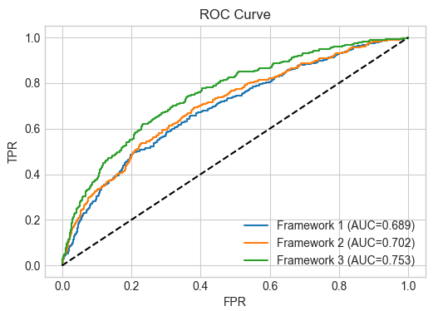
Example: Logistic Regression Improvement across Frameworks
Notes:
We can observe here ROC curve of Logstc Reg for the 3framework
- Regime feature consistently improves performance as Green curve stays above others

Slide 16
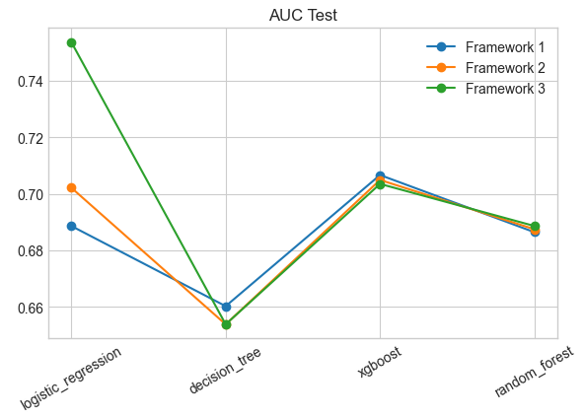
Example: Comparing models and Frameworks
Notes:
Here we have all our models:
- Framework 3 improves only Logistic Regression while others show almost no change across frameworks
- meaning that only Linear models benefit from regime information

Slide 17
Example: Stress-Test Results
Scenario | Relative Change in PD
2008 Financial Crisis | +39.5%
COVID Shock | +37.9%
Severe Recession | +33.6%
Sovereign Debt Crisis | +26.5%
Oil Shock Stagflation | +11.3%
Notes:
After performing stress tests we noticed that it produced economically realistic results:
Better economic conditions —> Lower PD
Worse economic conditions (crisis) —> Higher PD

Slide 18
Conclusions
Incorporating macroeconomic regimes into credit risk modeling can:
enhance risk assessment
improve model interpretability
support more informed lending and risk management decisions
Notes:
The project successfully demonstrates that ….

Slide 19
Conclusions
In term of goal achievements:
Logistic Regression improves AUC by ~9%
3 economic regimes were consistently identified
Stress-testing produced economically realistic results

Slide 20
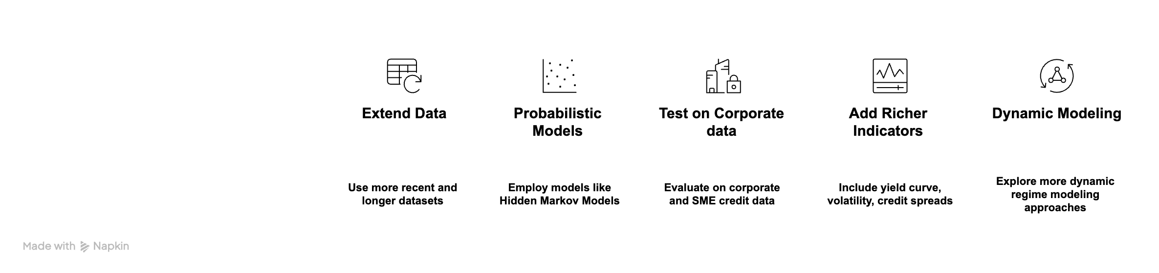
Future Scope of Work
1
2
3
4
5
Notes:
There are 5 directions we would pursue to extend this work:
- Use longer and more recent data to capture additional
- Use HMM to better capture uncertainty during regime changes
- Test the framework on SME and corporate lending, where macroeconomic sensitivity is stronger
- Add richer macro indicators for earlier regime signals
- Develop time-evolving regime models where transition probabilities adapt over time

Slide 21
Thank you to Prof. Joe Byers and the entire WorldQuant University team
Notes:
Tha’s the end. I would like to genuily
Thanks our mentor Professor Joe Byers and the entire WorldQuant University team for the structure, the rigour, and the opportunity. Thank you for watching

