Slide 1
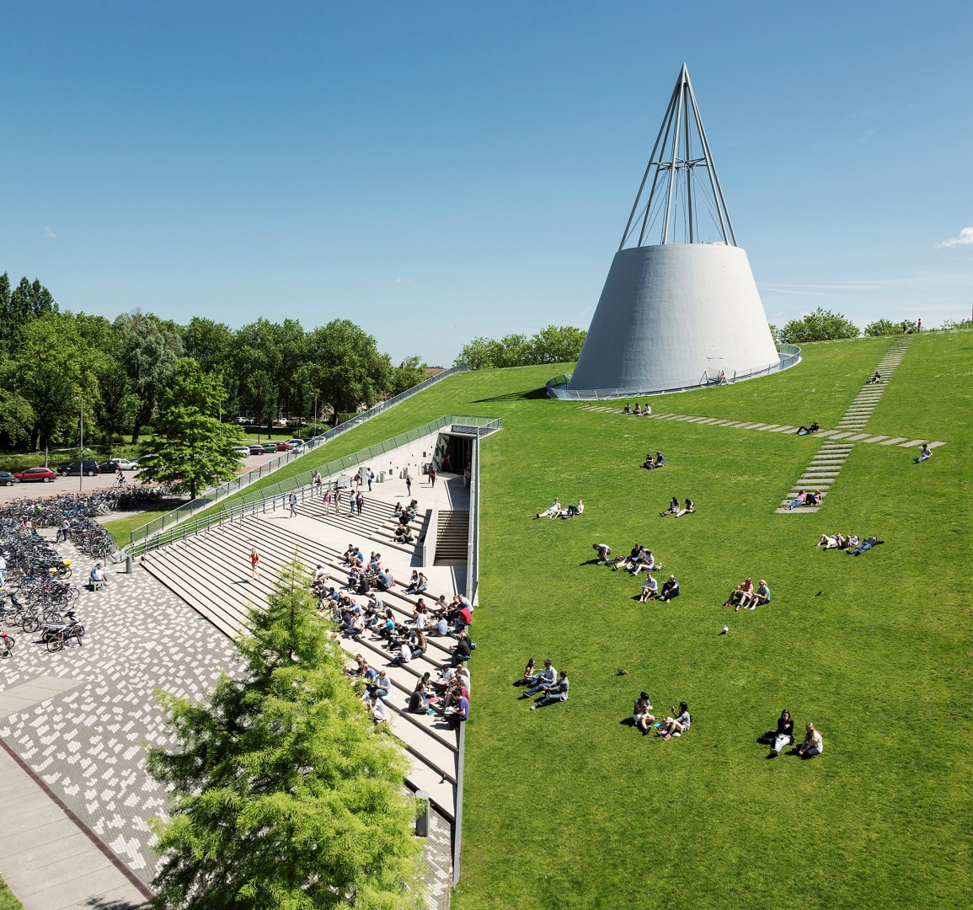
Object classification with Radar
Group 2
13.06.2023
Notes:
Chapter title
Page number
Repeat the question: I think you are asking
Broad question

Slide 2
Table of content
Background
Feature extraction
Machine learning algorithms
Convolutional Neural Network
Conclusion
13-06-2024

Slide 3
Background
Indoor human activity recognition using radar data.
Datasets: 1609 data, 6 types of activities, walking, sitting down, standing up, picking, drinking, and falling.
Micro-doppler signatures are used for classification.
13-06-2024

Slide 4
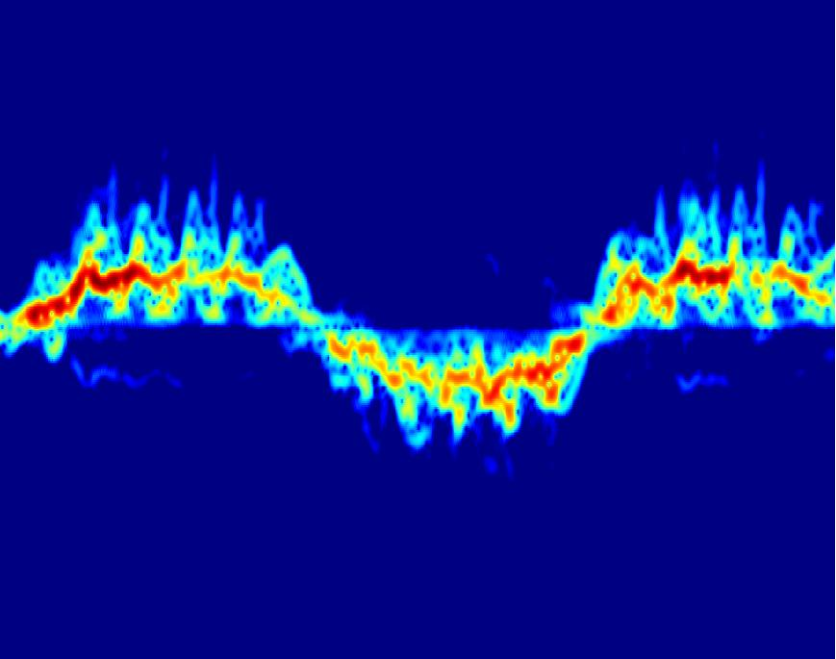
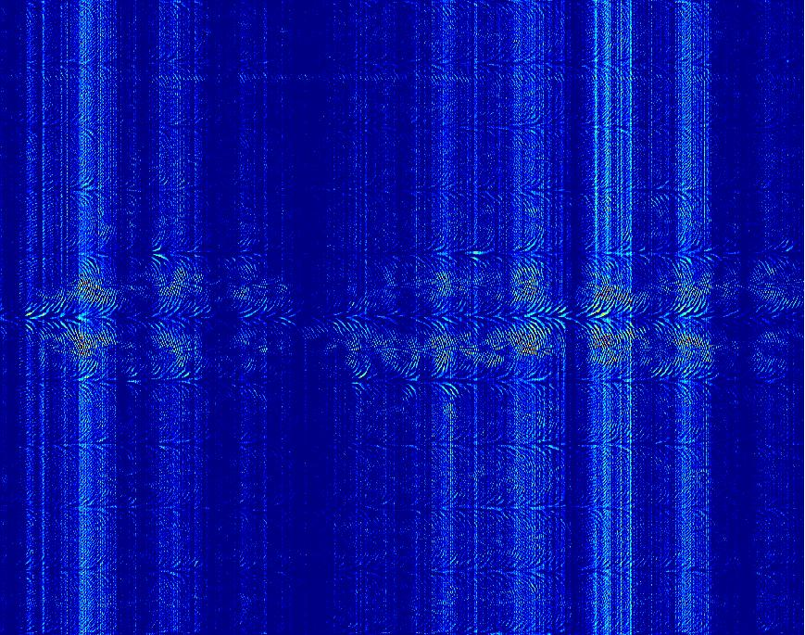
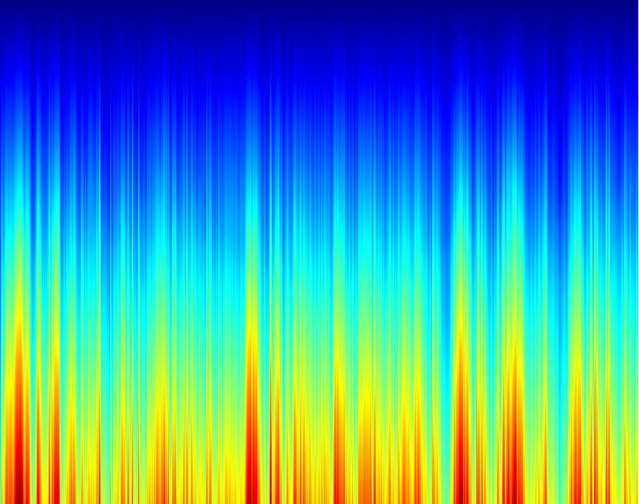
Preprocessing raw data
Doppler-time spectrogram
Doppler-time phase/unwrapped phase
13-06-2024

Slide 5
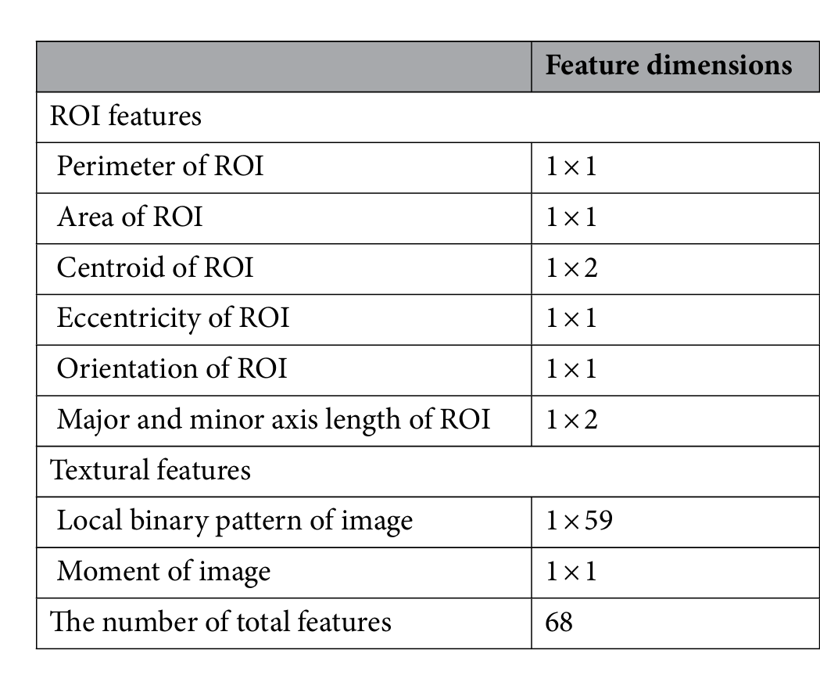
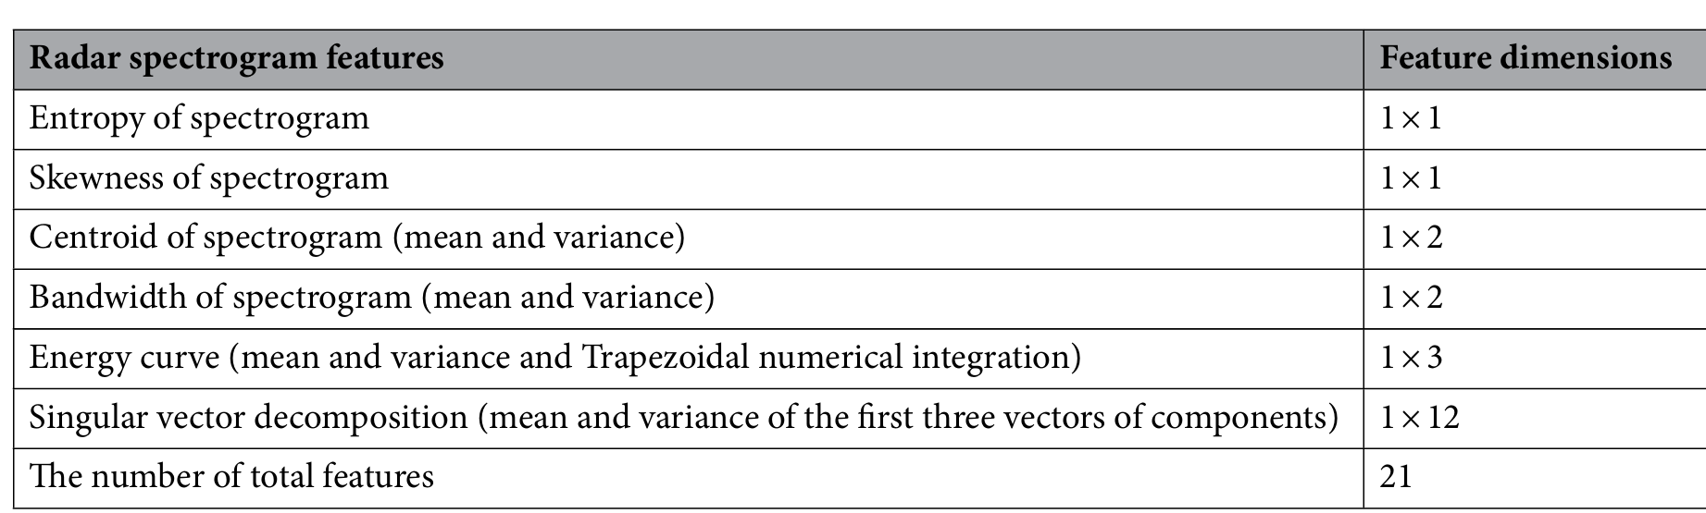
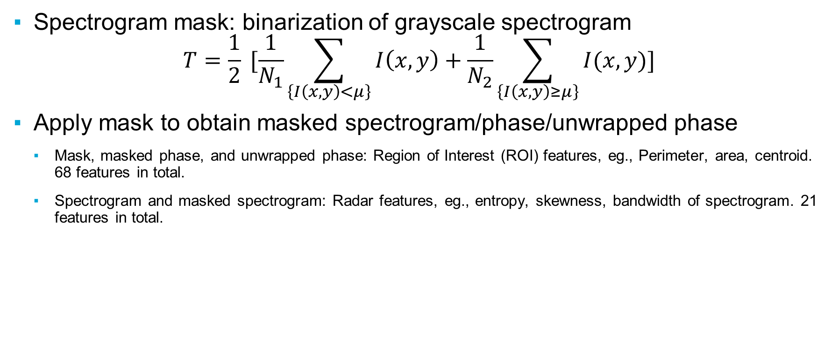
Feature extraction
Spectrogram mask: binarization of grayscale spectrogram
$$T=\frac{1}{2} [\frac{1}{N_{1}}\sum_{\left\{I\left(x,y\right)<μ\right\}}{I\left(x,y\right)+\frac{1}{N_{2}}\sum_{\left\{I\left(x,y\right)≥μ\right\}}{I(x,y)}}]$$
Apply mask to obtain masked spectrogram/phase/unwrapped phase
Mask, masked phase, and unwrapped phase: Region of Interest (ROI) features, eg., Perimeter, area, centroid. 68 features in total.
Spectrogram and masked spectrogram: Radar features, eg., entropy, skewness, bandwidth of spectrogram. 21 features in total.
13-06-2024

Slide 6
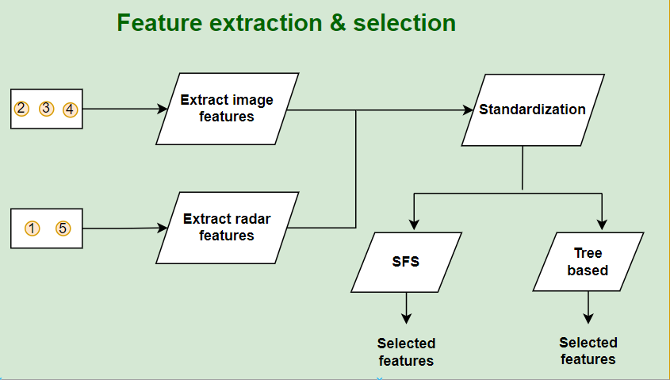
Feature selection
In total 1629 measurements
3 x 68 ROI features
2 x 21 radar features
In total 246 features
Train-test split
Selection basked on training
set
68
21
28
37
13-06-2024

Slide 7
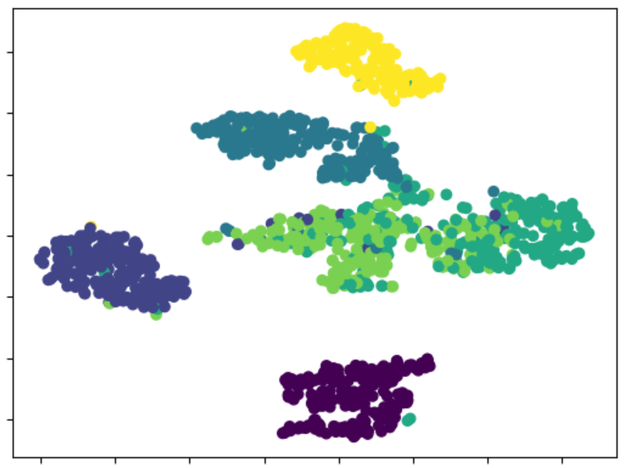
t-distributed stochastic neighbor embedding (t-SNE)
1
2
3
4
5
6
Visualization of the selected (SFS) features
13-06-2024

Slide 8
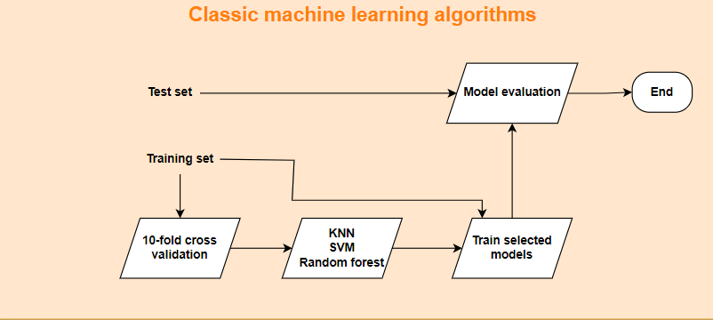
Machine learning algorithms
13-06-2024

Slide 9
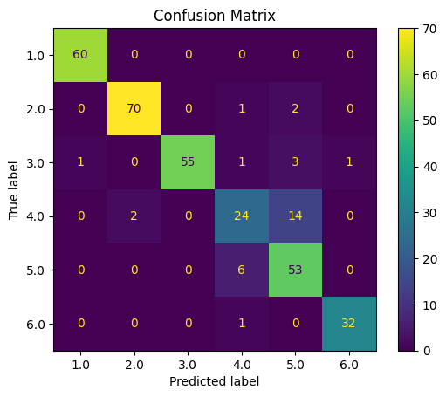
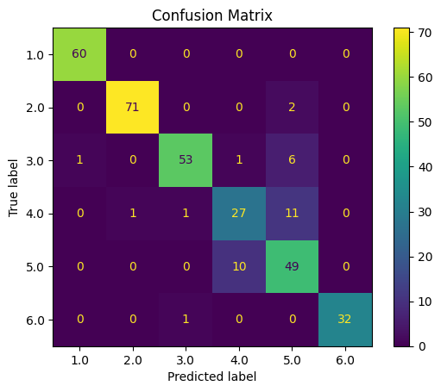
Support vector machine (SVM)
SFS & SVM
Accuracy around 0.902
Tree & SVM
Accuracy around 0.896
13-06-2024

Slide 10
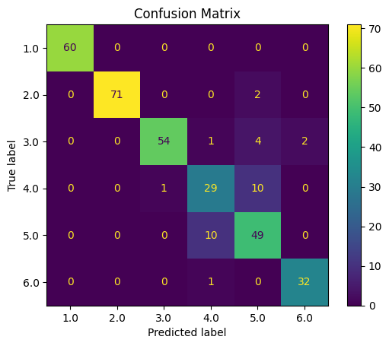
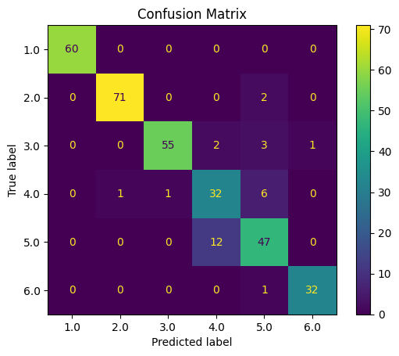
K nearest neighbors (KNN) & random forest
SFS & KNN
Accuracy around 0.905
SFS & Random forest
Accuracy around 0.911
13-06-2024

Slide 11
Results of machine learning algorithms
Feature selection method | Model type | Accuracy on test set
SFS | SVM | 90.2%
 | KNN | 90.5%
 | Random forest | 91.1%
Tree-based | SVM | 89.6%
13-06-2024

Slide 12
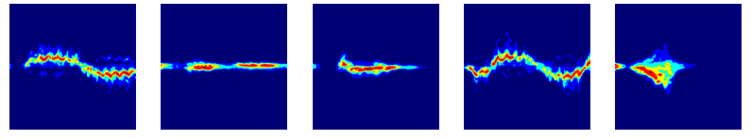
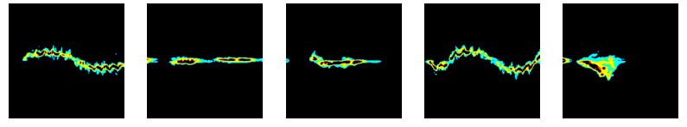
CNN: input data format
Spectrogram RGB image
Resize to 224*224*3
Normalize the pixels
Masked spectrogram RGB image
13-06-2024
Notes:
Hello, everyone. The second route we follow is to view the micro-doppler spectrogram as an image and input it to CNN for feature extraction and classification.
In this project, we choose two different data format: spectrogram and masked spectrogram obtained from previous data processing.
Compared with the spectrogram, the masked version focus more on the movement of major body parts, such as the torso and the legs. Some minor details are ignored.
To deal with activities with different time length, we first resize the images.

Slide 13
CNN: model design, ConvNet
Module 1
Module 2
Module 3
Classifier
Conv 1 (32,3*3)
BN
Max pool (2*2)
Conv 2 (32,3*3)
BN
Max pool (2*2)
Conv 3 (64,3*3)
BN
Max pool (2*2)
Conv 4 (64,3*3)
BN
Max pool (2*2)
Conv5 (128,3*3)
BN
Conv6 (128,3*3)
BN
Max pool (2*2)
Flatten
Linear 1 (6272,512)
Dropout
Linear 2 (512,128)
Dropout
Linear 3 (128, 6)
Dropout
Input
Image
Output
Class
A simplified version of VGG13 Net
Activation function: ReLU
BN: Batch normalization layer
13-06-2024
Notes:
For this task, we design two CNN models.
The first model is a simplified version of VGG13.
It consists of three modules and a classifier.
Each module has two convolution layers, batch normalization, and pooling layers
The final classifier contains three linear layers attached with dropout to prevent overfitting

Slide 14
CNN: model design, ConvSE
Conv 1
BN
Max pool
Conv 2
BN
Max pool
Conv 3
BN
Max pool
Conv 4
BN
Max pool
Conv5
BN
Conv6
BN
Max pool
SE Module
Flatten
Linear 1
Dropout
Linear2
Dropout
Linear 3
Dropout
Concatenate
Module 1
Module 2
Module 3
Classifier
Input
Image
Output
Class
Max pool
Max pool
13-06-2024
Notes:
The second model adds some extensions to the first model.
It combines the output feature map of all three modules and concatenates them across the channel dimension.
(To make the feature map equal size, the max pooling layers are used.)
In this way, both low level and high level features can be considered in the classification stage.
The next question is shall we treat those features with equal importance, or assign them different weights?
To learn the importance of different feature maps, we add an attention mechanism based SE module after concatenation.

Slide 15
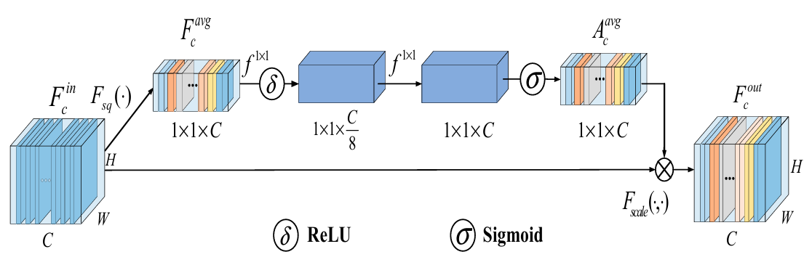
Squeeze-and-Excitation (SE) Module
Squeeze the pixels in each channel with global average pooling
Learn the weights of each channel map and apply to the input
13-06-2024
Notes:
Now let me explain a bit about the SE module, which is called squeeze and excitation.
It first squeeze the pixels in each channel with average pooling, and then learn the weights of each channel by two linear layers.
Finally the learned weights are multiplied with the corresponding channel map to get the output.
In this way, different channels are assigned with different importance.

Slide 16
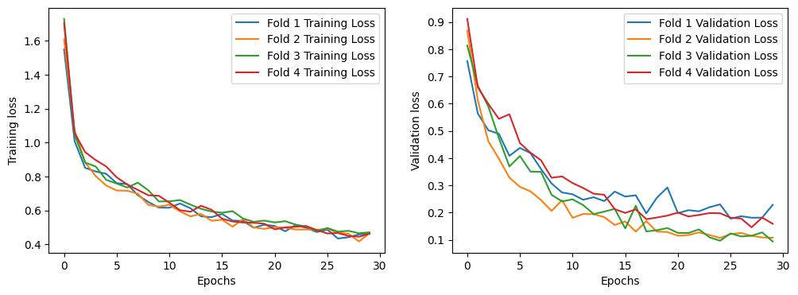
CNN: Hyperparameter tuning
4-fold cross validation
13-06-2024
Notes:
Next, we use 4-fold cross validation for hyperparameter tuning.
This figure shows the training and validation loss for the tuned hyperparameter.
After 30 epochs, both the training and validation loss tends to converge, so the model is not overfitting.

Slide 17

CNN: model training
Loss function: Focal Loss (gamma = 2)
Emphasize the importance of confusable samples
Optimizer: Adam, learning rate = 0.0001
Batch size: 32
Number of epochs: 30
13-06-2024
Notes:
After that, we perform model training.
In terms of loss function, we choose the focal loss in order to focus more on samples which are difficult to classify.
Compared with the cross entropy loss, it just adds a weight term, which will be large if the classification of a sample is wrong.
We choose the Adam optimizer for faster convergence.
With the tuned learning rate and batch size, we train each model for 30 epochs.

Slide 18
Results: CNN
Input data format | Model type | Accuracy on test set
Spectrogram | ConvNet | 88.04%
Spectrogram | ConvSE | 93.56%
Masked spectrogram | ConvNet | 90.80%
Masked spectrogram | ConvSE | 92.02%
13-06-2024
Notes:
Finally, we evaluate the results based on the accuracy on test set and confusion matrix.
From the table, we can see the improved model can achieve better accuracy and show better generalization ability.
For the two data format, their performance are very close, only differ by 1 or 2 percent.

Slide 19
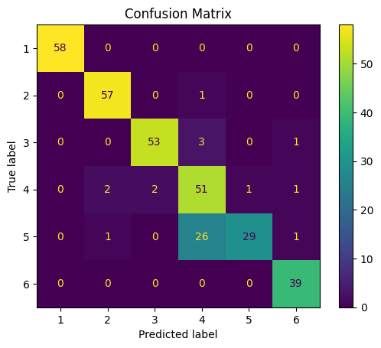
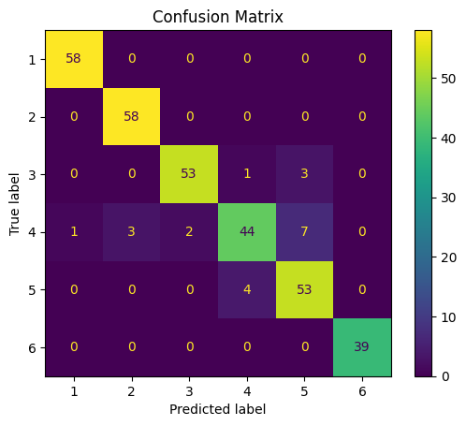
Results: Spectrogram + CNN
Spectrogram + ConvNet
Spectrogram + ConvSE
4: Picking up an object
5: Drinking water
13-06-2024
Notes:
Let’s look closer to the confusion matrix.
The 4th and 5th activity: picking up an object and drinking water can be the most difficult to classify.
While the convnet makes quite a lot wrong predictions in this, the improved model can classify with fewer errors.
The reason may be instead of only considering high-level features, the addition of low-level features can discover some details, which can be helpful in classifying two similar activities.

Slide 20
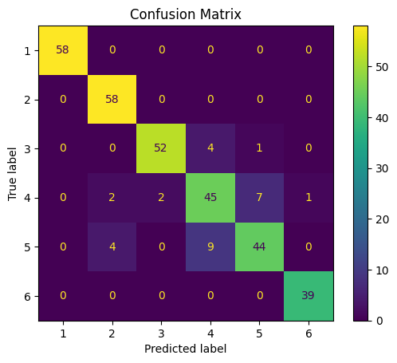
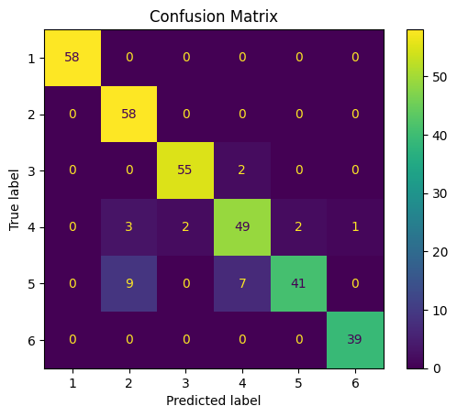
Results: Masked spectrogram + CNN
Masked spectrogram + ConvNet
Masked spectrogram + ConvSE
2: Sitting down
5: Drinking water
13-06-2024
Notes:
If we use the masked spectrogram as input, the performance can be better in classifying 4 and 5.
However, we notice the model can misclassify some drinking water activities as sitting down, and the reason is not so straightforward.
To summarize, the two data formats can be complementary in different tasks, so combining them with some fusion techniques may lead to better performance.

Slide 21
Comparison: Classical machine learning & CNN
Model type | Accuracy on test set | Model size | Model training time
Feature + KNN | 90.49% | 297 KB | 0.0047 sec
Feature + SVM | 90.18% | 129 KB | 0.04 sec
Feature + Random Forest | 91.10% | 2.3 MB | 0.345 sec
CNN | 93.56% | 22.9 MB | 8 min
13-06-2024
Notes:
In this project, we follow two routes to solve the problem, and both routes lead to very good classification results.
While CNN can have better performance than others and doesn’t need to extract features by ourselves, the model can be much more complex, thus requiring more time and space resources.
In conclusion, selecting an effective pipeline requires careful considerations of many factors.
Now this is the end of our presentation. We are very happy to hear your questions and feedbacks. Thank you for listening!

Slide 22
Reference
[1] Li Z, Le Kernec J, Abbasi Q, et al. Radar-based human activity recognition with adaptive thresholding towards resource constrained platforms[J]. Scientific Reports, 2023, 13(1): 3473.
[2] Cao L, Liang S, Zhao Z, et al. Human Activity Recognition Method Based on FMCW Radar Sensor with Multi-Domain Feature Attention Fusion Network[J]. Sensors, 2023, 23(11): 5100.
[3] Hu J, Shen L, Sun G. Squeeze-and-excitation networks[C]//Proceedings of the IEEE conference on computer vision and pattern recognition. 2018: 7132-7141.

Slide 23
Thank you for listening
Group 2

