Slide 1
Genetic Algorithm: The Happiness Pursuit (Knapsack Problem) team - 321
Tapadyuti Maiti | Simi Golbert Foss
INFO 6205 Data Structure and Algorithms - Final Project Genetic Algorithm - Happiness Pursuit

Slide 2
Problem
We have chosen the specific problem of finding the exact trail of activities list to achieve the maximum happiness factor through the day through Genetic Algorithm. Though this problem is essentially maps into Knapsack Problem, but we had faced few major roadblocks to convert it into solid code.

Slide 3
Inspiration
There has been lot of work going on to lead a beautiful and happy, calm, poised life as a Human being. Our initial thought was to solve this problem through genetic algorithm as it follows how our gene gets mutated naturally to cope up with the current nature. We gave a try to solve this problem by finding out the most optimal list of activities along with its reward points associated with Happiness. Albeit by doing these list of activity can’t guarantee to become Happy, but it’s a try is a worth.
We have found out list of 78 Activities and ranked them accordingly with its reward points associated with the approximate time taken to finish it. We accept the fact that these reward point can vary person to person.

Slide 4
Implementation
Following Steps were implemented sequentially to solve the problem through genetic algorithm:
Load Data from Excel Sheet and initialize Gene Symbol Table
Initilialise the Weighted Activity Graph
Make Generation 0 of 4 initial members
Do Evolution till 100.
Plot the result in JChart.

Slide 5
Fitness Function:
It defined as the:
Fitness of a Person = ______Sum of total reward points of a Person________ Maximum Reward point that can be achieved (960)

Slide 6
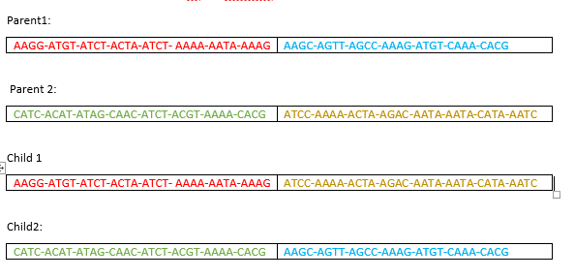
Cross Over Process:

Slide 7
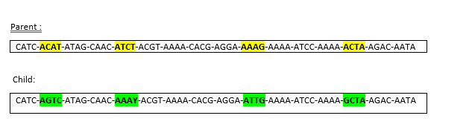
Mutation Process

Slide 8
Findings:
We have ran our GA to check how our results are coming up , below are given data of 5 experiment associated with its reward point.
Experiment | Fitness Score | Total Reward Point
1 | 0.287083333 | 275.59
2 | 0.306302083 | 294.04
3 | 0.3471875 | 333.3
4 | 0.373489583 | 358.549
5 | 0.400885417 | 384.85

Slide 9
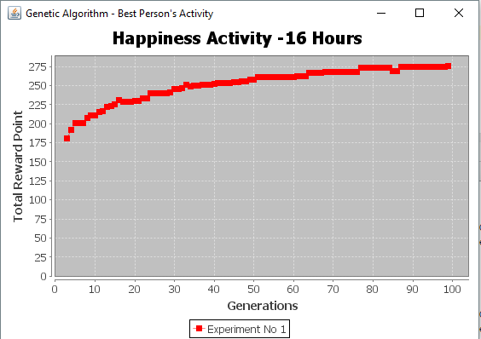
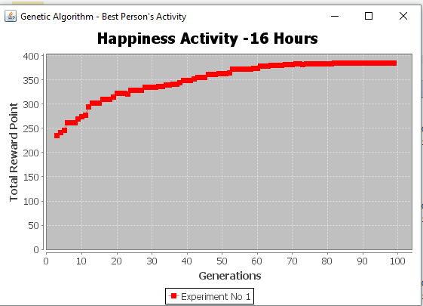
Experiment 1,2

Slide 10
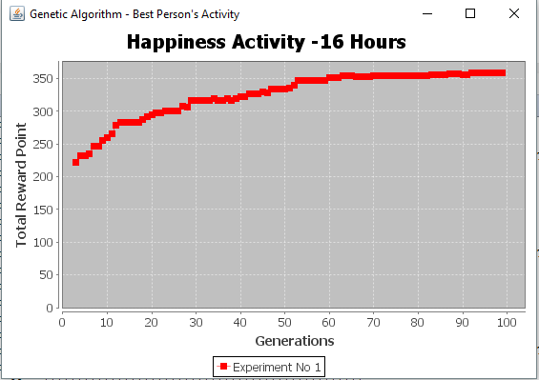
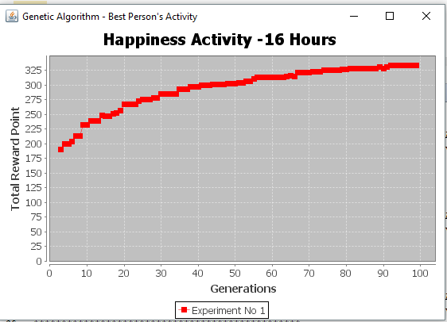
Experiment 3,4

Slide 11
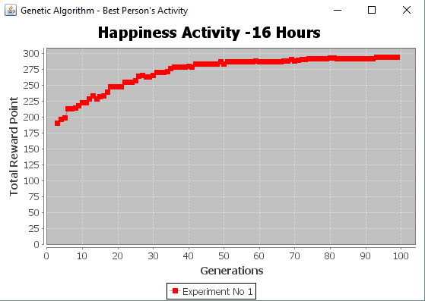
Experiment 5

Slide 12
Conclusion
As from the above graph we can see total reward points for happiness or our fitness function gets increasing as generations increases. We are culling with 0.5 ratio in each generation. After 100 generation we are getting approximately 300-400 reward points out which turns out to be an excellent solution as of activity listed out in our consideration. Thus we can infer that Genetic Algorithm repeatedly modifies the population by mutation of individual solutions to get the best solution.

