Slide 1
Power BI
Banking Dashboard

Slide 2
ABOUT THE PROJECT
The project is a banking project where we have used a banking dataset. Here in this dashboard we are going to show features like Loan analysis and Deposit Analysis and summary of the overall dataset.

Slide 3
Total Clients
3000
Some important KPI’s
Savings Account
$698.73M
Checking Account Amt
$963.28M

Slide 4
Financial Goals
Total Loan
$4.38B
Total Deposit
$3.77B
Bank Loan
$1.77B

Slide 5
Bank Numbers
$1.77B
$2.01B
$2.60B
Bank Loan
Bank Deposit
Business Lending

Slide 6
698.73
Saving Account (in Millions)
Checking amount and Saving amount
Foreign Currency Amount (in millions)
89.65

Slide 7
$ 89.65M
FOREIGN CURRENCY AMOUNT

Slide 8
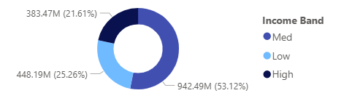
Bank Loan by Income band
What we observe?
Bank loan is highest for Mid Income band and lowest for High Income band.

Slide 9
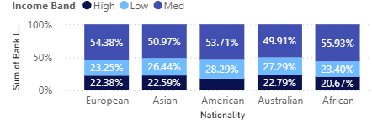
Bank Loan by Income band
What we observe?
Highest features are in the European countries followed by Asian Countries.
Lowest features are in Australian countries followed by African countries.

Slide 10
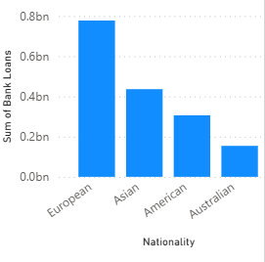
Bank Loan by Nationality
What we observe?
Bank loan is highest for European countries and lowest for Australian countries.

Slide 11
THANK YOU !

