Slide 1


Major Project Review-2 Presentation
Autonomous AI coding companion
Team No: 15
Student Name : Tapan Pendyala Guide Name : A. Rambabu
HT.No : 22EG107B58 Designation : Assistant Professor
Student Name : K. Ganasree
HT.No : 22EG107B33
Student Name : S.Nithin Kumar
HT.No : 22EG107B42
Student Name : P.Uday Kiran
HT.No : 22EG107B43

Slide 2
Contents
S.No | Title | Slide No
1 | Abstract | 3
2 | Objectives | 4
3 | Problem Statement | 5
4 | Methodology | 6
5 | Implementation | 7
6 | Results | 8
7 | Discussion | 10
8 | Conclusion and Future Work | 11
9 | Reference | 12

Slide 3
Abstract
Modern software development struggles with understanding large, evolving codebases due to missing context like historical decisions, developer intent, risk, and knowledge distribution. Existing AI tools focus mainly on code generation and lack insight into how and why systems evolve. This project introduces an Intelligent Context-Aware System that integrates data from version control, pull requests, issues, and documentation to build a unified knowledge layer using knowledge graphs, static analysis, and RAG. It enables temporal code analysis, risk assessment, and developer expertise mapping, delivering real-time insights directly in the IDE. This reduces context switching, improves productivity, and minimizes errors by transforming codebases into intelligent, context-aware systems.

Slide 4
Objectives
Objectives of the proposed work are:
Build a context-aware system by integrating code, commits, and documentation into a unified view.
Generate insights like code history, risk detection, and developer expertise mapping.
Improve productivity with real-time insights to reduce effort and speed up development.

Slide 5
Problem Statement
As software systems grow in size and complexity, developers struggle to understand codebases due to fragmented context such as past changes, developer intent, and potential risks. Existing tools, including AI assistants, largely focus on writing code rather than explaining its evolution or impact, resulting in inefficiencies and higher chances of errors. This highlights the need for a scalable solution that unifies project information and delivers clear, actionable insights to help developers work more efficiently and make informed decisions.

Slide 6
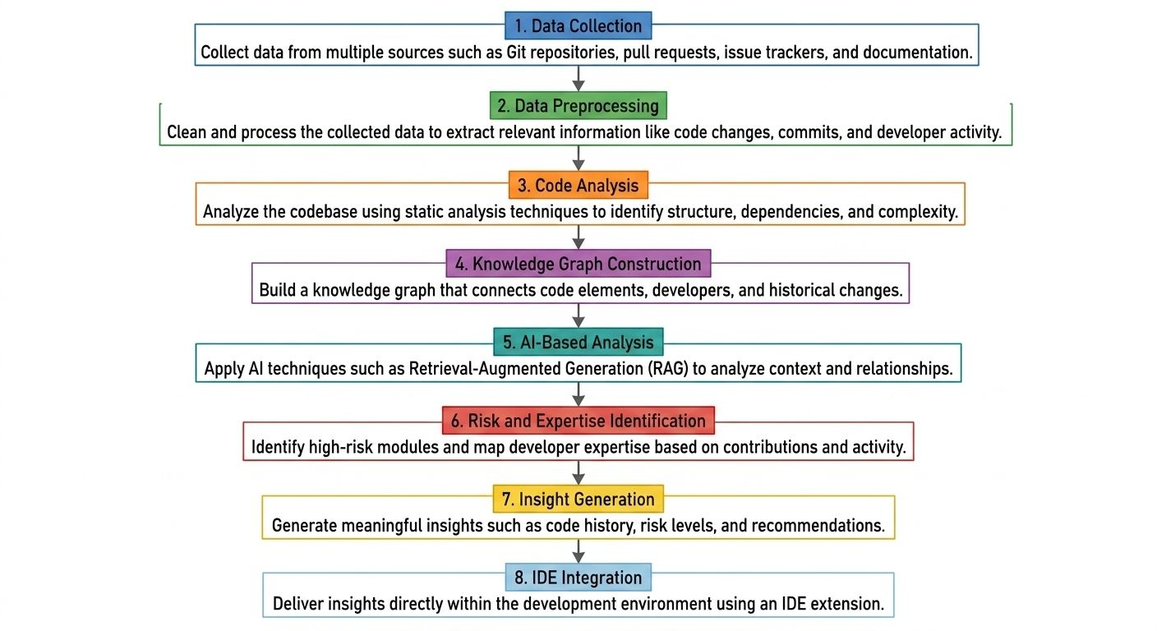
Methodology
Figure-1. Proposed Methodology

Slide 7
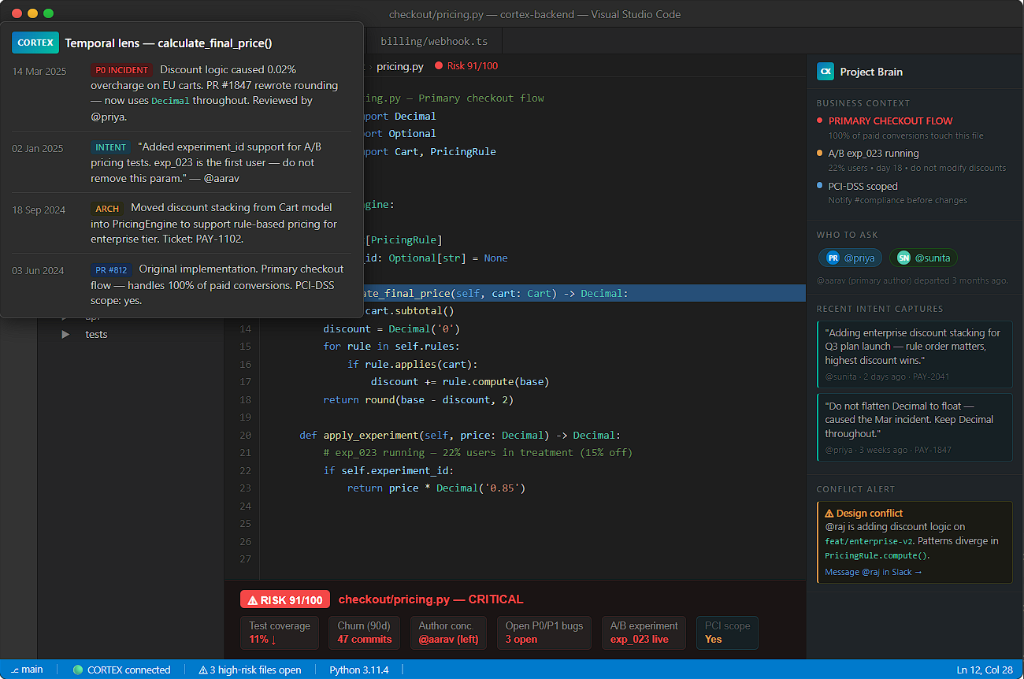
Implementation
Figure-2. User Interface for Implementation

Slide 8
Results
CORTEX improves developer productivity by enabling faster code understanding through intent and history, reducing time spent searching across commits, and accelerating onboarding with clear “who changed what and why” insights. It enhances code quality by identifying high-risk files early, prioritizing reviews based on risk, and reducing regressions in critical areas. The system strengthens knowledge retention by capturing intent, minimizing dependency on key individuals, and ensuring smooth team transitions. With real-time IDE intelligence, it delivers live risk signals, in-context insights while coding, and a continuously evolving project memory. Built on a modular, scalable architecture with an extensible knowledge graph, it targets measurable impact: 20–40% faster context understanding, 15–30% faster reviews, 20–35% quicker onboarding, 10–25% fewer regressions, and sub-200ms response times.

Slide 9
Discussion
The proposed system improves software development by providing better understanding of complex codebases through integration of multiple data sources. Unlike traditional tools, it offers deeper insights such as code history, developer intent, and system relationships.
Using knowledge graphs and AI techniques like RAG, the system can identify high-risk modules and map developer expertise, helping in safer and more efficient code changes.
The system reduces time spent on understanding code and minimizes context-switching. However, its performance depends on the quality of input data. Overall, it provides a scalable and practical approach for modern software development.

Slide 10
Conclusion and Future Work
Conclusion:
The proposed context-aware system improves understanding of complex software codebases by integrating project-level information into a unified intelligence layer. Using knowledge graphs and AI-based analysis, it provides insights such as code history, risk factors, and developer expertise directly within the IDE.
The system reduces the time required to understand code, improves decision-making, and minimizes errors, making it a scalable and practical solution for modern software development.
Future work:
• Integrate real-time runtime data such as logs and system performance metrics for improved analysis.
• Enhance the AI model to automatically capture developer intent without manual input
• Expand the system to support multiple IDE platforms and large-scale enterprise environments.
• Improve visualization through advanced dashboards and interactive architecture mapping.
• Incorporate predictive analysis to estimate the impact of code changes before implementation.

Slide 11
References
[1] T. Zimmermann, N. Nagappan, H. Gall, E. Giger, and B. Murphy, “Cross-project defect prediction: A large scale experiment on data vs. domain vs. process,” in Proc. 7th Joint Meeting of the European Software Engineering Conference and the ACM SIGSOFT Symp. on the Foundations of Software Engineering (ESEC/FSE), 2009, pp. 91–100.
[2] Stack Overflow, “Stack Overflow Developer Survey 2024,” Stack Overflow, 2024. [Online]. Available: https://survey.stackoverflow.co/2024/. [Accessed: Apr. 2026].
[3] DX, “2024 State of Developer Productivity,” DX Research, 2024. [Online]. Available: https://getdx.com/research/2024-state-of-developer-productivity. [Accessed:Apr.2026]. [4] P. Lewis et al., “Retrieval-Augmented Generation for Knowledge-Intensive NLP Tasks,” in Advances in Neural Information Processing Systems (NeurIPS), vol. 33, 2020, pp. 9459–9474.

Slide 12
References
[5] Y. Ding et al., “A Survey on LLM-Based Software Engineering: Trends and Challenges,” arXiv preprint arXiv:2403.09479, Mar. 2024.
[6] M. Chen et al., “Evaluating Large Language Models Trained on Code,” arXiv preprint arXiv:2107.03374, Jul. 2021.
[7] E. Nijkamp et al., “CodeGen: An Open Large Language Model for Code with Multi-Turn Program Synthesis,” in Proc. International Conference on Learning Representations (ICLR), 2023.
[8] T. J. McCabe, “A complexity measure,” IEEE Transactions on Software Engineering, vol. SE-2, no. 4, pp. 308–320, Dec. 1976.

Slide 13
References
[9] S. R. Chidamber and C. F. Kemerer, “A metrics suite for object-oriented design,” IEEE Transactions on Software Engineering, vol. 20, no. 6, pp. 476–493, Jun. 1994.
[10] C. Parnin and S. Rugaber, “Resumption strategies for interrupted programming tasks,” Software Quality Journal, vol. 19, no. 1, pp. 5–34, Mar. 2011.

