Slide 1


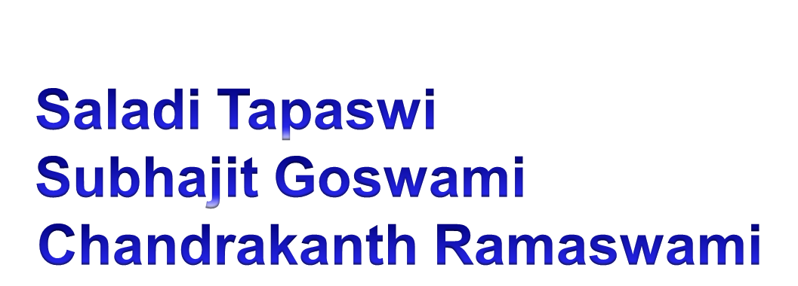

Slide 2
Why Kirana Web Application?
Reach people living in remote regions
People who cannot avail banking products and services
Technological awareness is minimum
One stop shop for products and services

Slide 3
Features Covered in Project
Has two users – one is Kirana Shop owner(agent on behalf of bank)and Customers
Services Provided by these modules:
    Transfer money
    Account Balance
    View Statement
    Loan Payment
    Sell insurance
    Give Loan
    Grocery Shopping
    Newsletter
    Notification
Secure Authentication and Authorization
Uses Open Source technologies

Slide 4
Technologies and Frameworks Used
Programming Language:JAVA,Eclipse IDE
Database: Mongo DB
Server: Apache Tomcat
Pre-requisite to use Eclipse IDE is JDK 1.8 environment should be installed before installing Eclipse IDE
Application type: Web Application

Slide 5


Slide 6
Prototype Link
https://github.com/TapaswiSaladi/INDUSIND-FINTECH-HACKATHON

Slide 7


Slide 8

QUESTIONNAIRE

