Slide 1

Lung Cancer prediction
DSC 530 Data exploration and Analysis
Final Term Project
Tapaswi chowdary Sriramineni

Slide 2

DATA SET
The data set that we are working on throughout this project is Lung cancer prediction.
This data is obtained from the survey that is created to find the data on the causes of the lung cancer.
This dataset provides the data of the level of air pollution and it's effect on the lung cancer.

Slide 3
Variables
The five variables that we will be working on in the project are:
Air pollution : The level of air pollution exposure of the patient. (Categorical)
Alcohol use : The level of alcohol use of the patient. (Categorical)
Dust Allergy : The level of dust allergy of the patient. (Categorical)
Genetic Risk : The level of genetic risk of the patient. (Categorical)
Chronic Lung Disease : The level of chronic lung disease of the patient. (Categorical)

Slide 4
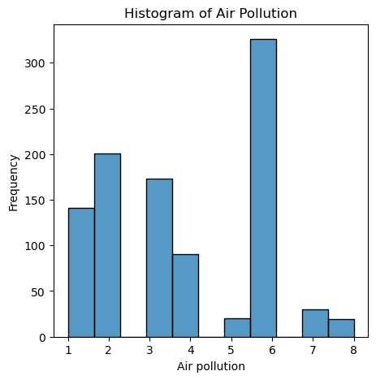
HISTOGRAMS
Histogram of Air Pollution
Mean: 3.84​ Mode: [6]​ Variance: 4.122522522522477​ Spread(IQR): 4.0​ Tail: ​ 995 6​ 996 6​ 997 4​ 998 6​ 999 6​

Slide 5
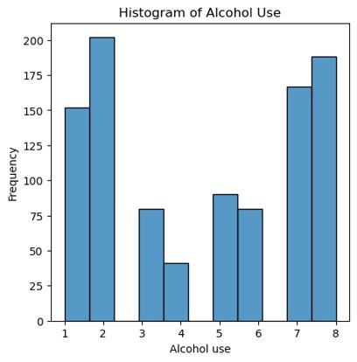
HISTOGRAMS
Histogram of Alcohol Use
Mean: 4.563
Mode: [2]
Variance: 6.866897897897863 Spread(IQR): 5.0
Tail:
995 7
996 8
997 5
998 8
999 5

Slide 6
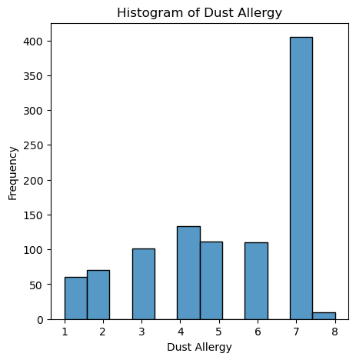
HISTOGRAMS
Histogram of Dust allergy
Mean: 5.165
Mode: [7]
Variance: 3.9236986986986877 Spread(IQR): 3.0
Tail:
995 7
996 7
997 6
998 7
999 6

Slide 7
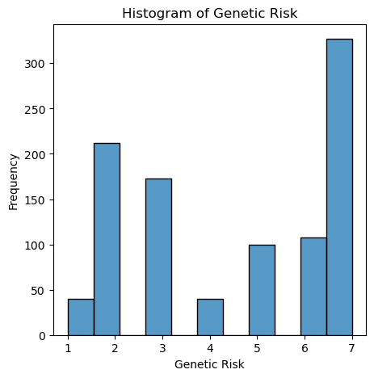
HISTOGRAMS
Histogram of Genetic Risk
Mean: 4.58
Mode: [7]
Variance: 4.524124124124109 Spread(IQR): 5.0
Tail:
995 7
996 7
997 5
998 7
999 5

Slide 8
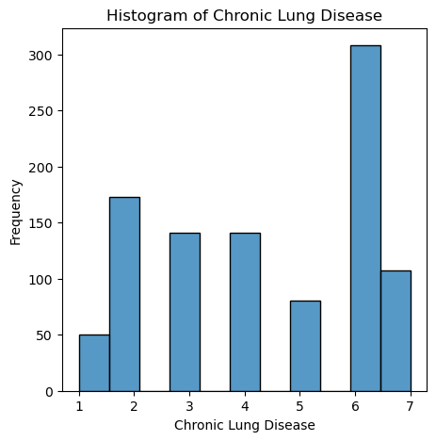
HISTOGRAMS
Histogram of Chronic Lung disease
Mean: 4.38
Mode: [6]
Variance: 3.417017017017018 Spread(IQR): 3.0
Tail:
995 6
996 6
997 4
998 6
999 4

Slide 9
Outliers:
These variables doesn't have any outliers. Based on the data's source, the maximum and lowest numbers in this dataset seem reasonable. Nothing out of the usual that may affect the analysis doesn't seem to exist.

Slide 10
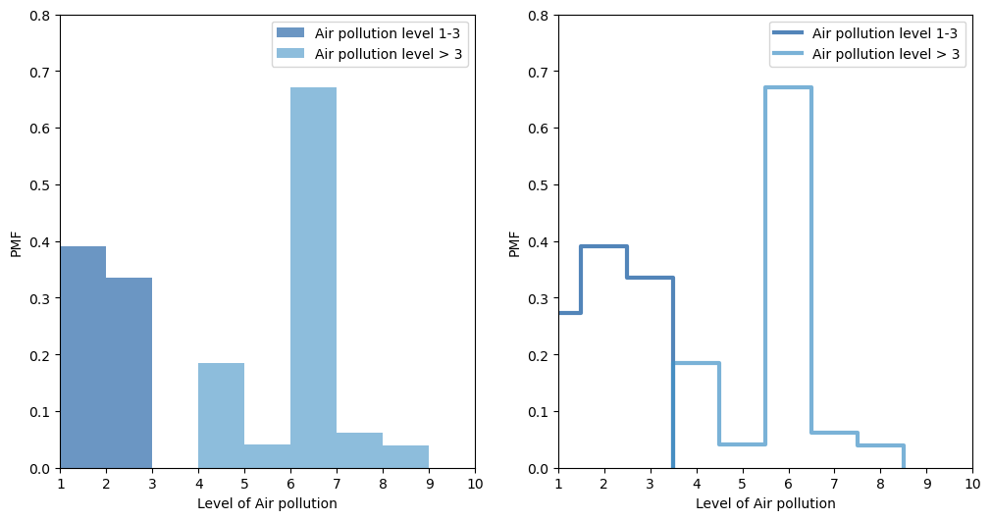
PMF
So we are comparing 2 Scenarios of the same variable:
Here we are considering the variable 'Air Pollution' and taking two scenarios where considering the airpollution level from 1-3 and comparing it with the rest of the range inorder to understand how it affects the lung cancer prediction

Slide 11
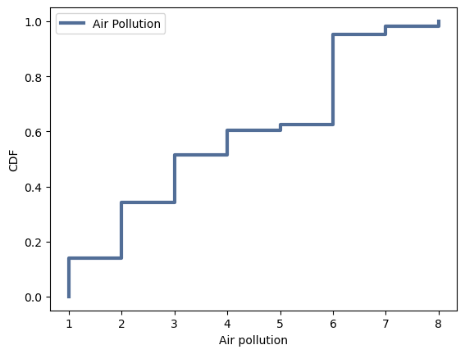
CDF
Here we are considering the variable 'Air pollution' and performing CDF on it.
According to the CDF the chances of having the cancer has increased along with the level of airpollution.
The most common level of air pollution according to the CDF will be 6 which means that most of the patients in the given data have been exposed to a level 6 air pollution. We can observe that there is just 25% of the people who are effected by the air pollution under the level of 1-3 but we can observe that more than 75% has the exposure to the higher levels of air pollution.

Slide 12
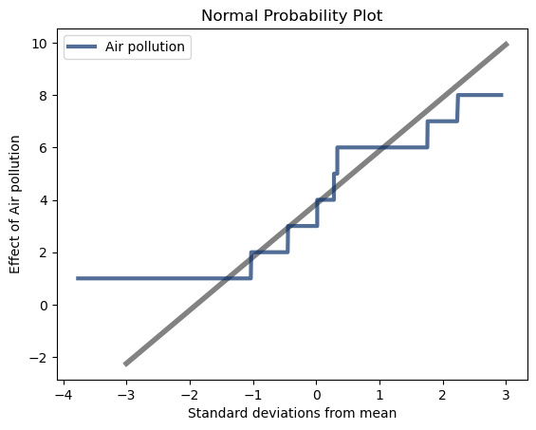
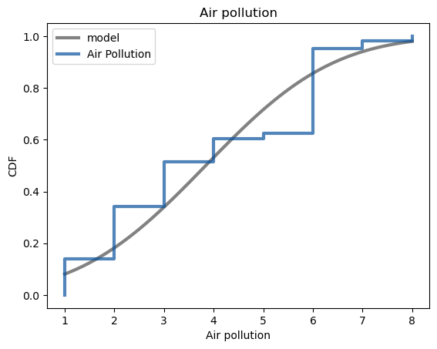
Analytical distribution
Here we are considering Normal Distribution
The curve is almost similar to the CDF graph which shows that is has the expected value. The highest value of the air pollution 8 is in 90th percentile rank and the lowest ranges are in 30th percentile which clearly shows that the effect of the air pollution is higher in higher ranges.

Slide 13
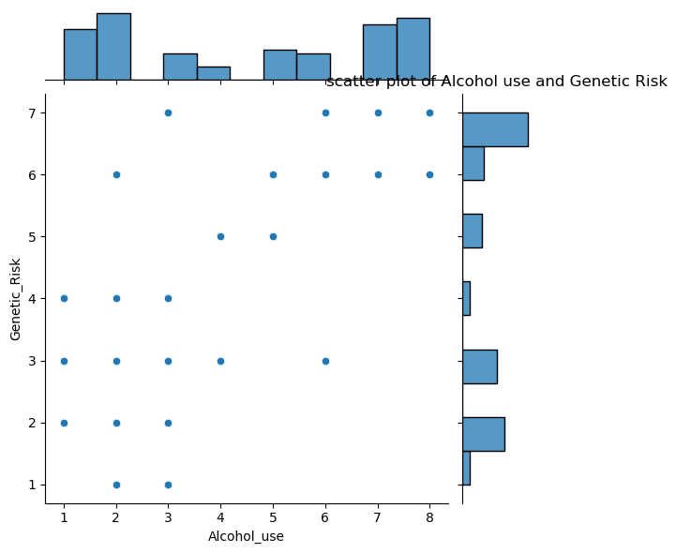
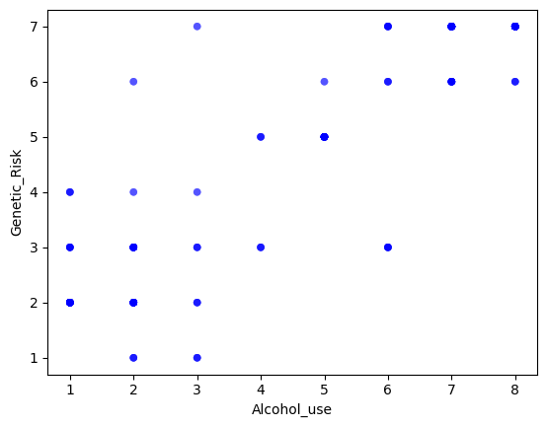
Scatter Plots
<- Fig 1
Here we are comparing two variables 'Alcohol_use' and 'Genetic_Risk'. Using the Seaborn and Joinplot(fig 1) and thinkplot (fig 2)
From the scatter plot we can say that these two variables have many overlapping points almost 80% of them which depicts the correlation between the two variables
Fig 2 ->

Slide 14
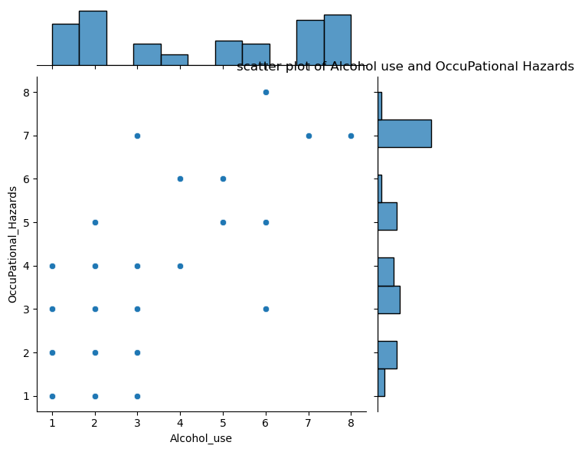
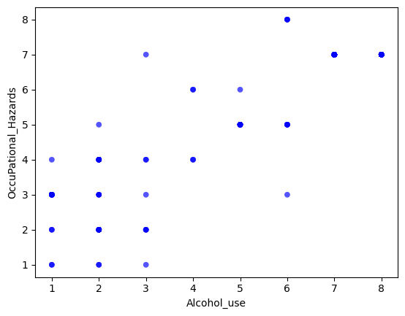
Scatter Plots
<- Fig 1
Here we are comparing two variables 'Alcohol_use' and 'OccuPational_Hazards'. Using the Seaborn and Joinplot(fig 1) and thinkplot (fig 2)
From the scatter plot we can say that these two variables have many overlapping points almost 90% of them which depicts the correlation between the two variables
Fig 2 ->

Slide 15
Hypothesis Testing
Null Hypothesis
My hypotheseis is to point out the no correlation between the Age and Airpollution variables which depicts that in the lung cancer prediction the Air pollution effect doesn't depend on the age of the person
pvalue: 0.0
The pvalue shows that in the lung cancer prediction the air pollution effect is not dependent on the age of the patient

Slide 16
Regression Analysis
The formula is 'Alcohol_use ~ Genetic Risk'
Result is :
Intercept: -0.3867359943357907 Slope: 1.0807283830427465
p-value of slope estimate: 2.7193e-320
R^2: 0.7694971870880725
An R-squared score of 0.7695 suggests that the independent variables in the model can account for around 76.95% of the variability in the dependent variable. This number ranges from 0 to 1, with 0 indicating that the model explains no variability and 1 indicating that it fully accounts for all variability.

Slide 17

Data set
Data source:
Link: https://www.kaggle.com/datasets/thedevastator/cancer-patients-and-air-pollution-a-new-link?resource=download

