Slide 1
Spring AOP Basics

Slide 2
Topics
Why AOP?
AOP concepts
Spring AOP
Shantanu Banerjee

Slide 3
Cross Cutting Concern
A simple Banking application!
void transfer(Account fromAcc, Account toAcc, int amount) throws Exception {
if (fromAcc.getBalance() < amount) {
throw new InsufficientFundsException();
}
fromAcc.withdraw(amount);
toAcc.deposit(amount);
}
Shantanu Banerjee

Slide 4
Cross Cutting Concern
A simple Banking application with logging and Security check
void transfer(Account fromAcc, Account toAcc, int amount, User user, Logger logger)
throws Exception {
logger.info("transferring money...");
if (! checkUserPermission(user)){
logger.info("User has no permission.");
throw new UnauthorizedUserException();
}
if (fromAcc.getBalance() < amount) {
logger.info("Insufficient Funds, sorry");
throw new InsufficientFundsException();
}
fromAcc.withdraw(amount);
toAcc.deposit(amount);
//get database connection
//save transactions
logger.info("Successful transaction.");
}
Cross Cutting Concern
Shantanu Banerjee

Slide 5
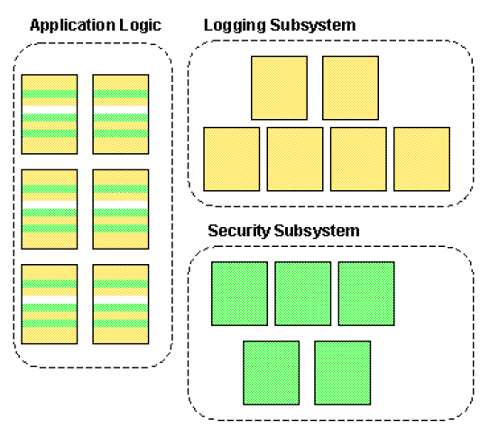
The banking code with cross cutting concern
Shantanu Banerjee

Slide 6
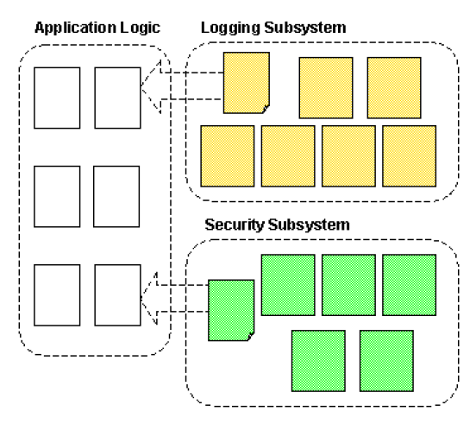
Banking application with Separated concerns
Shantanu Banerjee

Slide 7
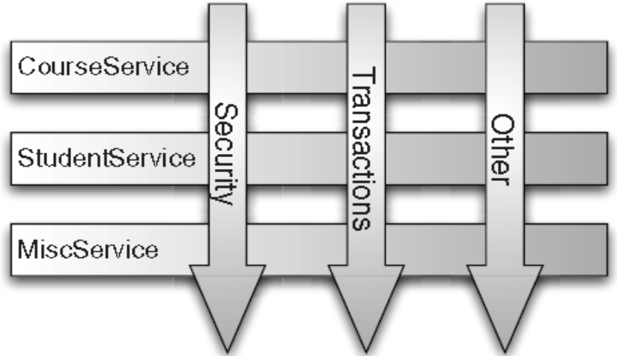
Why AOP?
Aspect-oriented programming (AOP) provides for simplified application of cross-cutting concerns
Examples of cross-cutting concerns
  Logging
  Transaction management
  Security
  Auditing
  Locking
  Event handling
Shantanu Banerjee

Slide 8
AOP Concepts

Slide 9
AOP Concepts: Joinpoint
A join point is a well-defined point in the program flow.
You can insert additional logic at Joinpoint's
Examples of Jointpoint's
  Method invocation
  Class initialization
  Object initialization
Shantanu Banerjee

Slide 10
AOP Concepts: Advice
Advice is code that is executed when a join point is reached.
Types of Advice
  before advice, which executes before joinpoint
  after advice, which executes after joinpoint
  around advice, which executes around joinpoint
Shantanu Banerjee

Slide 11
AOP Concepts: Pointcuts
A collection of joinpoints that you use to define when advice should be executed
By creating pointcuts, you gain fine-grained control over how you apply advice to the components
An expression that matches zero or more join points.
pointcuts pick out certain join points in the program flow
Example
  A typical joinpoint is a method invocation.
  A typical pointcut is a collection of all method invocations in a particular class
Pointcuts can be composed in complex relationships to further constrain when advice is executed
Shantanu Banerjee

Slide 12
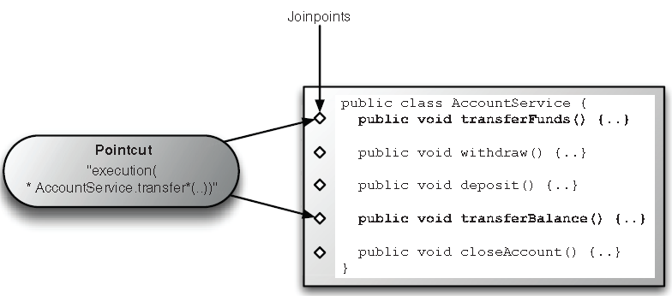
Defining Pointcuts
Shantanu Banerjee

Slide 13
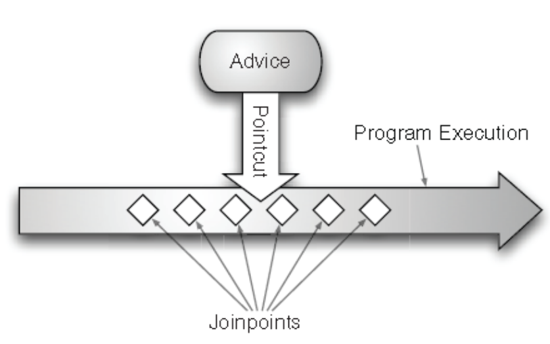
AOP Concepts: Aspects
A modularized implementation of a software concern that cuts across various objects in a software implementation. Logging is a good example of an aspect.
An aspect contains the advice and pointcuts
Advice
Pointcut
ASPECT
Shantanu Banerjee

Slide 14
AOP Concepts: Weaving
Process of actually inserting aspects into the application code at the appropriate point
Types of Weaving
  Compile time weaving
  Runtime weaving
Shantanu Banerjee

Slide 15
AOP Concepts: Target
An object whose execution flow is modified by some AOP process
They are sometimes called advised object
Shantanu Banerjee

Slide 16
AOP Concepts: Introduction
Process by which you can modify the structure of an object by introducing additional methods or fields to it
You use the Introduction to make any object implement a specific interface without needing the object's class to implement that interface explicitly
Shantanu Banerjee

Slide 17
Types of AOP

Slide 18
Types of AOP
Static AOP
  The weaving process forms another step in the build process for an application
  Example: In Java program, you can achieve the weaving process by modifying the actual bytecode of the application changing and modifying code as necessary
Dynamic AOP
  The weaving process is performed dynamically at runtime
  Easy to change the weaving process without recompilation
Shantanu Banerjee

Slide 19
Spring AOP

Slide 20
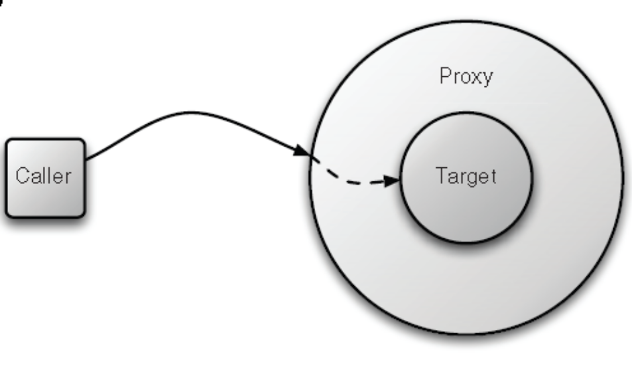
Spring AOP
In Spring, aspects are woven into Spring-managed beans at runtime by wrapping them with a proxy class
The proxy class poses as the target bean, intercepting advised method calls and forwarding those calls to the target bean
Shantanu Banerjee

Slide 21
Spring AOP
Based on proxies
  When you want to create an advised instance of a class, you must use the ProxyFactory class to create a proxy of an instance of that class, first providing the ProxyFactory with all the aspects that you want to be woven into the proxy
  You typically use ProxyFactoryBean class to provide declarative proxy creation
Shantanu Banerjee

Slide 22
HelloWorld Spring AOP

Slide 23
MessageWriter Class
We want to display “Hello World !” through AOP
public class MessageWriter {
public void writeMessage() {
System.out.print("World");
}
}
Shantanu Banerjee

Slide 24
Target
The joinpoint is the invocation of the writeMessage() method
What we need is an “around advice”
public class MessageWriter {
public void writeMessage() {
System.out.print("World");
}
}
Shantanu Banerjee

Slide 25
Around Advice
● MethodInterceptor is AOP Alliance standard interface for around Advice
● MethodInvocation object represents the method invocation that is being advised
  public class MessageDecorator implements
  MethodInterceptor {
  public Object invoke(MethodInvocation invocation)
  throws Throwable {
  System.out.print("Hello ");
  Object retVal = invocation.proceed();
  System.out.println("!");
  return retVal;
  }
Shantanu Banerjee

Slide 26
Weaving MessageDecorator Advice
Use ProxyFactory class to create the proxy of the target object
  public static void main(String[] args) {
  MessageWriter target = new MessageWriter();
  // create the proxy
  ProxyFactory pf = new ProxyFactory();
  //Add the given AOP Alliance advice to the tail
  //of the advice (interceptor) chain
  pf.addAdvice(new MessageDecorator());
Shantanu Banerjee

Slide 27
Weaving MessageDecorator Advice
  //Set the given object as target
  pf.setTarget(target);
  //Create a new proxy according to the
  //settings in this factory
  MessageWriter proxy = (MessageWriter) pf.getProxy();
  // write the messages
  target.writeMessage();
  System.out.println("");
  // use the proxy
  proxy.writeMessage();
  }
  }
Shantanu Banerjee

Slide 28
Acknowledgement
Spring in Action
Spring Documentation
Shantanu Banerjee

Slide 29
target
AUdience
Advice
Pointcut
Aspect
Aspect
Proxy
Shantanu Banerjee

Slide 30
Questions?

Slide 31
Thank You for your patience

Slide 32
AOP Example 1
Scenario
Logger (Advice)
IBank
logBefore(){}
logAfter(){}
withdraw()
execution of the
Method BankImpl.withdraw();
withdraw()
{}
Pointcut
BankImpl
(target)
Proxy
Shantanu Banerjee

Slide 33
Pointcut Formats (AspectJ)
Spring AOP users are likely to use the execution pointcut designator the most often. The format of an execution expression is:
execution(modifiers-pattern? ret-type-pattern declaring-type-pattern? name-pattern(param-pattern) throws-pattern?)
Shantanu Banerjee

Slide 34
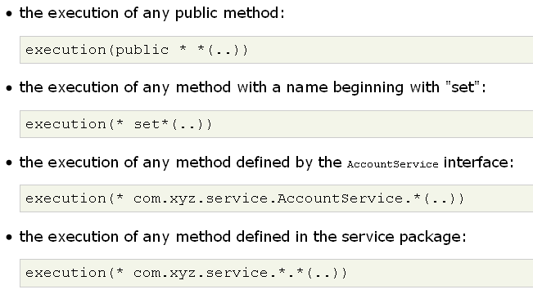
Pointcut expression examples
Shantanu Banerjee

Slide 35
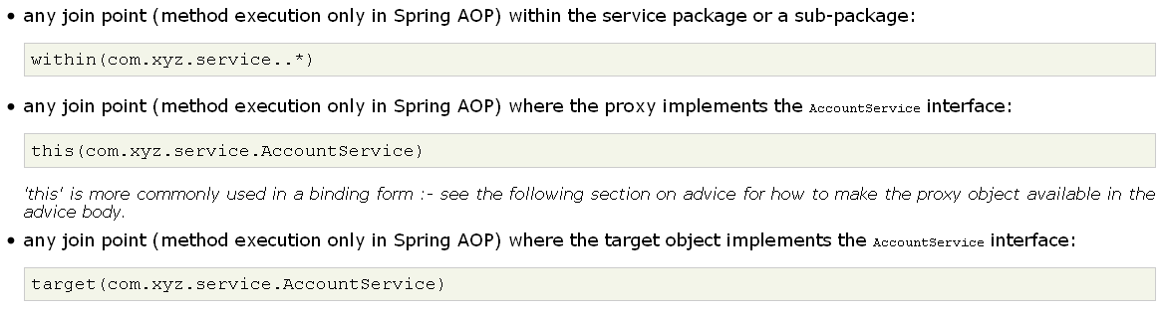
'target' is more commonly used in a binding form :- see the following section on advice for how to make the target object available in the advice body.
Shantanu Banerjee

Slide 36
any join point (method execution only in Spring AOP) where the target object has an @Transactional annotation:
  @target(org.springframework.transaction.annotation.Transactional)‘
  @target' can also be used in a binding form :- see the following section on advice for how to make the annotation object available in the advice body.
any join point (method execution only in Spring AOP) where the declared type of the target object has an @Transactional annotation:
  @within(org.springframework.transaction.annotation.Transactional)'@within' can also be used in a binding form :- see the following section on advice for how to make the annotation object available in the advice body.
any join point (method execution only in Spring AOP) where the executing method has an @Transactional annotation:
  @annotation(org.springframework.transaction.annotation.Transactional)‘
  @annotation' can also be used in a binding form :- see the following section on advice for how to make the annotation object available in the advice body.
Shantanu Banerjee

Slide 37
any join point (method execution only in Spring AOP) which takes a single parameter, and where the runtime type of the argument passed has the @Classified annotation:
  @args(com.xyz.security.Classified)‘
  ‘@args' can also be used in a binding form :- see the following section on advice for how to make the annotation object(s) available in the advice body.
any join point (method execution only in Spring AOP) on a Spring bean named 'tradeService':
  bean(tradeService)
any join point (method execution only in Spring AOP) on Spring beans having names that match the wildcard expression '*Service':
  bean(*Service)
Shantanu Banerjee

