Slide 1


42bot
Ng Wai Keat | nwai-kea
Pang Lin San | lpang
Wang Khang Waei | kwang

Slide 2


Problem Statement
Repeated tech issues from students in the Tech Support channel
BOCALs having to manually respond and sometimes assist the tickets in said channel
BOCALs have to manually operate some processes related to core which could use a lot of time (role change, managing requests)

Slide 3

Solution
42bot
Automate role switching and allocation in the campus
Display blackhole days remaining for students and check their availablility
Simplifies blackhole day requests in support ticket channel
Provides an FAQ for frequently faced tech problems by students

Slide 4
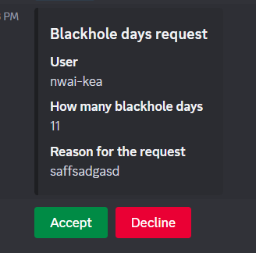
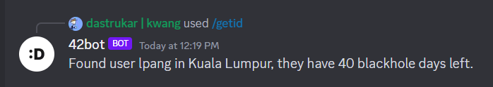
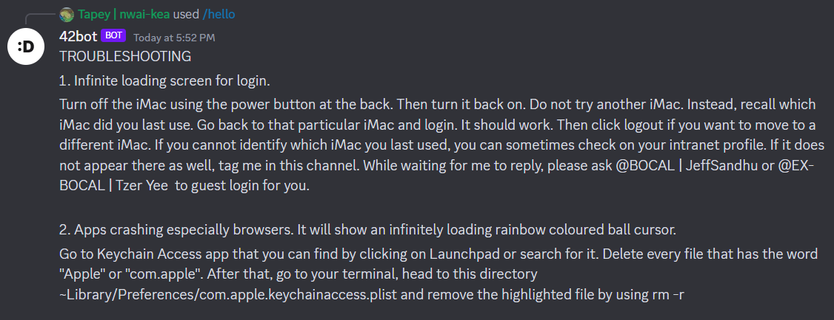
Demo

Slide 5

Pros
Cons
Automates repetitive tasks that
took long periods of time
Students able to check their blackhole status from discord
BOCALs do not need to be on #tech-support duty 24/7 (at least for the more common issues)
Able to filter blackhole requests while having power to resolve or reject
FAQ part has to be frequently updated to make sure more questions are handled
Bot unable to handle too much requests for now due to API reasons
Student Discord nickname must be strictly Name | Intra for the bot to work
Potential abuse issue if students somehow gain access to BOCAL accounts

Slide 6

Future Updates
Potential implementation of OpenAI / Archiving of common tech issues
Implement a nickname setting function in the future
Adjust bot security/privileges to accomodate BOCALs needs

Slide 7
Questions?

Slide 8
Thank You :D

