Slide 1
PHISON LAB-Report
Group 1
311831014 杜孟軒 311831010 葉奕均
311831002 董柏辰 311831020 邱柏誠

Slide 2
Outline
Problem definition
Solution
Improvement
Discussion
Conclusion

Slide 3
Unknown bug fix!!

Slide 4
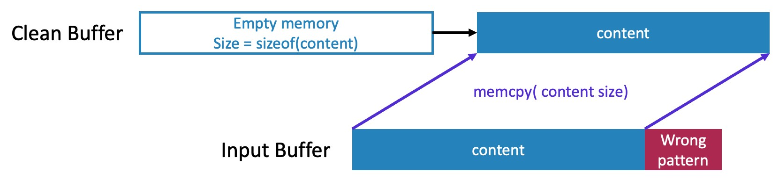
buffer – read/write
Problem : For some unknown reasons, the buffer in ssd_write() is unclean.
solution : Clean Buffer
We clean the buffer before pass it to ssd_do_write().

Slide 5
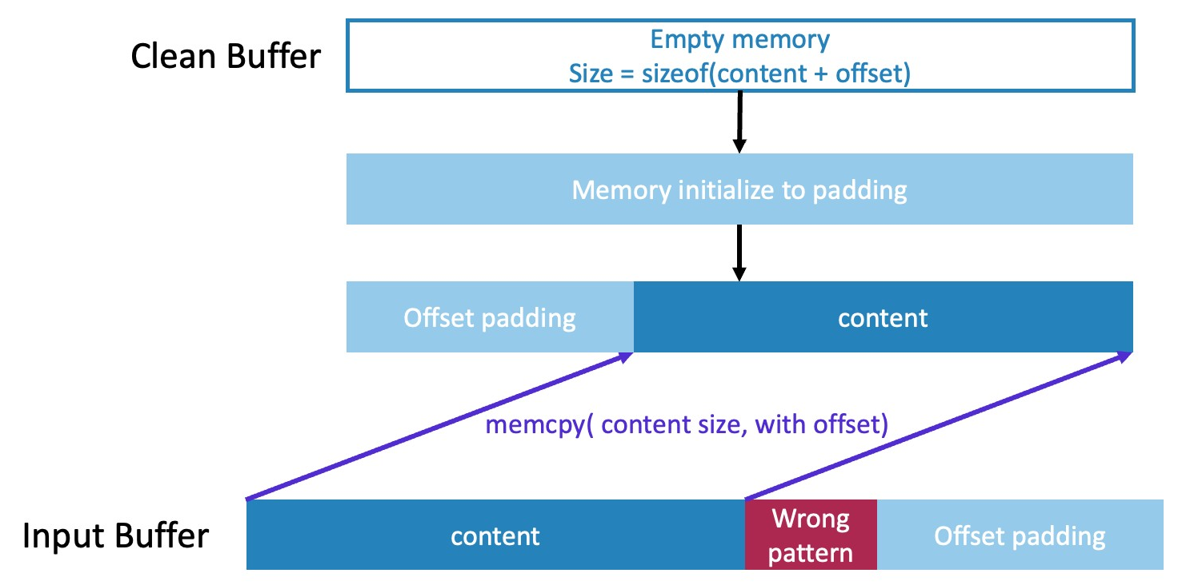
fwrite() - Invalid offset position
Problem : Due to unknown reasons, the offset padding tokens appear at the end of the content instead of the beginning where they should be.
solution : Offset when Clean Buffer

Slide 6
Problem definition

Slide 7
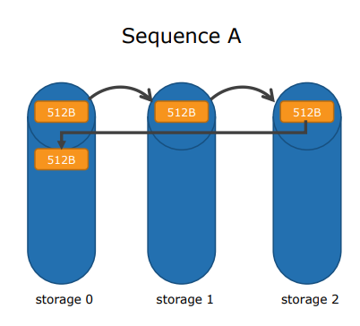
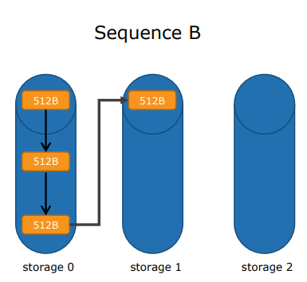


Problem definition
Complete basic write/read function
Modify writing sequence A to sequence B
Implement garbage collection
Keep WAF as minimum as possible
Compare data pass

Slide 8
Solution

Slide 9
Solution - read/write
Size
define data size need to write.
lba
start point = offset / 512
Offset
lba_range
define the offset of start point to write .
range need to write = (offset + size - 1) / 512 - lba +1
pseudo code
1. loop start i=0 to lab_range
2. write ssd a page size (512) data, if data < 512, still write 512
3. offset += page size
4. loop end

Slide 10
Solution - A2B
To solve the problem from sequence A to sequence B, we need to modify get_next_pca() function.
from
if ( curr_pca.fields.block == PHYSICAL_NAND_NUM - 1) {
curr_pca.fields.page += 1;
}
curr_pca.fields.block = (curr_pca.fields.block + 1) % PHYSICAL_NAND_NUM;
to
if ( curr_pca.fields.page == PHYSICAL_PAGE_NUM - 1) {
curr_pca.fields.block += 1;
}
curr_pca.fields.page = (curr_pca.fields.page + 1) % PHYSICAL_PAGE_NUM;

Slide 11
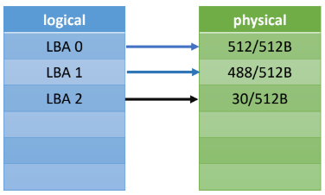
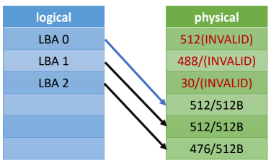
Solution - overwrite
If the ssd has files(left) and need to overwrite a big files(3 page size),
the result will like (right).
a1
a2
Before
After
Overwrite 3 page size data

Slide 12
GC looping problem
After GC is completed, there will be one NAND being written to and one partially filled NAND.
We need to coordinate the entire writing order.
valid
valid
empty
empty
empty
empty
valid
writing
after GC block

Slide 13
Solution - Queue
To implement GC, we create two queues, available_queue and over_provisioning_queue, to store available NAND and empty NAND respectively.
The queue contains a struct with four parts.
block_number : to determine which block it is,
state : determine open or static,
invalid_num : to count how many invalid page,
page_start_from : to record where can write.

Slide 14
Solution - basic GC
When idle or all available blocks are static, we will run GC.
The simple principle is to find two NANDs whose sum of (valid_num) less than capacity and the largest pair.
We copy valid data to new empty NAND and erase those NANDs we found, Then, we choose one NAND add to op_queue, append the other NAND and the copied NAND to av_queue.
av_queue
b1
b2
b1
op_queue
b2

Slide 15
Solution - basic GC
capacity = LOGICAL_PAGE_NUM = 20
erase
erase
Invalid = 15
valid = 5
Invalid = 12
valid = 8
Invalid = 13
valid = 7
Invalid = 0
valid = 15
Invalid = 1
valid = 19
Invalid = 0
valid = 0
Invalid = 1
valid = 19
Invalid = 0
valid = 0
Invalid = 0
valid = 0
Found a pair that sum(valid) < capacity and largest.
OP

Slide 16
Solution - basic GC
pseudo code
1. count the number of invalid each Nand
2. sorted them and descending to make invalid_list
3. loop ( i = 0 to i < invalid_list.size - 1 )
4. valid_1 = capacity - invalid_list[ i ]
5. loop ( j = i+1 to j < invalid_list.size )
6. valid_2 = capacity - invalid_list[ j ]
7. if valid_1 + valid_2 <= capacity: “found”
8. loop end
9. loop end
10. Do GC with select Nands and empty Nand
Notes:
sort 時會優先將Static block放尾巴，再將Open block 依invalid num 大到小排列
gc的時候會從queue的頭開始找(這樣我可以盡量拿 invalid num很大的Static block去gc)

Slide 17
If all block static – GC
When get_next_block() returns a block with a static state, it represents all block is static in our queue looping mechanism.
In this scenario, all NANDs are almost full. If we can find a block that contains invalid pages, we can use GC to free these invalid spaces more effectively.
valid
Invalid
valid
valid
empty
valid
valid
valid

Slide 18
Improvement

Slide 19
Improvement - write buffer
Scenario
When write data < 512, we will write 512 into ssd now.
Solve method
Add writer buffer, if data < 512, it will write to buffer instead of ssd.
When buffer >= 512, write buffer data into ssd.

Slide 20
Improvement - small page size
Scenario
When write data < 512, we will write 512 into ssd now.
For example: write a single char “a” will save total size 512 data into ssd.
Solve method
Decreasing the sector size such as 128.

Slide 21
Improvement - efficient GC
Our Implementation
Our search algorithm is similar to the "select two items" baggage problem.
In this case, NAND_NUM = 5 is sufficient, but there is a performance drop when we increase NAND_NUM.
We use simple GC algorithm.
Solve method
More efficient search algorithm, try another GC algorithm.

Slide 22
Discussion

Slide 23
Discussion
Actual performance as a product:
In the actual SSD controller, when discussing time and space complexity, for example, is our gc algorithm more efficient and better in terms of capacity configuration compared to the general GC algorithm?
In bigger scenario, NAND_NUM = 256, PAGE_NUM = 1000

Slide 24
Discussion
Faced with a confusing situation:
if we take these command:
w(write) 30(size) 0(offset)
w(write) 2048(size) 30(offset)
which one of results is right?
30 512 2048 2078
30 512 2048 2078

Slide 25
Discussion
For our implemented SSD controller, is there any suggestion to improve?

Slide 26
Conclusion
We learn how to read/write to an SSD.
A good GC algorithm will improve the performance.

