Slide 1
HYPER-LOCAL REVERSE MARKETPLACE
Baiskit
Compare global prices, connect with local vendors, and shop smarter — all in one basket.
Global Compare
Local Vendors
Verified Resale
Create Baiskit
TEAM MEMBERS
UNDER THE GUIDANCE OF
Stuti Shrivastava (25BCE10887)
Dr. Mamta Patnakar
Aryan Awasthi (25BCE11419)
School of Computer Science & Engineering
Gulshan Nijammudin Shaikh Mansuri (25BCE11141)
VIT Bhopal University
Tapish Upadhyay (25BCE10583)
Akshara Sharma (25BCE10666)
01

Slide 2
INTRODUCTION
What Is Baiskit?
Baiskit is a hyper-local reverse marketplace. Instead of a buyer hunting across apps for a deal, the buyer posts what they need, their budget and quantity — a baiskit — and nearby shopkeepers, service providers and verified resellers respond with offers, shown alongside global e-commerce prices.
HOW THE FLOW FLIPS
Traditional marketplace
Seller lists
Buyer searches
Buyer compares
1
Reverse
Baiskit (reverse)
The buyer states the need and price; sellers come to the buyer
Buyer posts need + budget
Nearby sellers offer
Best match wins
2
Hyper-local
Shops, services and resellers within a short radius of the user
Sellers compete for the buyer's request, so the buyer sets the terms instead of the platform.
3
Trust-first
Identity-verified sellers carry a visible trust badge
02

Slide 3
THE PROBLEM
Buyers Compare Apps. Never the Whole Market.
Shoppers juggle multiple apps to compare prices, but even then only see big e-commerce platforms — never the local shopkeeper down the street, a nearby service provider, or a trustworthy second-hand seller.
SAME NEED, THREE WORLDS
Finding a Study Table
Price comparison tools cover only global platforms, not local shops
Global Platform
₹2,499
3-day delivery
No way to discover nearby vendors or service providers for the same need
Second-hand marketplaces lack trust — anyone can list anything
Local Shopkeeper
₹2,150
Pickup today
Buyers can't set a budget and get matched to sellers who fit it
Switching between apps to compare deals wastes time and money
Second-hand Seller
₹1,200
Unverified
No single view brings global, local, and resale prices together.
Problem: There is no single platform that compares global, local vendor, and verified resale prices while matching buyers to sellers by budget.
03

Slide 4
OBJECTIVES
Primary Objectives
1
Aggregate and compare prices from global e-commerce platforms
2
Onboard local vendors, shopkeepers & service providers to list prices
3
Enable trusted second-hand selling through user verification
4
Let users set a budget & quantity to get matched sellers via Baiskit
5
Surface nearby offers and deals in real time
6
Build a scalable, trust-first social shopping experience
04

Slide 5
EXISTING WORK
Existing Systems and Their Limitations
EXISTING SYSTEM | WHAT IT DOES | LIMITATION
Amazon / Flipkart | Large online catalogues with home delivery | Ignores the local shop next door; buyer cannot name a price
Price-comparison sites (Google Shopping, Smartprix) | Compare one product across online stores | Cover online sellers only — no local, service or resale prices
OLX / Quikr / Facebook Marketplace | Peer-to-peer classifieds for used goods | Weak seller verification, so fraud and fake listings are common
Justdial / Urban Company | Directories and bookings for local services | Fixed listings; providers don't compete on a buyer's budget
Quick-commerce (Blinkit, Zepto) | Fast delivery from dark stores | Platform-owned inventory; independent shopkeepers are left out
Gap: no existing system lets a buyer post one request and receive competing offers from global, local, service and verified resale sellers together.
05

Slide 6
PROPOSED WORK
What Exactly Are We Building?
Shopper
→
Baiskit Platform
→
Best Price, Best
Seller — Matched
BAISKIT MATCH
Study Table
Budget: ₹2,000 · Qty: 1
Proposed System
Local Shop
A social shopping platform that provides:
₹1,950
Global e-commerce price comparison
Local vendor & shopkeeper price listings
Service-provider rate listings (Rapido-style)
Verified second-hand marketplace
Resale (Verified)
₹1,200
“Create Baiskit” budget-based matching
Nearby deals & offers discovery
Contact Best Match
06

Slide 7
METHODOLOGY
How We Built Baiskit
An iterative (Agile) approach: each phase was built, reviewed with our guide, and refined before moving on.
01
02
03
04
05
06
Requirement Analysis
Design
Module Development
Integration
Testing
Deployment
›
›
›
›
›
Surveyed buyers & shopkeepers; mapped vendor categories
Wireframes, navigation structure, system architecture
Auth, listings, Create Baiskit, verification, matching
Connected front end, REST API, database and services
Unit, integration, UI and user-acceptance testing
Hosted on Vercel at baiskitnew.vercel.app
Status: all six phases complete — the working web app is live and being demonstrated in this review.
07

Slide 8
NOVELTY
What Makes Baiskit New
FEATURE | AMAZON / FLIPKART | OLX / QUIKR | JUSTDIAL | BAISKIT
Buyer posts budget, sellers respond | ✗ | ✗ | ✗ | ✓
Global + local prices in one view | ✗ | ✗ | ✗ | ✓
Service providers alongside products | ✗ | ✗ | ✓ | ✓
Second-hand with verified sellers | ✗ | ✗ | ✗ | ✓
Nearby offers & sales by distance | ✗ | ✓ | ✓ | ✓
Reverse buying for everyday retail
Reverse auctions exist in B2B procurement; Baiskit brings them to individual shoppers.
One request, four seller types
Global platforms, local shops, service providers and resellers answer the same baiskit.
A blue-tick for second-hand
Social-media style verification badge applied to C2C resale.
08

Slide 9
REAL-TIME USAGE
Who Uses Baiskit, and How
S
College student
K
Neighbourhood shopkeeper
Needs a study table under ₹2,000. Posts one baiskit and gets a verified resale offer at ₹1,200 and a local shop at ₹1,950.
Sees live requests from buyers within a few km and wins customers who would have ordered online.
E
Electrician / plumber
H
Household reseller
Lists service rates like a ride captain and responds to repair requests posted nearby.
Sells an old cycle or phone after ID verification, so buyers trust the listing.
WHERE IT FITS
College campuses · Residential colonies · Tier-2 & tier-3 towns · Local markets with many small vendors
09

Slide 10
REQUIREMENTS
Hardware & Software Requirements
H
Hardware
S
Software
COMPONENT | SPECIFICATION
Processor | Intel Core i5 / AMD Ryzen 5 or above
RAM | 8 GB minimum (16 GB recommended)
Storage | 256 GB SSD
Network | Stable broadband internet
Client device | Any smartphone or PC with a modern browser, GPS for nearby deals
Server | Cloud hosting (Vercel) — no dedicated hardware
CATEGORY | TOOL
Operating system | Windows 10/11, macOS or Linux
Front end | React.js, Tailwind CSS
Back end | Node.js, Express.js
Database | PostgreSQL
Tools | VS Code, Git & GitHub, Postman
Deployment | Vercel; Chrome / Edge for testing
10

Slide 11
SYSTEM ARCHITECTURE
Overall System Architecture
USER
Shopper or seller using the app / web
↓
FRONTEND — React Native / React
Home, categories, baiskit form, listings UI
↓
PRICE AGGREGATION SERVICE
REST API — Node / Express
Pulls prices from global platforms & vendor listings
Coordinates requests across all services
↓
VERIFICATION SERVICE
DATABASE — PostgreSQL
Runs KYC checks and assigns the trust badge
Stores listings, prices, users & baiskit requests
BAISKIT MATCHING ENGINE
Ranks sellers against a user's budget & quantity
11

Slide 12
LITERATURE REVIEW
What Prior Research Tells Us
# | AUTHOR(S), YEAR | KEY FINDING | HOW BAISKIT USES IT
1 | Bakos, 1997 | Electronic marketplaces lower buyers' search costs and push prices toward competitive levels | One request reaches every seller type, cutting search cost further
2 | Brynjolfsson & Smith, 2000 | Online prices are lower but still widely dispersed across retailers | Shows the same item side by side from global, local and resale sellers
3 | Resnick et al., 2000 | Reputation systems build trust among strangers trading online | Ratings and sales history form each seller's trust score
4 | Jap, 2002 | Online reverse auctions let buyers make sellers compete on price | Brings reverse bidding from B2B procurement to everyday shoppers
5 | Pavlou & Gefen, 2004 | Institution-based trust (verification, escrow) drives C2C buying | ID-verified badge as platform-level assurance
6 | Montgomery et al., 2004 | Shopbots should rank offers on utility, not price alone | Matching engine weighs price, distance and seller trust
Full citations on the References slide.
12

Slide 13
STAKEHOLDERS
Target Users / Stakeholders
Shoppers
↓
Baiskit Platform
↑
Vendors &
Shopkeepers
Service
Providers
Verified
Resellers
Admin
USER
PURPOSE
Shoppers
Compare prices, create baiskits, buy from best option
Vendors / Shopkeepers
List products & prices, respond to baiskit requests
Service Providers
List service rates, similar to a ride-captain model
Verified Resellers
List second-hand items with identity verification
Admin
Verify users, moderate listings and manage categories
13

Slide 14
MODULE DESCRIPTION
Module Description
01
02
03
Global Price Compare
Local Vendor Connect
Service Provider Rates
Aggregates prices across major e-commerce platforms
Shopkeepers & vendors list live prices for the same product
Freelancers & service providers list rates, Rapido-captain style
04
05
06
Verified Resale
Create Baiskit
Nearby Deals
Second-hand listings with identity-verified sellers
Set a budget & quantity to get matched sellers instantly
Surfaces offers and sales from vendors close to the user
14

Slide 15
FEATURE SPOTLIGHT
Trust-First Second-Hand Selling
Anyone can list an old item — but only verified users carry a trust badge, similar to Instagram's blue tick. Buyers instantly know who they can trust.
A
Aditi Sharma
✓
Verified Seller
✓
ID & Document Check
★ 4.8 · 32 items sold
Sellers verify identity before listing resale items
✓
Verified Badge
LISTED ITEM
A visible tick appears next to trusted sellers' names
Study Table (Used, Good Condition)
✓
Rating & History
Past sales and buyer ratings build a visible trust score
₹1,200
Posted 2 days ago
✓
Safer Transactions
Buyers can filter listings to verified sellers only
15

Slide 16
FEATURE SPOTLIGHT
Create Baiskit — Buy on Your Terms
Instead of hunting for a good deal, the user sets exactly what they want to pay and how many they need. Baiskit then finds every platform, vendor, or service provider that fits.
CREATE BAISKIT
Wireless Earbuds
1
Enter Product / Service
Your Budget
Search or select what they want to buy
₹1,500
2
Set Budget & Quantity
Quantity
e.g. ₹2,000 max, 1 unit
1
3
Baiskit Matches Sellers
Global platforms, local vendors & resellers checked instantly
Find My Matches
4
Contact Best Match
Local Vendor — Rahul Electronics
₹1,450
User reaches out directly to the matched seller
Verified Resale — Priya K.
₹1,100
16

Slide 17
INTERFACE BLUEPRINT
App Navigation Structure
The app is organized into three fixed layers so users always know where they are.
Top Bar
Menu icon · Search bar · Profile icon — one single row
Middle Section
Categories · Offers · Sale Nearby — three content blocks
Bottom Navigation
Home · Vendors · Add · Create Basket · Orders — five icons
TOP BAR — DETAIL
BOTTOM NAV — DETAIL
🔍 Search on Baiskit
U
Home
Vendors
Add
Basket
Orders
17

Slide 18
UI DESIGN
UI Design — Home Screen
Top Bar
🔍 Search
Bottom Strip
Menu · Search · Profile — a single row
5 fixed icons for one-tap access to core actions
Categories
Electronics
Fashion
Home
Books
Middle Section
Offers
Note
Categories, Offers, Sale Nearby stacked as tappable blocks
Flat 20% off — Electronics
Design blueprint used to build the live home screen.
Sale Nearby
Rahul Electronics — 0.4 km
Priya's Resale Store — 0.8 km
Home
Vendors
Add
Basket
Orders
Home Screen
18

Slide 19
MODULE WORKFLOW
Module Workflow — User Flow
User
↓
Login / Registration
↓
Home
Search / Categories
Create Baiskit
Sell / Add Product
↓
↓
↓
Browse products & offers
Set budget & quantity
List item, get verified
Compare Results → Contact Vendor / Seller → Complete Deal
Every path — buying or selling — leads back to a direct, trusted connection.
19

Slide 20
MODULE WORKFLOW
Inside a Baiskit Request
How the Create Baiskit, Matching and Verification modules work together for one request.
BUYER
1
SYSTEM
2
SYSTEM
3
SELLERS
4
Post request
›
Validate & geo-filter
›
Notify sellers
›
Send offers
Item, budget, quantity, location
Find sellers in the category within radius
Vendors, providers & resellers get an alert
Price, availability, pickup / delivery
SYSTEM
5
BUYER
6
BUYER
7
BUYER
8
Rank offers
›
Compare matches
›
Contact & deal
›
Rate seller
Score on price, distance and trust badge
Over-budget offers filtered out
Chat or call the chosen seller
Feeds the seller's trust score
20

Slide 21
IMPLEMENTATION
Technology Stack
Frontend (App)
React Native / Flutter
Frontend (Web)
React.js + Tailwind CSS
Backend
Node.js + Express.js
Database
PostgreSQL / MongoDB
Price Aggregation
Web scraping + vendor API integrations
Verification
KYC/document check + trust-score service
Baiskit Matching Engine
Python — rule-based + ML ranking
Deployment
AWS / GCP + Vercel
Additional: Git/GitHub for version control · REST APIs for service communication · Push notifications for baiskit matches
21

Slide 22
IMPLEMENTATION & CODING
Core Logic: Matching a Baiskit
matchEngine.js
Filter
1
function rankOffers(req, offers) {
return offers
.filter(o => o.price <= req.budget
&& o.qty >= req.qty
&& distanceKm(req.loc, o.loc) <= req.radiusKm)
.map(o => ({ ...o, score:
0.5 * (1 - o.price / req.budget)
+ 0.3 * (1 - distanceKm(req.loc, o.loc) / req.radiusKm)
+ 0.2 * (o.verified ? o.rating / 5 : 0) }))
.sort((a, b) => b.score - a.score);
}
Drop offers above budget, short on quantity, or outside the search radius
2
Score
50% price saving, 30% proximity, 20% verified rating
3
Sort
Highest score first — what the buyer sees as Best Match
routes/baiskit.js
router.post('/baiskit', auth, async (req, res) => {
const b = await Baiskit.create({ ...req.body, buyer: req.user.id });
await notifyNearbySellers(b);
res.status(201).json(b); });
API
4
Saving a baiskit triggers alerts to nearby sellers
22
Notes:
Replace these snippets with the actual code from your repository if it differs — the examiners may ask you to walk through it line by line.

Slide 23
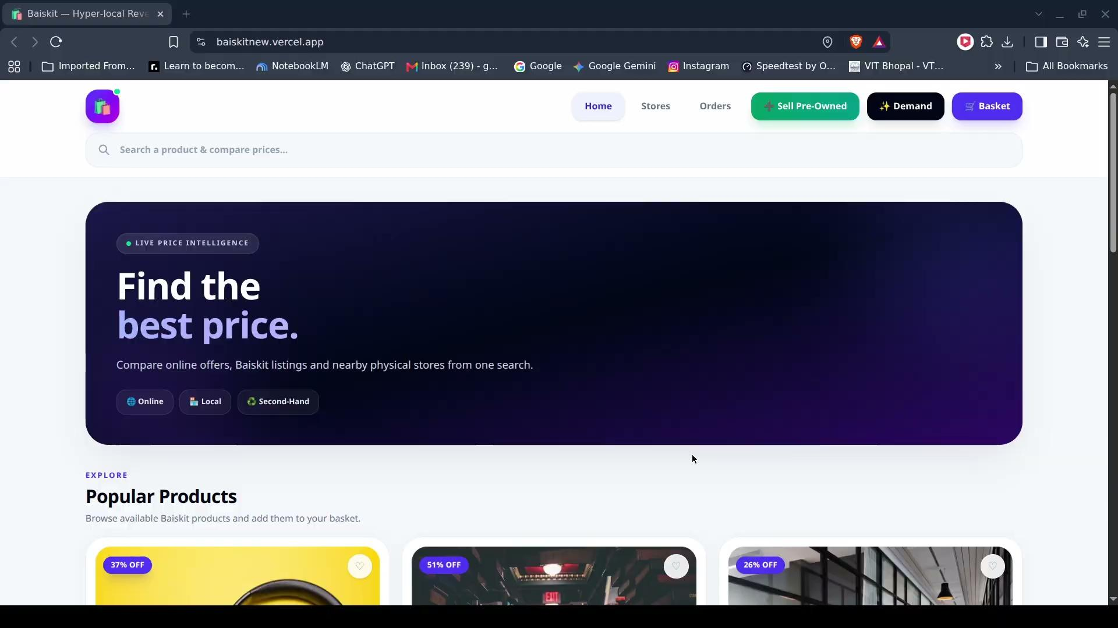

DEMO VIDEO
Baiskit in Action
TRY IT LIVE
baiskitnew.vercel.app
Scan with any phone camera to open the deployed app
Watch Demo Externally
23

Slide 24

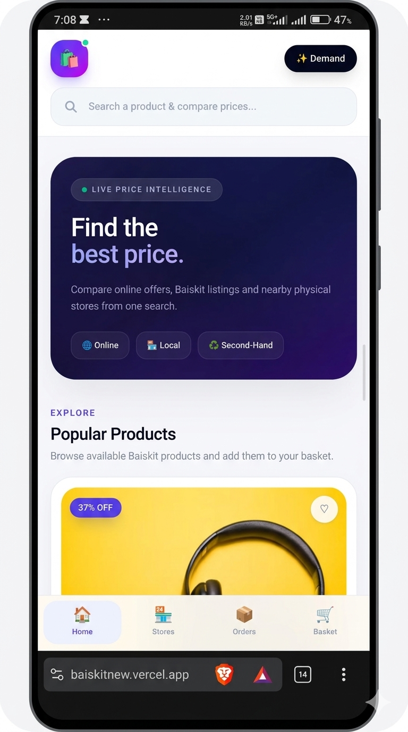
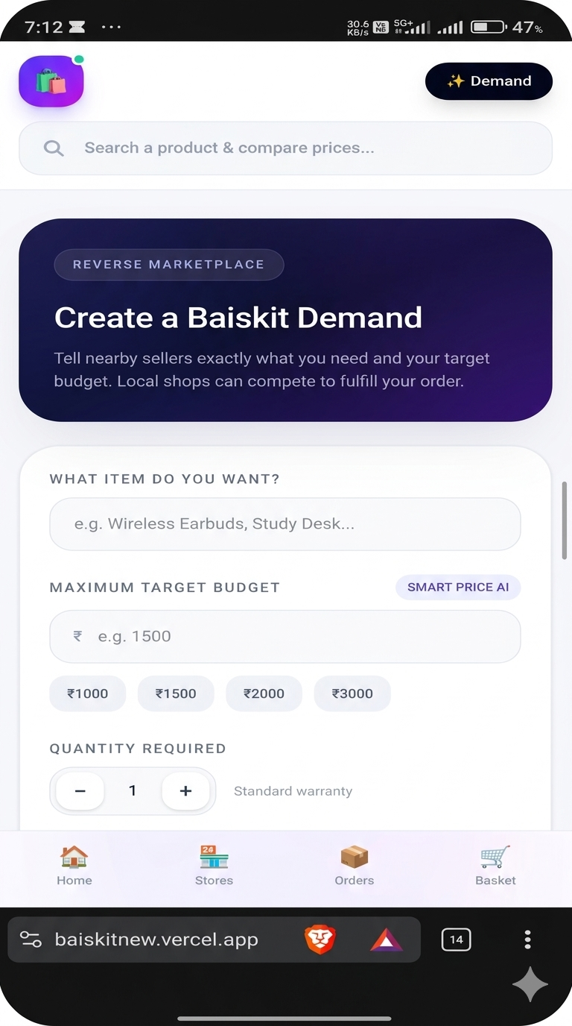
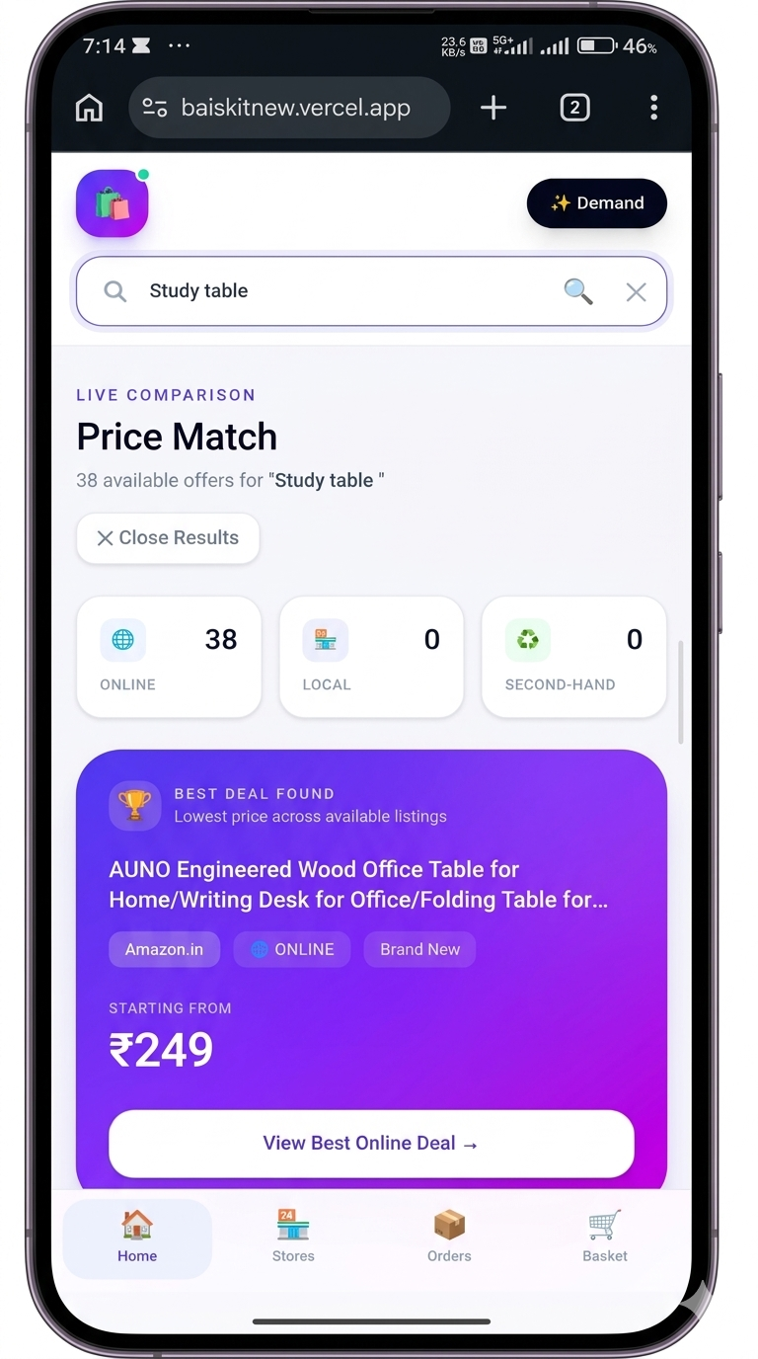
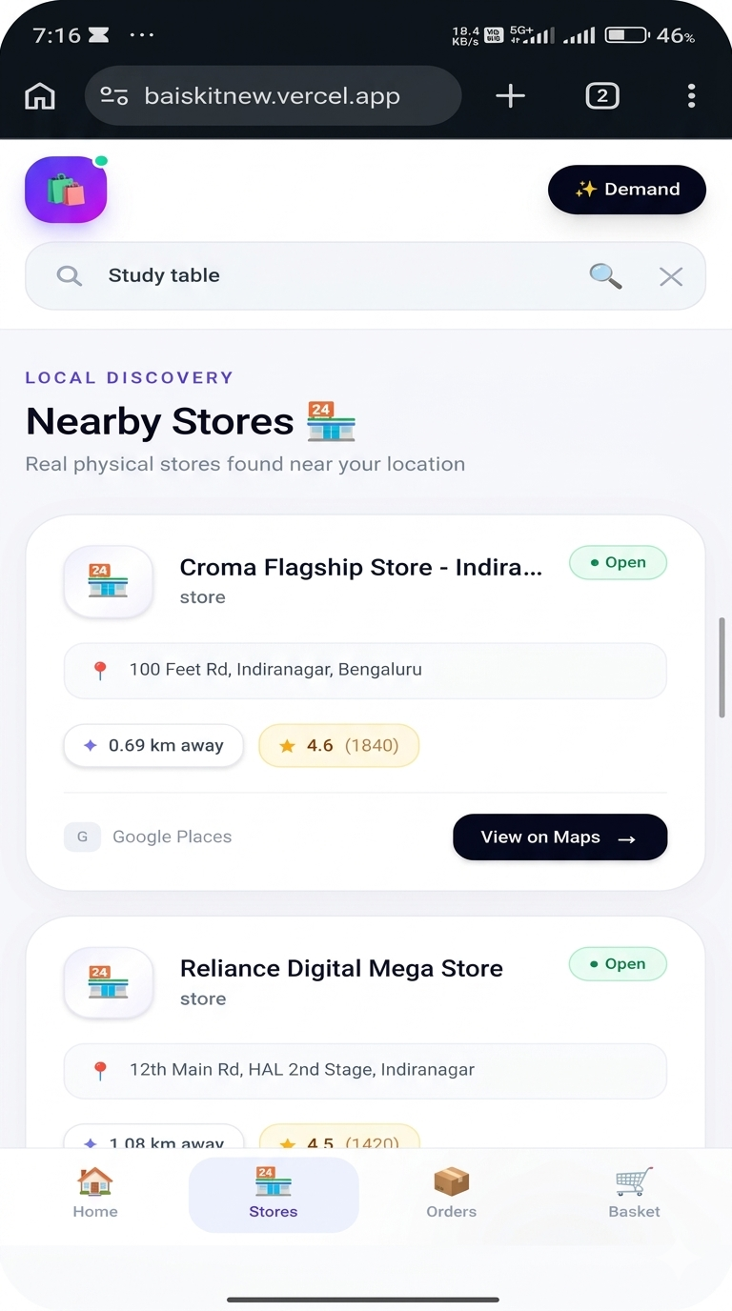
Project Snapshots

Slide 25
TESTING
Testing Strategy and Test Cases
Unit
ID | MODULE | TEST INPUT | EXPECTED RESULT | STATUS
TC01 | Login | Valid email & password | User reaches home screen | Pass
TC02 | Login | Wrong password | Error shown, no access | Pass
TC03 | Create Baiskit | Budget left empty | Form blocks submit, asks for budget | Pass
TC04 | Matching | Budget ₹2,000; offer ₹2,499 | Offer filtered out of matches | Pass
TC05 | Matching | Two offers within budget | Higher score ranked first | Pass
TC06 | Verification | Seller completes ID check | Verified badge shown on listings | Pass
TC07 | Nearby deals | Location permission granted | Offers sorted by distance | Pass
Matching score, budget filter, form validation
Integration
Front end ↔ REST API ↔ database
UI / Responsive
Phone, tablet and desktop browsers
User acceptance
Students & shopkeepers tried real flows
25
Notes:
Confirm each status against your own test runs before the review and change any that did not pass.

Slide 26
RESULTS
Input and Output
INPUT — BUYER'S BAISKIT
OUTPUT — RANKED MATCHES
Product
Study table
1
Verified Resale — Priya K.
₹1,200
0.8 km · ★ 4.8 · Verified
Budget
₹2,000
→
2
Local Shop — Rahul Furniture
₹1,950
Quantity
1
0.4 km · Pickup today
Search radius
5 km
—
Global platform listing
₹2,499
Filtered: over budget
Seller filter
Any (verified preferred)
Sample run — a nearby verified resale offer beats the online listing by ₹1,299.
26

Slide 27
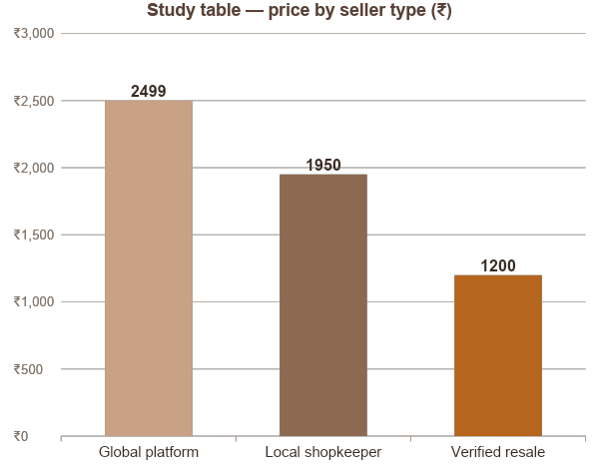
DISCUSSION
What the Results Show
52% saved
versus the global listing when a verified resale offer fits the budget
Zero wasted offers
the budget filter removes every offer the buyer could not afford
Local shops visible
nearby vendors now appear next to online prices for the same item
Trust drives choice
verified sellers rank higher, so buyers pick them with confidence
27

Slide 28
CONCLUSION
Conclusion
Baiskit turns shopping around: the buyer states the need and the budget, and global platforms, local shopkeepers, service providers and verified resellers compete to fill it.
The working web app shows that one hyper-local, trust-first platform can save buyers money while giving small local sellers real digital visibility.
WHAT WE DELIVERED
✓
Unified view of global, local, service and resale prices
✓
Create Baiskit: budget-first, reverse buying
IN ONE LINE
✓
Verified-seller badge for safer second-hand deals
Don't search the market — post your baiskit and let the market come to you.
✓
Deployed and accessible at baiskitnew.vercel.app
28

Slide 29
IMPACT
Expected Outcome & Future Scope
EXPECTED OUTCOME
FUTURE SCOPE
One view of global, local & resale prices for any product
AI-based price-drop prediction across vendors
Local vendors and service providers gain real digital visibility
Hyperlocal delivery partner integration
Safer second-hand buying through identity verification
Voice search for products and services
Budget-first buying with the Create Baiskit tool
Loyalty rewards for verified sellers & frequent buyers
Faster, more confident purchase decisions
Cross-border price comparison for global brands
29

Slide 30
REFERENCES
References
1
Bakos, J. Y. (1997). Reducing buyer search costs: Implications for electronic marketplaces. Management Science, 43(12), 1676–1692.
2
Brynjolfsson, E., & Smith, M. D. (2000). Frictionless commerce? A comparison of Internet and conventional retailers. Management Science, 46(4), 563–585.
3
Resnick, P., Zeckhauser, R., Friedman, E., & Kuwabara, K. (2000). Reputation systems. Communications of the ACM, 43(12), 45–48.
4
Jap, S. D. (2002). Online reverse auctions: Issues, themes, and prospects for the future. Journal of the Academy of Marketing Science, 30(4), 506–525.
5
Pavlou, P. A., & Gefen, D. (2004). Building effective online marketplaces with institution-based trust. Information Systems Research, 15(1), 37–59.
6
Montgomery, A. L., Hosanagar, K., Krishnan, R., & Clay, K. B. (2004). Designing a better shopbot. Management Science, 50(2), 189–206.
30

Slide 31
Thank You
Questions & Suggestions?
Baiskit · baiskitnew.vercel.app · https://github.com/TapishUpadhyay/baiskit.git
31

